Slide 1
Service dogs
Created by Fleur

Slide 2
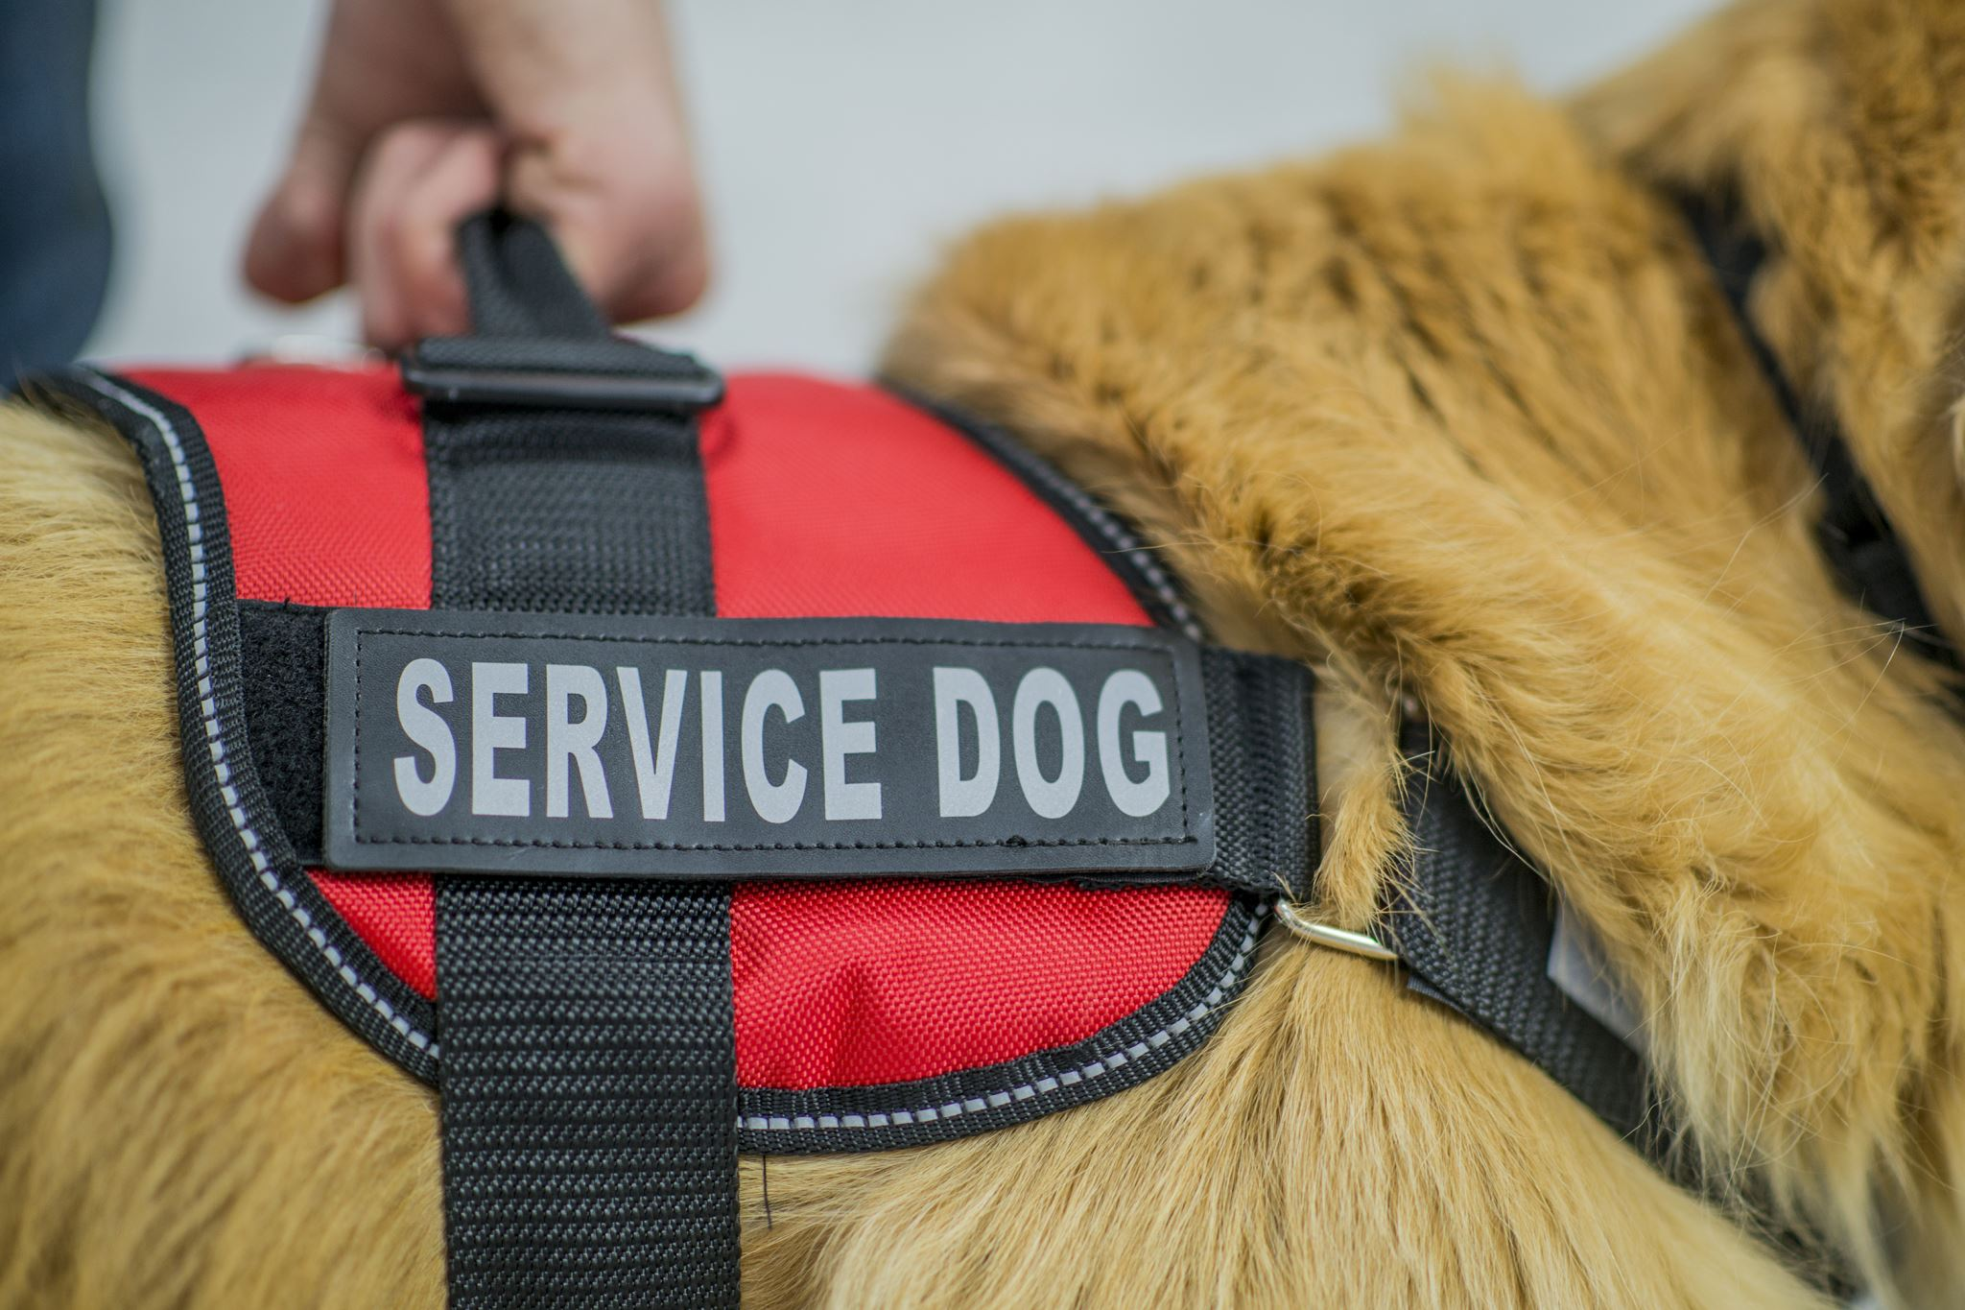
Service dogs are my heroes
Service dogs can help people with a handicap. they help you go to the supermarket and they can even help you with some chores.

Slide 3
Service dogs
Dogs trained to help people with disabilities
There are different service dogs for example Some are trained to help blind people.

Slide 4
The end

