Slide 1
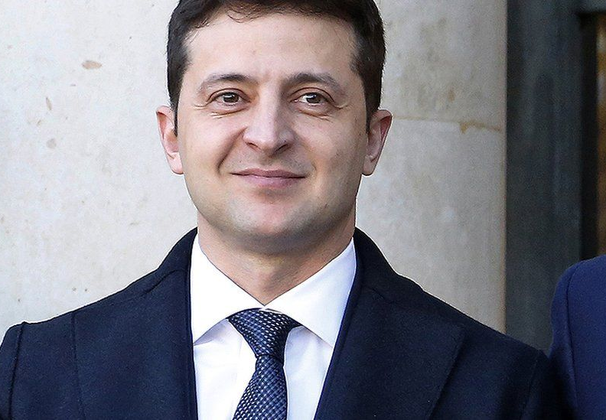
Volodymyr Zelensky
Made by
Gijs van Dongen

Slide 2
General information
Volodymyr Oleksandrovych Zelenskyy was born on January 25, 1978 Kryvyi Rih, Soviet Union
Zelensky's wife is called: Olena Zelenska

Slide 3
Childhood
Zelensky was born into a Russian-speaking Jewish family in Kryvy Rih in Dnipropetrovsk Oblast, south-eastern Ukraine. His grandfather, who served in the Red Army, lost three brothers in the Holocaust. His father is a professor of cybernetics and computer hardware at the Kryvyi Rih Economic Institute, his mother is an engineer. As a child, he lived with his parents in Mongolia for four years. After returning to Ukraine, Zelensky completed a Gymnasium education, followed by a law degree.

Slide 4
His time as comedian
At school, Volodymyr Zelensky already began to entertain. in 1997 he founded a cabaret group in Moscow: Kwartal 95. When Zelensky founded the cabaret group, he had been living in Moscow, Russia for 5 years. In 2006 Zelensky became famous in Ukraine by participating in the Ukrainian version of Dancing whit the stars. Zelensky also starred in several comedies. With colleagues from his cabaret group, he set up a production company through which he made television programs through which his films, cabaret shows and his TV series were sold to 21 countries.

Slide 5
career as a politician
on December 31, 2018, Zelensky announced that he wanted to run on behalf of a new political party called: Servant of the people for the presidential elections in 2019. Zelensky took on incumbent President Petro Poroshenko and Prime Minister Yulia Tymoshenko, who came to power since 2014 goods. after the 1st round win on April 1, 2019, Zelensky was favorite for the presidency

