Slide 1
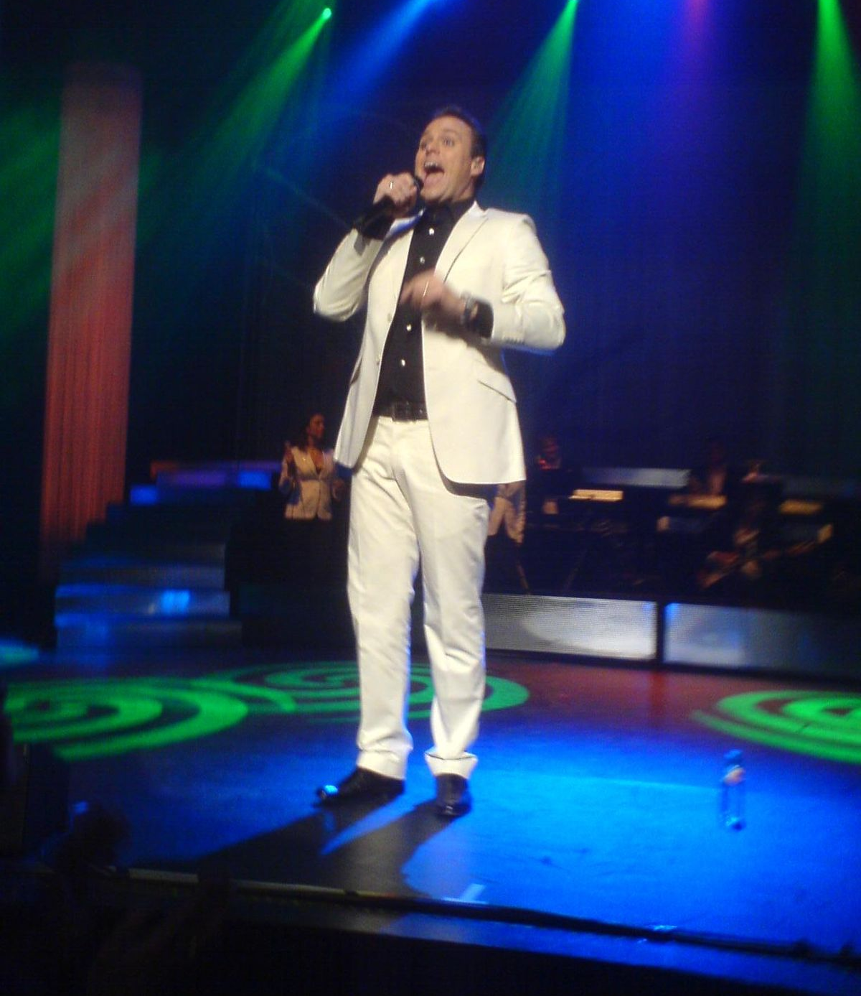
My presentation is about
Frans bauer

Slide 2
About
Frans Bauer is an very popular musician in the netherlands. He has one very popular song (do you have a moment for me) and a lot more.

Slide 3
What does he do in a life
1. singing
2. eating
3. listen to music
4. work in the studio
5. more eating

Slide 4
Here is a song vid
https://youtu.be/xR-hWde2YsY

