Slide 1
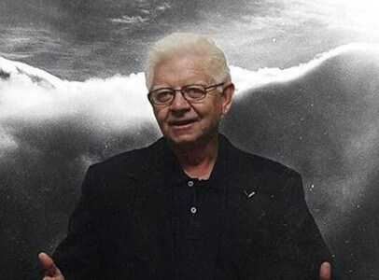
WHO IS OKTAY SINANOGLU?

Slide 2
Oktay Sınanoglu was born on February 25, 1935 in Bari, Italy. Italy entered World War II in 1939. After entering the Second World War, he returned to Turkey with his family. Oktay Sınanoglu became a faculty member at Yale University in 1960. On July 1, 1963, he received the title of full professor in chemistry.

Slide 3
He founded the theoretical chemistry department at Yale University in 1964. During his tenure at Yale, "Many-Electron Theory of Atoms and Molecules" (1961), "Solution Theory" (1964), "Theory of Chemical Reaction Mechanisms" (1974), "Micro thermodynamics" (1981), and "Valency Shell Interaction Theory" (1983) carried out his work.

Slide 4
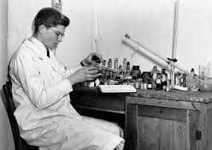
With the special law enacted in 1975, she was given the title of Professor of the Republic by the state.

Slide 5
Awards Won By Oktay Sınanoglu
He won the "TÜBİTAK Science Award" in Chemistry in 1966, the "Alexander von Humboldt Research Award" in Chemistry in 1973, and the "International Outstanding Scientist Award of Japan" in 1975. He died on April 19, 2015 in Florida, USA.

Slide 6
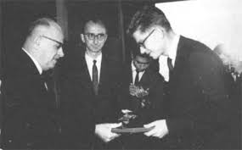

Slide 7
Academic Books
Modern Quantum Chemistry : Istanbul Lectures (Academic Press,1965)
Sigma Molecular Orbital Theory (Yale Press,1970)
Three Approaches to Electron Correlation in Atoms and Molecules (with K.Brueckner,Yale Press,1971)
New Directions in Atomic Physics (with E.Condon,Yale Press,1971)

