Slide 1
FINAL REPORT
Group number 2
Marco De La Torre-Jonas Kreh
Marta Rivero-Sara Barzagli
Claudia Ortega-Raminta Milasiute
Alba Báñez-Aira Labanauskaite
Manuel Navarro-Diego Pini

Slide 2
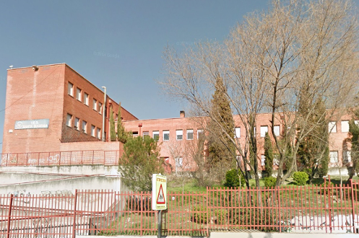
MONDAY

Slide 3
WE PLAYED SOME GAMES TO INTRODUCE OURSELVES

Slide 4
German presentation
Max Planck Gymnasium

Slide 5
BE LEAF

Slide 6
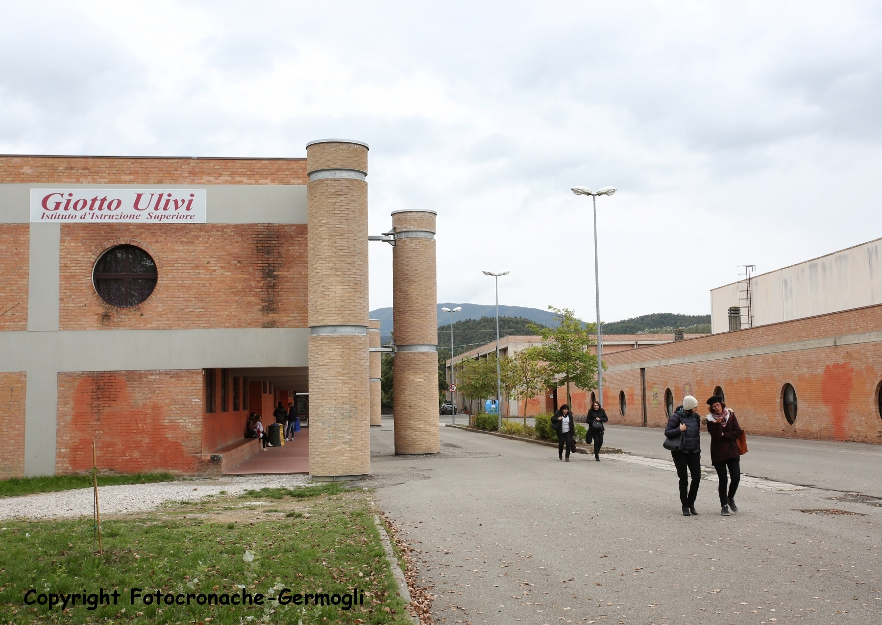
Italian presentation
Giotto Ulivi

Slide 7
The Hive

Slide 8
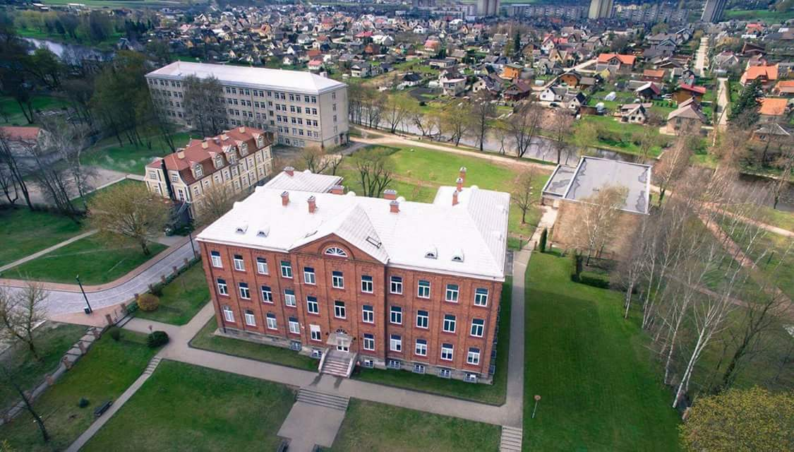
Lithuanian presentation
Marijampoles Marijonu Gimnazija

Slide 9
GREEN
STARS

Slide 10
Spanish presentation
I.E.S. Santa Eugenia

Slide 11
Teenearth

Slide 12
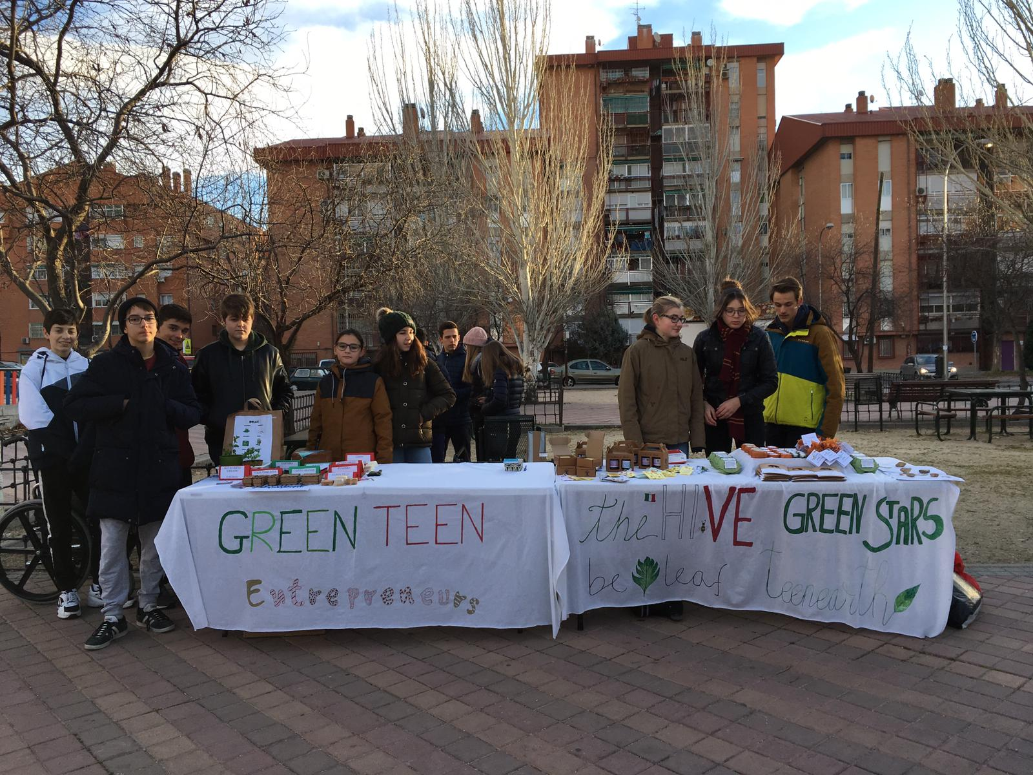
TUESDAY

Slide 13
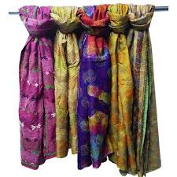
Our item: SCARFS

Slide 14
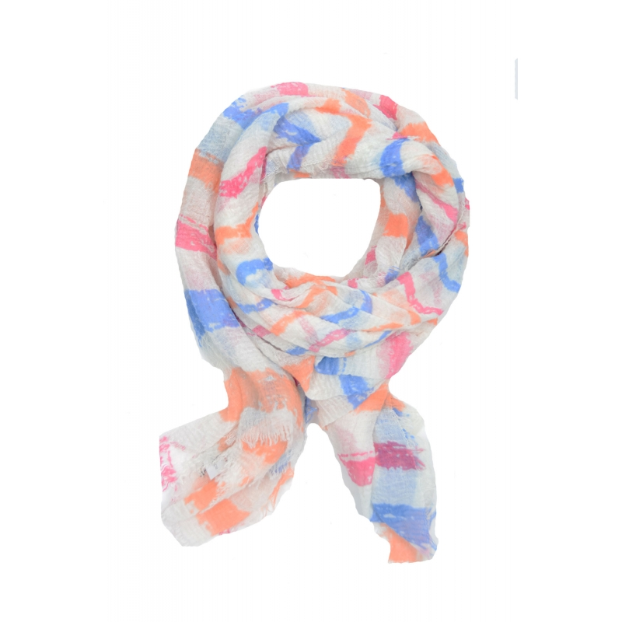
On tuesday, we did:
“STREET MARKET”
Brand & Countryof the brand:
-”Adda Gatti”
Price:
-1,99$
Made of:
-Cotton and acrylic
Made in:
-China
Comments:
-Disorder

Slide 15
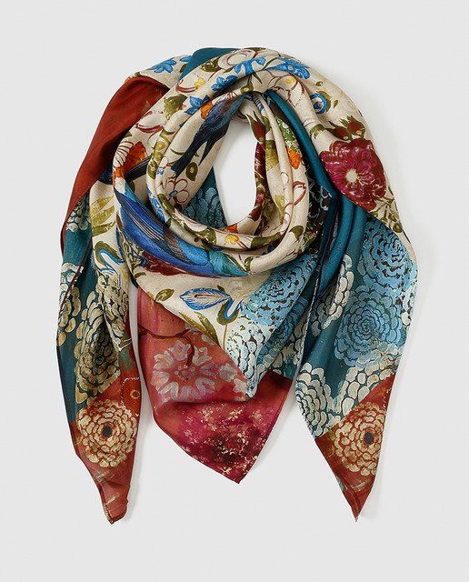
And on wednesday, we did:
“MEGASTORE”
El Corte Inglés
Brand & Countryof the brand:
-”Abbacino”
Price:
-23,95$
Made of:
-Cotton and acrylic
Made in:
-Spain
Comments:
-Order

Slide 16
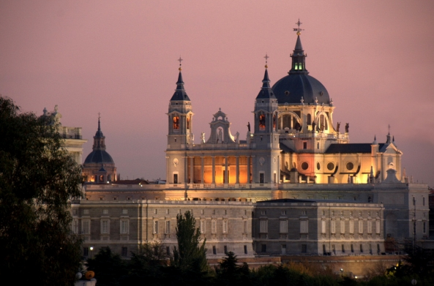
WEDNESDAY
WEDNESDAY
WEDNESDAY

Slide 17
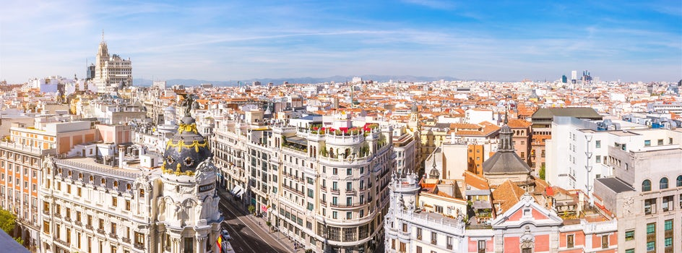
We visited Madrid answering some questions about the streets

Slide 19
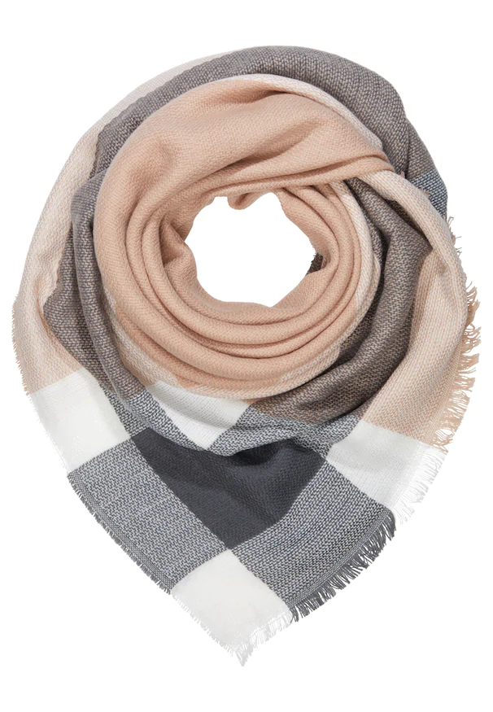
“SMALL SHOP IN OUR NEIGHBOURHOOD”
Maxi China
Brand & Countryof the brand:
-”Onladiny Square”
Price:
-4,75 $
Made of:
-Acrylic
Made in:
-China
Comments:
-Desorder

Slide 20
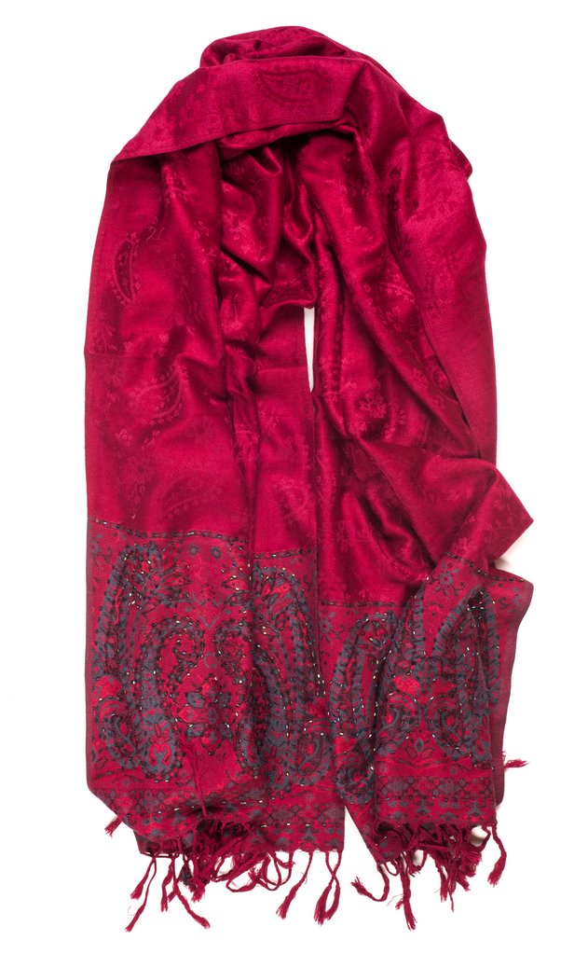
“LOW COST SHOP”
Brand & Countryof the brand:
-”Crimson”
Price:
-2,50 $
Made of:
-Wool
Made in:
-China
Comments:
-Desorder

Slide 21
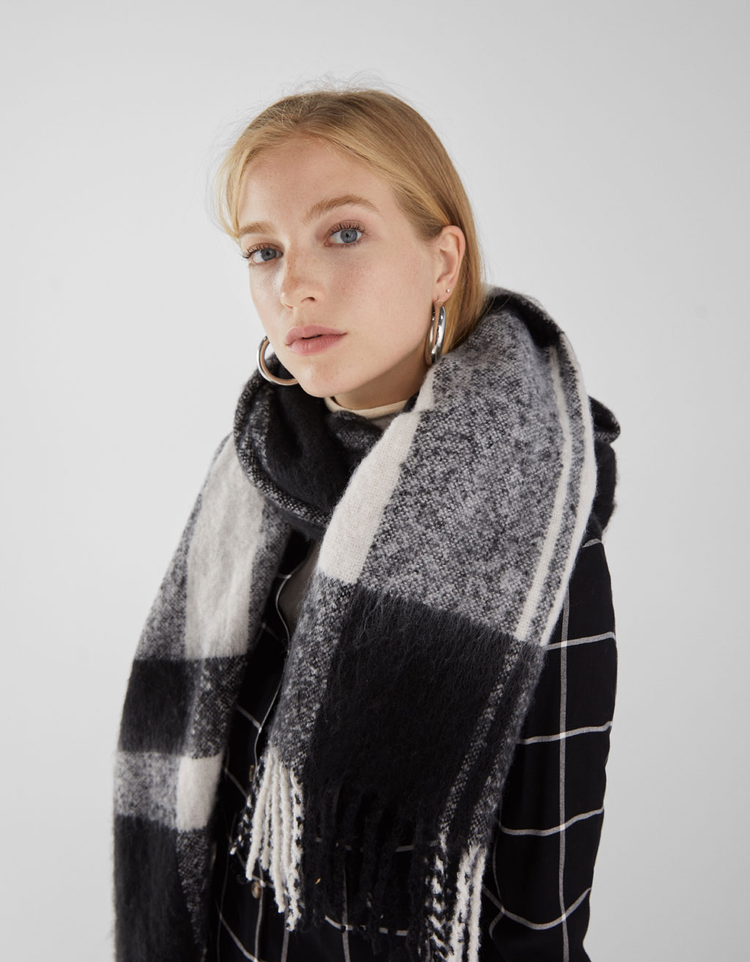
“SPANISH SHOP”
Bershka
Brand & Countryof the brand:
-”Bershka”
Price:
-14,99 $
Made of:
-Acrylic---- 100%acrylic
Made in:
-China
Comments:
-Order

Slide 22
FOREIGN SHOP
Brand & Country of the brand:
Levis
Price:
22,75
Made of:
Cotton
Made in:
Spain

Slide 23
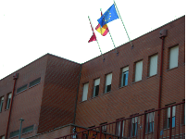
THURSDAY

Slide 24
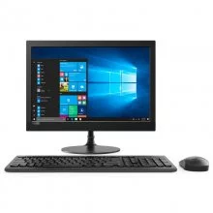
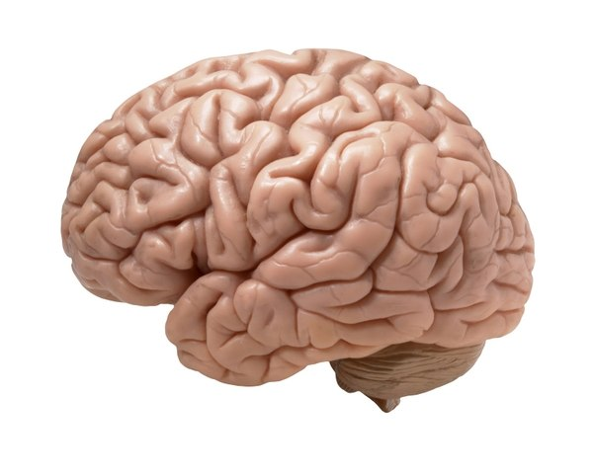
We made this incredible presentation

Slide 25
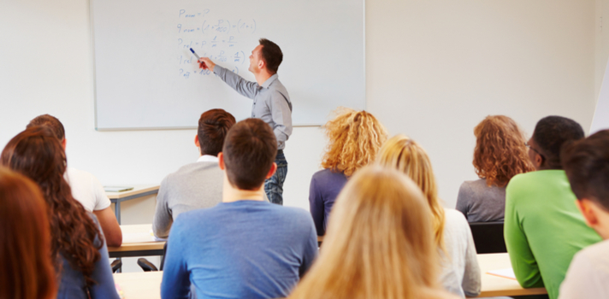
We went to some classes

Slide 26
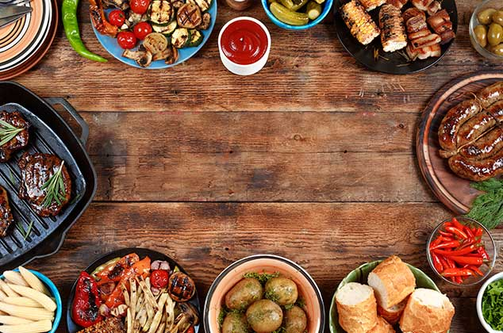
And then we had lunch all together

Slide 27
THANK YOU SO MUCH FOR LISTENING TO US

