Slide 1
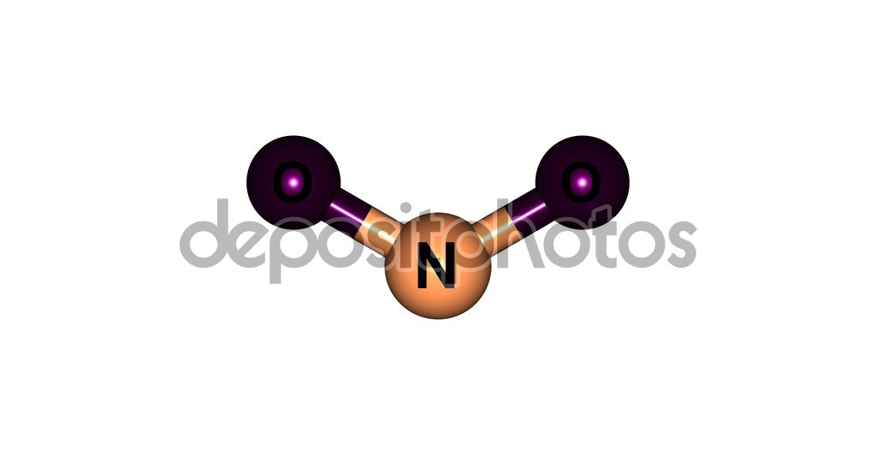
Nitrogen dioxide
Nitrogen dioxide (NO₂). It is a red gas, toxic and a strong irritant. NO₂ is the product of the oxidation of nitrogen monoxide (NO) into the atmosphere.
The concentration limit values of NO₂ in the air are the same in all the countries of the European community. This limit is 40 ppm (i.e. mg/dm³).

Slide 2
Nitrogen dioxide is a pollutant that has negative effects on human health and it causes acid rain.
The main source of emission of nitrogen oxides (NO_{x} = NO + NO₂) is the vehicular traffic; other sources are civil and industrial heating systems and power plants.

Slide 3
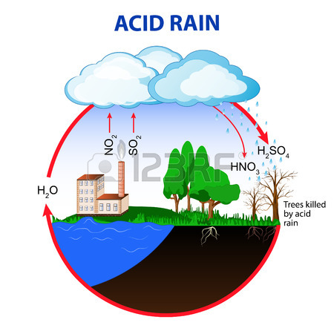
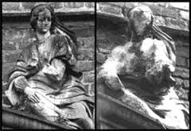
Acid rains
NO₂ reacts with water vapor in the air.
The reaction gives nitric acid. This acid is soluble in water and it falls down with rain. Therefore the rain is acid and it erodes limestone monuments, iron structures and it causes irritations.

