Slide 1
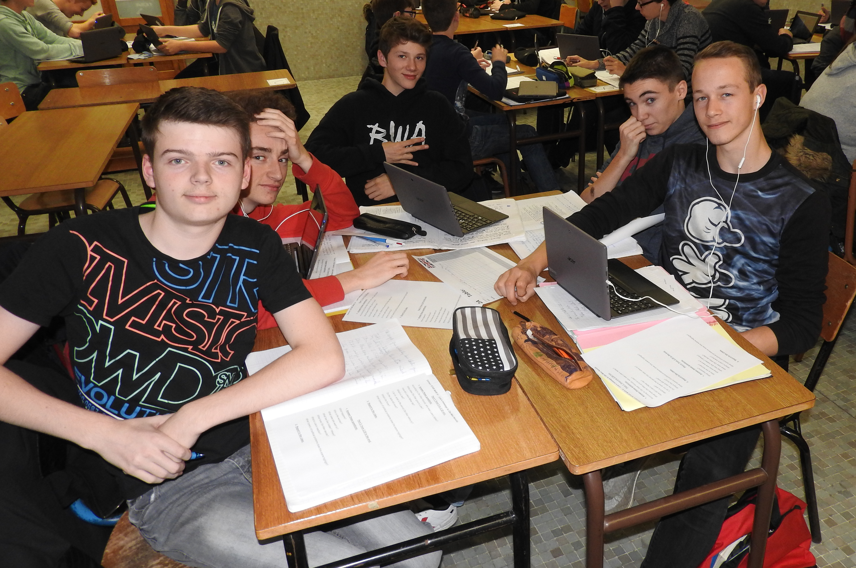
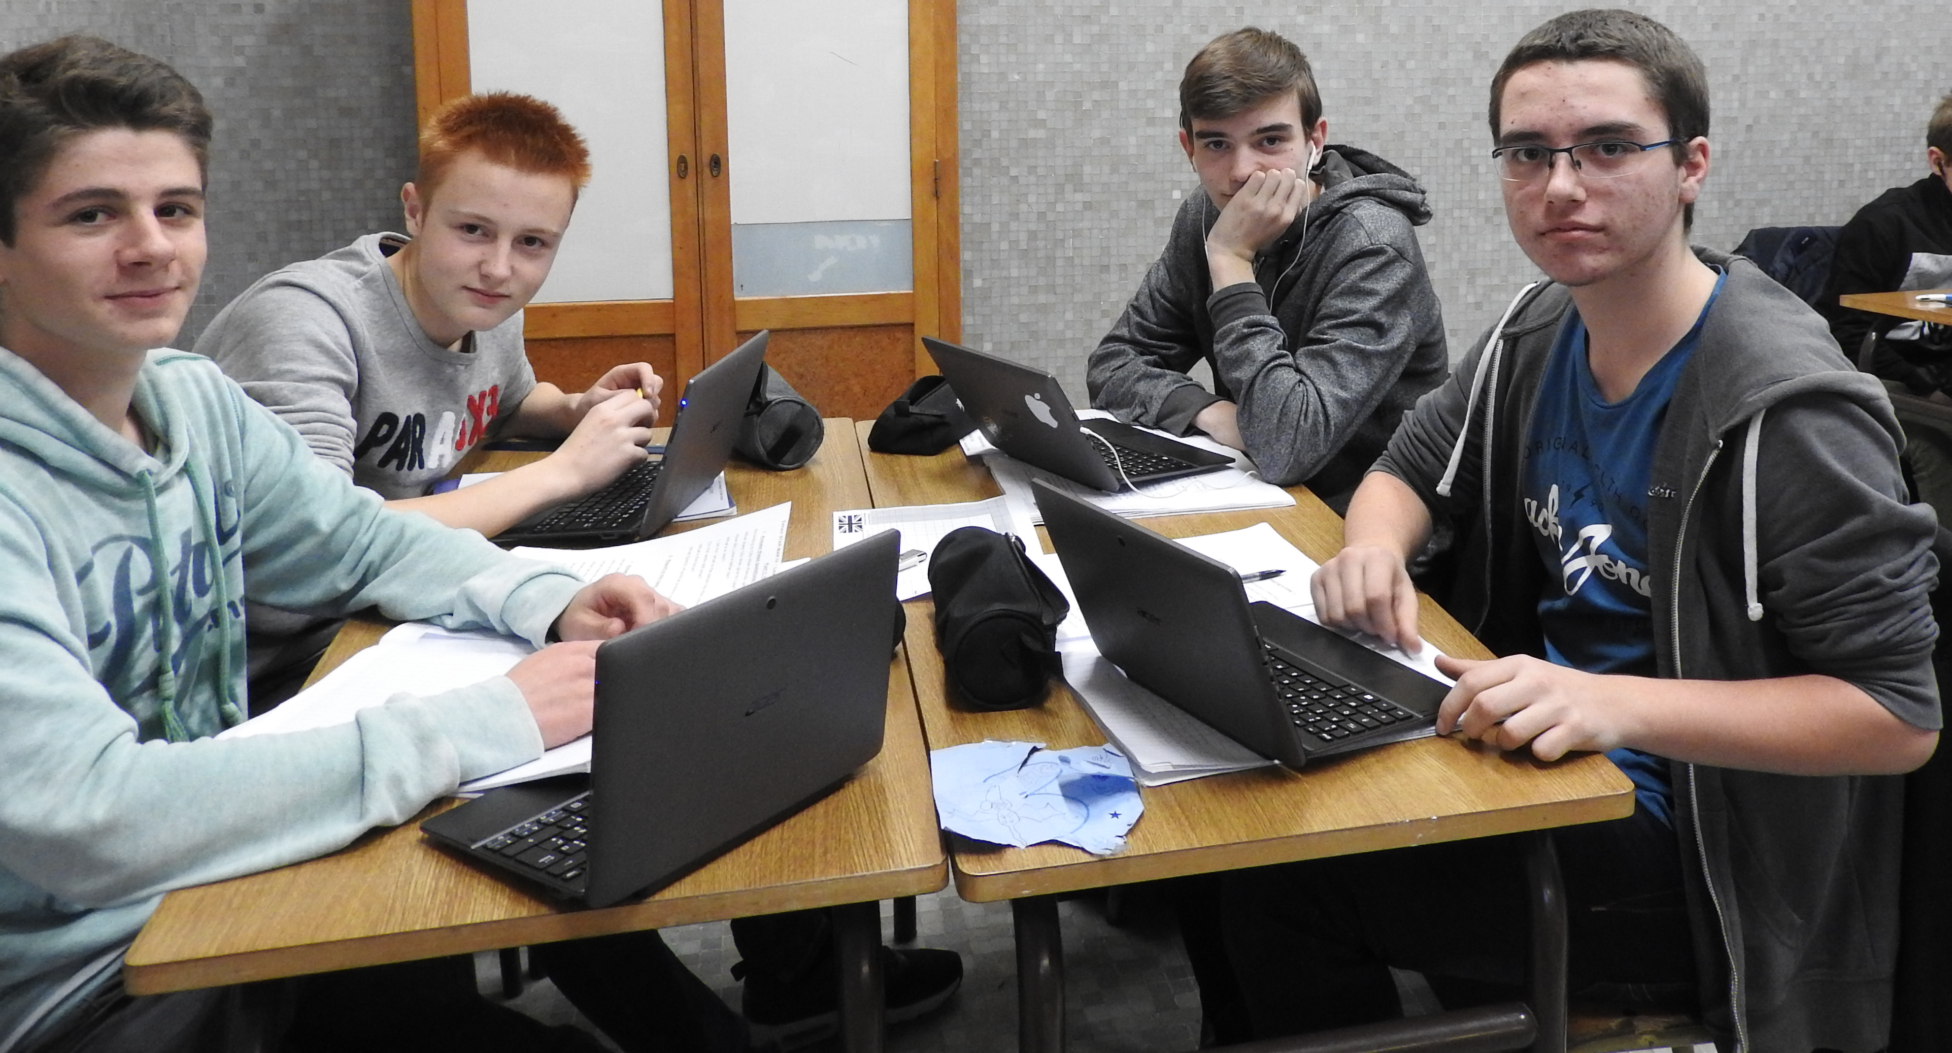
Seconde A Class A
As you know us know, let’s play a game.
1. Link our faces with our names.
Théo
Hugo
Thomas
Thomas
Jeremy
Alexandre
Titouan
Michel
Nathan

Slide 2
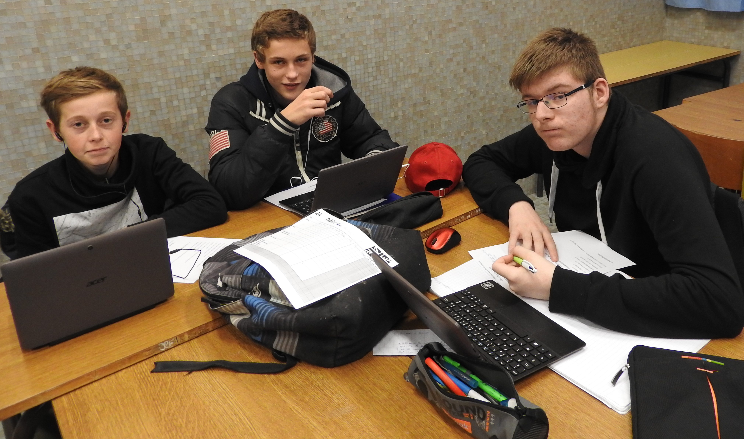
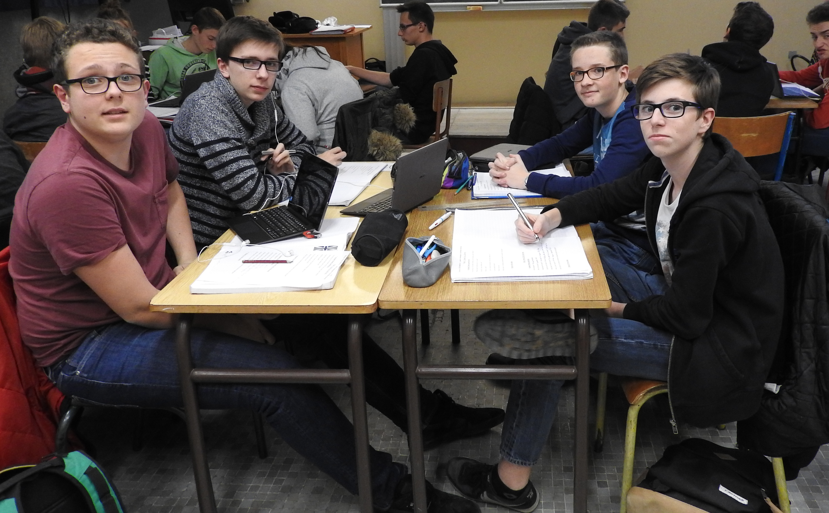
Firmin
Léonard
Maxence
Alexandre
Hugo
Maxime
Guillaume
Tanguy was absent today.

Slide 3
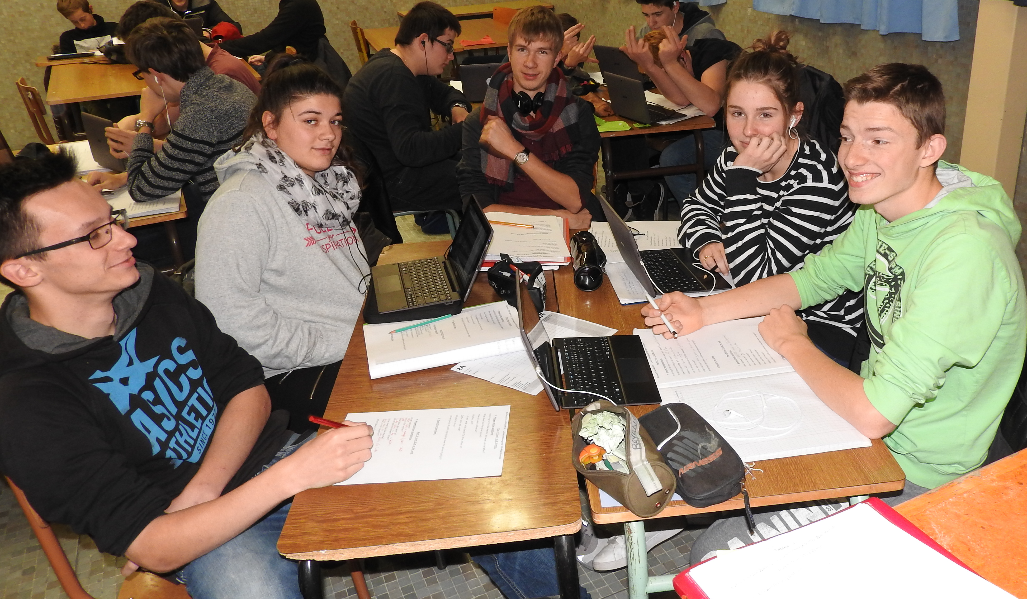
Benoit
Lilian
Léopold
Alexis
Ilona
Bryan
Ilona
Léa

Slide 4
2. You now know where we are from. Can you insert a map of the area where we are from?

Slide 5
3. Have you listened to us carefully? If so, you should know what are our favourite social networks.
List them all.

