Slide 1
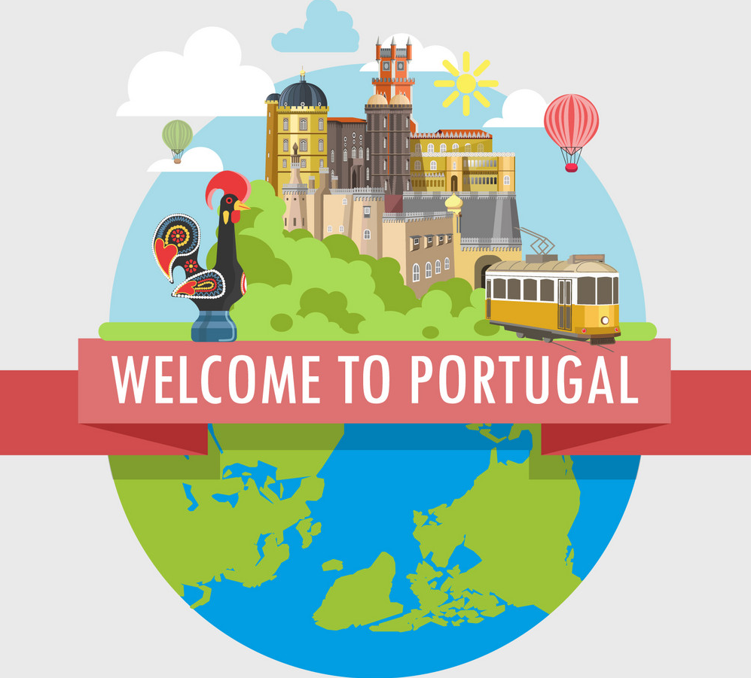

Slide 2
MEET THE TEAM
PATRÍCIA VIEIRA
GONÇALO RODRIGUES
TOMÁS DUARTE
DANIEL COELHO
ADAN NADEEM

Slide 3
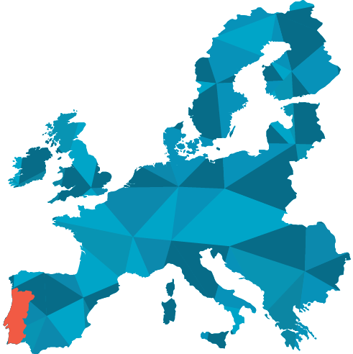
PORTUGAL: QUICK FACTS
Portugal is the oldest nation-state in Europe
Portugal was the world’s first maritime power, and birthplace to some of the world’s first explorers.
Portuguese is the official language of eight other countries outside of Portugal

Slide 4
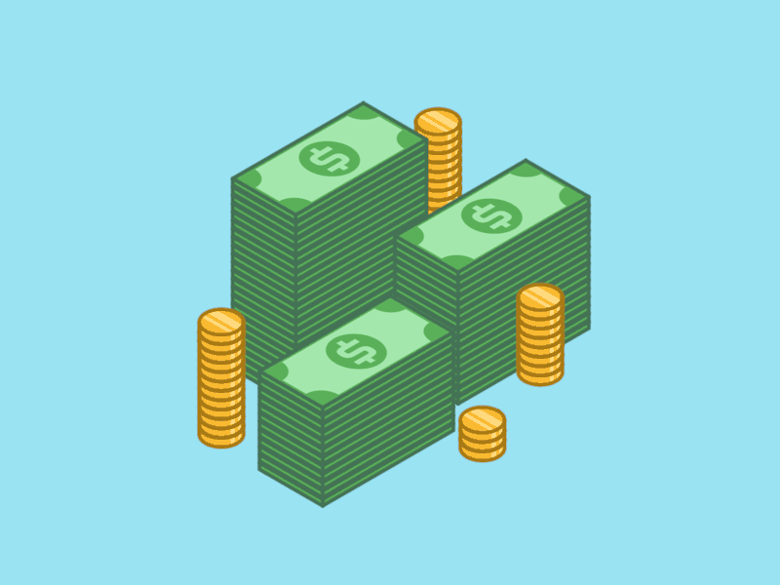
USEFUL INFORMATION

Slide 5
USEFUL INFORMATION
USEFUL INFORMATION
TIME ZONE
WET (Western European Time): No UTC/GMT offset,
Daylight Saving Time +1 hour March to October.
CURRENCY
The Portuguese currency is the
ATMs are the easiest way to get cash. You can use an international debit card at the ATMs with Multibanco. When/if we go to smaller villages, bring cash. The ATM withdrawal limit is €200 per day, and many banks charge a foreign transaction fee of 2-3%.
Banks are open Monday to Friday from 8.30 to 15.00. But ATMs are available at any time.
- Visa and MasterCard are the two most poupular credit cards in Portugal.
- In Portugal we have “The Contactless Card”, which allows payments of less than 20 euros without entering the PIN
-Self-Service, Paypal and MB Net are the most used payment methods by Portuguese consumers.
ATMS /MONEY/ CREDIT CARD USE:

Slide 6
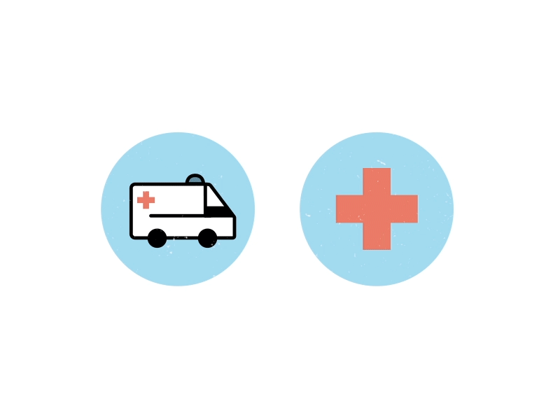
USEFUL INFORMATION
OPENING HOURS IN GENERAL
Mini-Markets and shops: 09:00am to 19:00pm
Supermarkets: 09:00am to 20:00pm
Shopping centre: 10:00am to 23:30pm
Banks and Post Offices: 8:30am to 15:00pm
Hospitals: 24/7
Historical places and monuments:
9:30am to 17:00pm
Or
10:00am to 17:30pm
HEALTH/EMERGENCY
A list of emergency numbers to call in the event of an emergency in Portugal.
Ambulance: 112
Fire: 112
Police (national): 112
Sea Rescue in Lisbon: 214 401 919
Maritime Police in Lisbon: 210 911 100

Slide 7
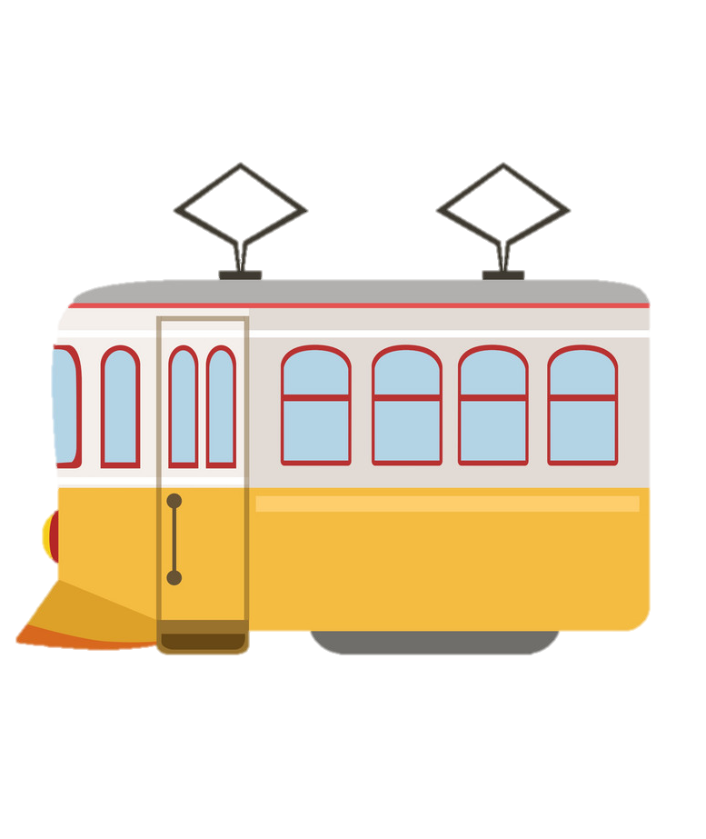
PUBLIC TRANSPORTATION

Slide 8
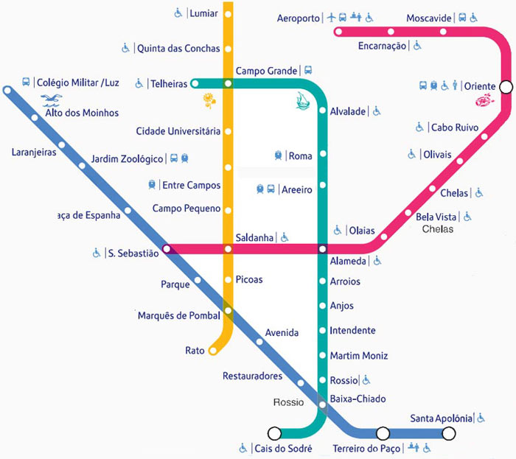
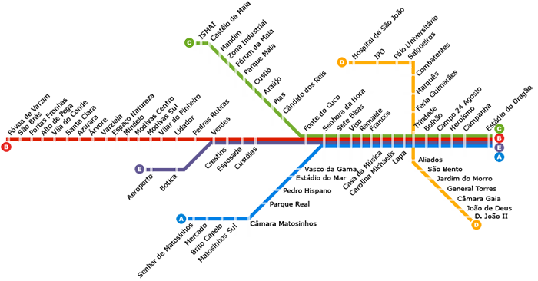
PUBLIC TRANSPORTATION
Metro(www.metrolisboa.pt)
(www.metrodoporto.pt)
– undoubtedly the best way to get around the city. It runs from 6:30 a.m. to 1 a.m.

Slide 9
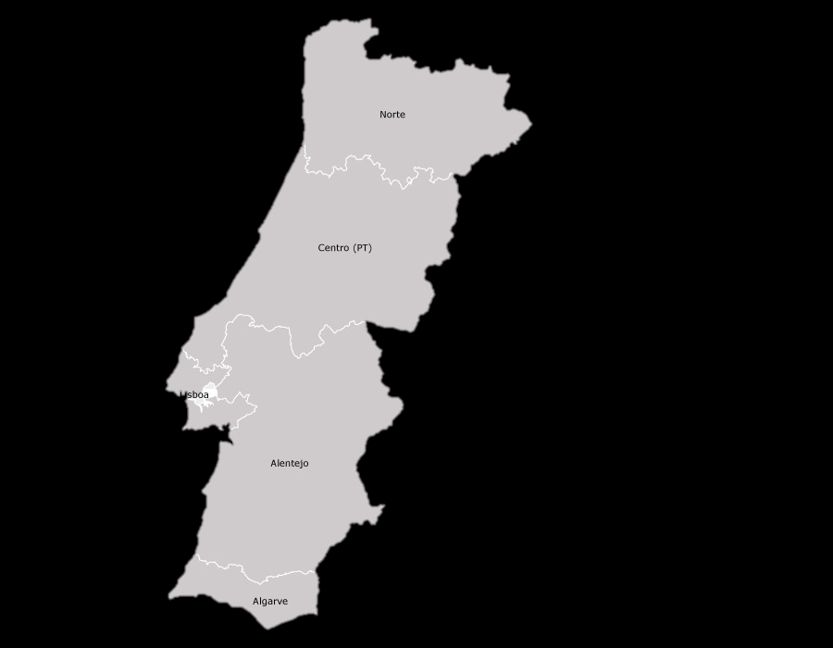
PUBLIC TRANSPORTATION
TRAIN
Forget about driving and explore Portugal by train. The country's reliable public transportation system reaches each corner and region minimizing the need for a car and enhancing travel experiences by chugging along past the cork oaks and olive trees, vineyards, mountainsides, and the sparkling coast. From the resorts of the Algarve(South) to the remote villages in the north, the daily trains provide a unique way to see Portugal's different sides!

Slide 10
PUBLIC TRANSPORTATION
BOAT
Lisbon extends along the banks of the Tejo estuary, and the commuter ferries are an integral component of the capital’s public transport network. The ferry services provide an alternative means of travel from the residential districts south of Lisbon, which avoids the bottleneck of the Ponte 25 de Abril suspension bridge.
For visitors in Lisbon, the ferries provide an enjoyable and inexpensive activity, with wonderful waterside views of the city, which are a fraction of the price of the expensive tourist boats.

Slide 11
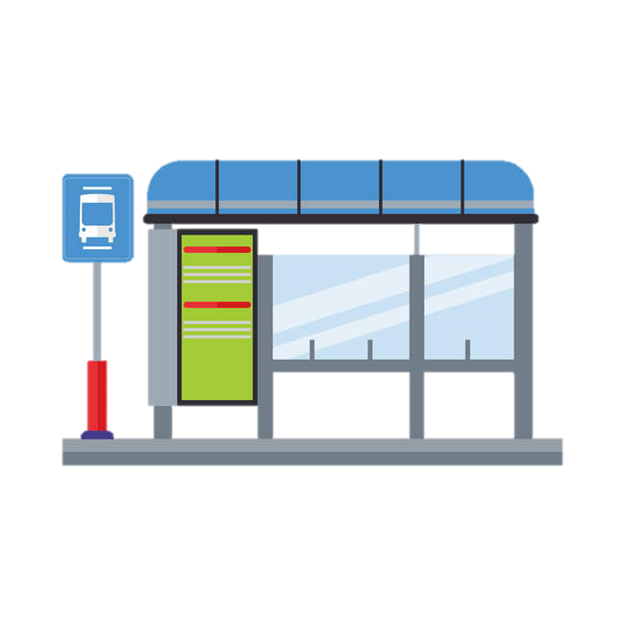
PUBLIC TRANSPORTATION
Trams, Buses, Funiculars, Lifts (www.carris.pt) – their lines conveniently connect to Metro. Ride vintage tram No. 28 for great views of Lisbon’s old quarters. There’s also an extensive network of night buses numbered 200+ that run at least once per hour.
1,45€-2,00€

Slide 12
FOOD HABITS

Slide 13
FOOD HABITS
PORTUGUESE FOOD HABITS
Breakfast: bread, ham ,cheese, cakes, coffee, tea, milk, juice.
Lunch/Dinner: Soup, salad, fish, meat, vegetables, rice, pasta, potatoes, fruit, pastery, coffee.
-We usually sit down and take an hour to Lunch / Dine.
- Portuguese meals are based on the Mediterranean diet.
CHALLENGE:
pick the correct ingredientes for the mediterranean diet.

Slide 14
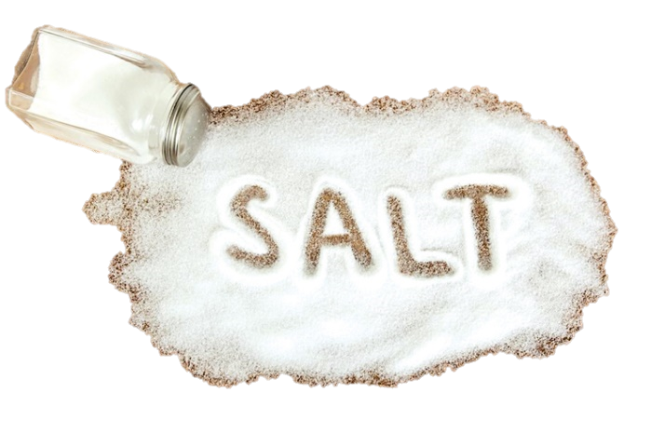
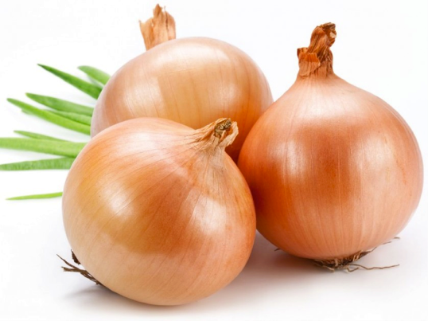
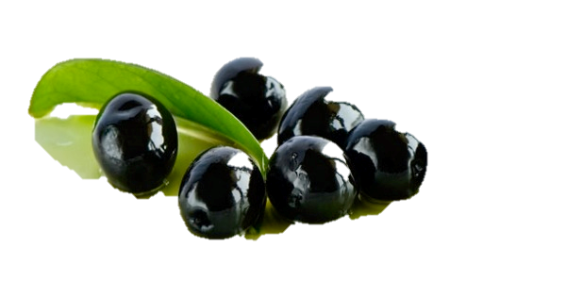
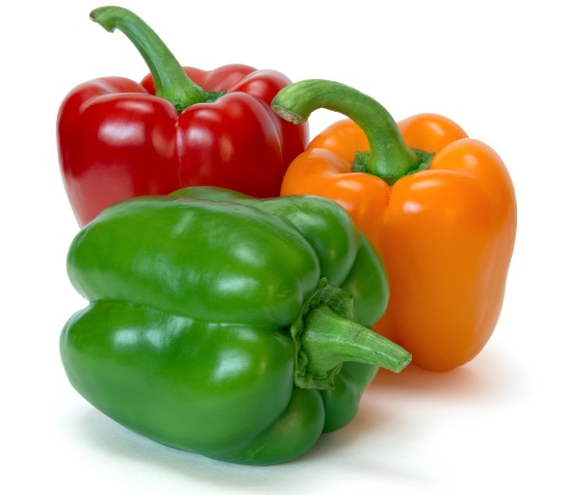
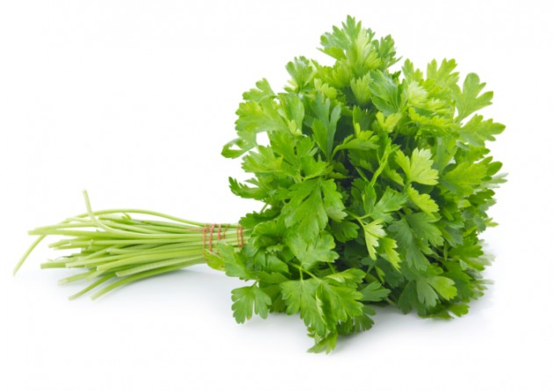
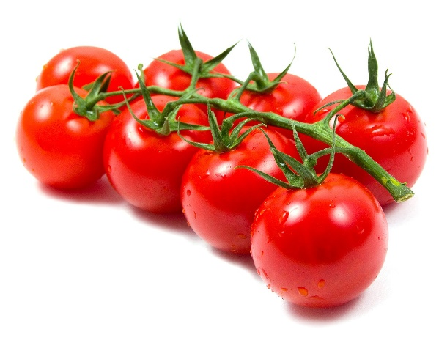
FOOD HABITS
check the correct answers

Slide 15
GREETINGS

Slide 16
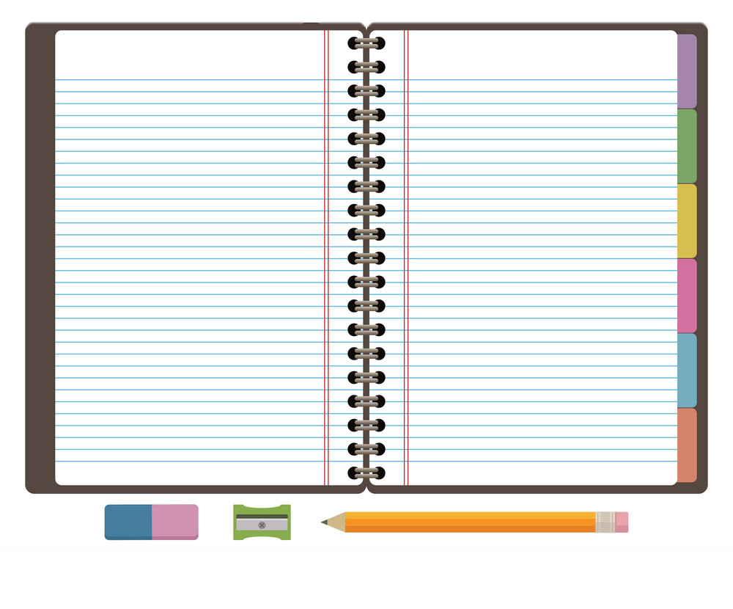
GREETINGS
USEFUL KEY PHRASES
z
Portuguese
Bom Dia
Boa Noite
Boa Tarde
Olá
Adeus
Até já
Tudo Bem?
Até Logo
Não entendo
Pode repetir?
Se faz favor / Com licença
English
Good Morning
Good afternoon (if greeting) Good Night (if farewell)
Good afternoon
Hello
Goodbye
See you
How are you?
See you later
I don’t understand
Could you repeat, please
Excuse me

Slide 17
USEFUL KEY PHRASES
Could you speak more slowly, please?
Could you repeat it, please?
Where can I find a toilet/ bathroom?
How do I get to _____ ?
Where is the _____ ?
Do you accept credit cards?
Where can I exchange currency/money?
Where can I find an ATM?
Can I see the menu, please?
I’d like ______.
The check, please.
How much is this?
z
Pode falar mais devagar?
Pode repetir?
Onde fica a casa de banho?
Como vou para ______?
Onde fica o(a)______?
Aceita cartões de crédito?
Onde posso trocar dinheiro?
Onde há uma caixa multibanco?
Posso ver a ementa, por favor?
Queria ______.
A conta, por favor.
Quanto custa isto?

Slide 18
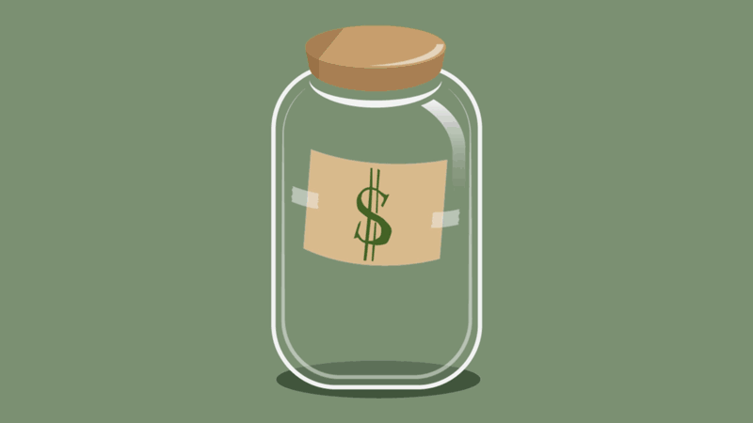
TIPPING

Slide 19
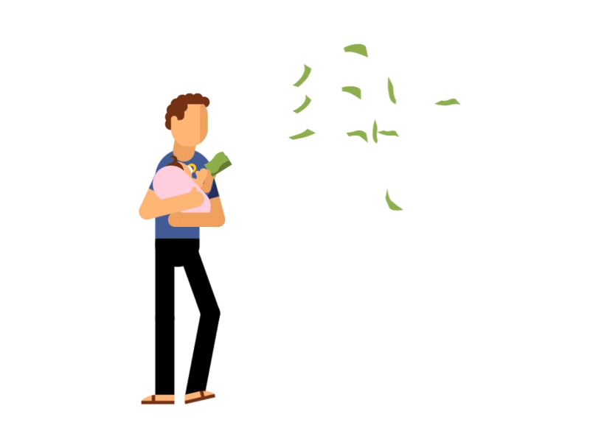
TIPPING
Tipping in Portugal
In Portugal, tipping is completely voluntary, and is mostly used at restaurants.
We don’t usually tip at shops or coffee shops.
The tips are usually from 5 to 20% of the payment.

Slide 20
PRESENTS

Slide 21
PRESENTS
Presents
When we talk about presents, we always try to give something as a token of gratitude.
For example, if we are going to be accommodated by someone, we will give them something that has a meaning behind it, like some traditional Portuguese food or some symbolic items related to our country.

Slide 22
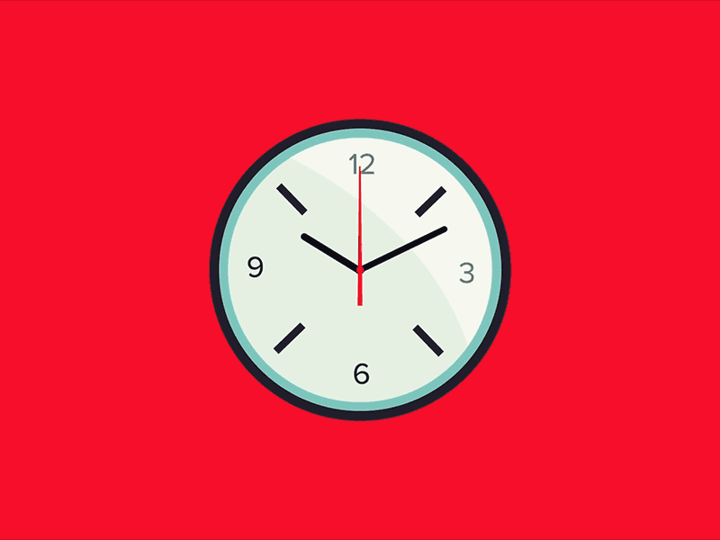
PUNCTUALITY

Slide 23
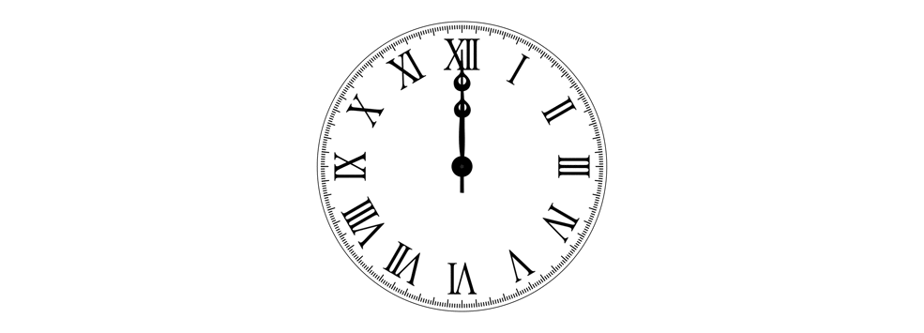
PUNCTUALITY
Punctuality:
When it comes to punctuality there is some information you should know.
In a Portuguese meeting, natives will rarely arrive before the fixed time. We usually arrive just on time, which means that we are seated and ready to start the meeting 5 to 10 minutes after the scheduled time.
If we’re talking about a seminar or conference, speakers actually wait for 15 minutes before starting the event, it’s called the “15 academic minutes”.
This will not happen in some foreign countries, where people start working at exactly the scheduled hour.

