Slide 1
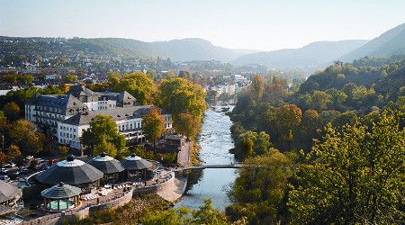
Bad Kreuznach
www.bad-kreuznach-tourist.de

Slide 2
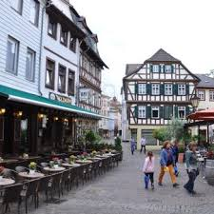
Facts & figures
approximately 50 000 residents
placed in Rhineland-Palatinate
5 districts (Bosenheim, Planig, Ippesheim, Winzenheim and Bad Münster)
City is divided into two parts: old town and new town
www.ich-geh-wandern.de

Slide 3
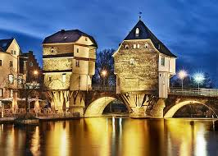
Bridge houses
Built in 1480 on top of the old Nahe Bridge
Bridge was built to unite Bad Kreuznach
At first it was not planned to built houses on the bridge
A bullet that dates back to the 30 Years War can be seen in one of the houses
www.bad-kreuznach-tourist.de

Slide 4
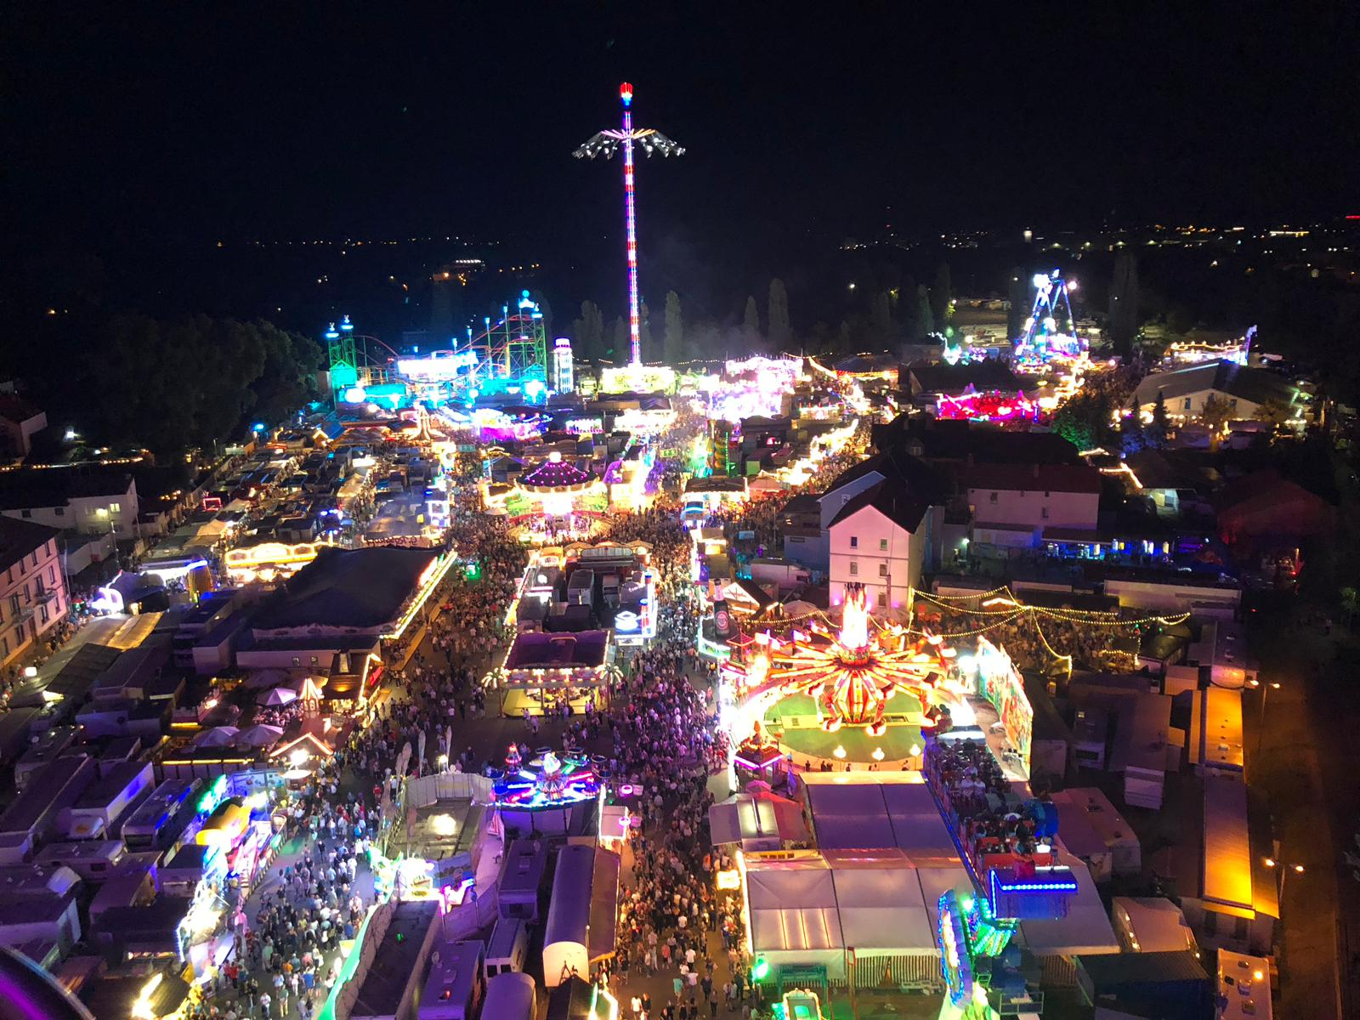
Jahrmarkt
Festival in Bad Kreuznach once a year
Every 3rd weekend in August
500 000 visitiors every year
First „ Jahrmarkt“ was 1810
Everybody goes there to meet people
Lots of rollercoasters and other attractions

Slide 5
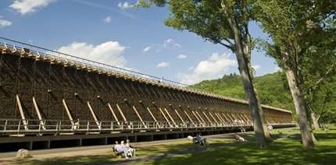
Salinas
Europes biggest salina park
„Bad“ in Bad Kreuznach → means „spa/cure“
Many people with respiratory diseases come to the salinas to inhale salty air
Built in 1732
Water is pumped from 500 m deep wells
9 meters tall
http://www.gradierwerk-saline.de

Slide 6
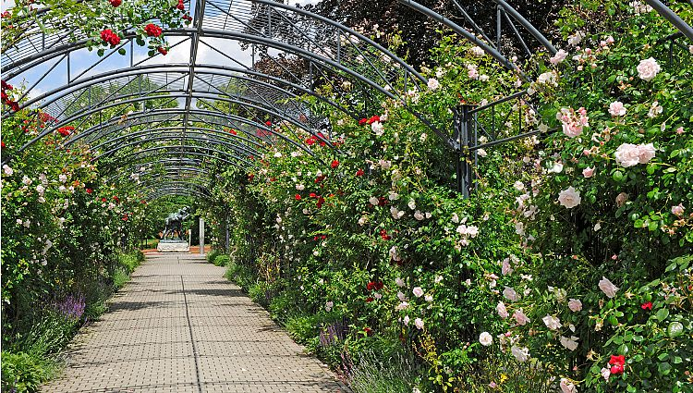
Roseninsel
„Island of roses“ – link between the salina area and the municipal spa gardens
Created in 1905
Great variety of different types of roses
Very beautiful in summer next to the river
Tourist magnet in spa/ hotel area
www.bad-kreuznach-tourist.de

Slide 7
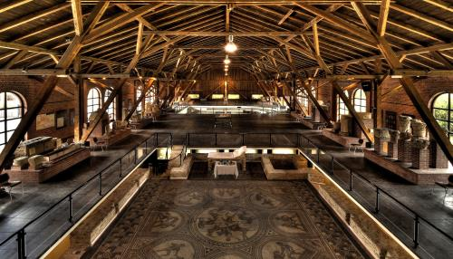
Roman heritage
Romans halls with preserved mosaics of Roman villa
Original water pipes built by Romans can be seen
Roman halls date back to 3rd century AD
Located in a big park with old trees → popular spot for weddings
http://www.media-k.eu

