Slide 1



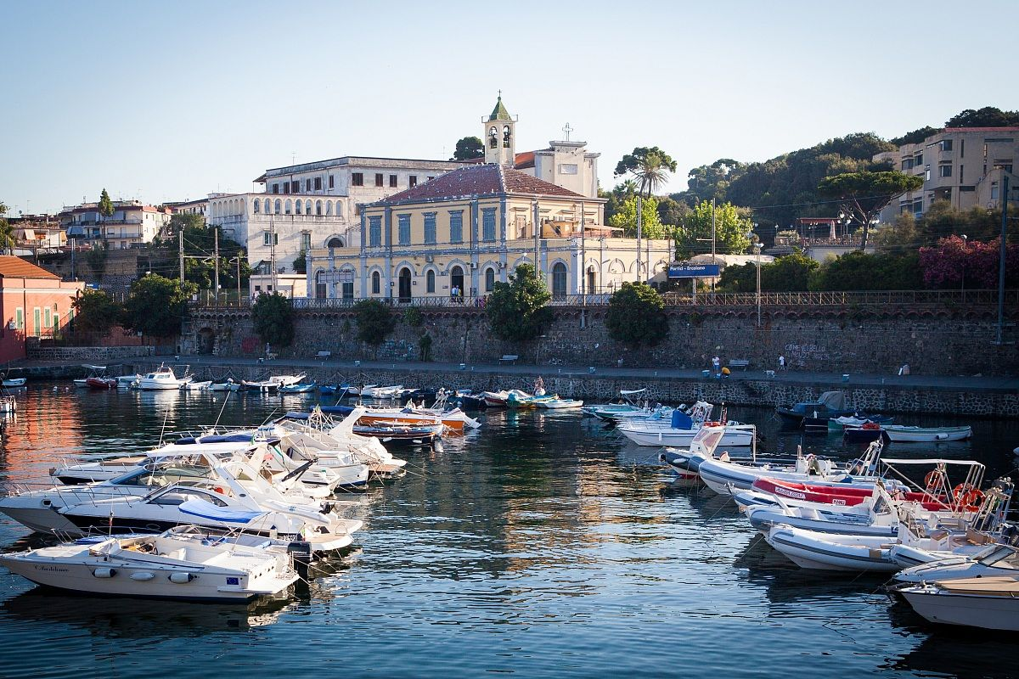
Cultural Guide: Southern Italy

Slide 2
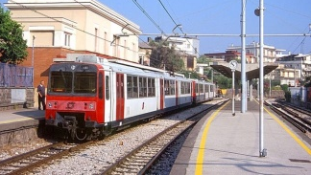
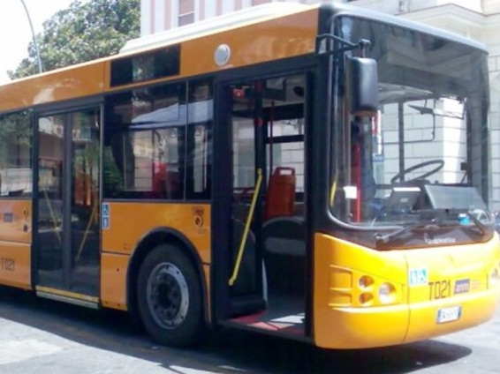
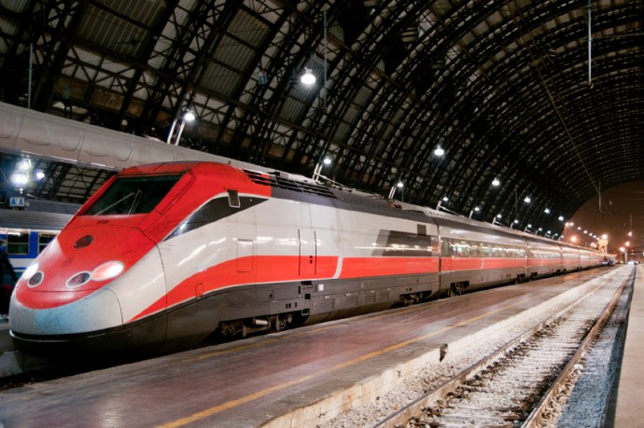
Public Transport
The public transportation system of Naples is operated by two companies and includes city buses, funicular lines, regional buses, Metro Lines 1, 2 and 6, Circumvesuviana, Circumfegrea and Cumana train lines.
Hourly ticket – costs €1.50 and it lasts 90 minutes from the time the ticket is validated
Daily ticket – costs €4.50 and it lasts until midnight of the day the ticket is validated
Weekly ticket – costs €15.80 and it lasts until midnight of the last day of the week of validity
Hourly, daily, weekly and monthly tickets can be purchased at tobacco shop (tabaccheria) or newspaper stands. There are ticket machines at many of the railway, metro and cable railway stations as well as at selected bus stops throughout the city.

Slide 3
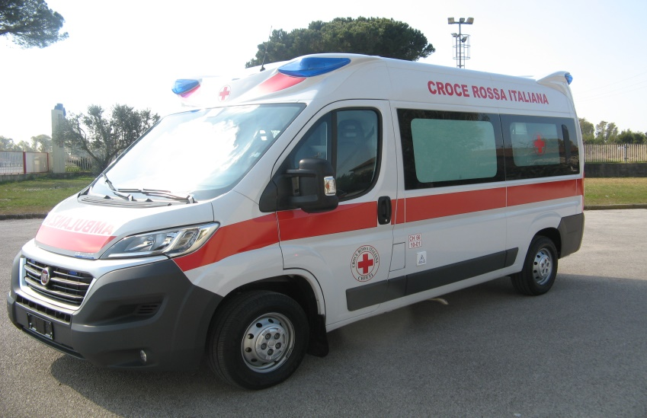
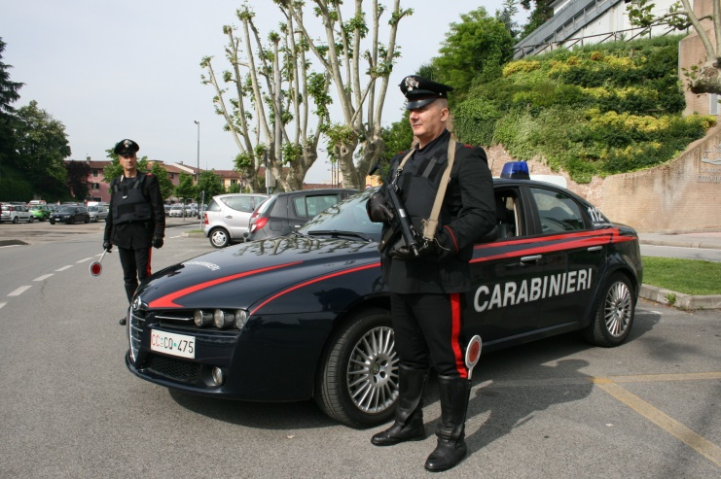
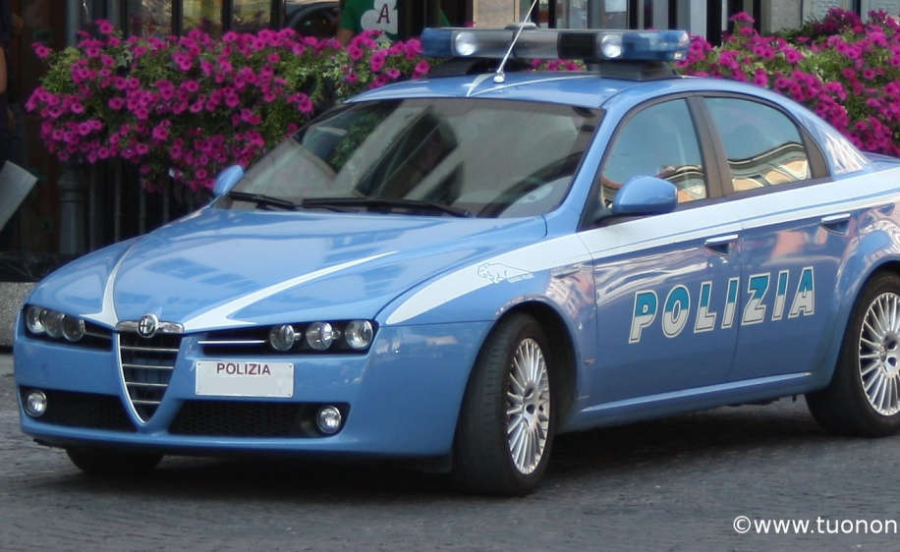
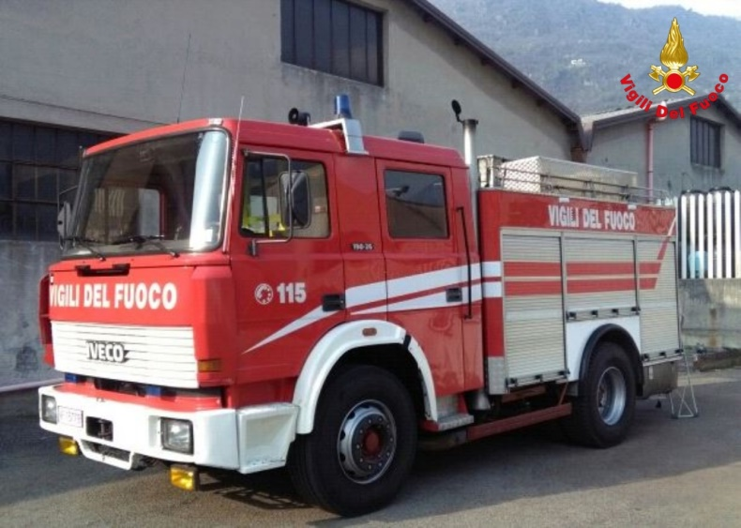
118: Ambulance
115: Fire-brigade
113: Polizia (Police)
112: Carabinieri (military police)
Health/emergency, Police and Fire Brigade

Slide 4
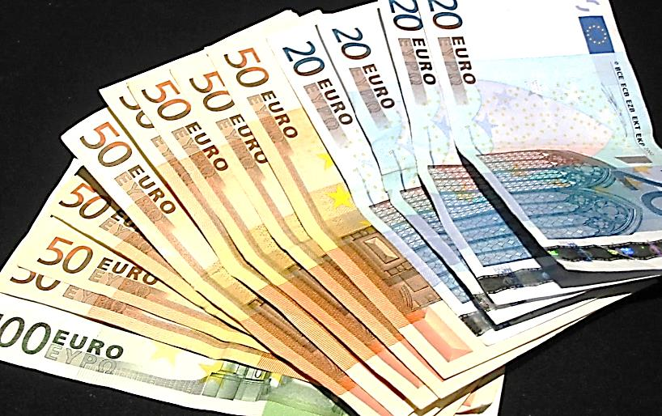
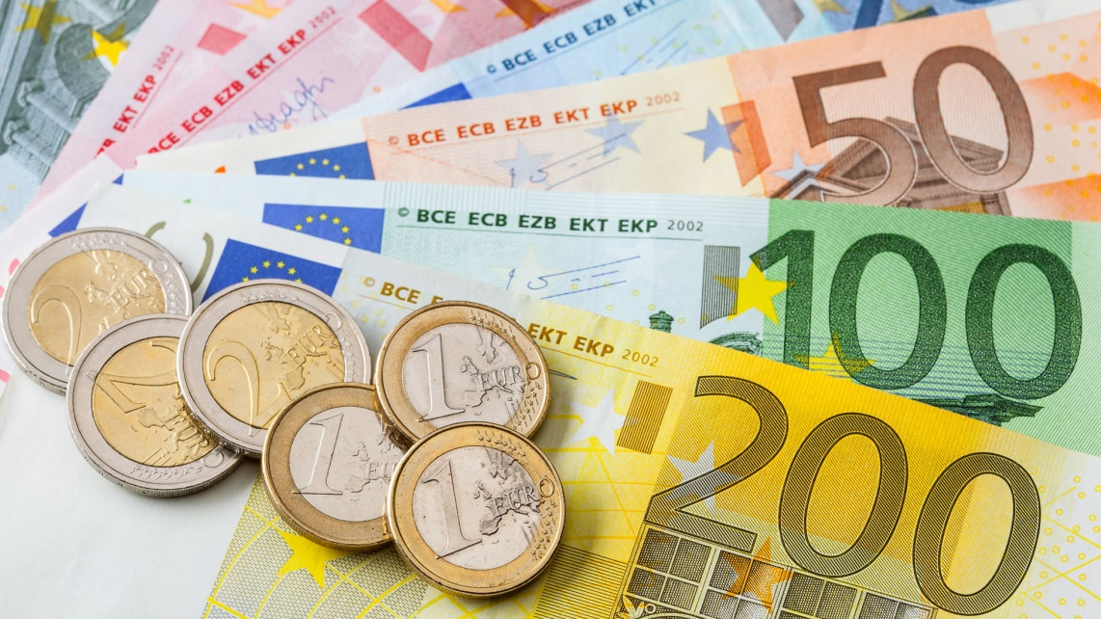
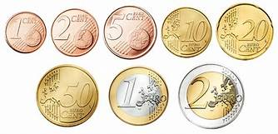
Money
The italian currency is EURO (€). The cheapest and fastest
way to get cash is from ATM machines, called BANCOMAT.
We suggest to keep with you some cash money for a daily use because many small shops and bars don’t accept credit cards.

Slide 5
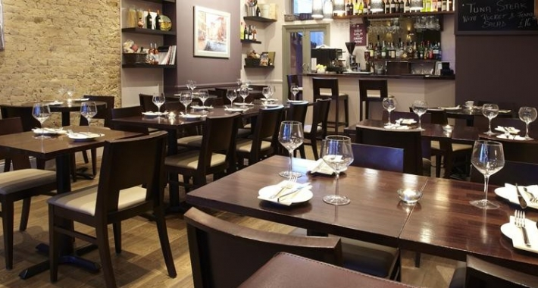
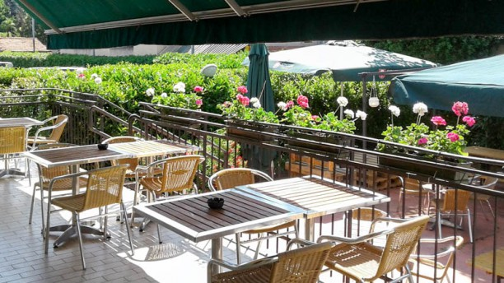
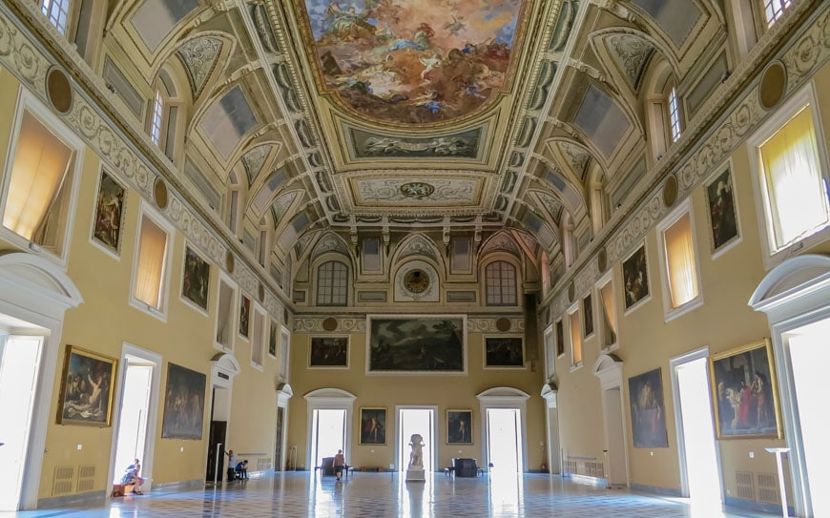
Opening Hours
Museums & monuments: 8,9 am - 7.30 pm
Retail Shops: 9 am - 1.30 pm / 4.30 – 8.30 pm
Stores and Malls: 8 am - 9 pm
Restaurants: lunchtime 12 am - 4 pm,
dinner 7 - 12 pm
Bars: 7 am - 12 pm
Banks: 8.30 am - 1.30 pm / 2.45 – 4 pm (Mon-Fri)
Central Post Office: 8.30 am – 6 pm (Mon-Fri) on Saturday 8 - 12.30 am
Schools: Public schools in Southern Italy hardly ever have a full time schedule for lessons. Generally the lessons start at 8/8.30 am and finish at 1/1.30 pm or even later with one day off (generally on Saturday)

Slide 6
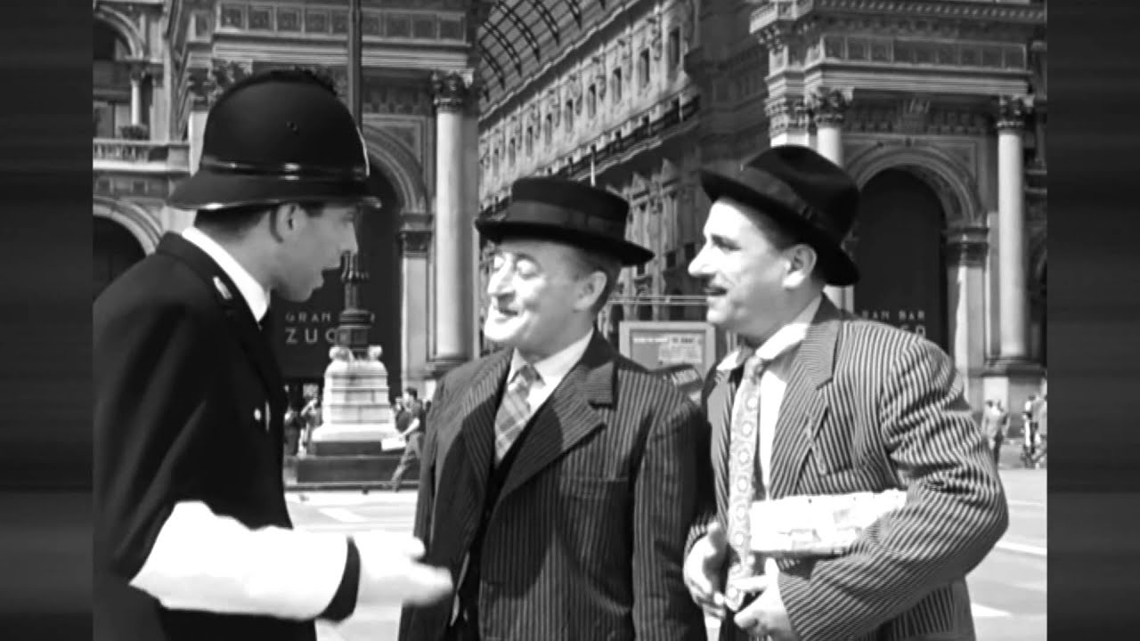
Useful phrases
Il treno ferma…? Does the train stop at… (place) ?
Che ore sono? What time is it?
A che ora apre/chiude l’ufficio? What time does the office open/close?
Può aiutarmi, per favore? Can you help me, please?
Come posso raggiungere…? How can I get … (somewhere)
Possiamo prenotare un tavolo? Can we reserve a table? (at the restaurant)
Vorrei ordinare… I’d like to order…(restaurant)
Buon appetito Enjoy your meal
Grazie!/Prego! Thank you!/You’re welcome!
Da dove vieni? Where are you from?
Come ti chiami? What’s your name?
Dov’è il bagno? Where is the toilet?
A destra!/A sinistra! To the right!/To the left!
Quanto costa? How much does it cost?
Posso pagare con carta di credito? Can I pay by credit card?
Communication tilt !!

Slide 7
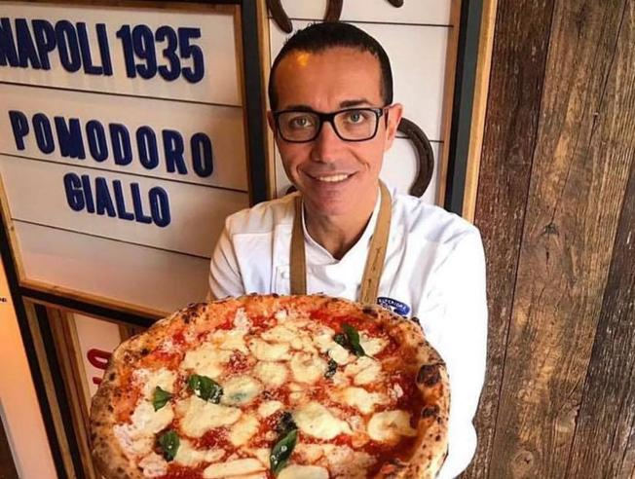
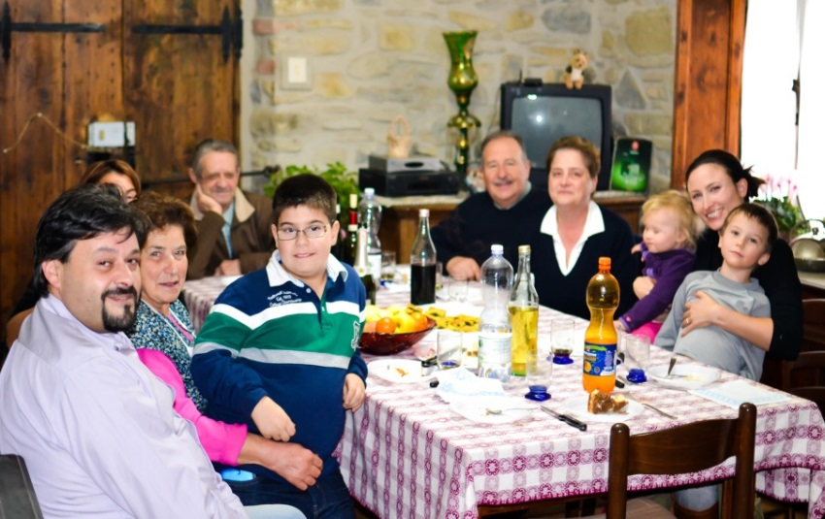
Food Habits
Southern Italian families are not used to the International breakfast but prefer having sweet stuff such as milk and cereal, bread with jam or Nutella, biscuits, bakery products and of course litres of moka coffee (6.30 – 7.30 am)
The habit of having several coffee breaks during the day is very common as well as that of enjoying the so called “aperitivo” before lunch. It’s generally made of sparkling bitter drinks with different salty snacks.
People generally have a full meal at lunchtime (1.30-2 pm) with at least 3 courses (Pasta, meat/fish with vegetables, dessert and fruit)
We usually have dinner around 8.30 - 9 pm. Our dinner generally consists of a rich dish of meat with vegetables, mozzarella and other dairy products, salad and typical bakery products or simply a well prepared Pizza.
Sorbillo, the best pizzeria in Italy
Italians at lunchtime

Slide 8

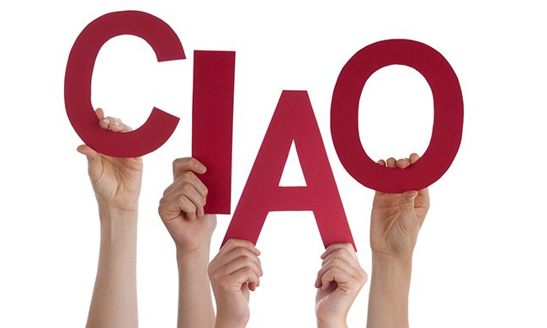
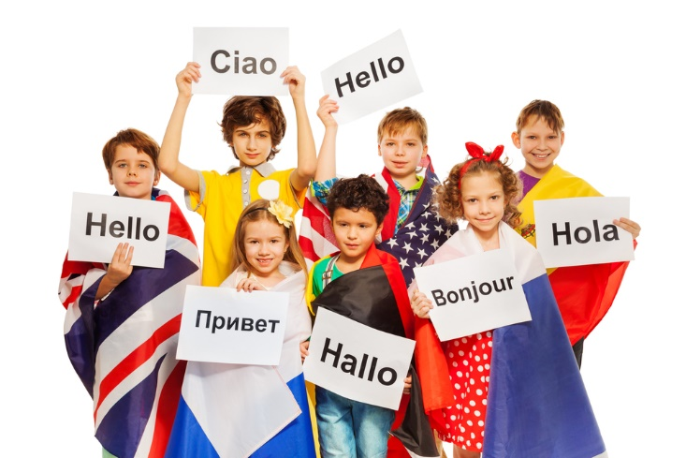
Greetings
Ciao! Hello!
Salve/Buongiorno! Hello/Good Morning!
Piacere di conoscerti! Nice to meet you!
Buonanotte! Good Night!
Benvenuti! Welcome!
Come stai? How are you?
Ci vediamo dopo! See you later!
A presto! See you soon!
Buona Giornata! Have a nice day!
Buon viaggio/ volo Enjoy your trip /flight

Slide 9
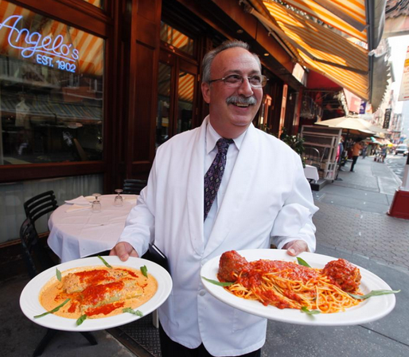
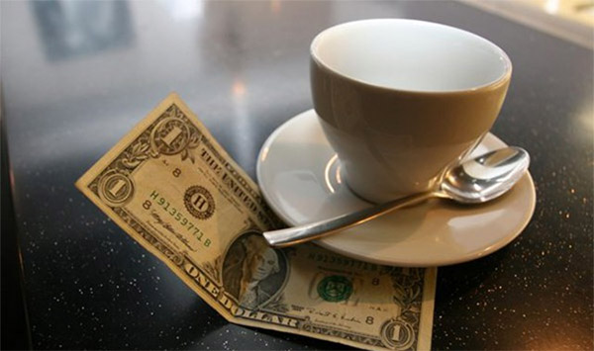
Tipping
Tipping in Italy can be confusing because a tip may already be included in the bill. Remember that tipping in Italy is considered a “bonus,” so the amount should reflect the level of service. Though we may feel obligated to tip for a job well done, tipping in Italy isn’t always necessary.

Slide 10
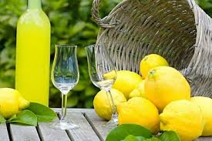
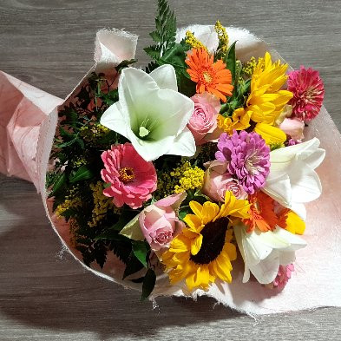
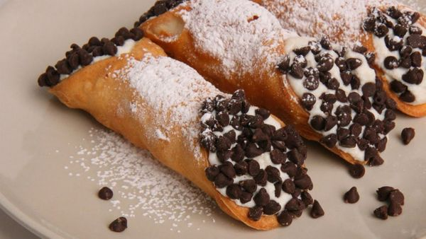
Presents
Gifts are expected for social events and to express thanks for an invitation. If you are invited to someone’s home, a gift like wine, chocolates or flowers are quite appropriate. You may consider a gift for the children as well.
The price paid for a gift sould never be told.
To give home-made food as a gift is considered a labor of love.
New Year’s Epiphany, Valentine’s day, Mother and Father’s day, Carnival, Christmas and Name day are all considered gift giving occasions.
Keep in mind: Food and Liquors are quite appriciated and, when giving wine, make sure it is a good vintage one as Italians are wine connoisseurs!

Slide 11
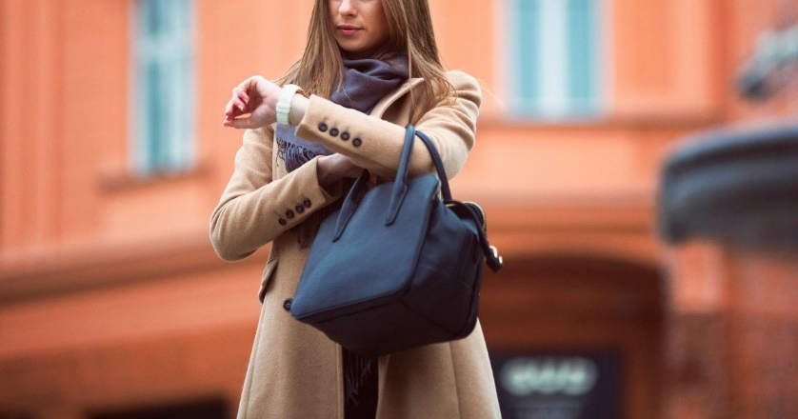
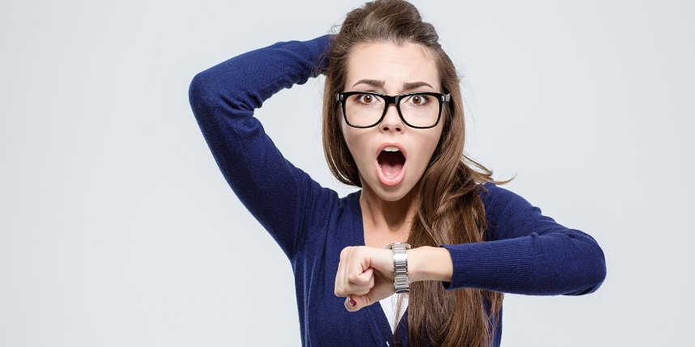
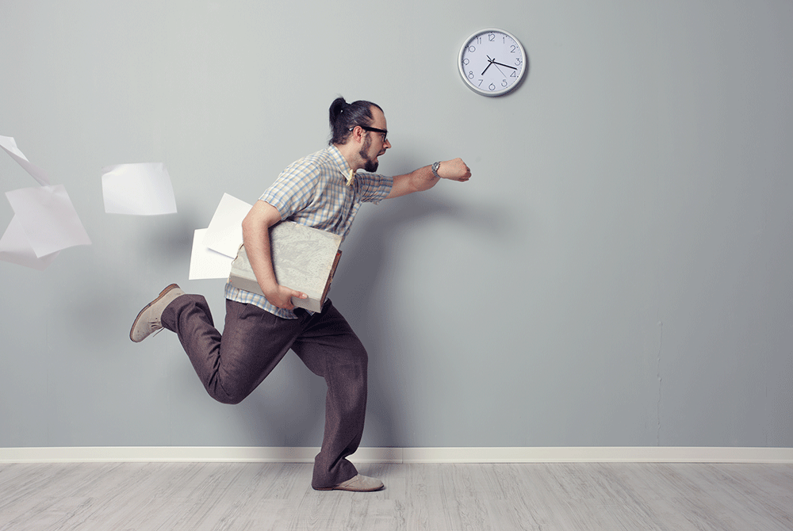
Punctuality
The stereotype of being late is…true, especially in Southern Italy. When an Italian takes an appointment he is not so punctual. We don’t say ‘’let’s meet at 9 o’clock’’ but we are less precise, in fact it’s more common to hear ‘’see you this night/about 9’’. Sometimes it can happen that you have to wait even 10-15 mins before finally meeting up with your friends.

