Slide 1
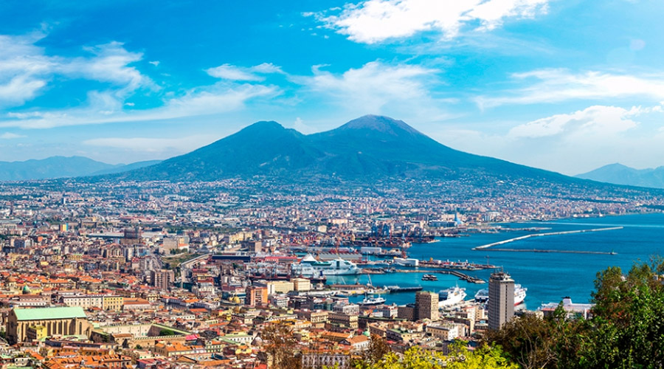
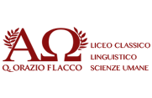
NAPLES

Slide 2
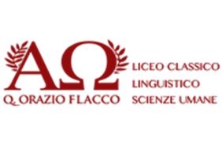
The city of Naples, in southern Italy, stands in the heart of the homonymous bay next to Vesuvius, the active volcano still known today for having destroyed the ancient Roman city of Pompeii. Dating back to the second millennium BC, Naples has centuries of history of art and architecture behind it. Partenope was, in ancient Greek mythology, a siren. According to the tradition, the three sirens Partenope, Ligeia and Leucosia are beaten in song by Orpheus and for despair they throw themselves into the sea, where they are turned into rocks. The mermaid would have died in the place where today stands Castel dell'Ovo and right there one of the patrons of Naples, Santa Patrizia, was buried. In Naples the Mermaid Partenope was venerated as a goddess; for example, Virgil will use his name in a poetic sense.

Slide 3
Languages ​​and dialects. The Neapolitan language (napulitano) is a Romance language. The Neapolitan has suffered in its history, like many other languages, influences and "loans" from the various peoples who have inhabited or dominated the Campania and central-southern Italy.
The Neapolitan replaced the Latin in official documents and in the court assemblies in Naples. In the last three centuries, in fact, the Neapolitan has been used with a certain frequency and with remarkable results also in the art. In literature and poetry, with Salvatore di Giacomo, Edoardo Nicolardi, Libero Bovio; in the theater, which gave rise to the Neapolitan theater; in the lyric, which between the seventeenth and eighteenth centuries produced entire librettos of works; in music, with the classic Neapolitan song; and in the twentieth century, even in the cinema.

Slide 4
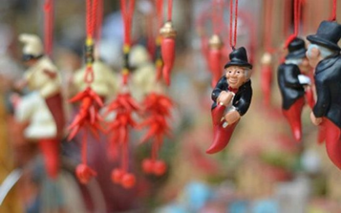
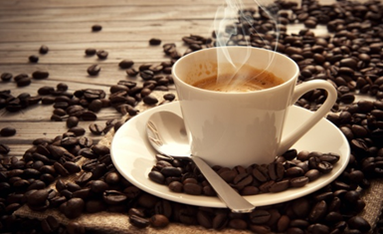
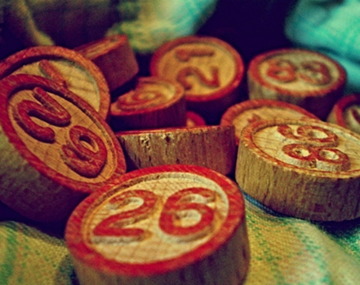
Traditions and folklore The rich and historical popular tradition of Naples and its millenary culture have determined over time a feeling of Neapolitanism. The Neapolitan cultural heritage, ranging from music to cuisine, from sacred rites to mystical beliefs, causes the city to be associated with different stereotypes: pizza, sun, tarantella and mandolin, four symbols of Naples, are in fact listed and recognized as the most classic symbols (sometimes used with derogatory meaning) of Italy in the international collective imagination. Vesuvius, the horn or the munaciello, are just a few exemples of the local popular superstition, as well as the tombola (a typical Christmas game), mask of Pulcinella and presepial art are major landmarks of the Neapolitan culture.

Slide 5
Cuisine
Neapolitan cuisine is an unmistakable cultural identity for the city of Naples and is closely linked to the historical and cultural events of the city. In fact, it represents one of the most famous symbols of "made in Italy" abroad. Typical dishes include Neapolitan pizza, Neapolitan pasta, eggplant parmigiana, gnocchi alla sorrentina, Neapolitan pastiera, and friarielli.

Slide 6
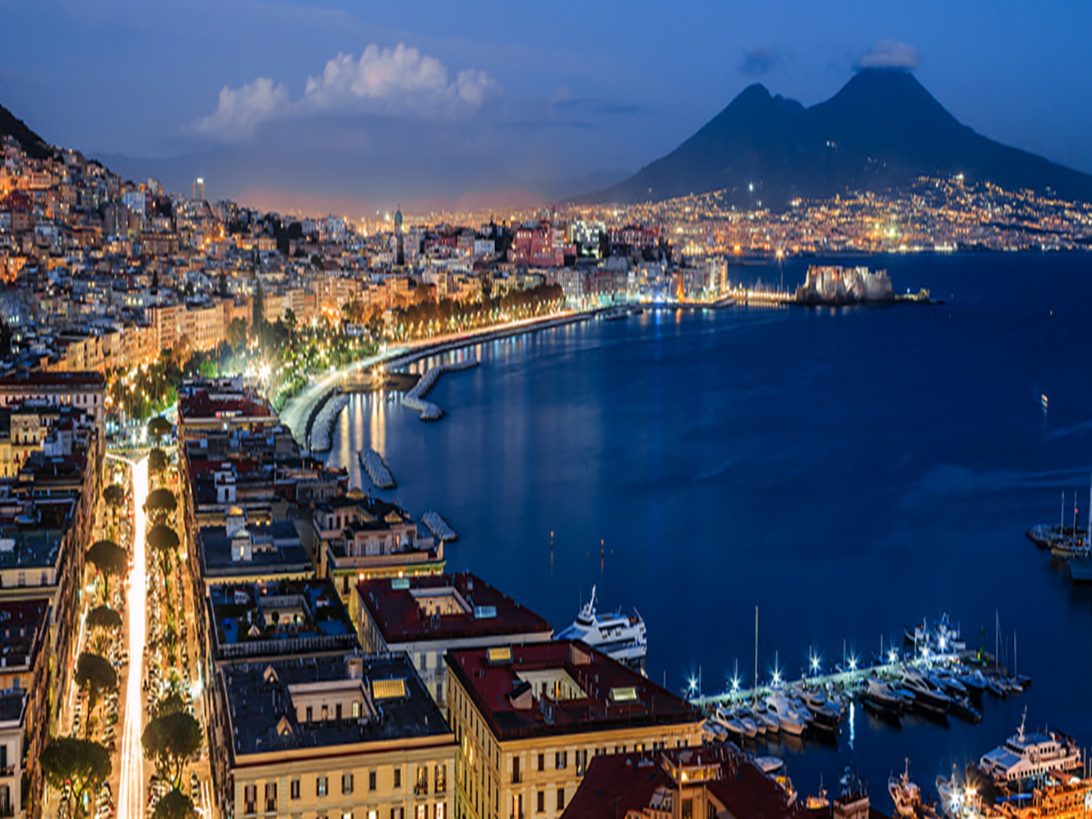
PLACES TO SEE IN NAPLES

Slide 7
Via San Gregorio Armeno is also known as Christmas Alley. On both sides of the alley are artists ‘workshops and stores producing and selling nativity scenes or presepi. Of course December is the busiest time of year but whenever you visit Naples you’ll be able to stock up on Christmas paraphernalia. The artists’ workshops and stores spill out onto the sidewalk making a very colorful and merry scene. You can get the bits and pieces to make your own nativity scene including cribs, figurines, Christmas lights, animated characters, mangers, stars, angels and the three wise men. The quality and price vary from store to store including fine works of art in terracotta, wood, ceramics, fabric and metal. The vendors have let their imaginations run wild and you can get much more than the traditional Naples nativities scenes.

Slide 8
Spaccanapoli (Unesco world heritage site) This street is 6 meters wide and runs for 2km. It is the main stretch for tourists which splits the center of the historic old town (centro storico) in half. The street was one of three Greco-Roman parallel main streets originally called Decumanus inferior. It is a straight narrow cobbled street running through a vibrant, colorful, noisy and exciting neighborhood, which make most visitors say: “NAPLES IS A STATE OF MIND”. The street will take you passed palaces, churches, shrines, stores, bars, restaurants and artists’ workshops.

Slide 9
National Archaeological Museum This museum is housed in a 17th century house and holds a rich collection of Roman artifacts from Pompeii, Stabiae and Herculaneum as well as an Egyptian collection. The ancient art includes works produced in the Roman era, Greek era and Renaissance era. It is considered one of the most important museums in the city and one of the most important in the world. Among the highlights there are the Farnese Hercules, Farnese Atlas, Farnese Bull and the Venus Kallipygos and the Herculaneum Papyri .

Slide 10
The Vesuvian towns of Miglio d’Oro. Ercolano, Portici and San Giorgio a Cremano are some of the several vesuvian towns which extend around the south-western side of the volcano, on the Gulf of Naples. They are the ideal destination for a one day sightseeing around the vesuvian neighborhood where you can discover important landmarks and enjoy their lively and charming atmosphere. You can visit the wonderful vesuvian villas of Miglio d’Oro such as the Royal Palace of Portici.

Slide 11
Herculaneum Of course, you can’t absolutely miss visiting Herculaneum ruins site, dated back to the Roman Empire and recognised UNESCO World Heritage as it provides “ a complete and vivid picture of society and daily life at a specific moment in the past that is without parallel anywhere in the world”.

Slide 12
Bourbon harbor If you feel like having a relaxing break you can go down the old nice Granatello harbour in Portici and walk along the lovely seafront promenade and enjoy the amazing view of the Gulf of Naples with its breathtaking islands of Ischia, Capri and Procida. You can also eat a huge variety of napolitan street food, an excellent pizza and some delicious specialities of the local tradition, like the famous 100% handmade ice-cream by "Gelateria Gallo"or the irresistible “cuoppo” of fried sea-food or crocchè. If you want to breathe the nicest fresh air, do not miss the wonderful Vesuvius Natural Reserve and book a guided tour along the craters of the mysterious volcano.

