Slide 1
The Succesful Job Interview
Group 5

Slide 2
JUST DO IT … OR JUST DON’T
DO’S | DON’TS
Making yourself presentable and good looking, dress appropriately | Do not lie about your skills, qualifications and experiences
Bring your CV, and be prepared for standard job interview questions | Do not act rudely, don’t try to be arrogant because it won’t help
Make yourself stand out from other potential employees | Do not arrive late
Effectively communicate your skills, your goals, your passion | Don’t make negative comments about your last job/colleagues.
Display a positive attitude regardless the topic of conversation | Do not use your smartphone during your interview

Slide 3
WHAT IS AN ASSESSMENT CENTRE?
An assessment centre is any combination of more than one objective selection technique used to measure suitability for a job. It usually involves attending a venue along with other candidates for a day or a half day.
An assessment center is a method that many organizations use to identify management potential and determine candidate's suitability for higher functional positions.

Slide 4
IS IT THE SAME AS AN INTERVIEW?
Interviews are 1 person generally. Assessment centres are numerous employees at once.
Interviews are shorter, because Assessment centres generally last a day.
Assessment centres focus more on measuring job-related behaviors and skills.

Slide 5
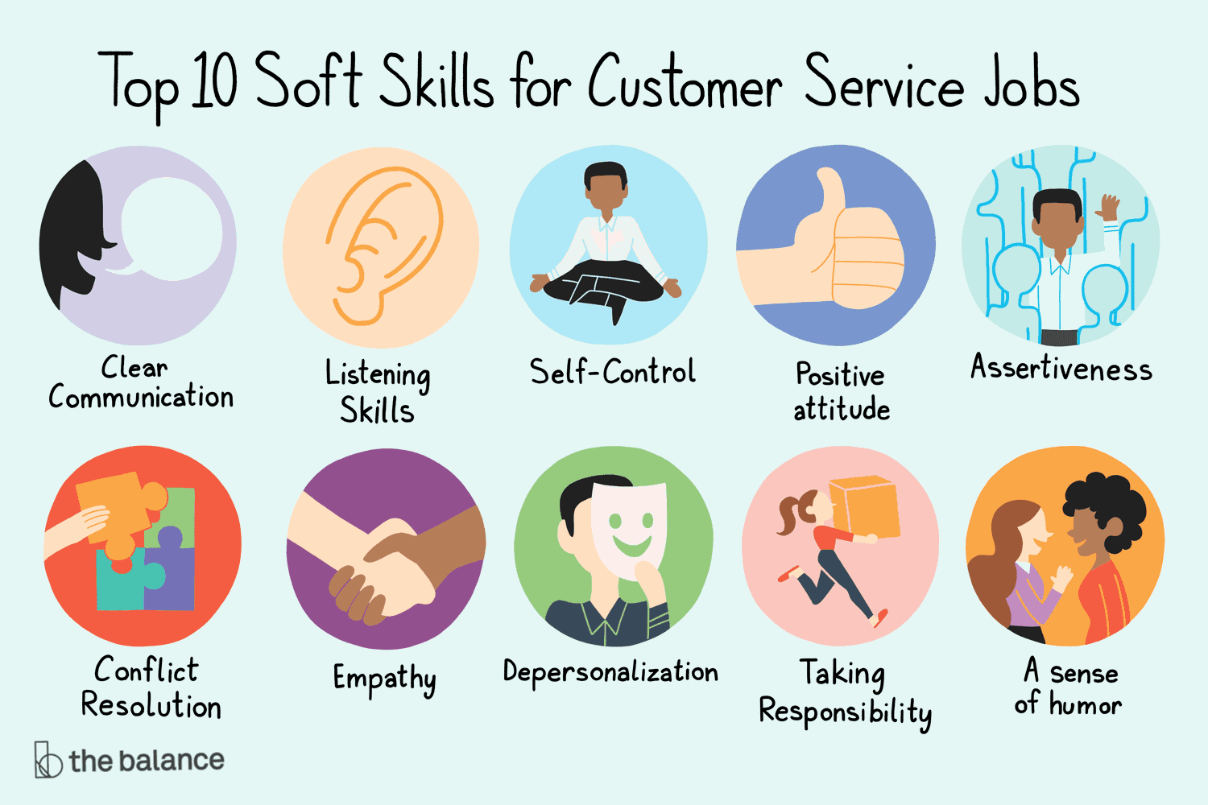
WHAT SKILLS DO YOU NEED FOR THIS?
Soft skills
Communication skills
Body language skills
Teamwork skills
Respect deadlines
Leadership skills
Being able to work under pressure
Adaptability
Creativity

Slide 6
Job Interview vs assessment centre

Slide 7
Group 5
Dario
Leonardo
Viola
Gary Neville
Flavio
Catalin
Ana
Alessandro
Bruno Fernandes
Matei
Beatriz
North Chadderton

