Slide 1
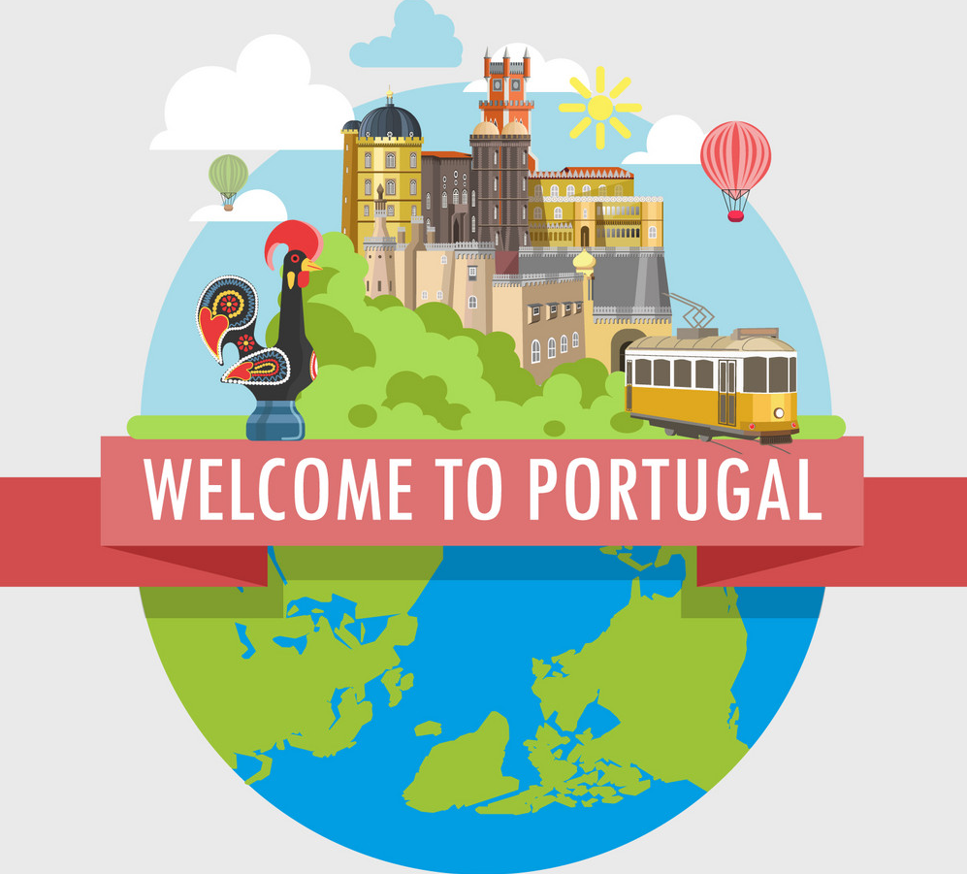

Slide 2
MEET THE TEAM
Patrícia Vieira
Gonçalo Rodrigues
Tomás Duarte
Daniel Coelho
Adan Nadeem

Slide 3
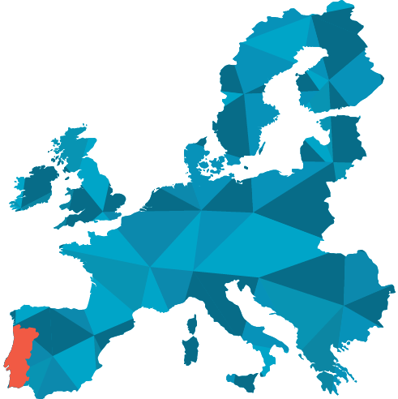
PORTUGAL
Portugal is the oldest nation-state in Europe
Portugal’s dictatorship for almost half of the 20th centuryis considered the longest in Europe
Portugal was the world’s first maritime power, and birthplace to some of the world’s first explorers.
Portuguese is the official language of eight other countries outside of Portugal
Portugal is a founding member of NATO and an EU member

Slide 4
USEFUL INFORMATION
USEFUL INFORMATION
TIME ZONE
WET (Western European Time): No UTC/GMT offset,
Daylight Saving Time +1 hour March to October.
CURRENCY
The Portuguese currency is the
ATMs are the easiest way to get cash. You can use an international debit card at the ATMs with Multibanco. When/if we go to smaller villages, bring cash. The ATM withdrawal limit is €200 per day, and many banks charge a foreign transaction fee of 2-3%.
Banks are open Monday to Friday from 8.30 to 15.00. But ATMs are available at any time.
ATMs /Money/ Credit card use:
- 1 Euro equals 4,76 Romanian Leus
- Romania minimum wage is 407€ which is less than Portugal(600€)
- Visa, MasterCard are the two most poupular credit cards in Portugal.
- In Portugal we have “The Contactless Card”, which allows payments of less than 20 euros without entering the PIN
-Self-Service, Paypal and MB Net are the most used payment methods by Portuguese consumers.
-Besides the Multibanco network, in Portugal there is a competitor to the Multibanco network, which already has 300 boxes, It's called Euronet Worldwide

Slide 5
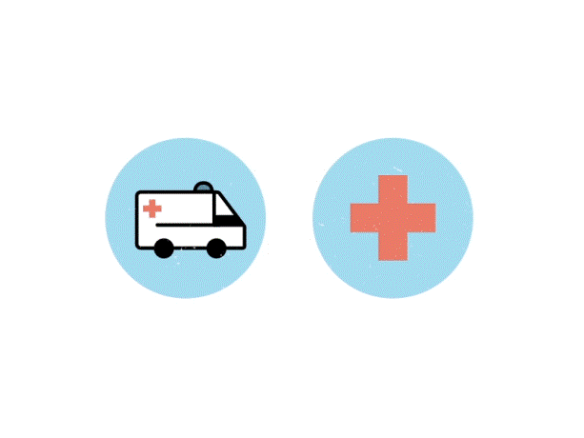
USEFUL INFORMATION
OPENING HOURS IN GENERAL
Mini-Markets and shops: 09:00am to 19:00pm
Supermarkets: 09:00am to 20:00pm
Summer later opening: 22:00pm
Shopping centre: 10:00am to 23:30pm
Banks and Post Offices: 8:30am to 15:00pm
Hospitals: 24/7
Historical places and monuments:
9:30am to 17:00pm
Or
10:00am to 17:30pm
HEALTH/EMERGENCY
A list of emergency numbers to call in the event of an emergency in Portugal.
Ambulance: 112
Child abuse: 213 433 333
Drug abuse: 1414
Fire: 112
Police (national): 112
Sea Rescue in Lisbon: 214 401 919
Maritime Police in Lisbon: 210 911 100

Slide 6
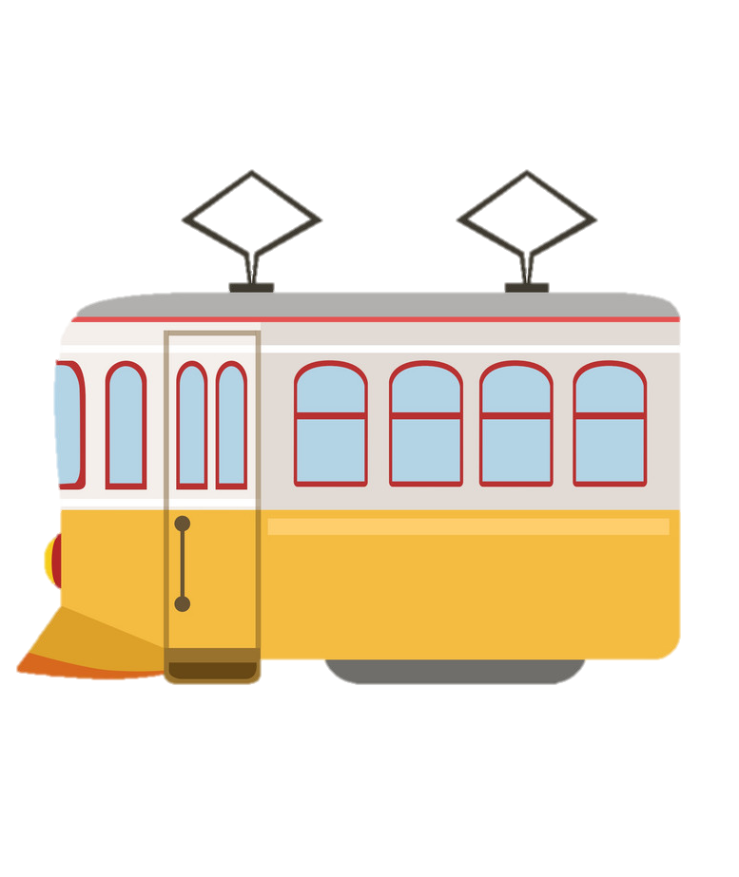
PUBLIC TRANSPORTATION

Slide 7
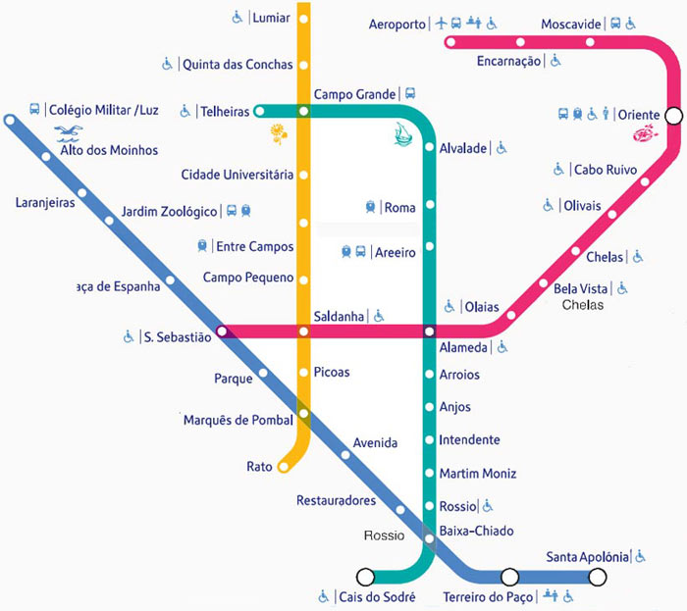
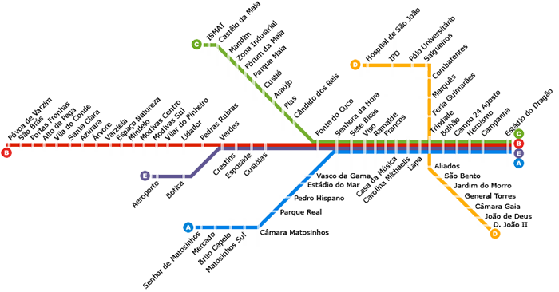
PUBLIC TRANSPORTATION
Metro(www.metrolisboa.pt)
(www.metrodoporto.pt)
– undoubtedly the best way to get around the city. It runs from 6:30 a.m. to 1 a.m.

Slide 8
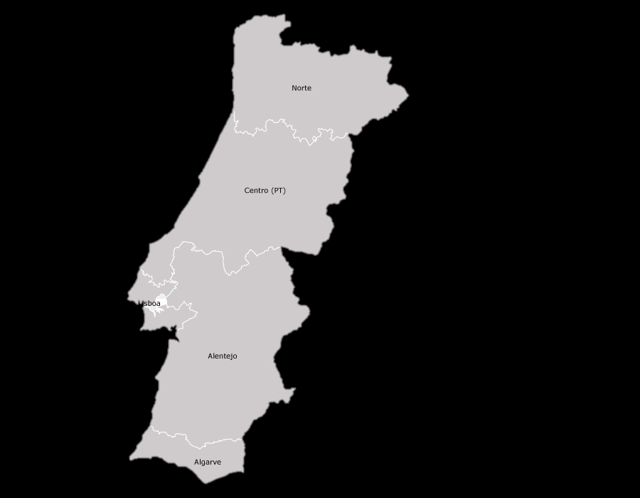
PUBLIC TRANSPORTATION
TRAIN
Forget about driving and explore Portugal by train. The country's reliable public transportation system reaches each corner and region minimizing the need for a car and enhancing travel experiences by chugging along past the cork oaks and olive trees, vineyards, mountainsides, and the sparkling coast. From the resorts of the Algarve(South) to the remote villages in the north, the daily trains provide a unique way to see Portugal's different sides!

Slide 9
PUBLIC TRANSPORTATION
BOAT
Lisbon extends along the banks of the Tejo estuary, and the commuter ferries are an integral component of the capital’s public transport network. The ferry services provide an alternative means of travel from the residential districts south of Lisbon, which avoids the bottleneck of the Ponte 25 de Abril suspension bridge.
For visitors to Lisbon, the ferries provide an enjoyable and inexpensive activity, with wonderful waterside views of the city, which are a fraction of the price of the expensive tourist boats. This article will provide a tourist guide to Lisbon’s ferries, including an overview of the major routes, fares and links to timetables.

Slide 10
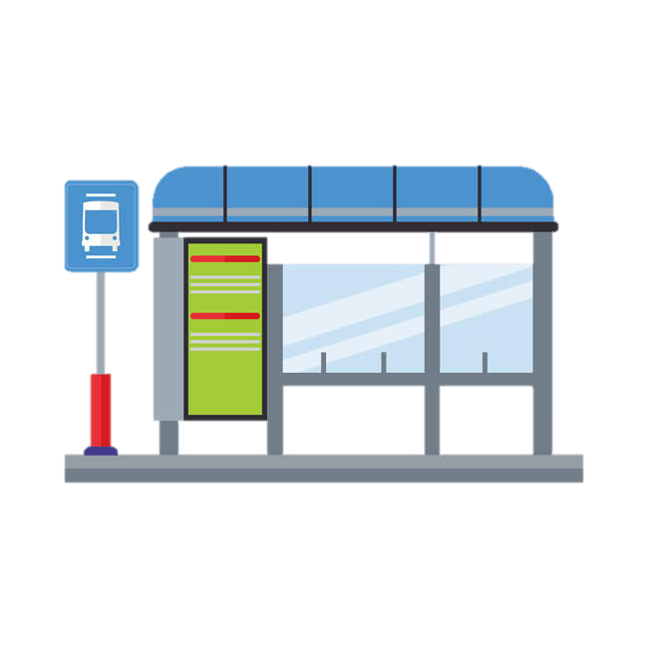
PUBLIC TRANSPORTATION
Trams, Buses, Funiculars, Lifts (www.carris.pt) – their lines conveniently connect to Metro. Ride vintage tram No. 28 for great views of Lisbon’s old quarters. There’s also an extensive network of night buses numbered 200+ that run at least once per hour.
1,45€

Slide 11
FOOD HABITS
Portuguese food habits
Breakfast: bread, ham ,cheese, cakes, coffee, tea, milk, juice..
Lunch/Dinner: Soup, salad, fish, meat, vegetables, rice, pasta, potatoes, fruit, pastery, cofee
-Mediterranean diet

Slide 12
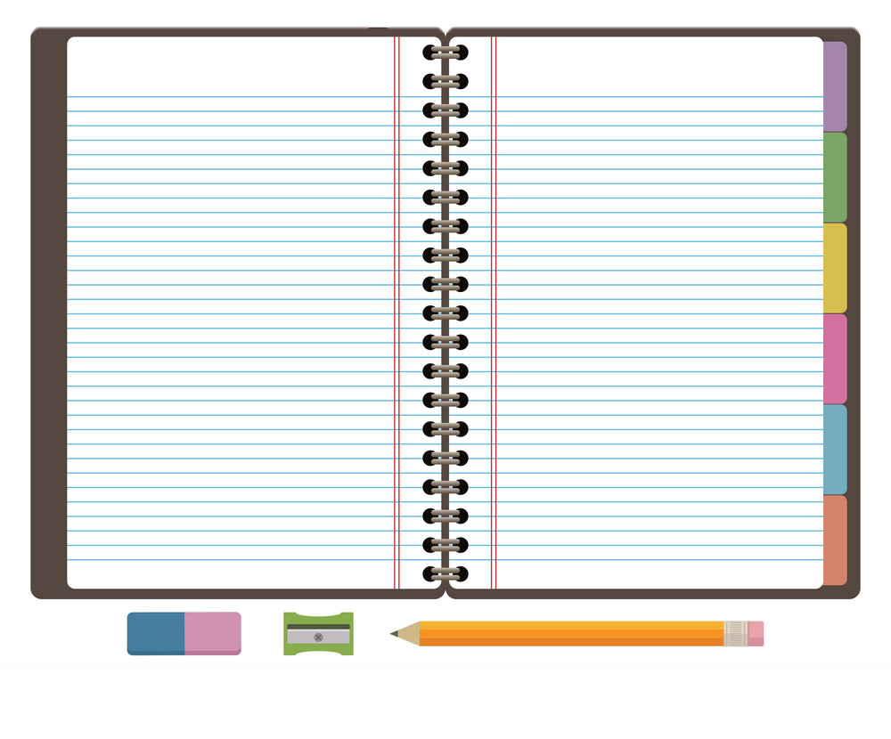
GREETINGS
Could you speak more slowly, please?
Could you repeat it, please?
Where can I find a toilet/ bathroom?
How do I get to _____ ?
Where is the _____ ?
Do you accept credit cards?
Where can I exchange currency/money?
Where can I find an ATM?
Can I see the menu, please?
I’d like ______.
The check, please.
How much is this?
Pode falar mais devagar?
Pode repetir?
Onde fica a casa de banho?
Como vou para ______?
Onde fica o(a)______?
Aceita cartões de crédito?
Onde posso trocar dinheiro?
Onde há uma caixa multibanco?
Posso ver a ementa, por favor?
Quero ______.
A conta, por favor.
Quanto custa isto?
z
Portuguese
Bom Dia
Boa Noite
Boa Tarde
Olá
Adeus
Até já
Tudo Bem?
Até Logo
Não entendo
Pode repetir?
Se faz favor / Com licença
English
Good Morning
Good Night
Good afternoon
Hello
Goodbye
See you
How are you?
See you later
I don’t understand
Could you reapet it please
Excuse me

Slide 13
TIPPING
Tipping in Portugal
In Portugal, tipping is voluntary, but usually people leave whatever was left on the payment for the tip.
Tipping is mostly used in restaurants

Slide 14
PRESENTS
Presents
When we talk about presents, we are very generous, we always try to give the best presents possible, for example, if we are going to be accommodated by someone, we will give them something that has a meaning behind it, like some traditional Portuguese food or some symbolic items related to our country.

Slide 15
PUNCTUALITY
Punctuality:
When it comes to punctuality there is some information you might know.
In a portuguese meeting, the regular portuguese rarely arrives before the fixed time, sometimes we arrive just on time and wait for the 15 minutes to pass, we call it “15 academic minutes”. when we talk about the same situation but refering to an english person, if a meeting is fixed at 18:00 they will generaly arrive at 17:45 and at 18:00 they are already discussing the subject, but in a portuguese meeting if you are said that the meeting will start at 18:00 it will probably start at 18:15 its just how it is suposed to be.

Slide 16
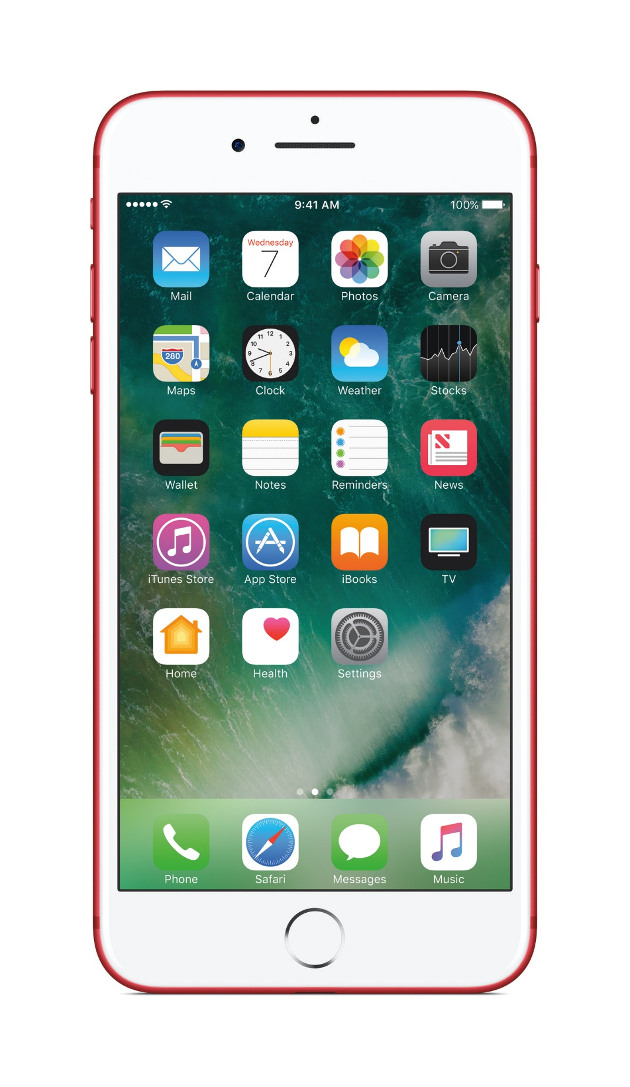
PHOTOS
You can follow on Instagram
To see more pictures of Portugal
visitportugal

