Slide 1
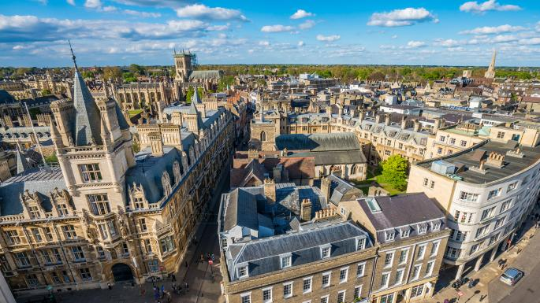
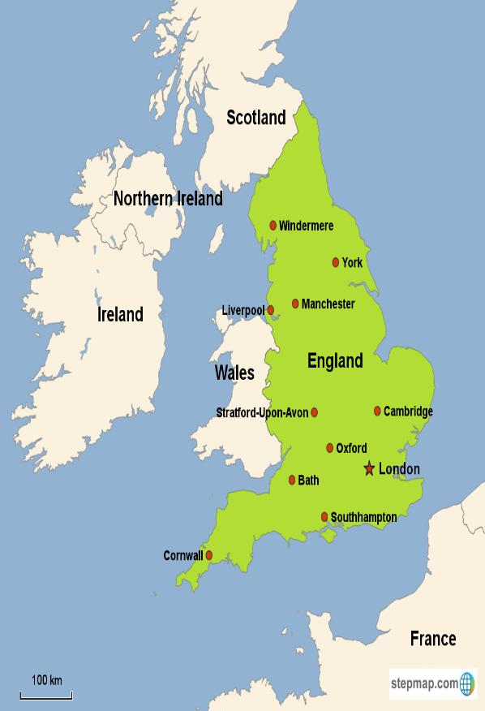
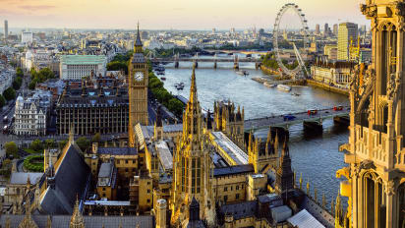
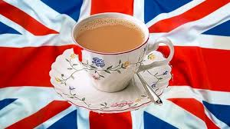
How to survive in England

Slide 2
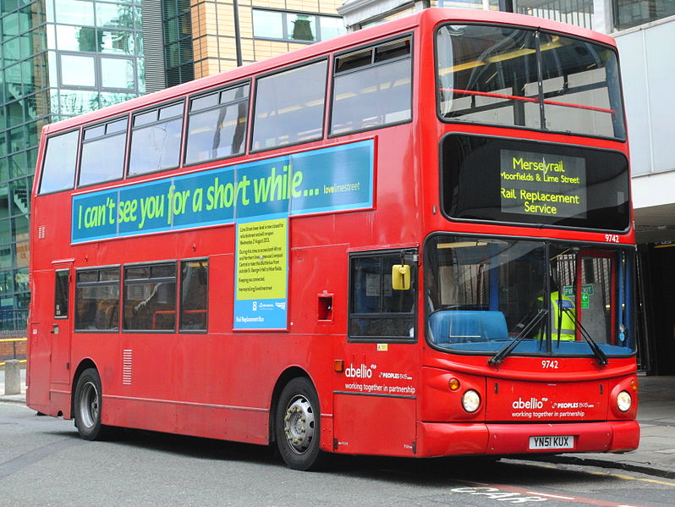
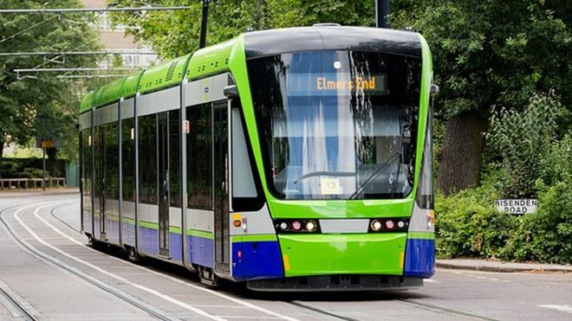
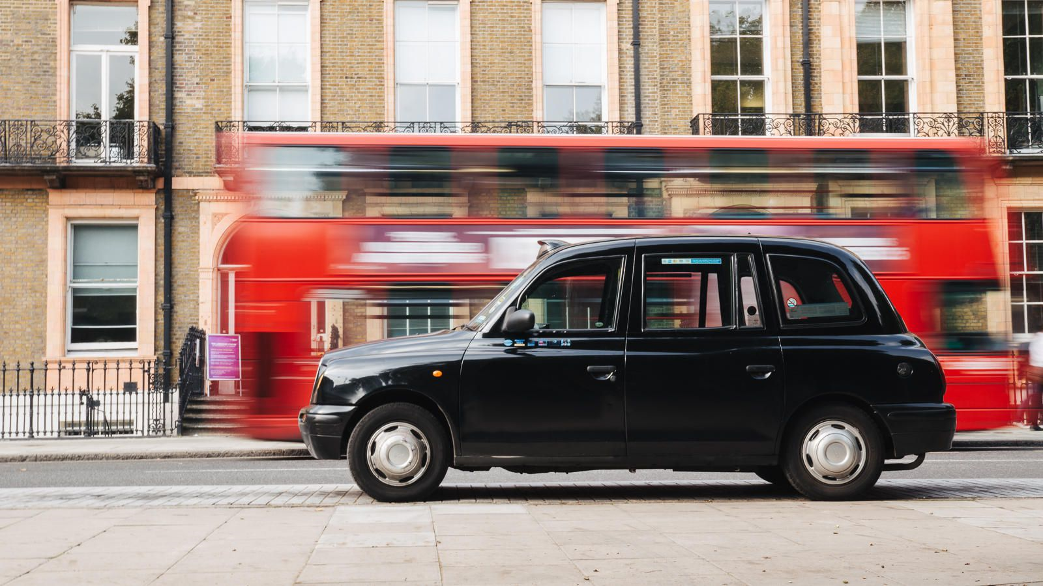
Public transport
PUBLIC TRANSPORT:
There are many ways to get around cities with public transport. The most popular way Is through the bus system – we can buy a ticket on our phone or when we are on the bus which allows us to get on as many buses as possible in the day. We can find out where we need to go via the app which is free to download on our phone. You can also track your bus to find out what time its going to get to you via the app. Another way of transport is via the tram – trams are much more quicker than buses. You buy a ticket at the tram stations and depending on where your going you pay a certain amount. Trams allow you to travel longer distances instead of local like buses. In places like London, tubes also exist which is like a tram. The last public transport option is a train. Train tickets need to be booked in advanced and are probably the most expensive option however you can travel long distances. Trains also have seating areas etc.

Slide 3
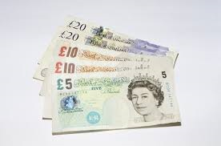
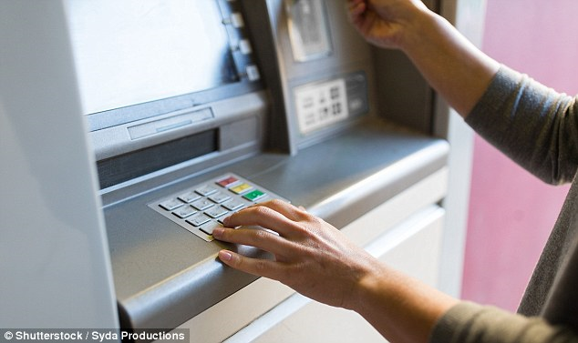
Money/ ATM/ credit card use
-The UK currently has around 70,000 ATMs and more than 97% of withdrawals are from a free-to-use machine. Earlier this month the banking industry body UK finance said that debit card payments had overtaken cash as the most popular form of payment in the UK for the first time.
-Barclays chose its branch in Enfield, North London, for the world's first cash machine in 1967 because its high windows provided enough space underneath for the safe and equipment.
-Lloyds launched the first computerized UK cash machine in Brentwood, Essex, in 1972. For the first time, the money was debited from your account instantly.
-The most money withdrawn from UK cash machines in a day is £730 million on December 23, last year.

Slide 4
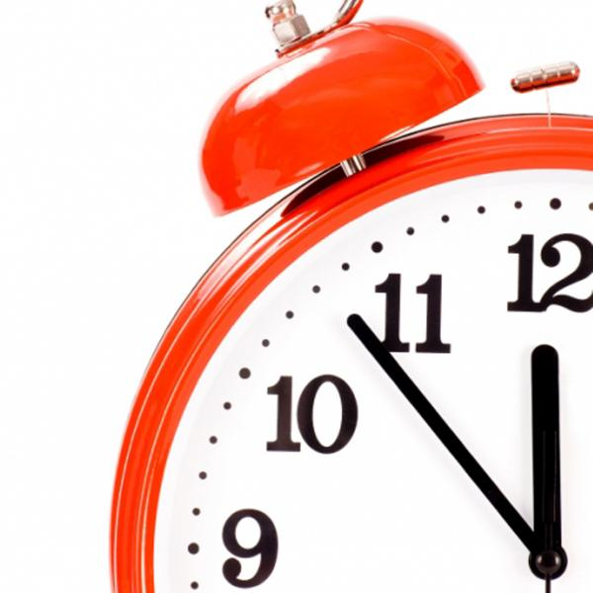
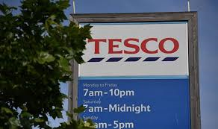
Open hours in general
On a Monday- Saturday shops tend to open quite early and shut quite late. Most shops open around 7-8 am and close around 7-8pm however some shops could have longer or shorter hours. On a Sunday, most shops only open for a couple hours or don’t open at all. This is due to the Christian culture of the UK and refers to the bible “on the seventh day he rested”. Banks don’t open on Sundays either.

Slide 5
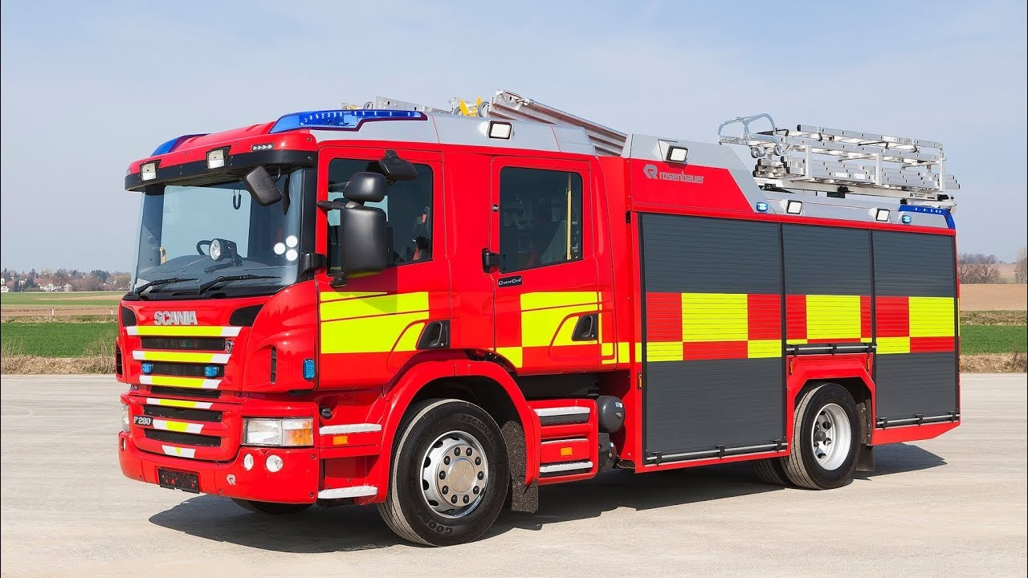
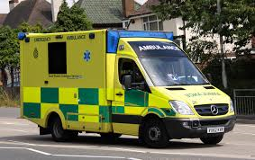
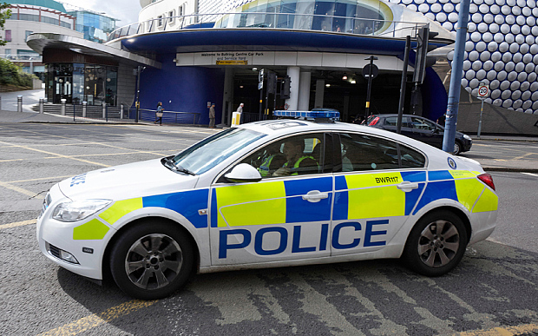
Health/ Emergency
In an emergency, you dial 999. The first person you speak to is a telephone operator who will ask which emergency service (fire, police, ambulance or coastguard) you require.
You will then be connected to an operator specific to the emergency service you require. You will asked for the address of the incident. Tell the operator:
• The name and number of the house or building if it is relevant
• The road or street name
• The village or town
• Why you need the fire service
• You may be asked for more information, such as "where is it near to?"
Give clear simple answers and follow any instructions they give you.

Slide 6
Key phrases/ useful phrases
What time is it?
Where are the toilets?
How are you?
Nice to meet you
Hello
Goodbye
Thank you
Please
Good morning
Good evening
I would like to buy this please
How much does this cost?
Where can I find…
Yes
No
I’m fine thank you
Can you help me?
Can you give me directions?
Is this correct?
I would like this please?
Cât este ceasul?
Unde sunt toaletele?
Ce mai faci?
Încântat de cunoștință
Salut
La revedere
Mulțumesc
Vă rog
Buna dimineata
Bună seara
Aș dori să cumpăr acest lucru, vă rog
Cât costă asta?
Unde pot să găsesc…
da
Nu
Sunt bine multumesc
Ma poti ajuta?
Îmi poți da indicații?
Este corect?
Aș vrea acest lucru, vă rog?
Cât este ceasul?
Unde sunt toaletele?
Ce mai faci?
Încântat de cunoștință
Salut
La revedere
Mulțumesc
Vă rog
Buna dimineata
Bună seara
Aș dori să cumpăr acest lucru, vă rog
Cât costă asta?
Unde pot să găsesc…
da
Nu
Sunt bine multumesc
Ma poti ajuta?
Îmi poți da indicații?
Este corect?
Aș vrea acest lucru, vă rog?
KEY PHRASES :
Thank you, thanks. You may also hear cheers
I’m sorry
Can I have…?
How much does this cost?
Yes/ no
How are you? Are you okay?
Do you know the way to…?
Great/ awesome

Slide 7
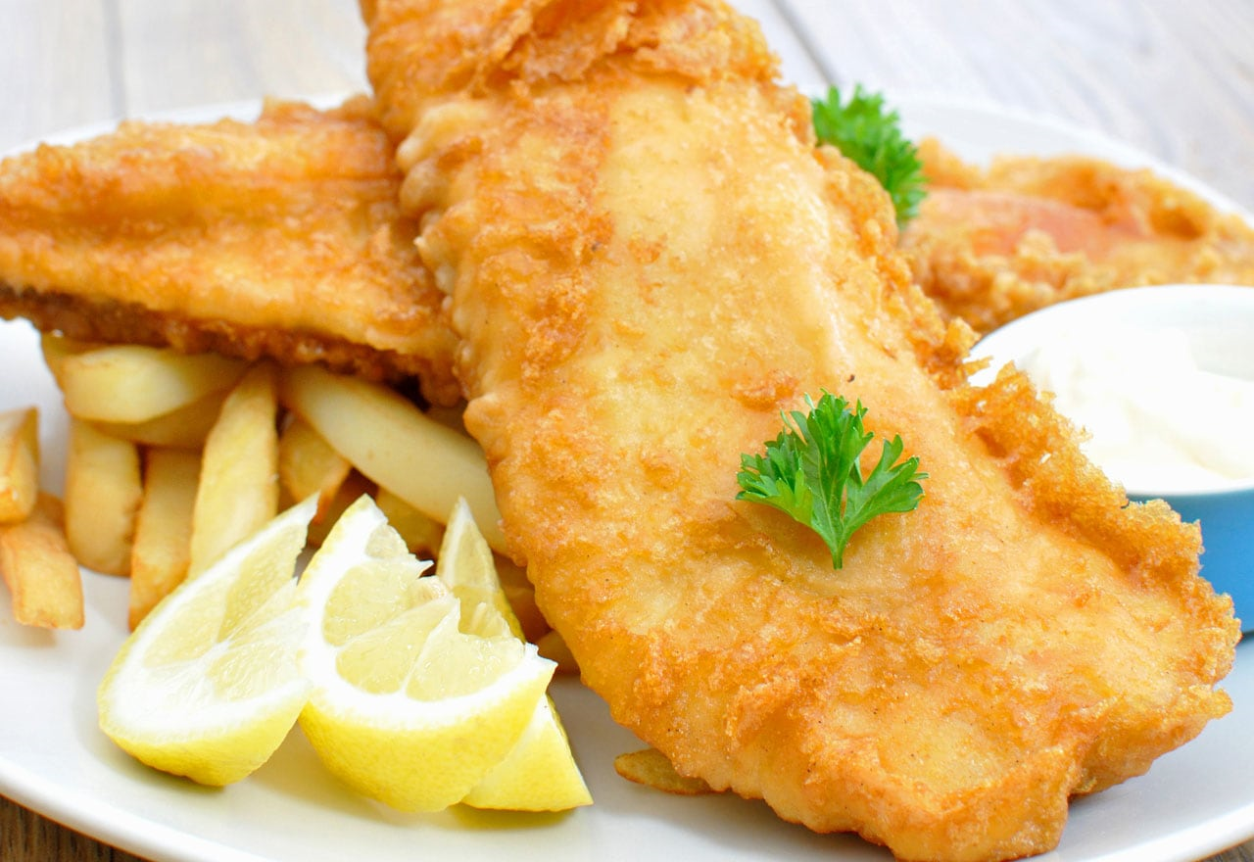
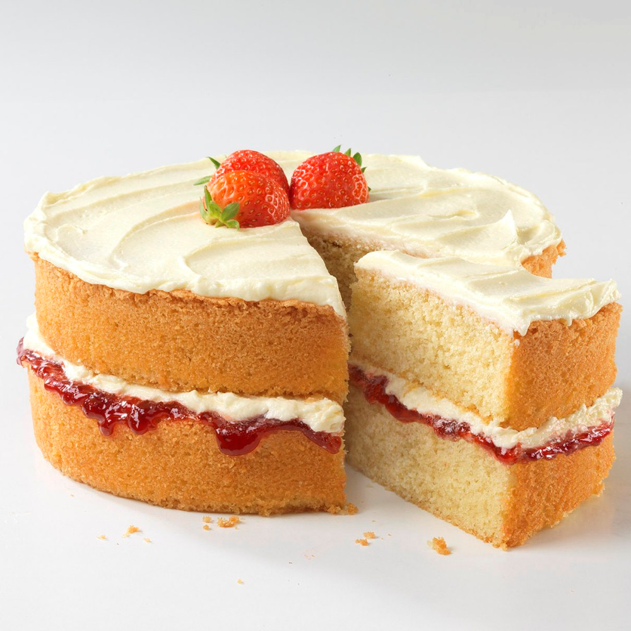
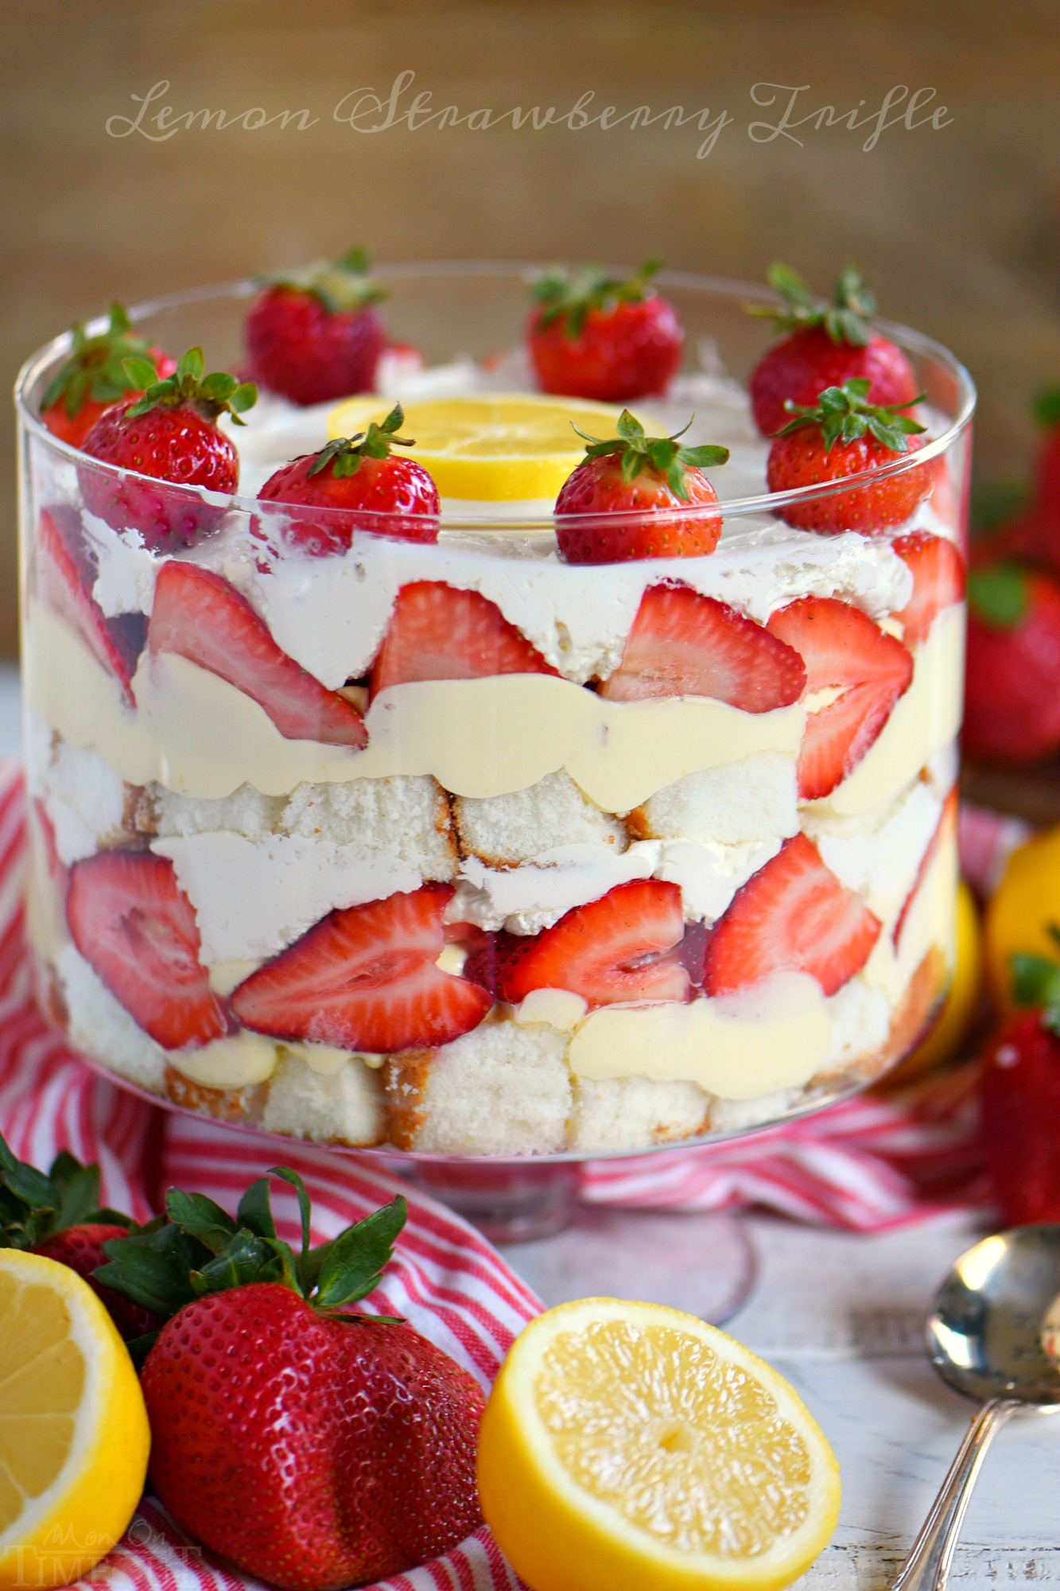
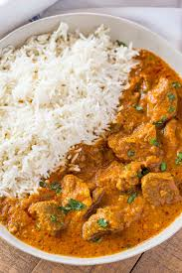
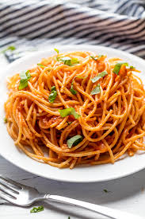
Food habits
National Dish: Fish and Chips.
There are many fast food restaurants such as McDonald’s, KFC, Subway and Burger King.
Breakfast: 7:30am – 10am, usually consists of a cup of tea alongside either cereal or toast.
Lunch: 12pm - 2pm, there are lots of foods available for lunch, hot meals such as Fish and Chips, a pasta dish or rice with curry, or cold meals such as sandwiches.
Afternoon tea: 3:30pm – 5pm, usually in the evening before ‘supper’. Tea is served alongside cakes, biscuits, mini sandwiches.
Evening meal: 6pm – 8:30pm, usually called ‘supper’ but also known as tea in the north. Typically consists of meat with two different vegetables. For example, Sunday roast, there would be meat (beef) with vegetables ( broccoli and peas).it is also common to have dessert with this for after your main food, this can be cakes, custard or trifle.

Slide 8
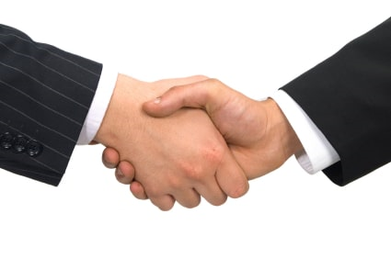
Greetings
The most common and politest way to greet someone is by a simple “Hello”. England doesn’t really stress the important of hierarchy or formality so you could use hello when speaking to an elder, your friend, a stranger or a child. Other variations include, “Hi” and “Hey” which are more informal and casual but can still be used in any situation. You might also here “Yo” or “What’s up” which is another way of saying hi. Nevertheless “Hi” and “Hello” are the most common ways of greeting someone.

Slide 9
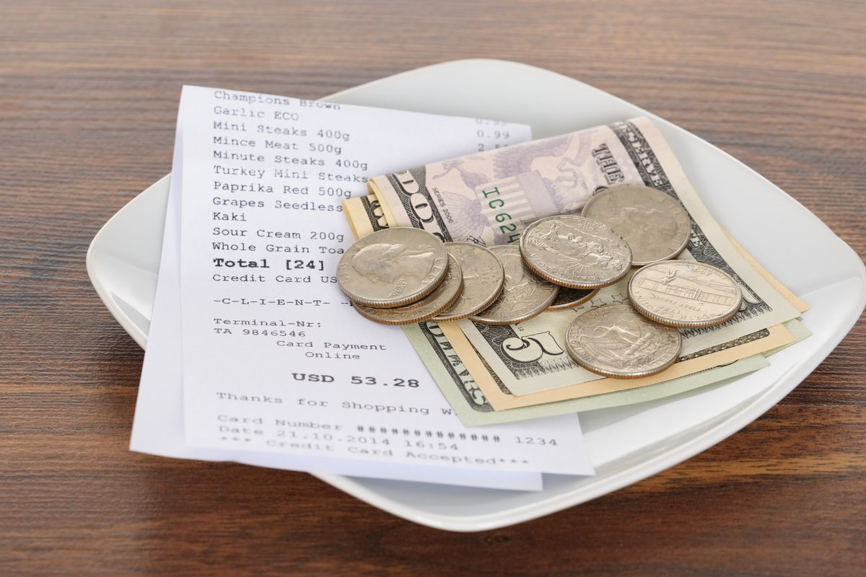
Tipping
For tipping we give a few pounds or pence just as a thank you for what someone working at the place working hard. If they are nasty or bad at their job, you may not tip as it may have slightly ruined your evening.

Slide 10
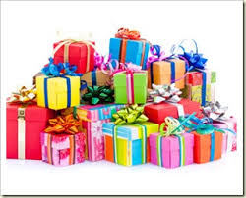
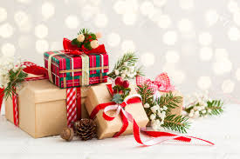
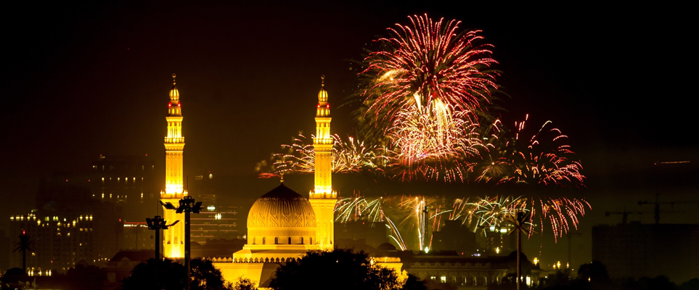
Presents
In England we give presents at Holidays such as Christmas (Christian holiday), Eid (Muslim holiday), and other religious holidays. We give presents at Birthdays or occasions like celebrations (accomplishing something). We give presents like toys for the kids, money, technology, etc…

Slide 11
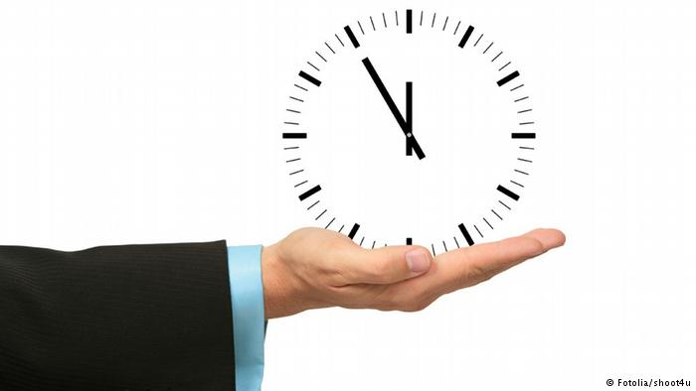
Punctuality
In the UK, punctuality is highly important and we stress a lot of significance on the matter. In schools, detentions are omitted if we are late to prepare for work and later life. Consistent absences could result in exclusion or being fired from your job.

Slide 12
Thank you!

