Slide 1
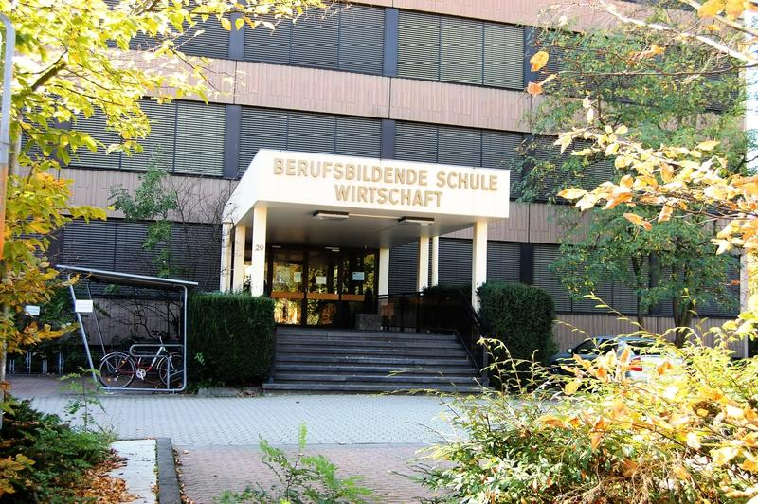
BBS Wirtschaft Bad Kreuznach
vocational business school
full time education (up to A levels)
Part-time education

Slide 2
Times start of school 7:30 am
School usually ends at:
12:40 pm
14:40 pm
16:25 pm

Slide 3
Economics-related subjects: business administration economics

Slide 4
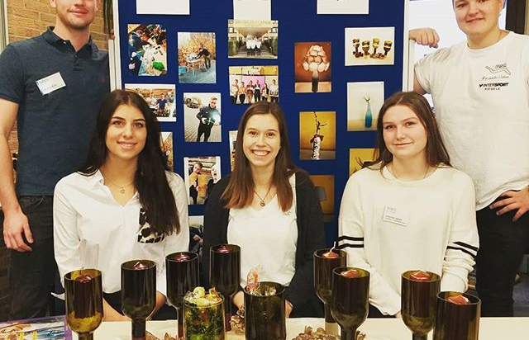
Small Business – Big Idea
Our school offers the oppertunity to found our own junior enterprise.
Currently our business „Lagoena Decoarata“ has a team of 14 motivated students who produce decorative articles such as candles made from recycled wine bottles.

Slide 5
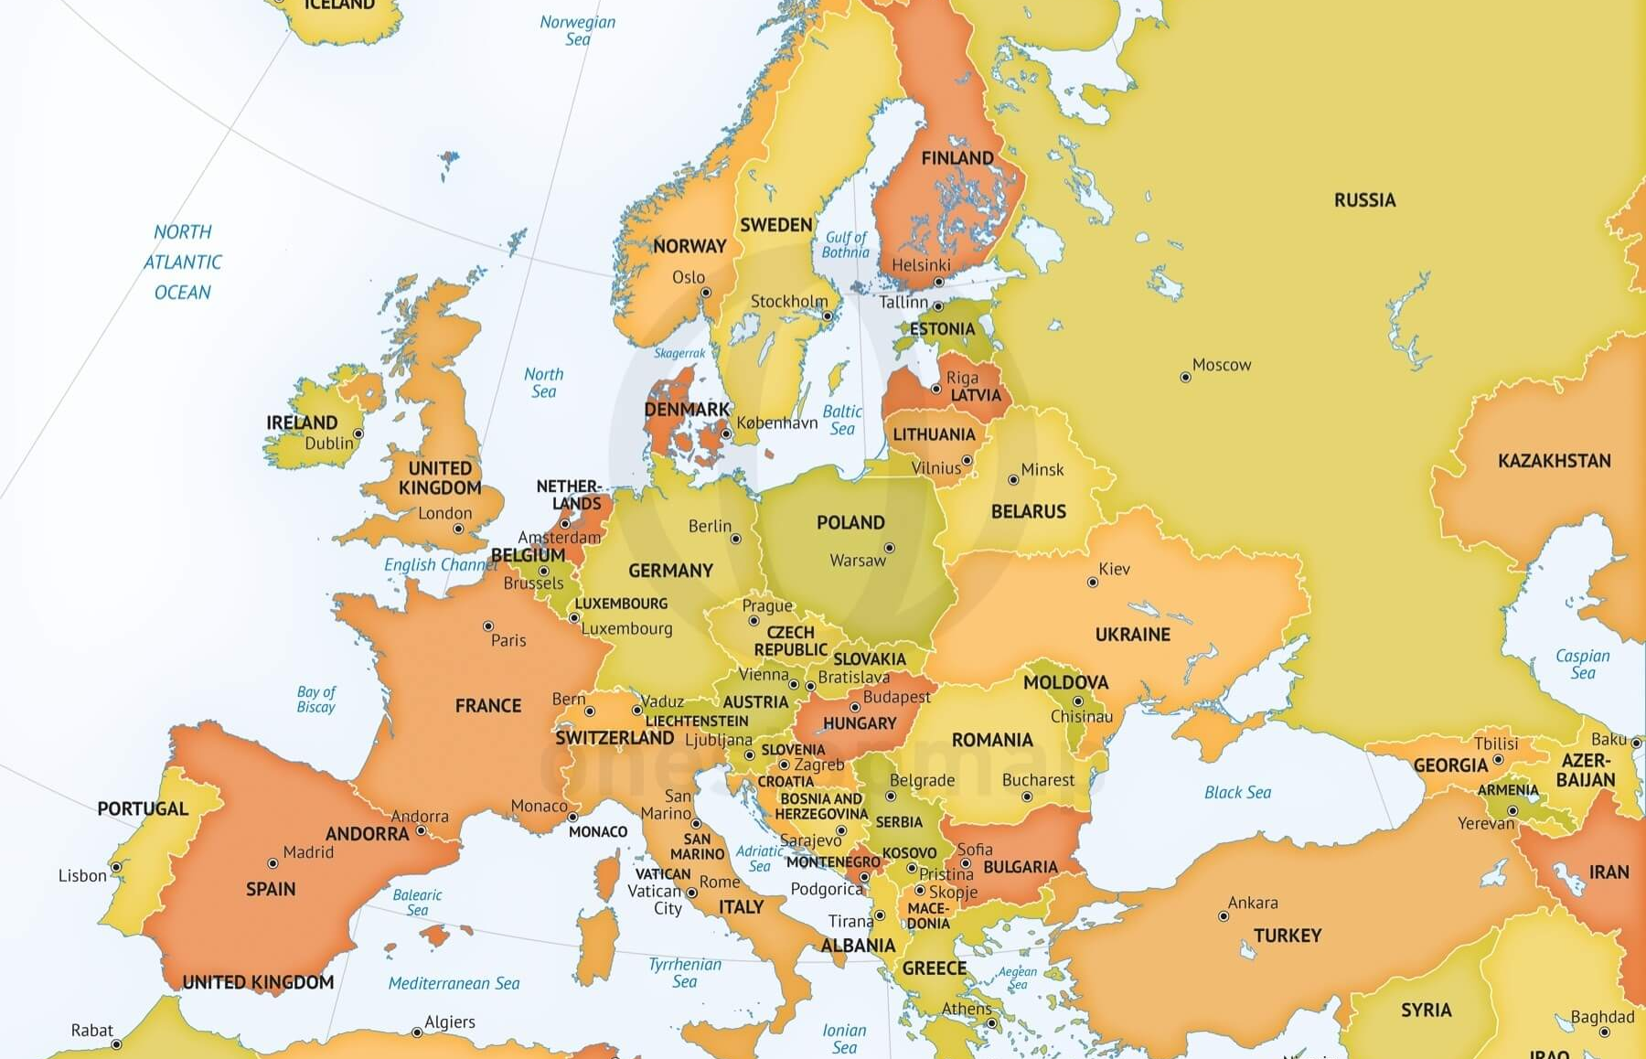
EBBD
Studying. Working. Living. In Europe.
The European Business Baccalaureate Diploma (EBBD) equips students with the necessary competence to master challenging tasks in international buisness.
It is a proof of excellence and readiness for mobility.
EBBD graduates will receive a accredited European qualification for professions in the field of business administration.
The certificate increases the opportunities of a future job in international business .
Our school is one of the few in Germany supporting EBBD.
Part of EBBD is to connect with other european schools to set the foundation for future international buisness relationships.

