Slide 1
UK Team.
What is a Letter of Application and what they should include…

Slide 2
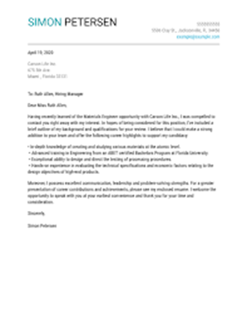
Theory behind application forms
An application letter is a document sent alongside your CV that to provide extra information on your skills and experience. In the UK we call this a letter of application but some might know it as a Motivation Letter?
It typically provides detailed information on why you are qualified for the position you are applying for.
The CV, which consists of all your past qualifications such as GSCE results, is included to let employers know exactly how skilled their potential employee is and allows them to assess whether they have the needed qualifications for the job.

Slide 3
Theory behind application letters
Application letters are useful because it allows recruiters and hiring managers to develop a better understanding of your fit for a certain position.
When an application letter is being reviewed, this is where first impression are made by an employer which is why the application letters are such an important stage of being recruited by a firm.
Overall application letters inform an employer about the type of person they will be hiring for their firm.

Slide 4
What they should include
Introduce yourself- need to know who you are and a bit about you.
Mention the job you're applying for-skills match which job you're talking about and want.
Show your skills and experience match the roles of the job- shows them why you are best for the job and why they should choose you
Encourage the reader to read your form- they learn more about you, shows your passion for the job
Tell them why your best for the job- shows that you are confident and more likely to get the job

Slide 5
What you shouldn’t include
Spelling or grammar errors- SPAG errors show that you don’t care about the job
Don’t lie- they will find out and you are not giving a true representation of yourself. If they find out they will know that you lied
Paragraphs too long- they will get bored or stop reading if the paragraphs are too long
Salary requirements- they want passionate employees not money hungry
Negative comments about current or past employer- it reflects your personality, don’t come off as disrespectful or rude
Information not related to the job- you will just be wasting time as they aren't interested in that

Slide 6
Examples of good application letters

Slide 7
Show that you have the skills and experience for the job
Mentions the job you are applying for
Shows interest in the company
Explains former job role
Resume attached

Slide 8
Give details about you and your address
Clearly states desire and motivation for job
Application is short and effective.
Asks questions about your potential role.
Signature

Slide 9
What makes a bad application?
Poor spelling and grammar.
Not following the instructions directed on the form e.g. giving irrelevant information.
Being informal e.g. using slang or abbreviations.
Missing the deadline for when the business request the application.
Lying.

Slide 10
Irrelevant information, not valid reason for wanting the job.
Not useful information to the business, doesn’t answer the question as the why they want the job.
Uses offensive terms and is very informal
Very informal, using slang.
Again, doesn’t link to what the application is asking for.
Overall, no cohesion to the application, talks about irrelevant, random topics and is unstructured

Slide 11
Examples of jobs with matching application letters

Slide 12
Application for the role of a teacher
One example of a job is teaching. This is a teaching job application.
Mention your interest for this role

Slide 13
Application for a role within the NHS

Slide 14
Thank you for listening!! This was Team GB!!

