Slide 1
Sam Healy
CV
Job Advert Examples

Slide 2
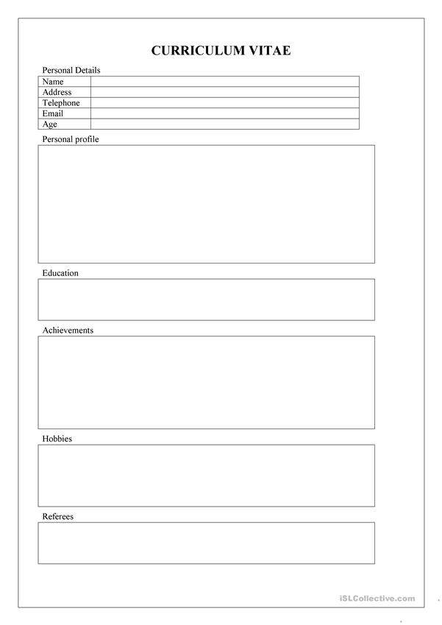
Sam Healy
16 Chiltern Drive, Royton
000009876456
SHealy167@northchadderton
17
At Sixth form at North Chad until 2022.
Studying PE, Business and English
Work experience at a car garage working there for 3 months in 20220.
North Chadderton School
North Chad 6th Form
GCSE Grades
English (6), Maths (7), Science (6) Geography (5), Spanish (5), PE (5), Business (8).
Football awards
Football
Darts
Mike Dean

Slide 3
Examples of Job Adverts
- Colourful
- Effective
- Describe job
- Showing the reasons why to join

