Slide 1
Ready4europe

Slide 2
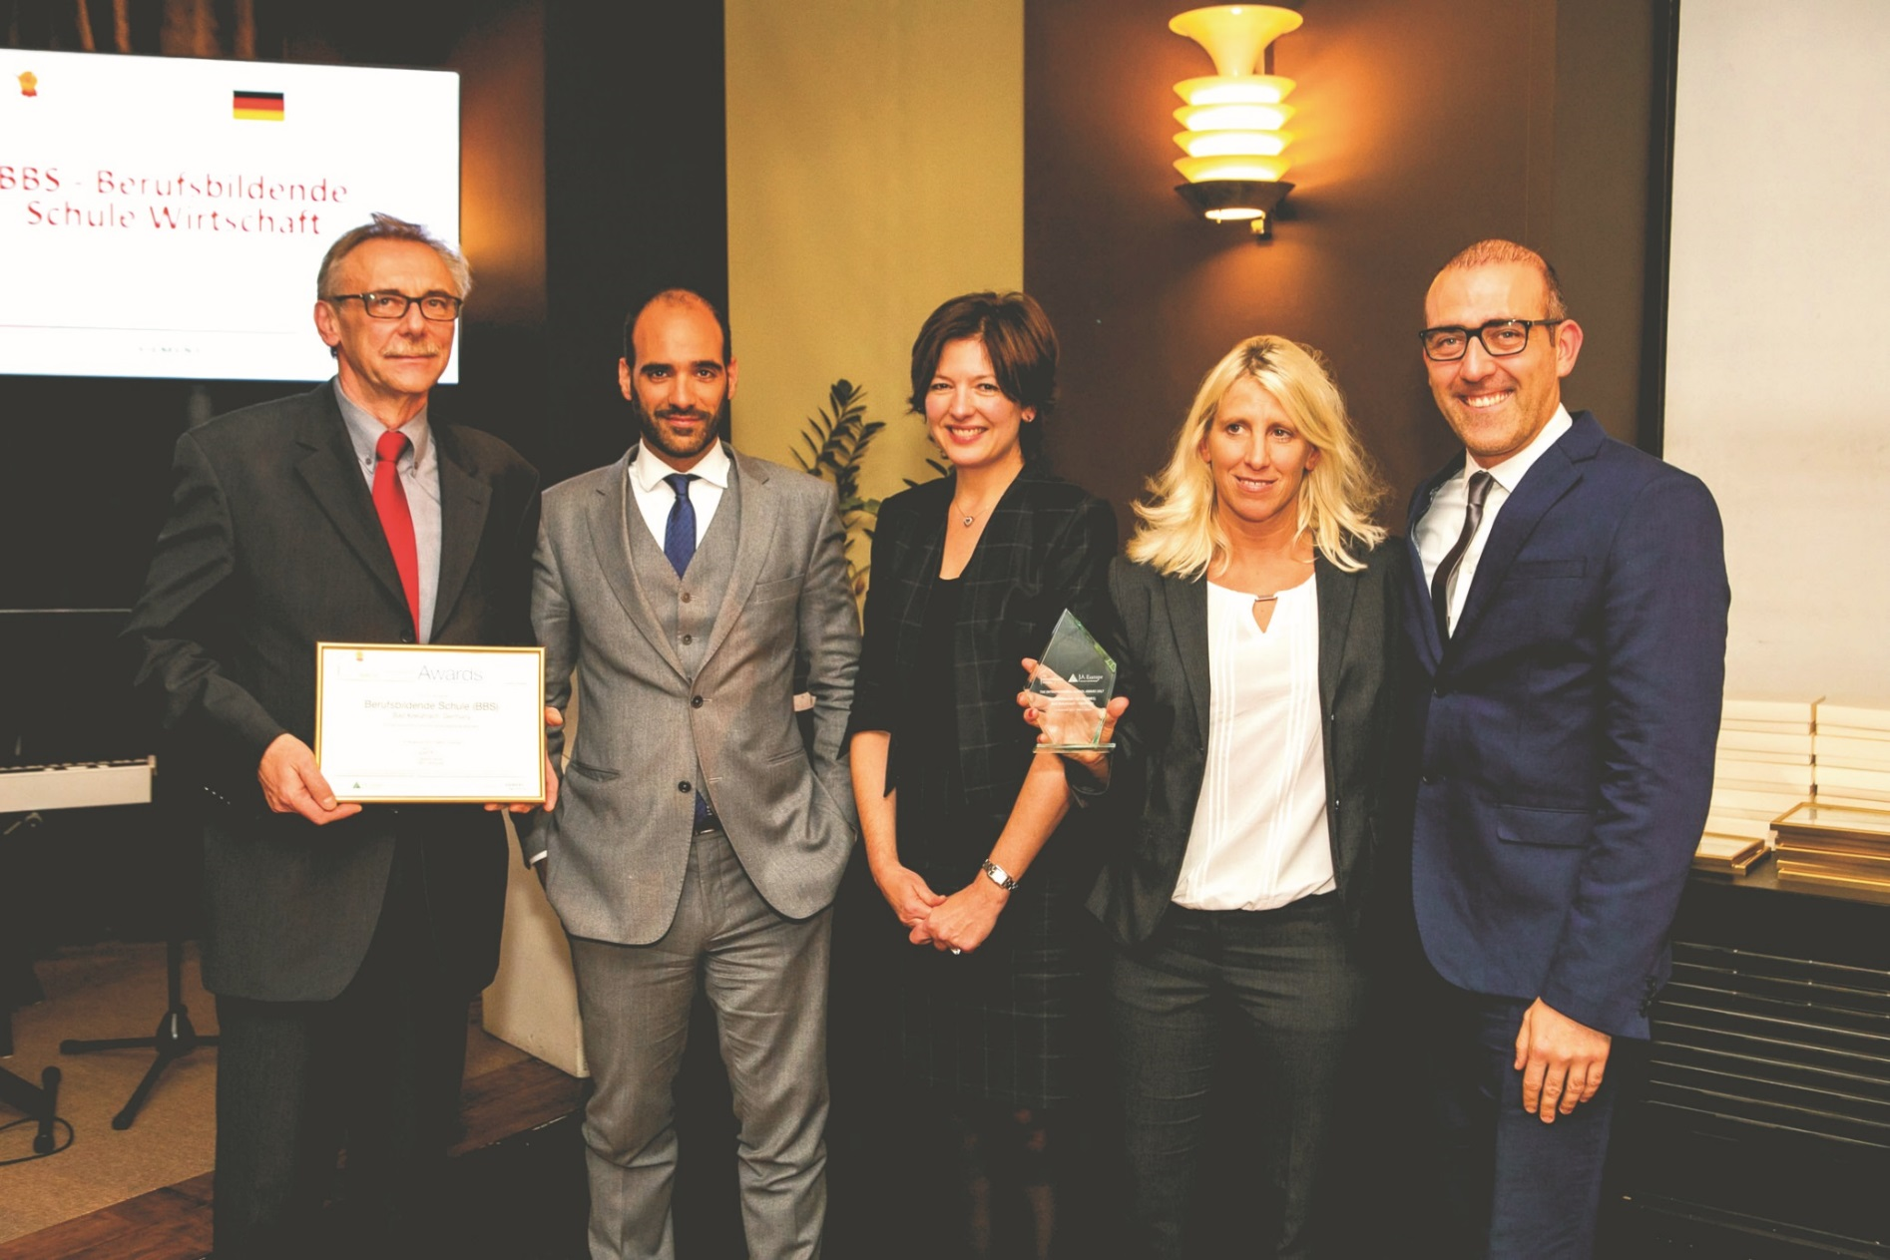
How we met… back in 2017
The Entrepreneurial School Award (TES Award) is an annual recognition of outstanding schools championing entrepreneurship education.
TES Award in Tallin/ Estonia in November 2017

Slide 3
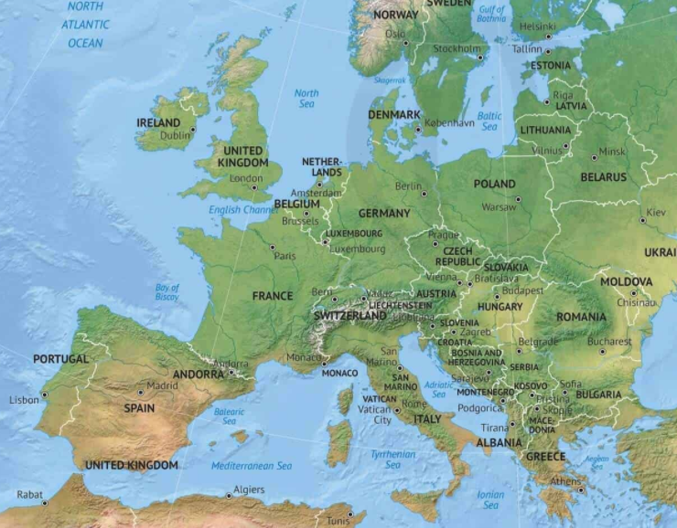
Project Start in September 2018
Partners in
Oldham/ UK
Lisbon/ Portugal
Pontedera/ Italy
Portici/ Italy
Targoviste/ Romania

Slide 4
Objects of Ready4euroe
Students should
learn about the partner countries/ cities/ schools
get an insight in everyday life in the partner countries by living in host families, going to school etc.
overcome prejudice and stereotypes
learn about the job market in the partner countries
be able to apply for jobs in the partner countries
be able to manage a successful job interview

Slide 5
structure of Ready4euroe
Year 1: 5 students plus teachers from each country would meet in one partner school and work on the following topics:
Getting to know the partner countries (Pontedera)
Overcoming prejudice and stereotypes (Lisbon)
Learning about every-day life in the partner countries (Romania)

Slide 6
Structure of Ready4euroe
Year 2: 5 students plus teachers from each country would meet in one partner school and work on the following topics:
Applying for a job in the partner countries
Writing a good CV (Germany)
Writing a good cover letter/ motivation letter (Portici)
Managing a successful job interview (Oldham)

Slide 7
Results
We can look back to…….
75 students travelling to host countries
More than 200 students involved in project activities
35 teachers travelling and many more involved in project activities
2 virtual mobilities
→ We improved our language skills, our intercultural competences, gained practical knowledge … and had tons of fun ☺

