Slide 1
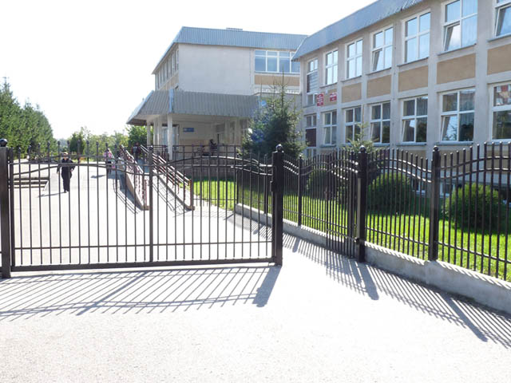
Primary School no 7 with Integrated Classes in Ełk
http://www.sp7.elk.edu.pl/

Slide 2
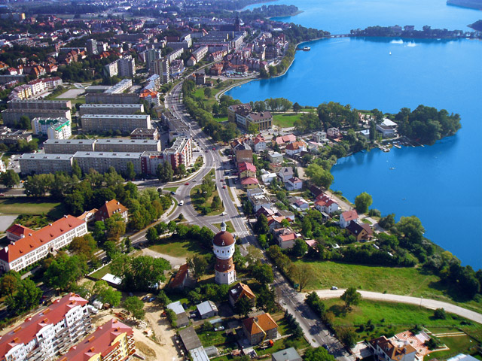
Our Town - Ełk

Slide 3
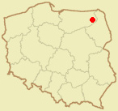
Where is it?
Covering a total area of 395 ha and with a population of nearly 60,000, Elk is the third largest town of Warmia and Mazuria, a region in the north-eastern part of the country. The town is located in the eastern part of the Warmian-Masurian Voivodship.
Warsaw
Surrounded by forests, Elk is located on a shore of the glacier-formed Lake Elckie; a river of the same name also flows through the town. As it lies in the continental climate zone, summers in Elk are often dry and hot while winters are cold with heavy snowfalls.

Slide 4
People in Ełk
Year 2013
59 790
MEN
28 802
WOMEN
30 988

Slide 5
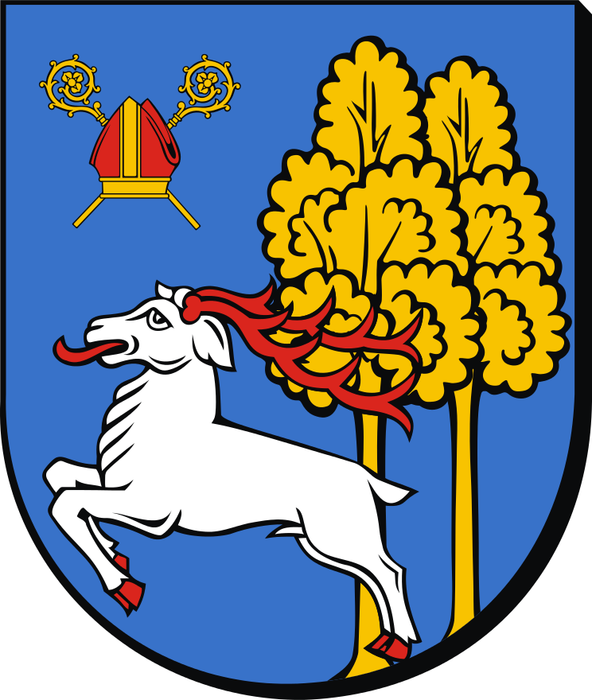
The city’s flag and coat of arms
This is a contemporary coat of arms. It presents a deer jumping over the stump.

Slide 6
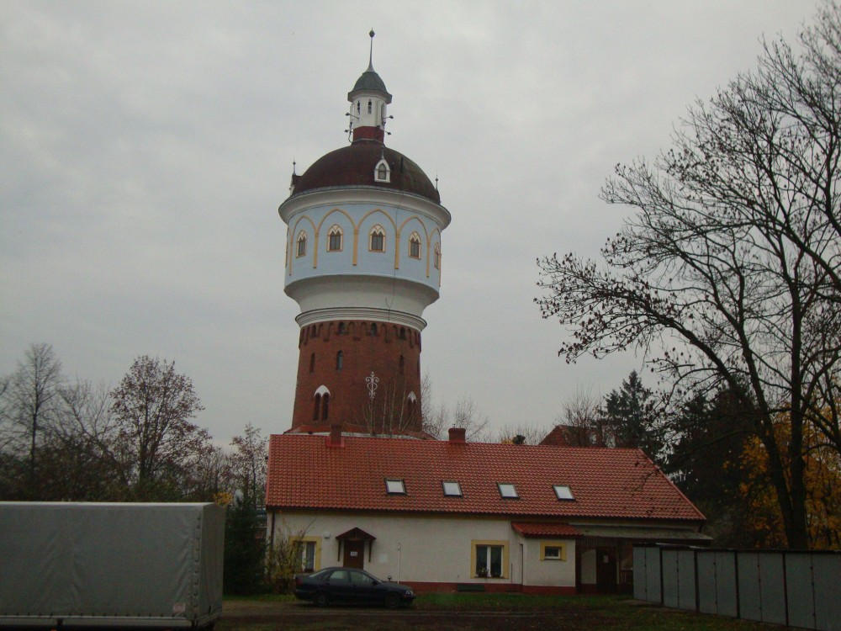
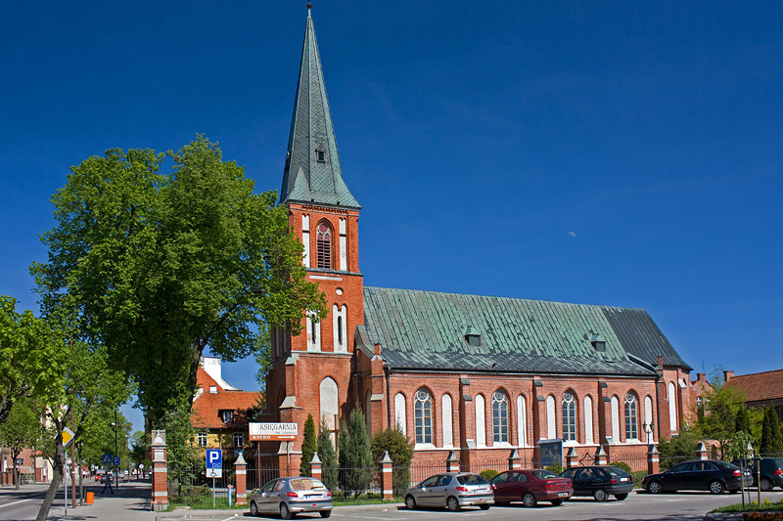
Sightseeing in Ełk
There are many fine examples of interesting architecture in Elk. The Art Nouveau tenements are particularly impressive sights, without doubt but you should also see the water tower and the neo-gothic St. Adalbert’s Church.

Slide 7
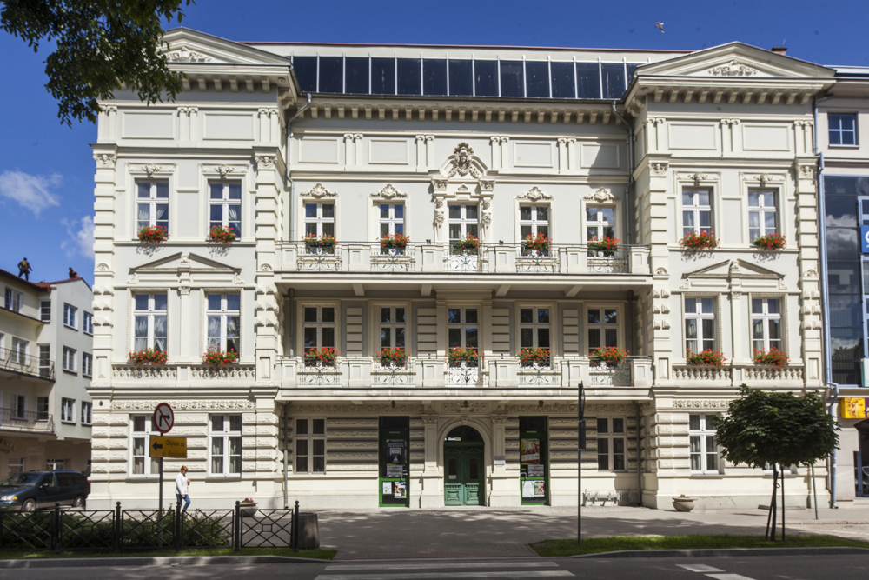
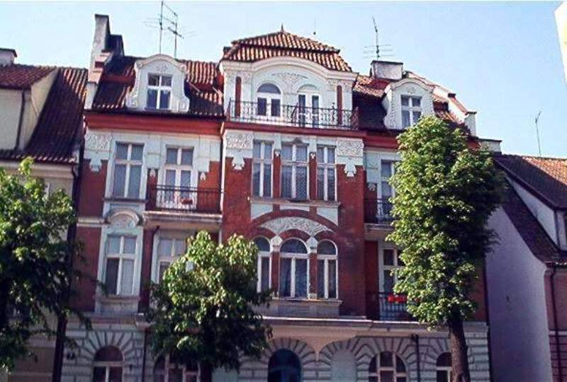
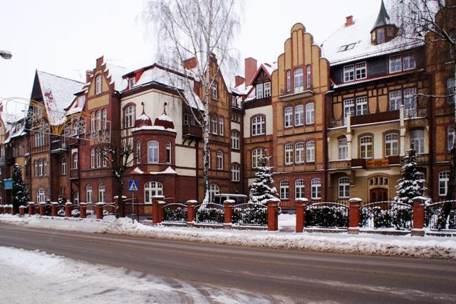
Ełk was once a German city. It has a specific prewar architecture.
A lot of people believe that Ełk’s old apartment- houses are beautiful and unique.

Slide 8
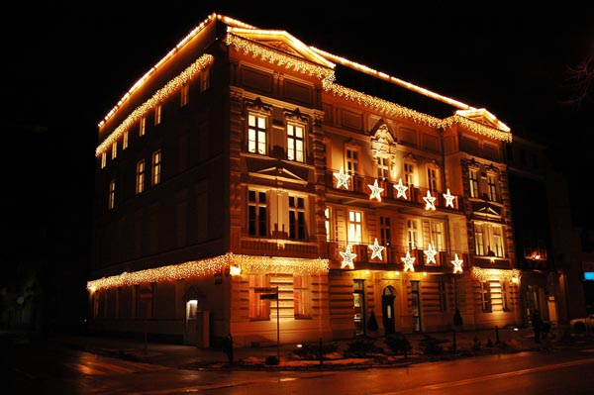
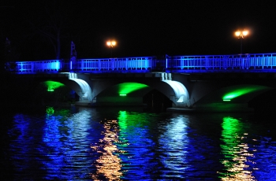
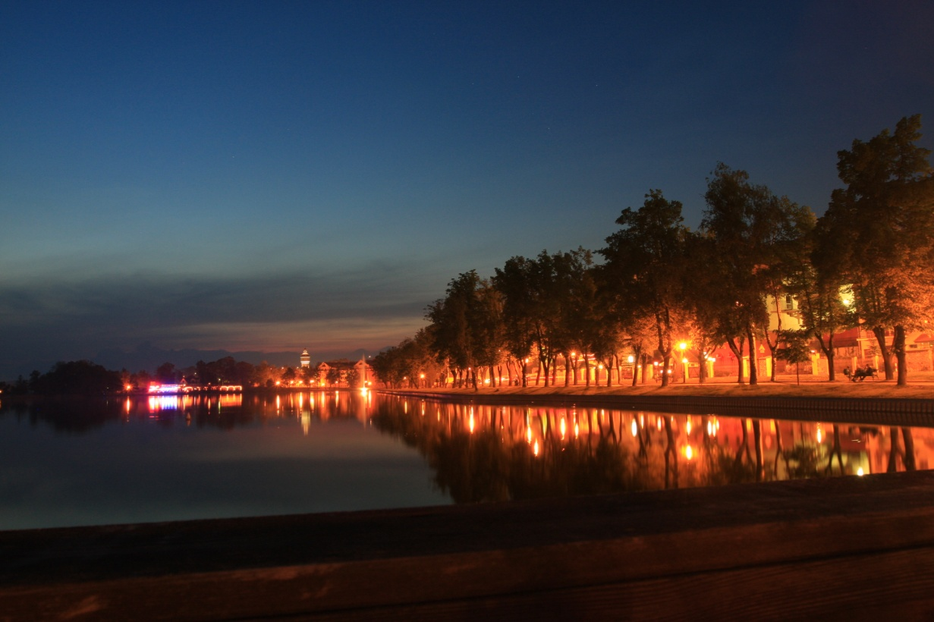
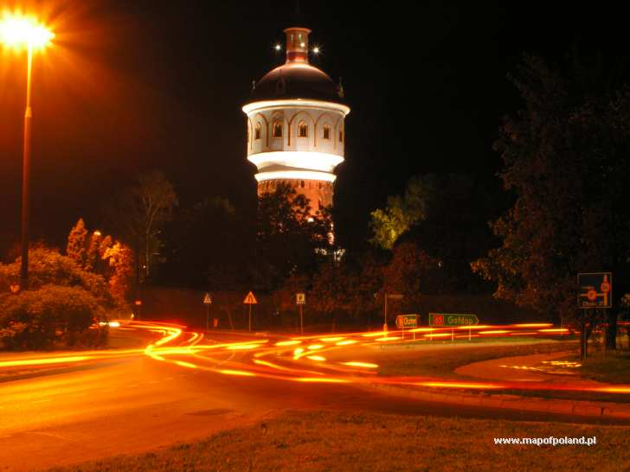
Ełk by night

Slide 9
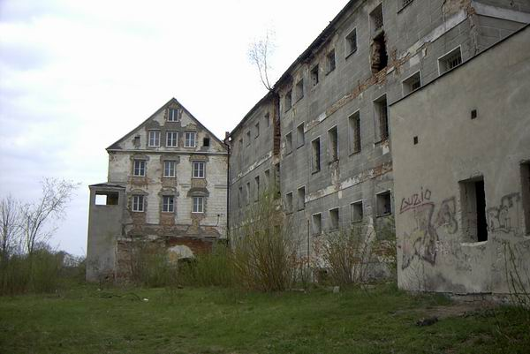
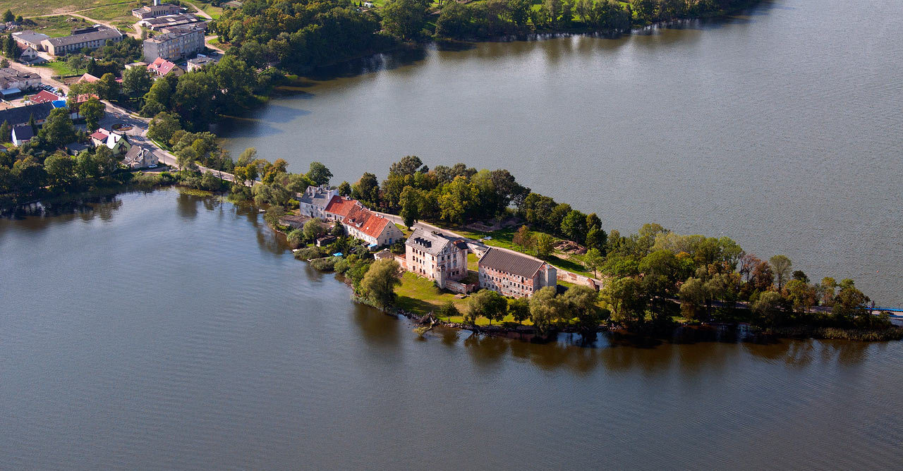
Close to the lake shore you can find the remains of an imposing fortified castle of the Teutonic Knights, dating from the 14th century.

Slide 10
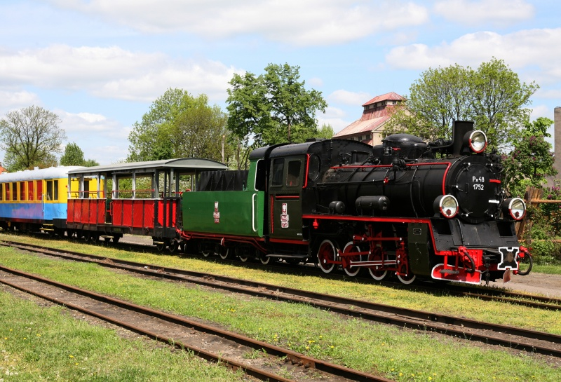
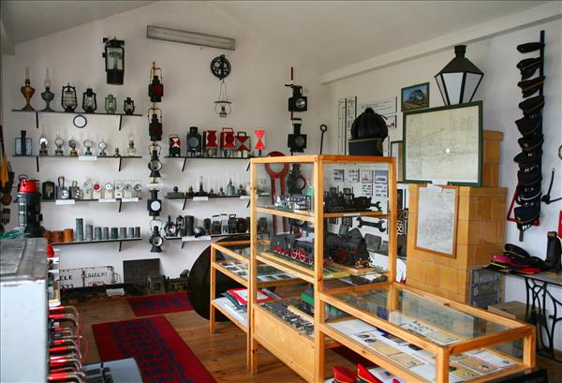
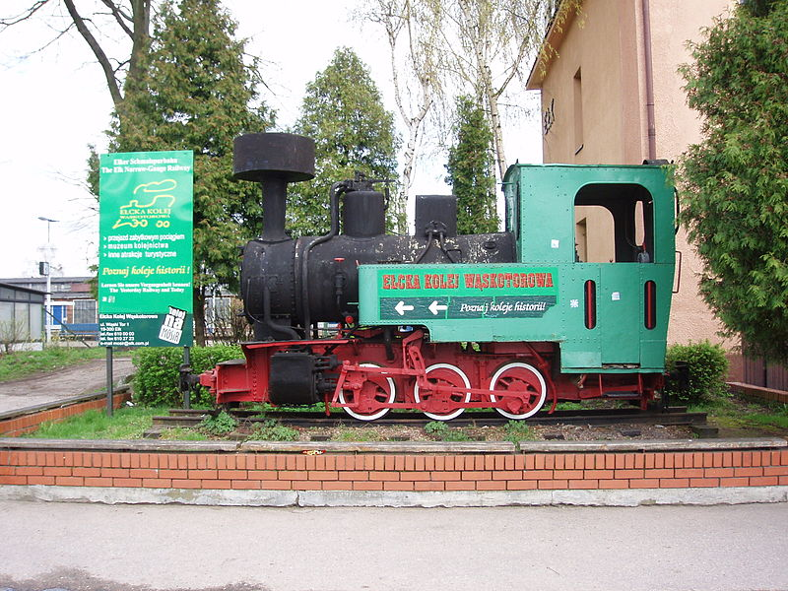
The Railway Museum in Ełk is a vast collection of historic locomotives and engines that have been stored here since 1918.

Slide 11
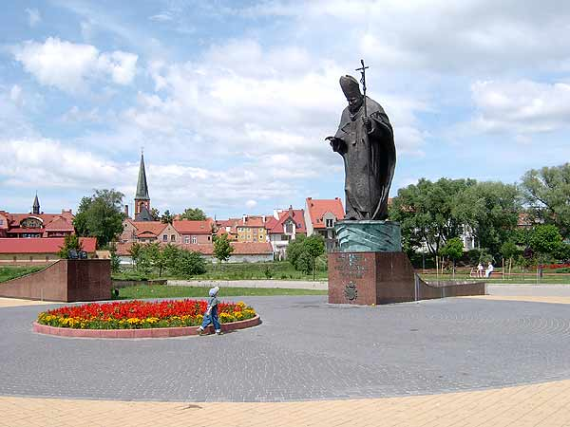
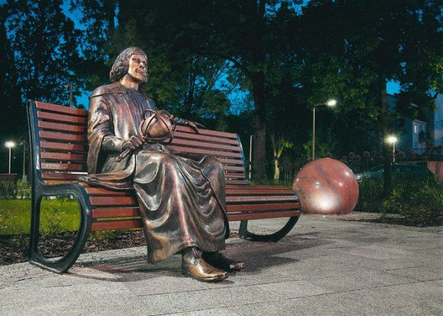
There are some monuments in Ełk. For example monument to Mikołaj Kopernik or the Pope John Paul II.

Slide 12
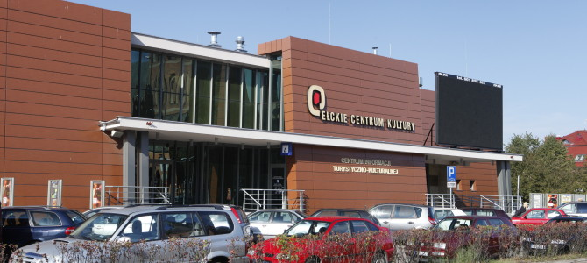
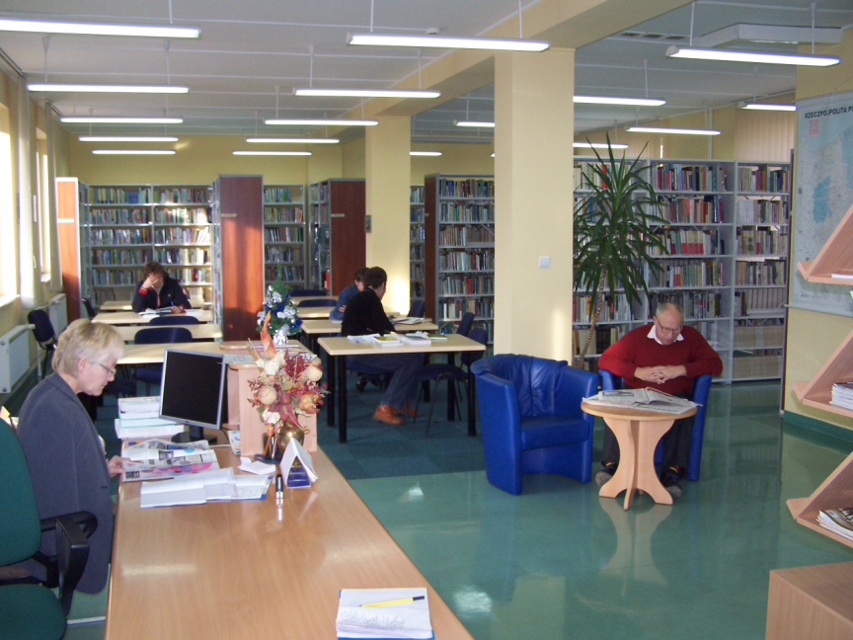
Culture
In Ełk there is the City’s Centre of Culture, cinemas, Public Library and others.

Slide 13
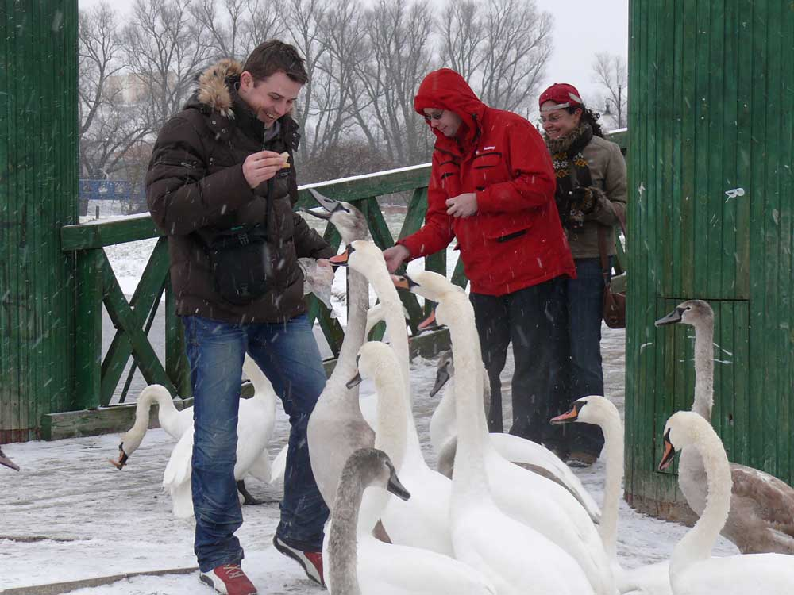
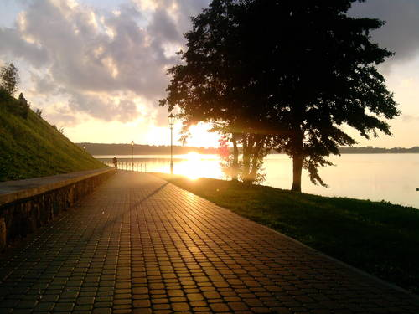
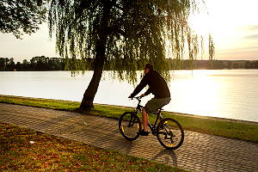
Elk has got a lot off alleys for the strollers, as well sa paths for the bicyclists, witch one can find by the lake. While taking a walk one can feed the swans.

Slide 14
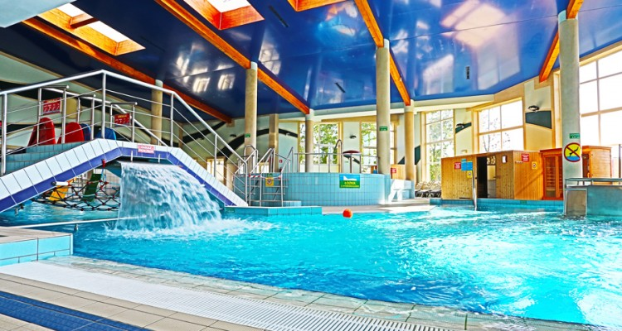
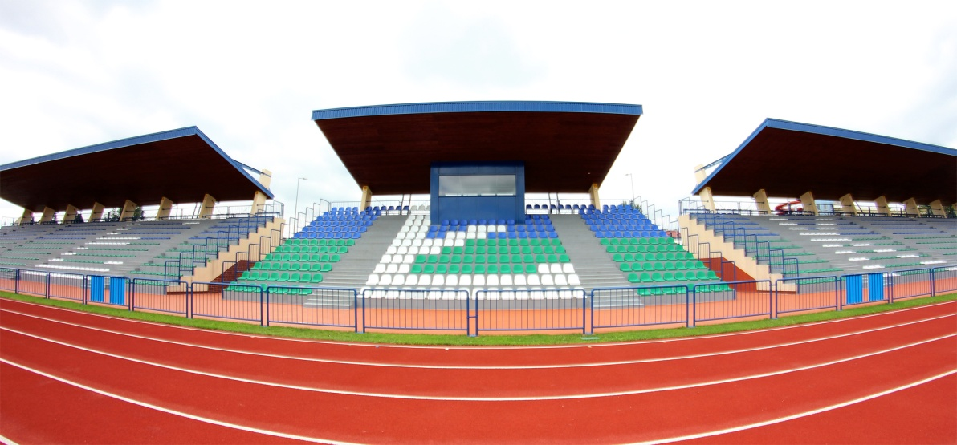
Sport
In Ełk there is a big Center of Sport and Recreation: swimming pool, tennis courts, gyms, rental places of water equipment and bicycles.

Slide 15
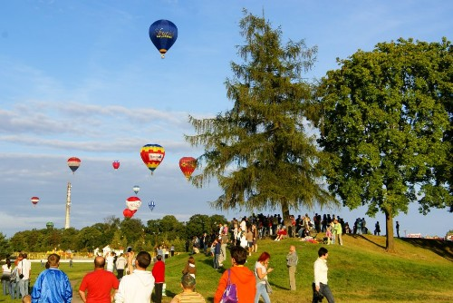
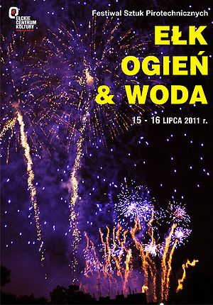
Events in Ełk
Every summer in Ełk take place such events like the Masurian International Balloon Competition or the Festival Ełk, Fire & Water

Slide 16
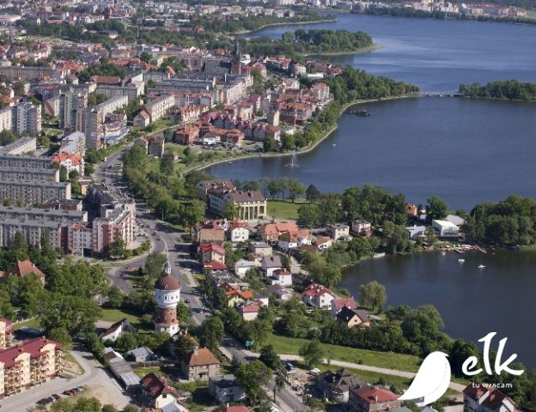
Ełk from bird’s eye view

Slide 17
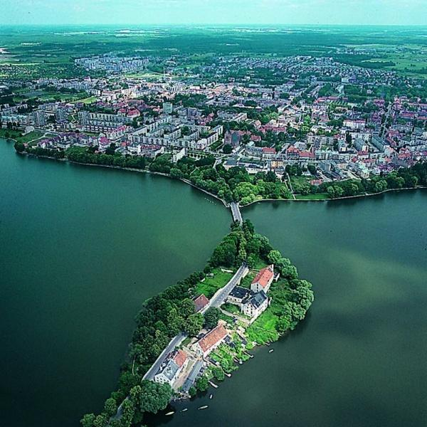

Slide 18
You can see out town here☺
https://www.youtube.com/watch?v=mOA9-DFqFfE

Slide 19
Source of photos:
http://elk-lyck.blogspot.com/
http://www.zamki.pl/?idzamku=elk
http://mazurytravel.com.pl/region/elk-miasto-i-powiat
http://www.mazurskiezawodybalonowe.pl/galeria2.php
http://leksykonkultury.ceik.eu/index.php/E%C5%82k,_Ogie%C5%84_%26_Woda_2011
http://mosir.elk.pl/park-wodny/plywalnia/
http://pribo-epb.elk.pl/pl/99-Nasze_Inwestycje/34-Ukonczone/138-Stadion_Miejski/4.html
http://www.egoturystyka.pl/portal.php?aid=12692859094ba7c41534e1d
http://www.digart.pl/praca/7388057/Elcka_promenada.html
http://www.cyrkulewski.pl/travel/view/elks-small.html
http://wirtualne.miasto.elk.pl/blog/2014/08/04/elckie-centrum-kultury/
https://pl.wikipedia.org/wiki/Miejska_Biblioteka_Publiczna_w_E%C5%82ku
http://andkus.republika.pl/galeria.htm
http://www.elk.pl/aktualnosci-wpis/966/powstanie-warszawskie-71-rocznica
http://www.krainajacwingow.pl/ekw-318.htm
http://www.dzieckowpodrozy.pl/elcka-kolej-waskotorowa-mazury-ceny/
http://www.staryspichlerz.pl/?mact=News,cntnt01,detail,0&cntnt01articleid=13&cntnt01origid=64&cntnt01returnid=60
http://elk.wm.pl/2102-5793,Elk-Zamek-krzyzacki,44517.html
http://www.rikoooo.com/fr/forum/217/42130
http://instalator.bianconeri.co.uk/realizacje.php
http://pxm.pl/index.php?menu=realizations
http://www.mapofpoland.net/Elk,photo,6167,Water-tower.html
http://www.elk.mm.pl/~mikolajzelku/index_pliki/Fotki-Elku/Miasto_fotki.htm
http://wirtualne.miasto.elk.pl/blog/author/admin?print=print-page
http://mapio.net/s/63251959/
https://pl.wikipedia.org/wiki/Flaga_E%C5%82ku
http://www.sadistic.pl/fotki-miast-z-lotu-ptaka-vt207789,30.htm
http://www.zamki.pl/?idzamku=elk

