Slide 1
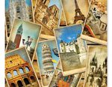
Greetings from Europe! – Postcard Exchange

Slide 2
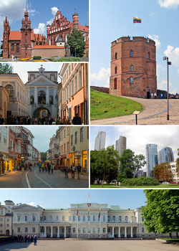
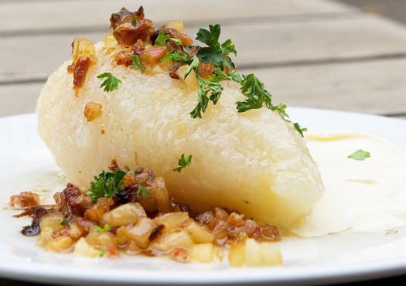
LIETUVA (LITHUANIA)
Traditional clothes The flag The capital – VILNIUS
Traditional food
Cepelina

Slide 3
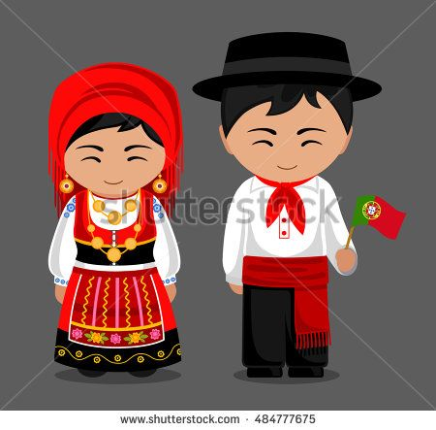
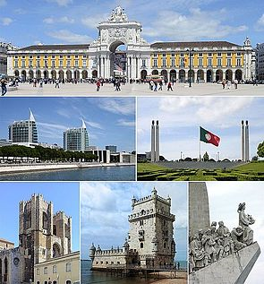
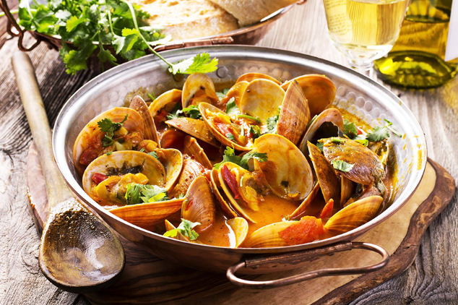
PORTUGALIJA (PORTUGAL)
Traditional clothes The flag The capital - LISBON
Traditional food
Molluscs

Slide 4
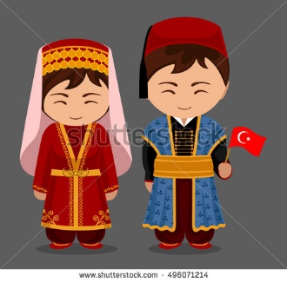
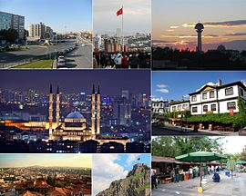
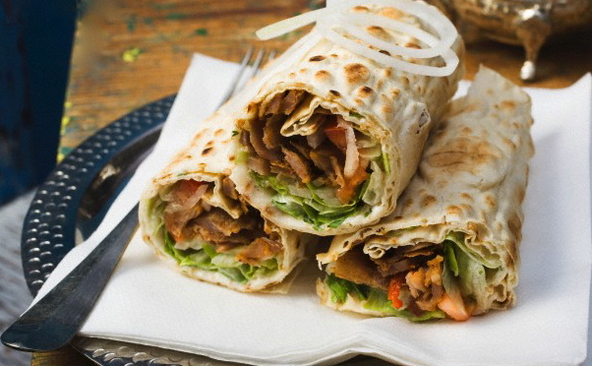
TURKIJA (TURKEY)
Traditional clothes The flag The capital - ANKARA
Traditional food
Kebab

Slide 5
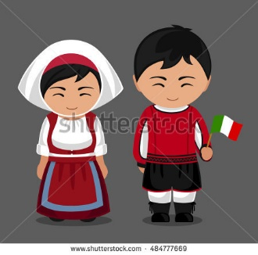
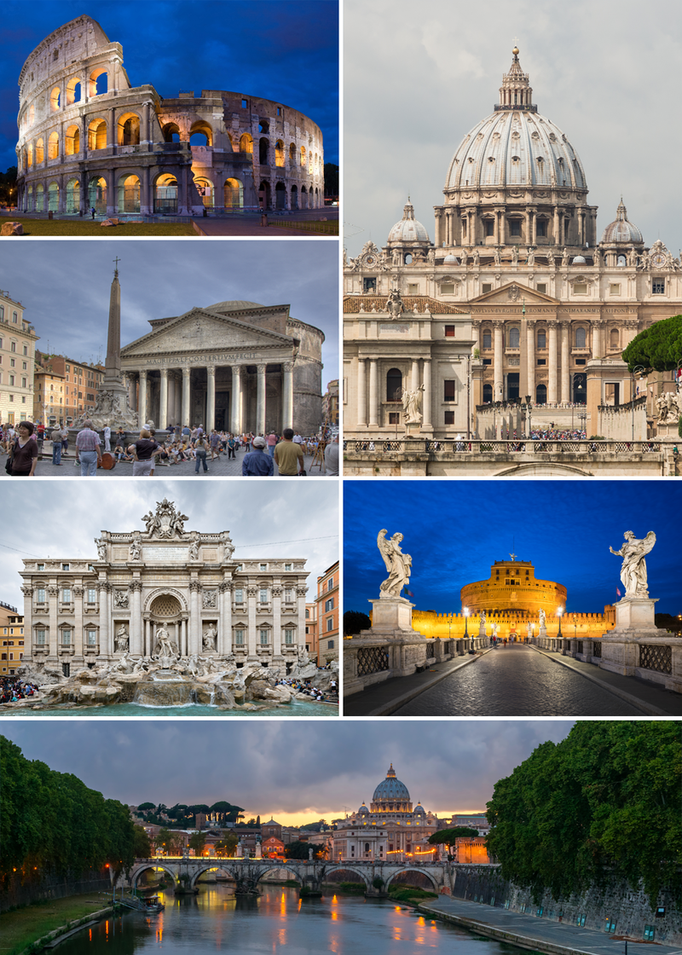
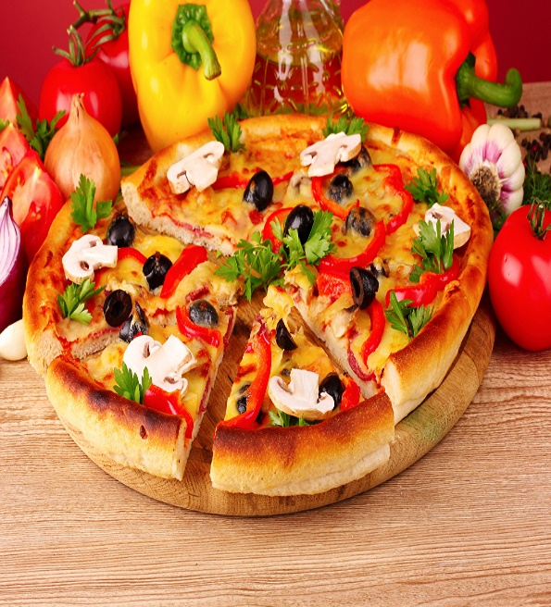
ITALIJA (ITALY)
Traditional clothes The flag The capital – ROME
Traditional food
Pizza

Slide 6
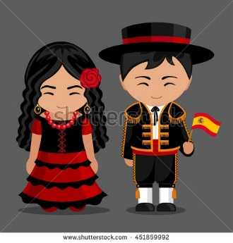
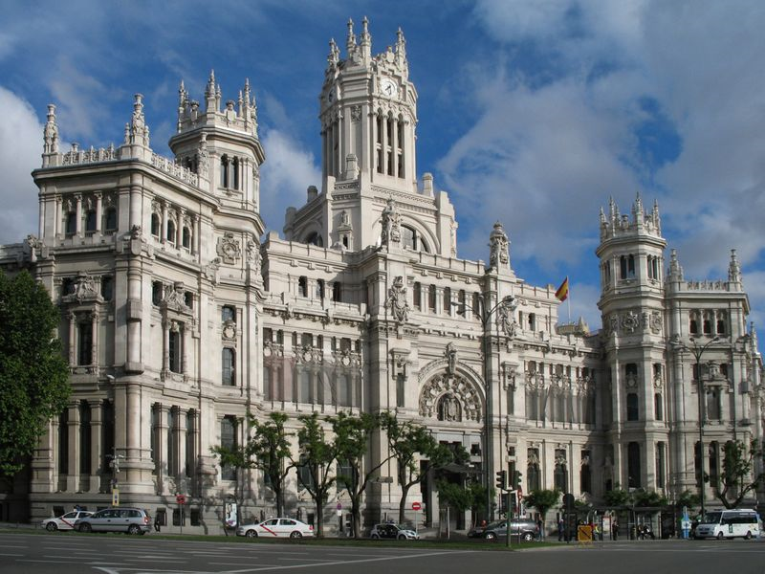
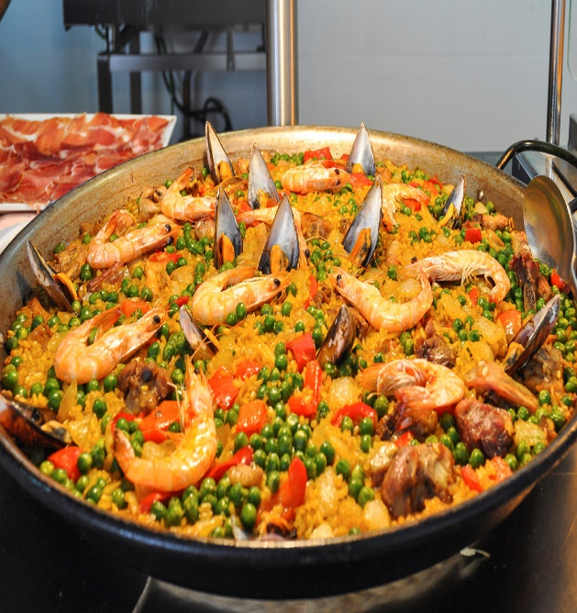
ISPANIJA (SPAIN)
Traditional clothes The flag The capital – MADRID
Tradinional food
Paella

Slide 7
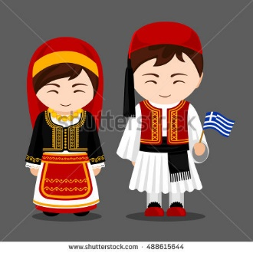
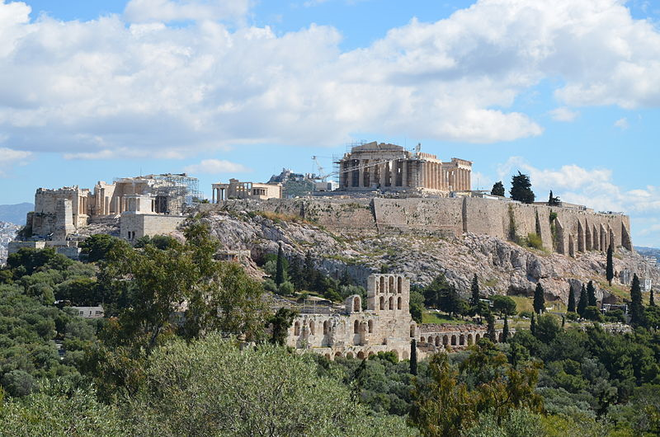
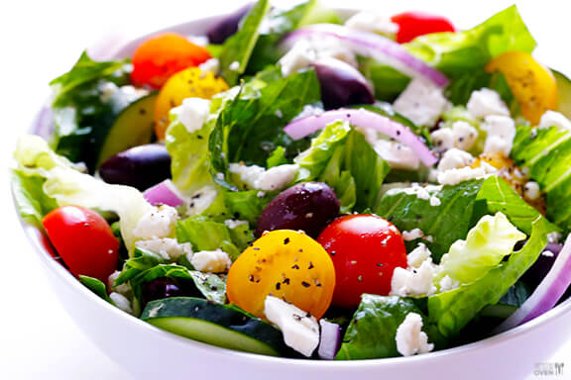
GRAIKIJA (GREECE)
Traditional clothes The flag The capital - ATHENS
Traditional food
Greek salad

Slide 8
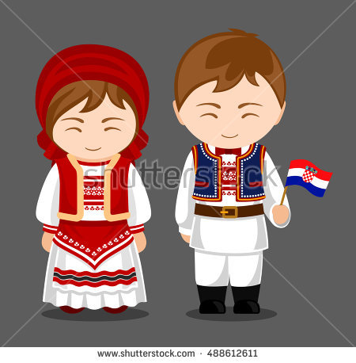
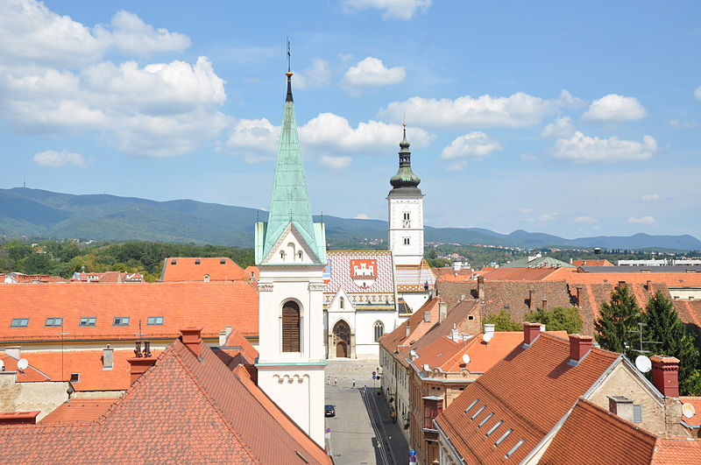
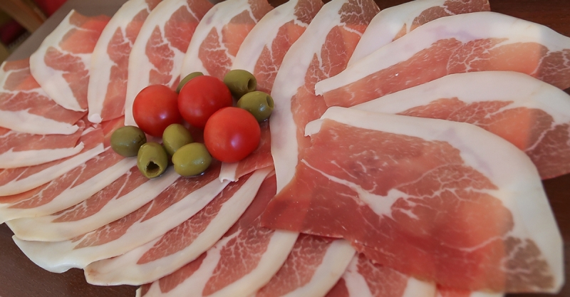
KROATIJA (CROATIA)
Traditional clothes The flag The capital – ZAGREB
Traditional food
Ham

Slide 9
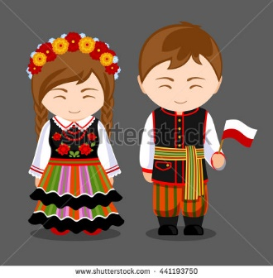
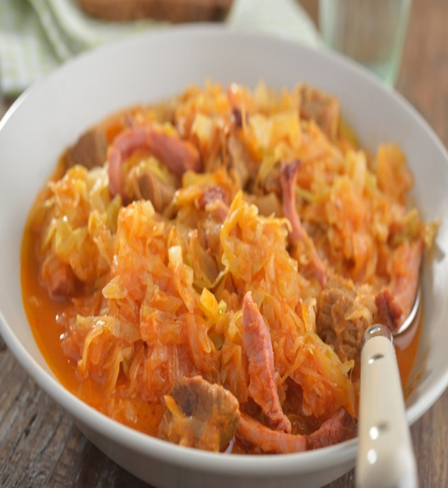
LENKIJA (POLAND)
Traditional clothes The flag The capital - WARSAW
Traditional food
Bigos

Slide 10
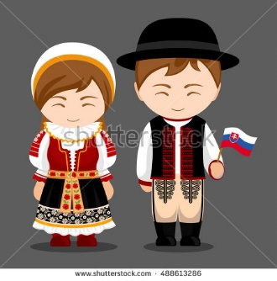
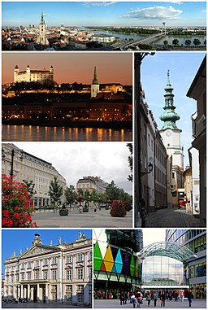
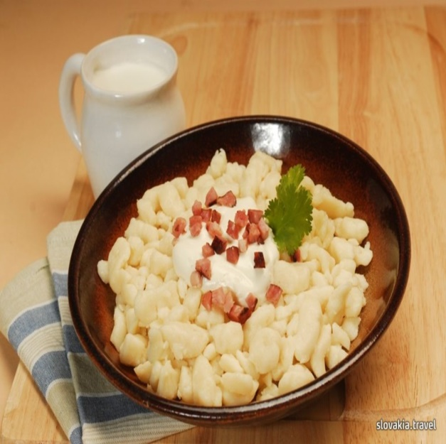
SLOVAKIJA (SLOVAKIA)
Traditional clothes The flag The capital - BRATISLAVA
Traditional food
Halušky

Slide 11
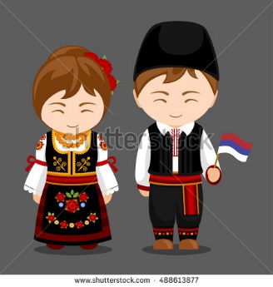
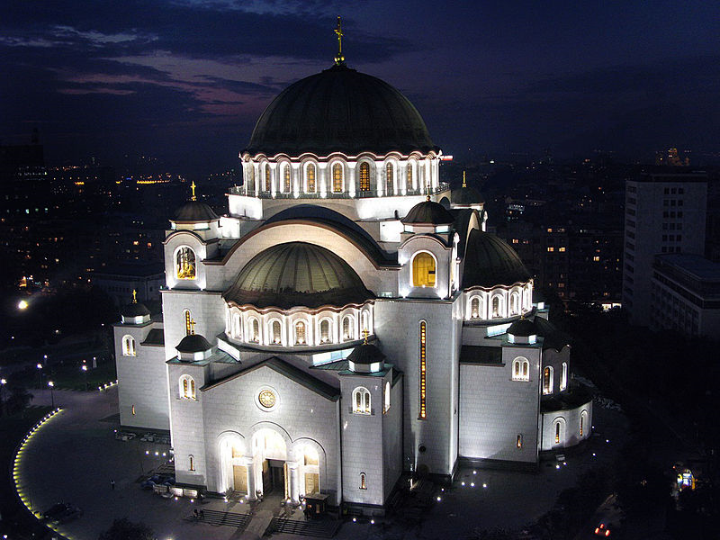
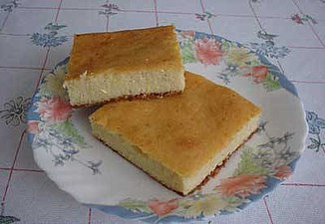
SERBIJA (SERBIA)
Traditional clothes The flag The capital - BELGRADE
Traditional food
Proja

Slide 12
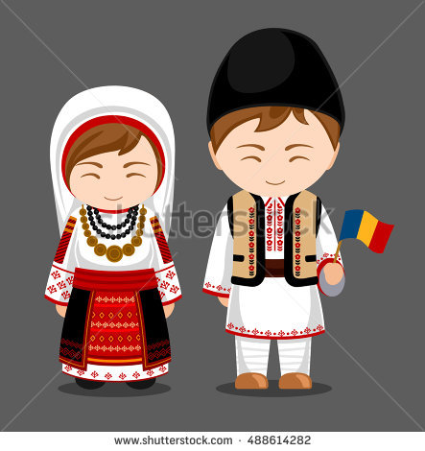
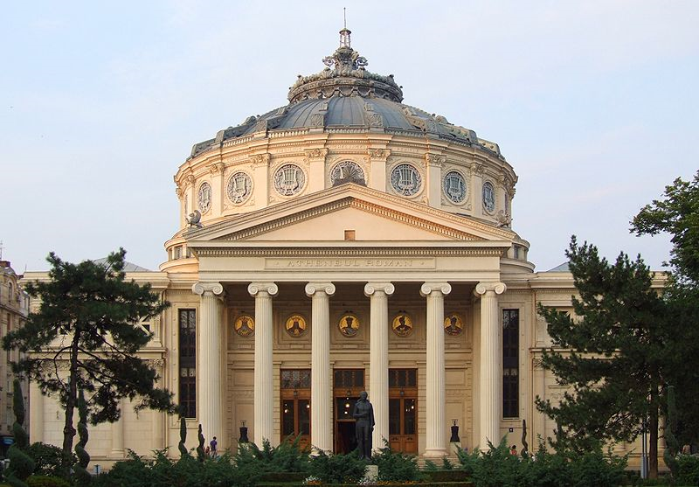
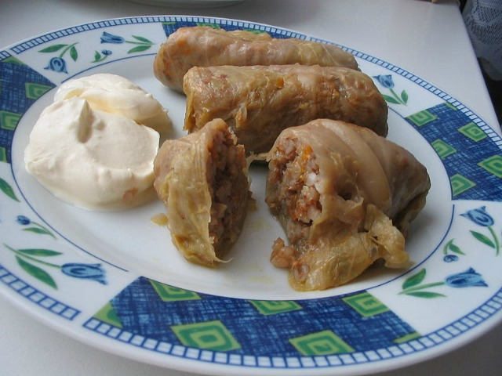
RUMUNIJA (ROMANIA)
Traditional clothes The flag The capital - BUCHAREST
Traditional food
Cabbage rolls

Slide 13
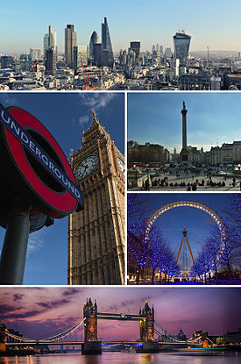
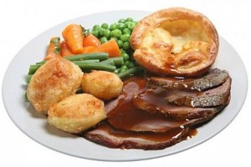
ANGLIJA (UNITED KINGDOM)
Traditional clothes The flag The capital - LONDON
Traditional food
Roast Dinner

