Slide 1
Traditional Latvian musical instruments
Latvian team: Inese, Maija, Māris, Artūrs, Samanta, Aija

Slide 2
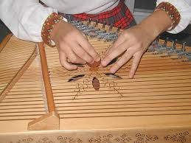
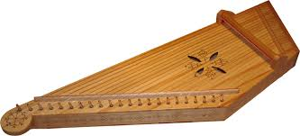
Kokle
The «Kokle» is the most popular Latvian string musical instrument.
Its quiet and rich sound is more suited for meditation, for playing alone.
The oldest known «kokle» is from 13th century.
In nowadays there are a lot of folk groups in Latvia but mostly women play this musical instrument.

Slide 3
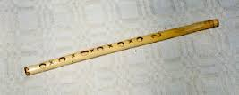
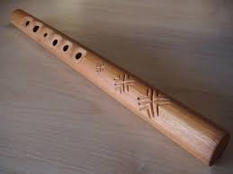
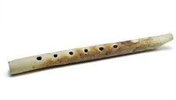
Stabule
The «Stabule» is the oldest national woodwind musical instrument of Latvia.

Slide 4
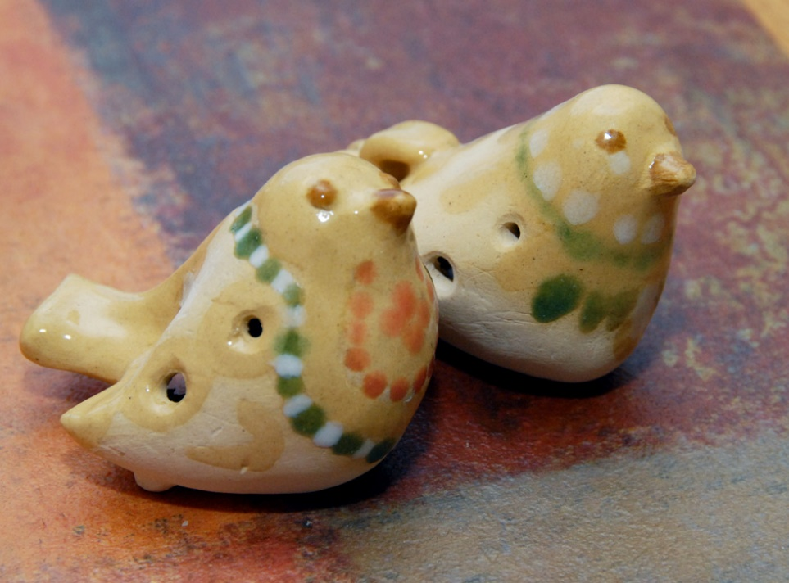
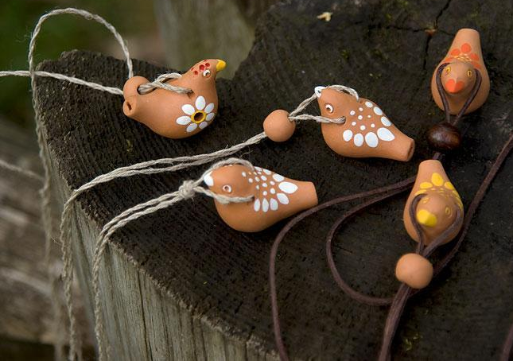
SVILPAUNIEKs
These musical instruments are with 2-3 holes for playing and look likes a bird, they are made of clay. All of them are in the different shapes.
The small boys love «svilpaunieks» and they are playing them in the free time.
These oldest instruments are from 16th century.
https://www.youtube.com/watch?v=pOTEKPWrK8c

Slide 5
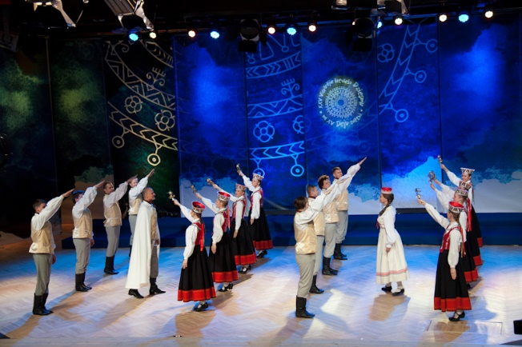
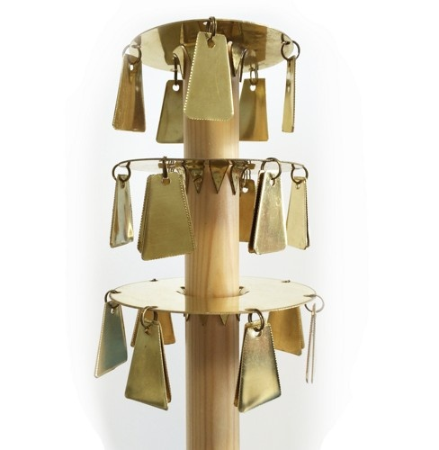
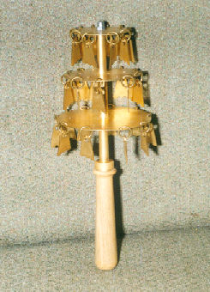
Trideksnis
This instrument is closely related to the wedding traditions in Latvia, they are used in folk dances, too.
The trideksnis is a percussion instrument, something like a metal rattle. It is held in the hand and shaken up and down.

Slide 6
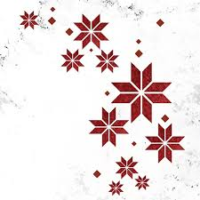
Enjoy Latvian music and our musical instruments!
https://www.youtube.com/watch?v=F81tZK10dh8

