Slide 1
FOLK MUSICAL INSTRUMENT
DULCIMER

Slide 2
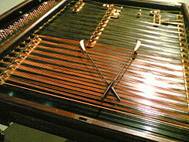
Dulcimer – stringed musical instrument from a group of chordophones, it is struck with chopsticks. Sometimes it is categorized to the group of citharas.

Slide 3
The construction of the instrument
The strings are stretched on a wooden board in the shape of a trapezoid. For the game we use two wooden sticks with a special curved shape.
Strings in the number of up to 100 are stretched in so-called bands along the body of the instrument.
Strings may be between 2 and 5 of the same amount in the level of volume of the instrument. They are attached by the pins, similar to the piano pins and we tune them with a special wrench.
The instrument has 2 or more stands: right to the bass strings and left to the higher strings. Another stand expands the scale of an instrument with additional sounds called Alters'.

Slide 4
Origins
The origins of cymbals are associated with the Middle East. The instruments of this type were made and used probably in the third century BC . Chordophones were called SANTIR or Pisantir and probably derived from the Greek psalterion.

Slide 5
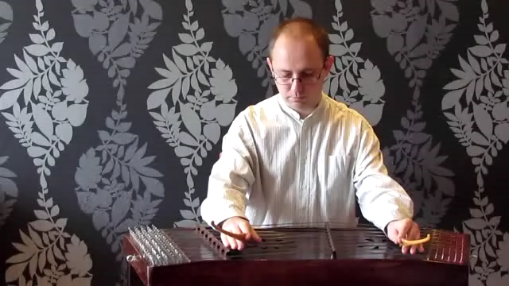
Playing technique
The sound comes out through freely alternate hitting the strings with chopsticks, taking advantage of the buzz and reverb. There are different styles of playing, from the melodic, through the broken chords to accompany, to mixed style, using both techniques together.
Enjoy the video.

Slide 6
Thank you for your attention.

