Slide 1
My school is in Lithuania
Let`s make music on in the classroom!

Slide 2
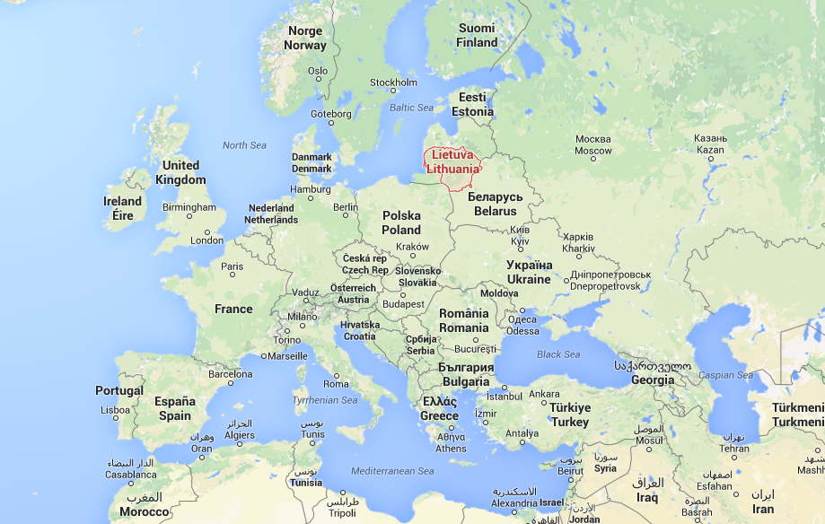
We are in Europe. Our neighbours are Latvia, Belarus, Poland and Russia

Slide 3
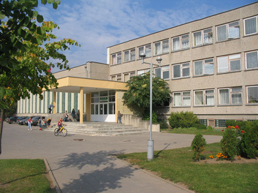
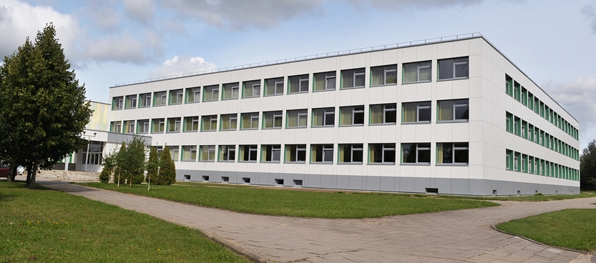
We study at Pavasaris Basic School
which creates a welcoming, safe and caring environment where everyone feels valued, supported and involved.
Our school in 2013
Our school now.

Slide 4
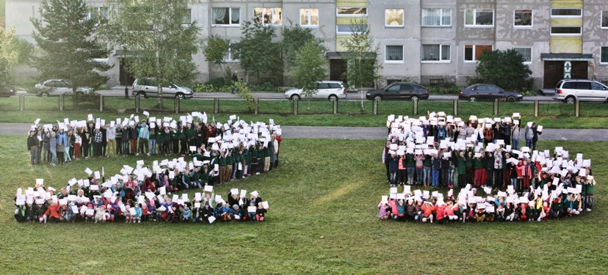
Last year we were celebrating our school`s 25th anniversary

Slide 5
At the first of September we start our school year

Slide 6
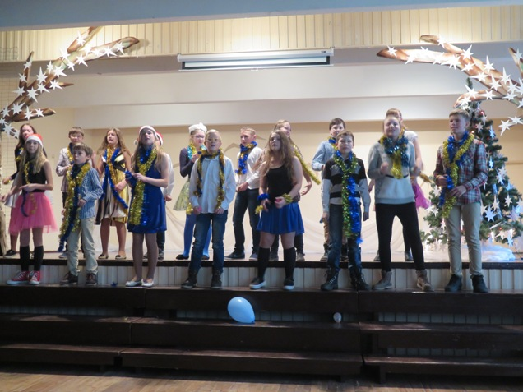
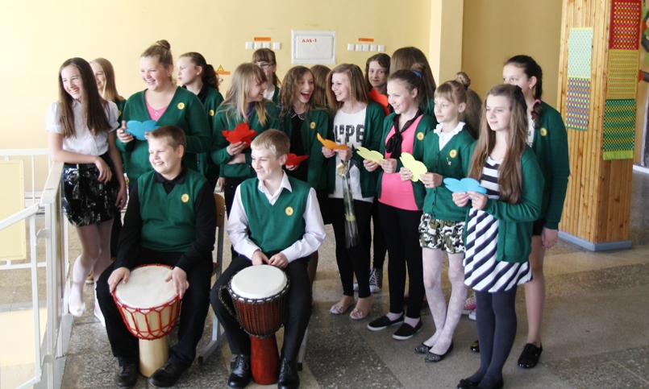
The school has nice and deep-rooted traditions. No school festival can be imagined without our young dancers and singers.

Slide 7
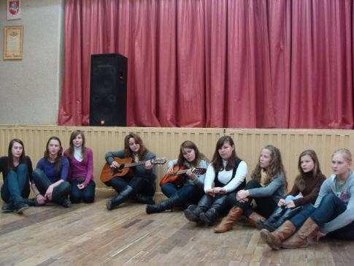
We celebrate lots of annual festivals
Christmas Charity Concert
The Green Song Contest

Slide 8
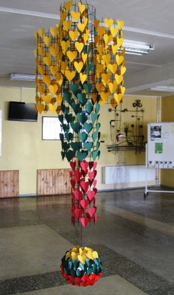
Every year we celebrate our country‘s Independence Day on 16th February

Slide 9
Participant
Primary | 13
Exact sciences | 6
Linguists | 10
Social studies | 12

Slide 10
Do you use music in your classroom?

Slide 11
When do you use musical elements?

Slide 12
How often do you use the elements of music in the classroom? (1)

Slide 13
How often do you use the elements of music in the classroom? (2)

Slide 14
What are the advantages of using music? (1)

Slide 15
What are the advantages of using music? (2)

Slide 16
What are the advantages of using music? (3)

Slide 17
What are the advantages of using music? (4)

Slide 18
Does music help develop imagination and creativity?

Slide 19
How do you think does music help to concentrate?

Slide 20
What is the possibility of using musical expression?

Slide 21
Thank you for your attention!

