Slide 1
The Legend of lake Szent Anna
By the girls from the 7th B class

Slide 2
Facts
Lake Szent Anna is one of the most magnificent natural treasure of Szeklerland, the only volcano lake in Central and Eastern Europe
Lake Szent Anna is situated 38 km from Csíkszentsimon
It’s the only Crater Lake in all of Romania
Its birth is related to the formation of a volcanic mountain range on the inner rim of the Transylvanian basin
The lake formed in a volcano crater at a 945 meters altitude,its length is 620m, its width is 460m, the total length of the lakeshore is 1.73km and its maximum depth is 7m
The lake has no link to any other source of water, it is supplied exclusively from precipitations, therefore the degree of mineralization of the water is very low. All the water in the lake comes from rain. All the water from the mountains around accumulated into this crater hole and created this impressive lake

Slide 3
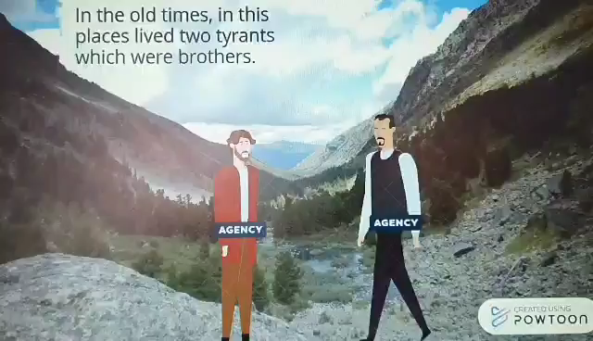
The legend of its formation

