Slide 1
SUNDAY
by: Ferencz Norbert
Szőcs Norbert

Slide 2
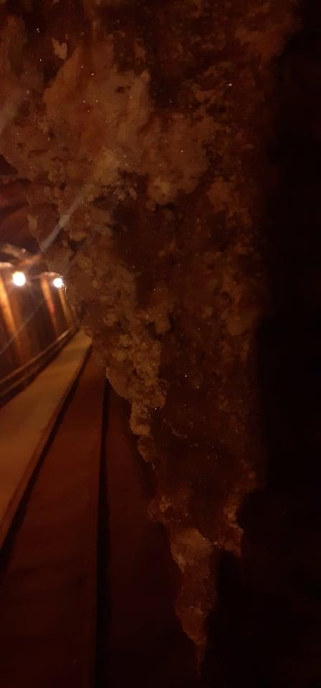
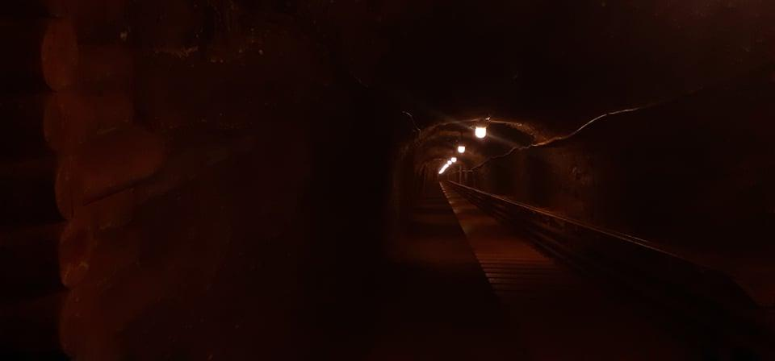
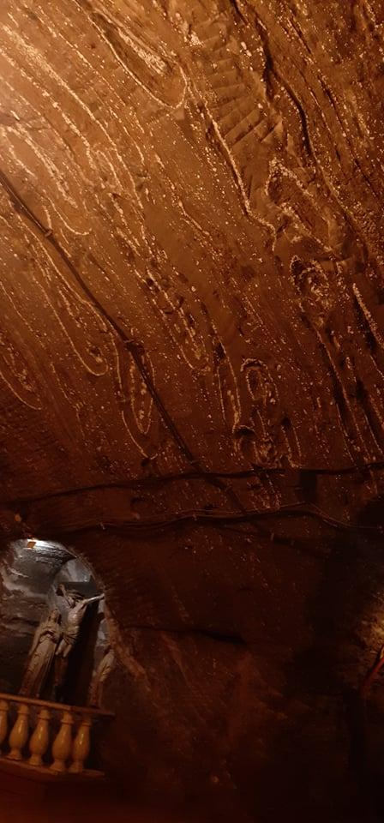
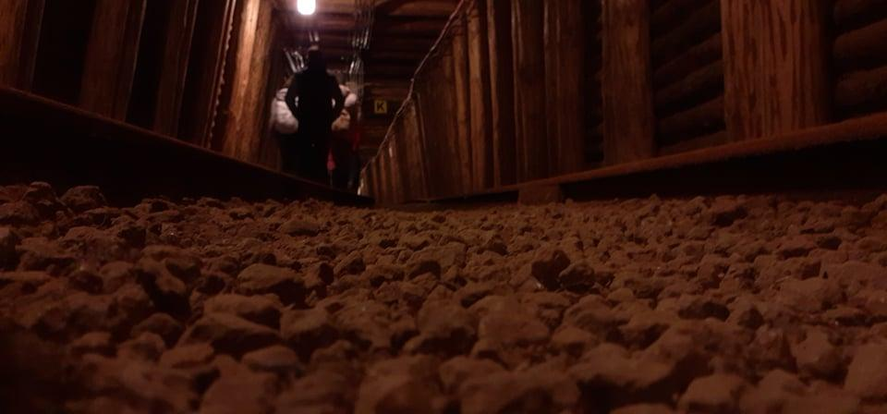
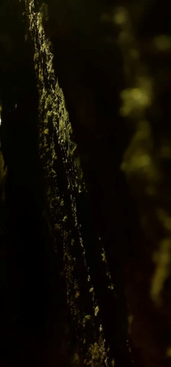
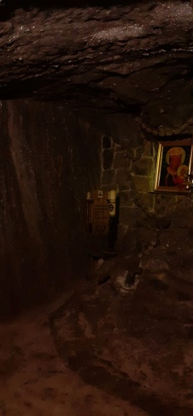
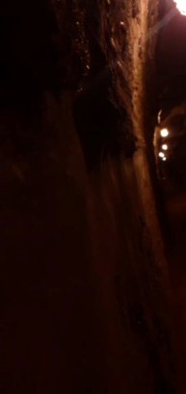
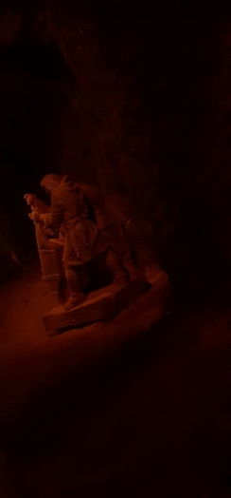
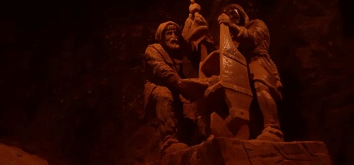
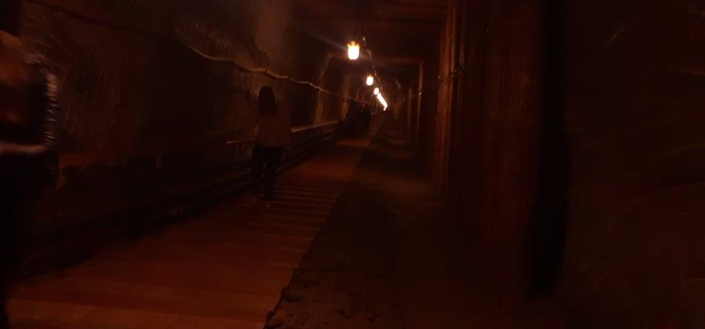
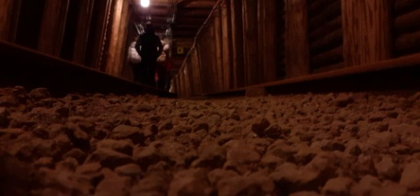
In The Salt Mine at Bochnia
We were in the salt mine at a depth of 200 meters underground.

Slide 3
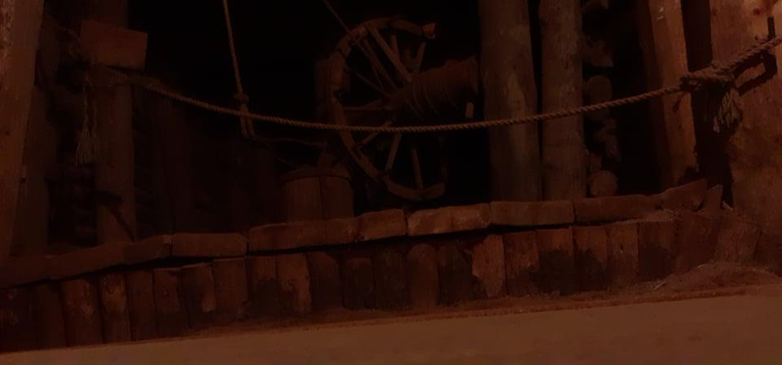
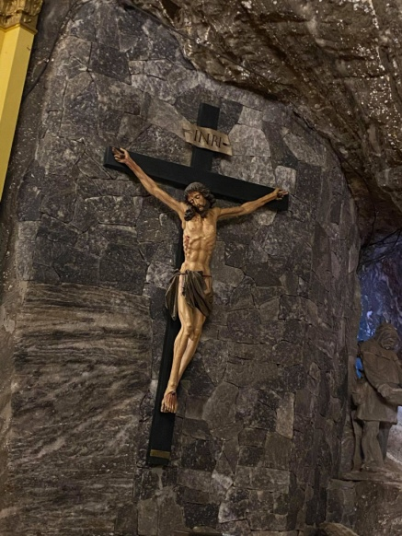
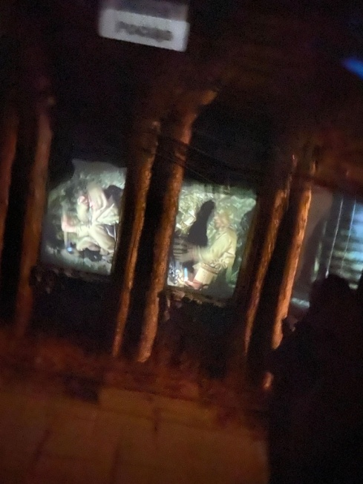
Underground Structures

Slide 4
The miners had many tools. They had horses underground. The machines worked with horses. The miners were really religious. They didn’t have helmets and many people died falling off the rocks. We travelled by a small train/minecart. In 250m deep is a park with a basketball room and a sitting room and a small shop.

Slide 5
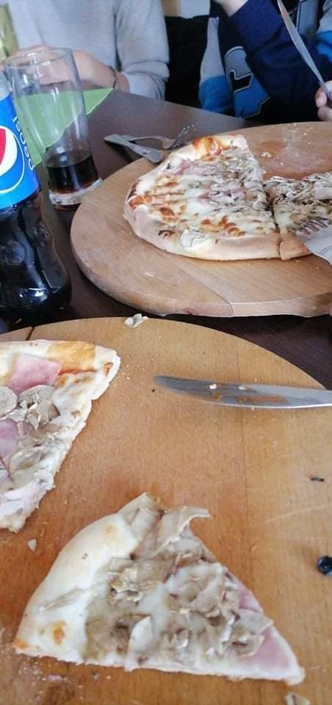
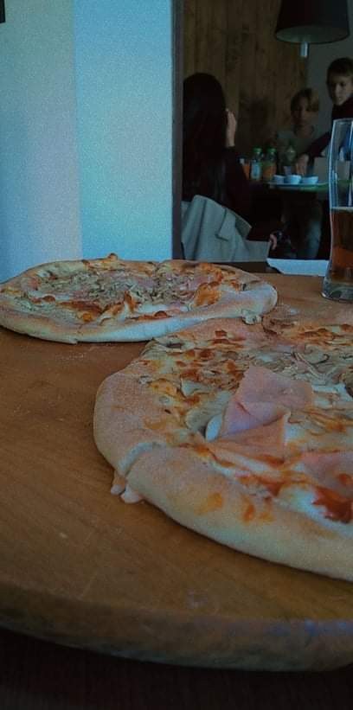
After salt mine we went to a pizza place. The pizzaplace was a copy of a The British pizza place. And the pizza was very delicios.

Slide 6
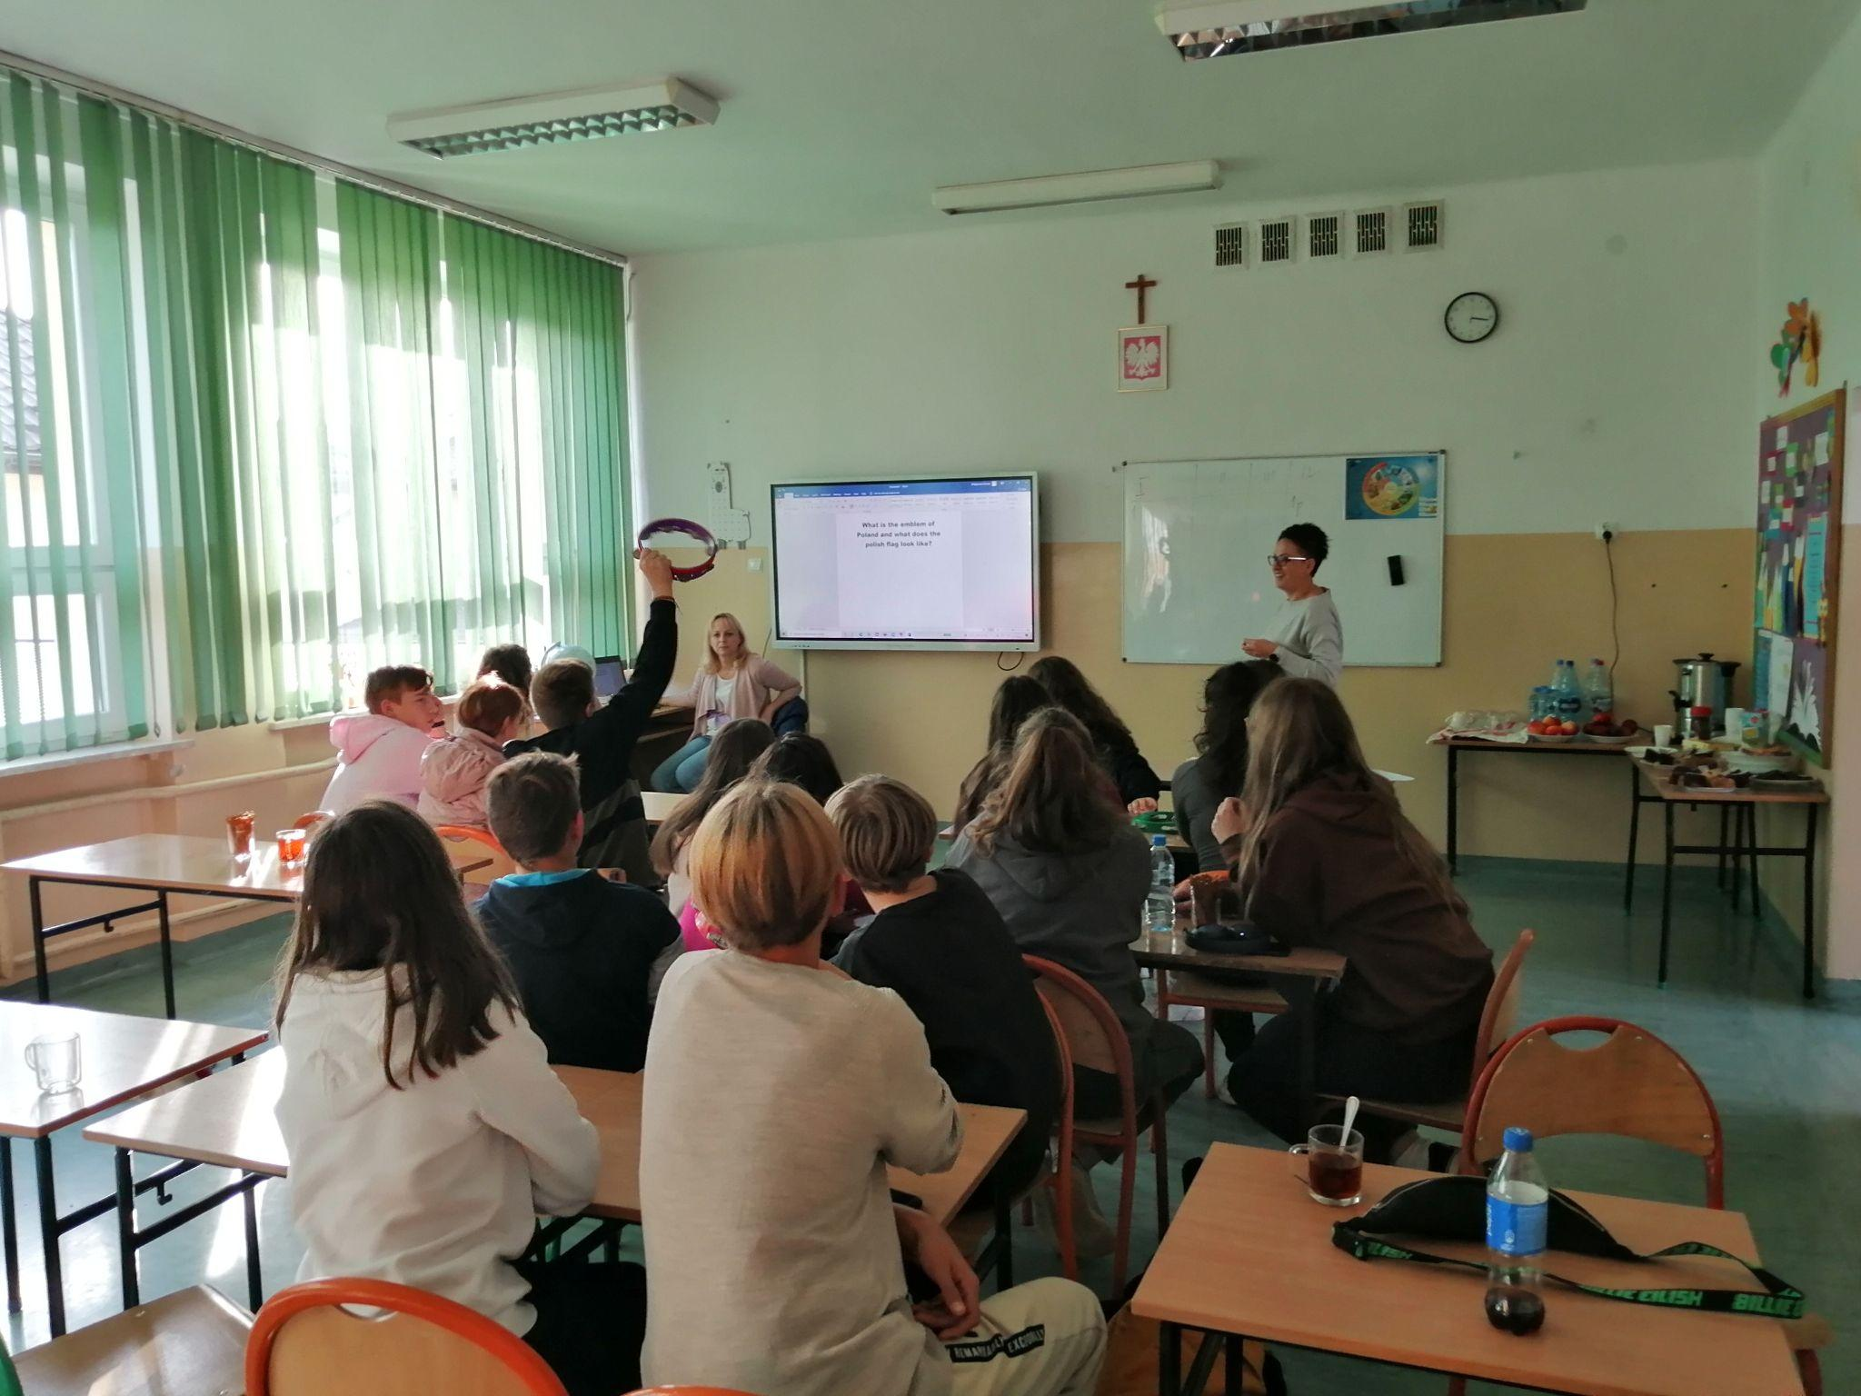
And after that we went back to the school and there we played a quiz. After that we said goodbye.

