Slide 1
Endes József

Slide 2
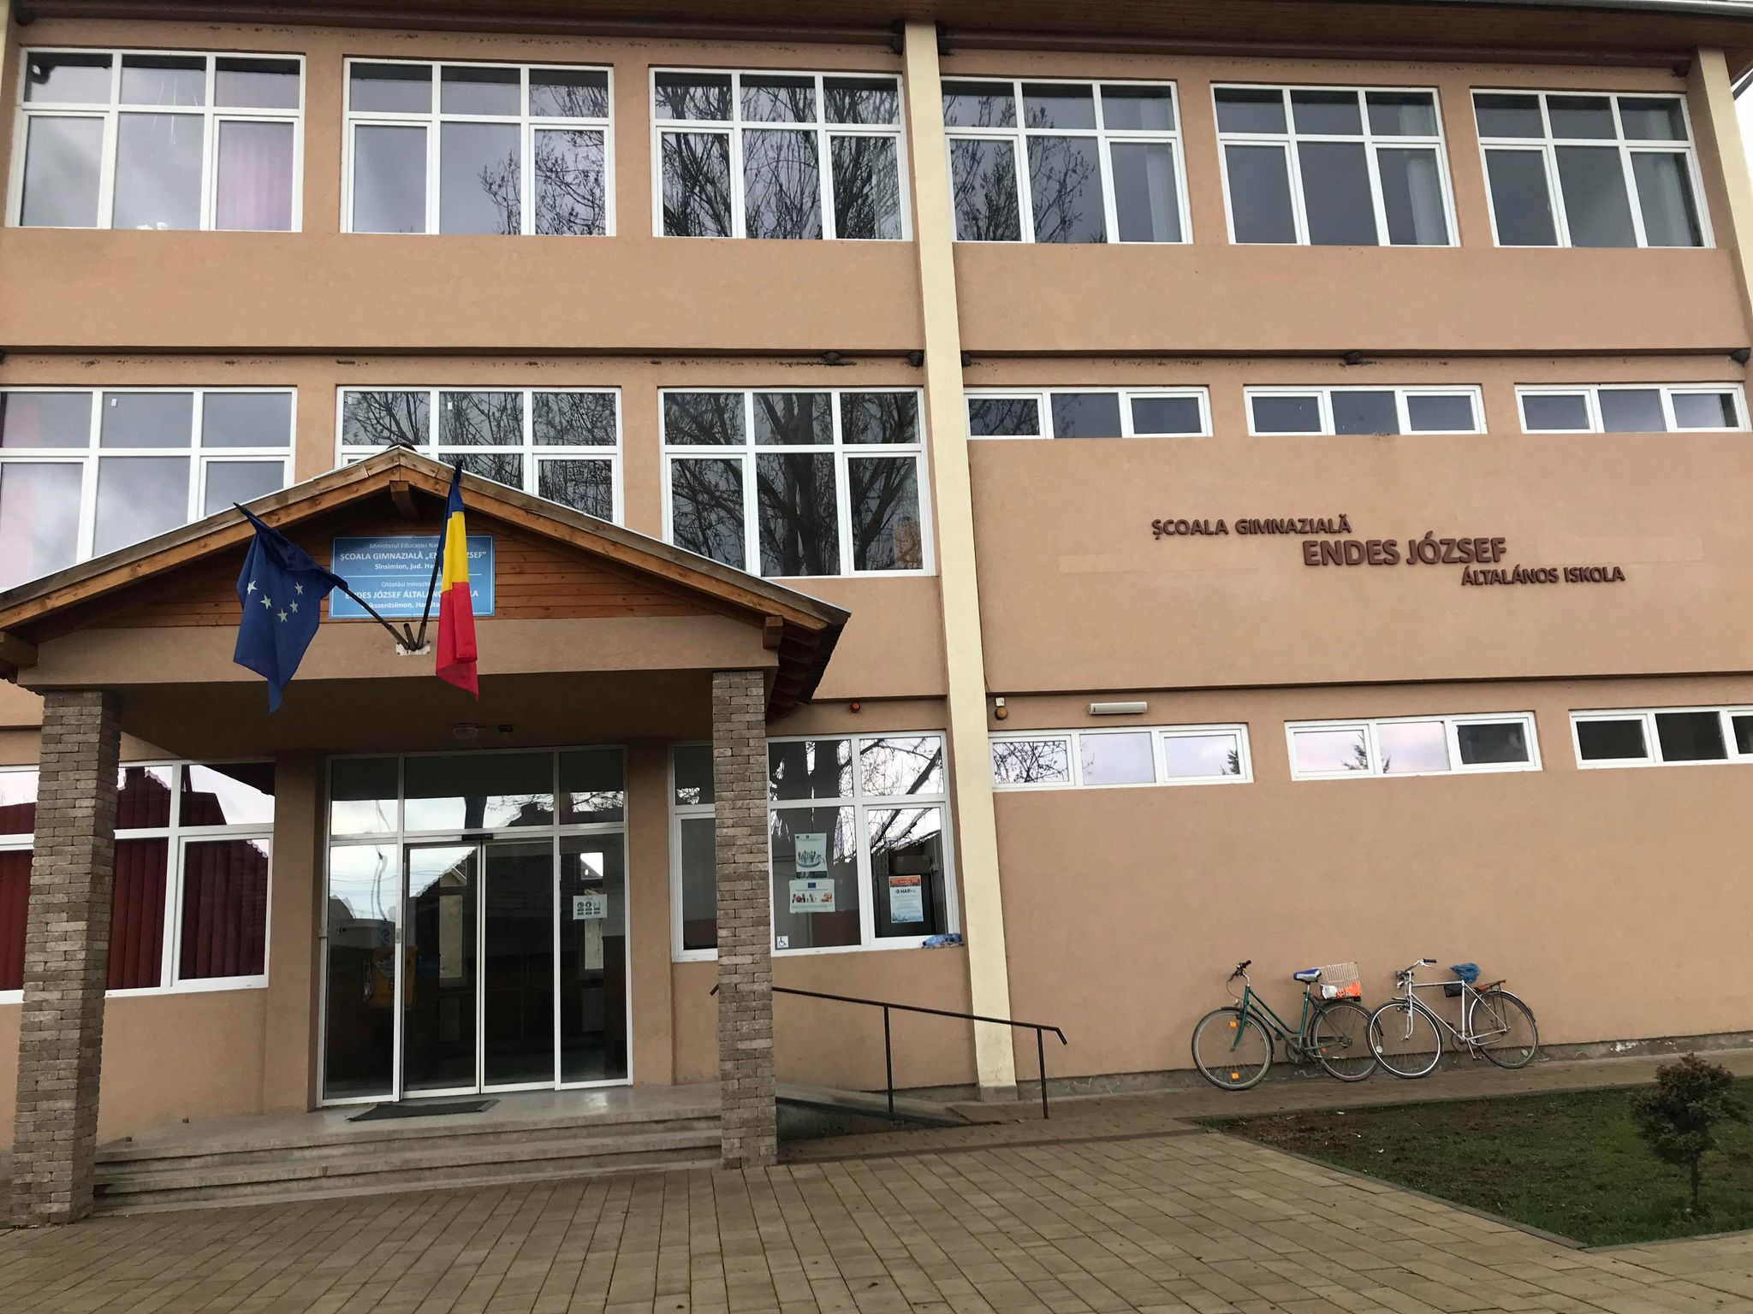
Our school took his name in 1991.

Slide 3
The Endes family was an important family from the 16th century. His father was János Endes, a local nobleman. His mother was Róza Bernáld.

Slide 4
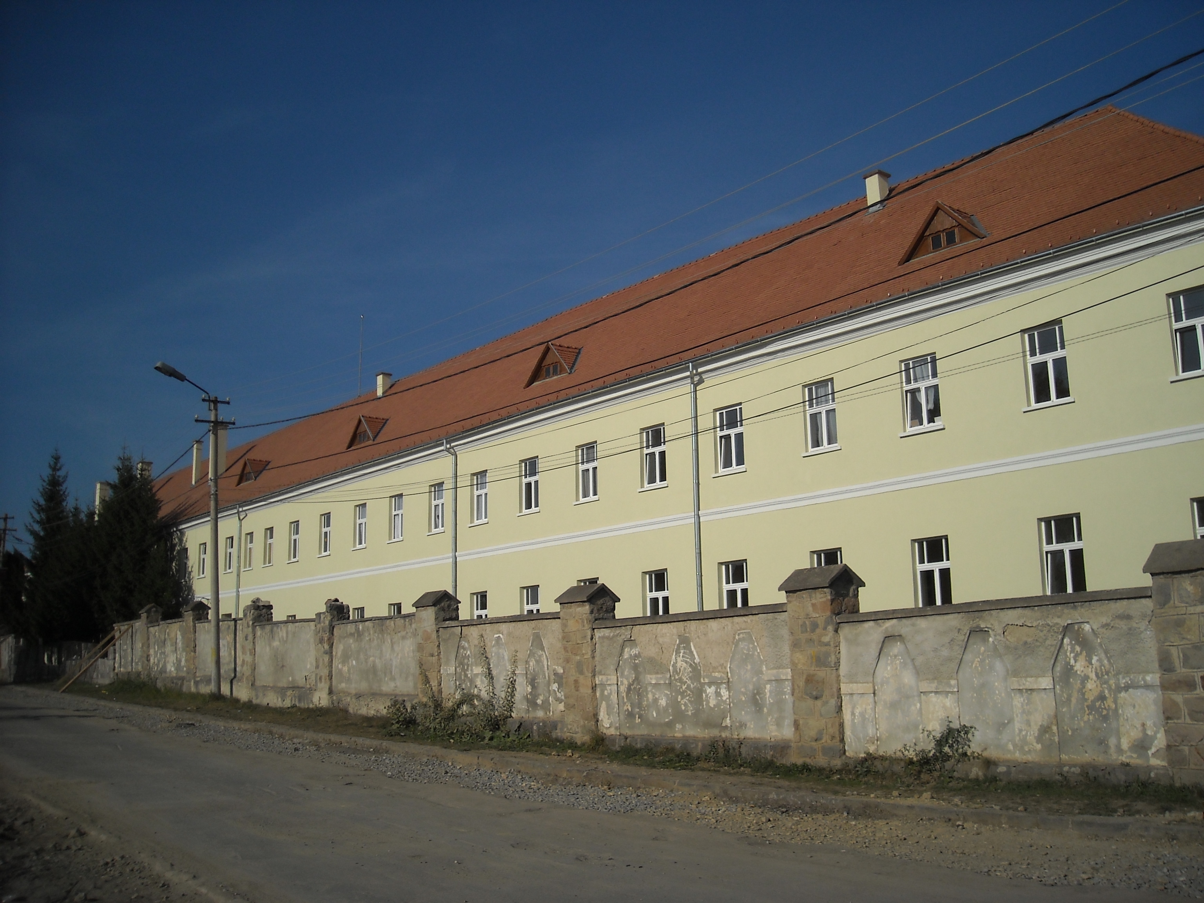
He was a student of the Csíksomlyó school in 1827. He continued his studies in Cluj-Napoca, where he studied law. In the 1840s we are among the officers of the Csíki border regiment.

Slide 5
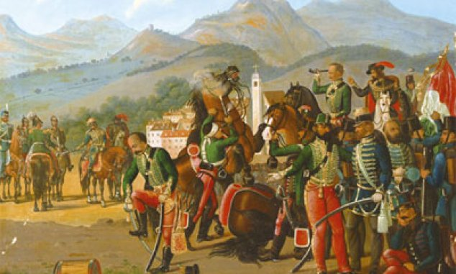
In the revolution and the war of independence of 1848-1849, Sándor Gál, commander of the Csíki Border Guard Regiment placed him in charge of the three Csíki battalions. His thorough training was appreciated by General Bem when he was promoted to captain and to major latter on.

Slide 6
After the fall of the War of Independence, József Endes was sentenced to death, then to 12 years in prison. In 1852 he was pardoned and released from prison. He returned to his homeland and took an active part in the social life of Csík.

Slide 7
He died in 1906 and was buried in Csíkszentsimon.

