Slide 1
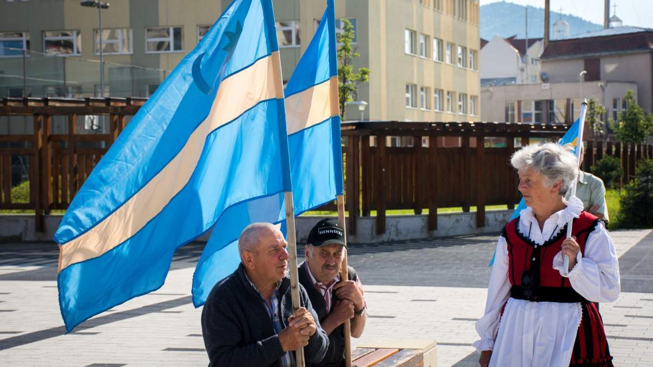
Szeklerland
Timea Sárosi end Roland Sárosi .

Slide 2
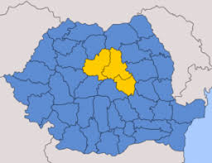
Installation
After the Defeat of Hungary in The First World War and the Trianon Peace Treaty of 1920, Szekelyföld became part of Romania.
With the second Vienna decision of 1940, Szeklerland was returned to Hungary in the present sense, in 1944 it was occupied by Soviet and Romanian troops, and with the 1947 Paris Peace Treaty, Szeklerland was again under the control of Romania.

Slide 3
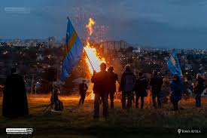
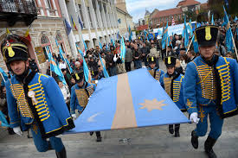
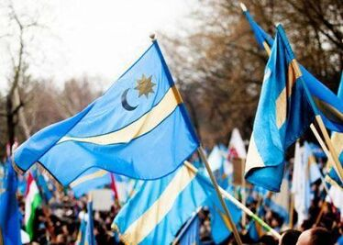
Installation 2.
During the regionalization of Romania in the 1950s, the outskirts of some settlements and villages belonging to the county of Szeklerland were taken from Ciuc to The Beákó county. Leaving the historical-ethnographic regions of Transylvania out of the attention of Aranyosszék, which is largely spoiled at present, only the majority of Hungarian speakers are here. Their share was 71.4% in 2002, 71.72% in 2011.

Slide 4
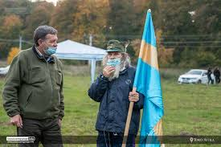
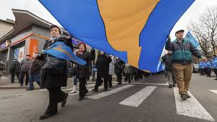
History
Among the letters of the Bishopric of Milkyvia, written between 1096 and 1228, there is a diploma that says that the Szeklers already lived in the present Szekler land in 1089. The date of the diploma is disputed. The first uncontested mention of the Szeklers after the conquest of The Szeklers was It falls during the reign of Stephen and is related to the battle of 1116 years near the Olsava River. During Géza LL, in 1146, in the Battle of the Lajta River, the Hungarian army also stood with the Hungarian army from szeklers and besenyekő.

Slide 5
History 2.
These reports probably only covered the Szeklers guarding the western border.
In 1210 it was related to the occupation of Bodon. The campaign was led by Saxons, underhokes, Szeklers and besens in the battle against Joachim of the Türje clan.
Description of the campaign lV. Bela survived in a 1250-year-old diploma, which was a 1250-year-old. It also contains a transcript of an older diploma of Andrew. At the beginning of the 13th century, the Szeklers had populous settlements in the regions of Sebes, Handd, Orbo and Daróv in southern Transylvania.

Slide 6
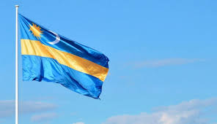
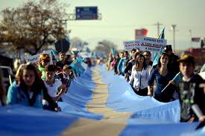
History 3.
The first szeklers in the mass settlement of Szeklerland were provoked by the settlement of the privileges of the Saxons of southern Transylvania. In 1224, András Ll placed the Saxon hospes of Transylvania under the control of the Ispan of Sibia.

Slide 7
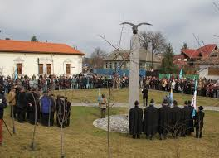
Administration
In today's sense, Szeklerland is located in Harghita, Covasna and Mures, and in a small part in bako, Brasov and Neamt counties. It is located in the historical Szeklerland region of Cluj and White Counties.
In today's sense, Szeklerland is 18 cities, of which there are seven municipiums and 134 municipalities, as well as parts of them.

Slide 8
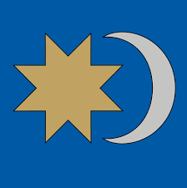
Religions
Most of them belong to the Roman Catholic denomination in Szeklerland, but they also have a large number of Reformed and Unitarian Szekler populations. The Romanians were mainly Greek Catholics, but in 1948 the Communist power banned the Greek Catholic Church and the faithful were declared Orthodox as Greek Easterners. Most of them were bosomed by the Romanian Orthodox Church, but few remained in their faith. At the same time, the number of Orthodox people in The Holy Land was increased by Romanians from Moldavia and Wallalava during communist times.

Slide 9
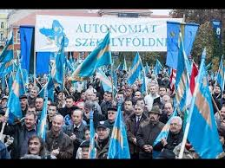
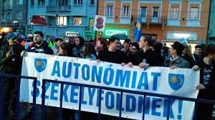
Population
According to the 2011 census data, the population of Szekelyföld is 810367 people in the area limited by the SZNT. The ethnic composition of the population is as follows :581159 (71.72%), Hungarian, 32809(4.04%)Romanian and 12888 (1.59%), other nationalities.
Of these :
urban population :388041 (47.74%) Rural population :422326 (52.26%) Men :406640 (50.26%) Female :403727 persons (49.82%)

Slide 10
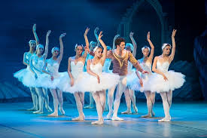
Sports
Ice hockey, basketball, handball, football team, dance, athletics, ballet, hip hop, horse riding, swimming and folk dance

Slide 11
Attractions
If you would like to visit Szeklerland or are only in the country it is worth visiting these beautiful places : Bear Lake, Killer Lake, Békási - Strait, Mohos Peat Foot, St. Anne's Lake, Saddle roof, Armenian Church of Gheorgheni, The Site of the Farewell to Csiksomjo, Gyimesi Strait, Ruins of Gyimesbükki Rákóczi Castle, Csíkszeredai Castle in Mikó.

Slide 12
Thank you so much for watching our live performance, we hope you enjoyed it.

