Slide 1
Csíkszentsimon (Sînsimion-Ro)
A Short Presentation of Our Village

Slide 2
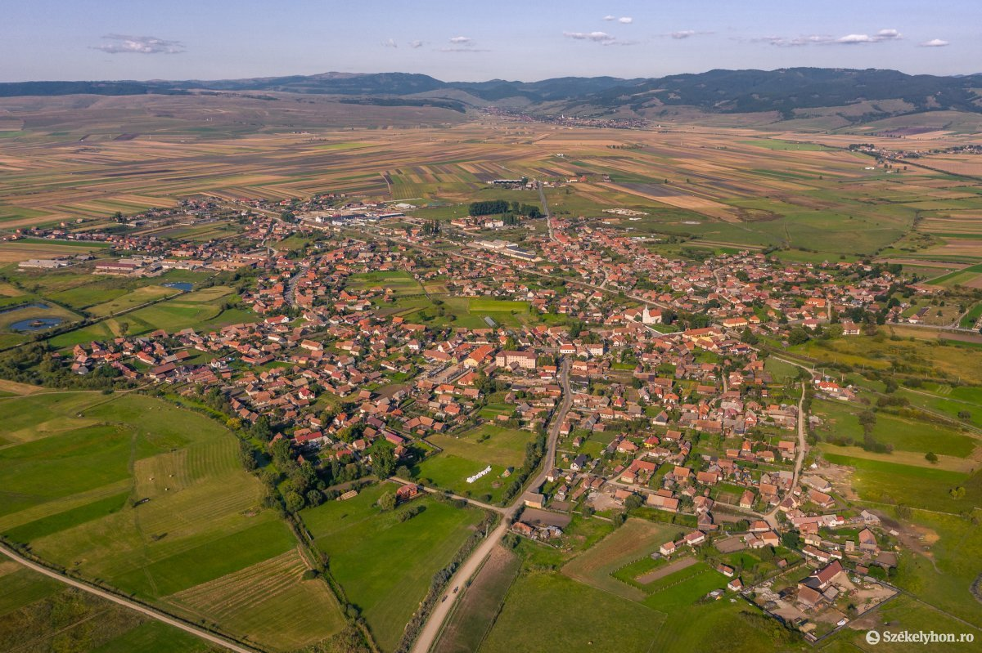
Geographical location of Csíkszentsimon
Te settlement is around 46.30 km2 (square kilometers)
In 2012 the village had 2438 inhabitants although it has increased since then.
The river Olt passes through the territory of Csíkszentsimon.
The closest city is Csíkszereda (Miercurea Ciuc-Ro.)

Slide 3
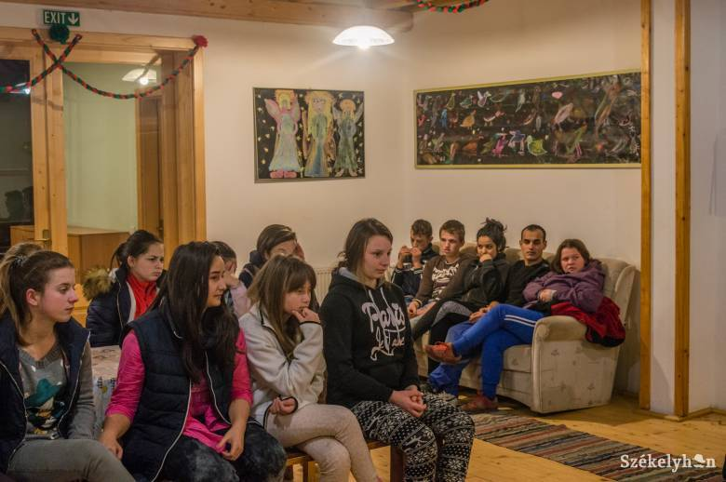
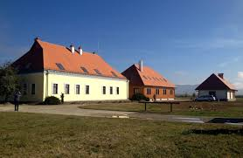
Bőjte house
The St. Francis Foundation was founded by the Franciscan monks of Transylvania in the spring of 1993.
It aims to help the little ones, those who have no one else!

Slide 4
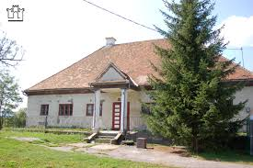
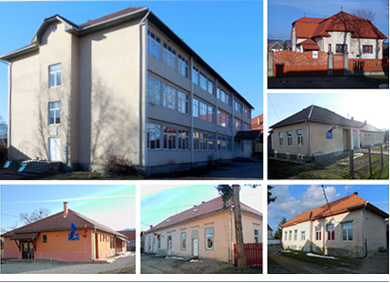
Endes József
The Endes family comes from Csíkszentsimon.
Endes József was a colonel in the War of Independence from 1848. After the war he was inprisoned. After 3 years he got out and returned to his home and took part in the region’s social life.
Our school was named after him.

Slide 5
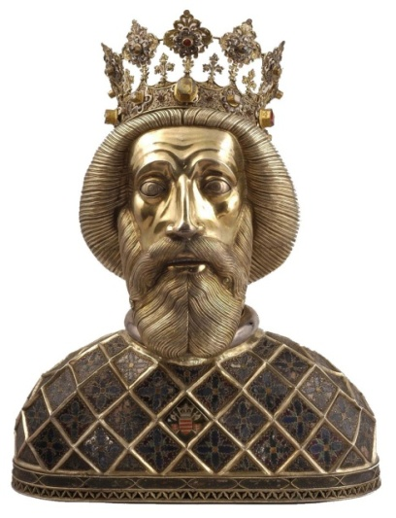
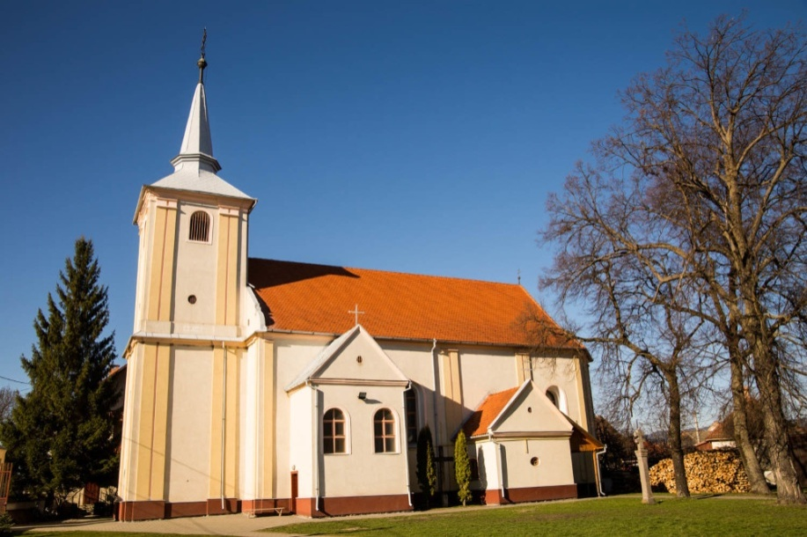
King Szent László
Sent László (St. Ladislaus) was a knight king, the protector of the Hungarian Christianity and the kept the nation together. It is highly respected by the Roman Catholic community of Csíkszentsimon.
The church was built in his honor between 1823 and 1835.

Slide 6
Csíki Sör Gyár –The Csíki Beer Factory
It was built by Attila Lénárd in
2014.
It became a tourist attraction of the region

Slide 7
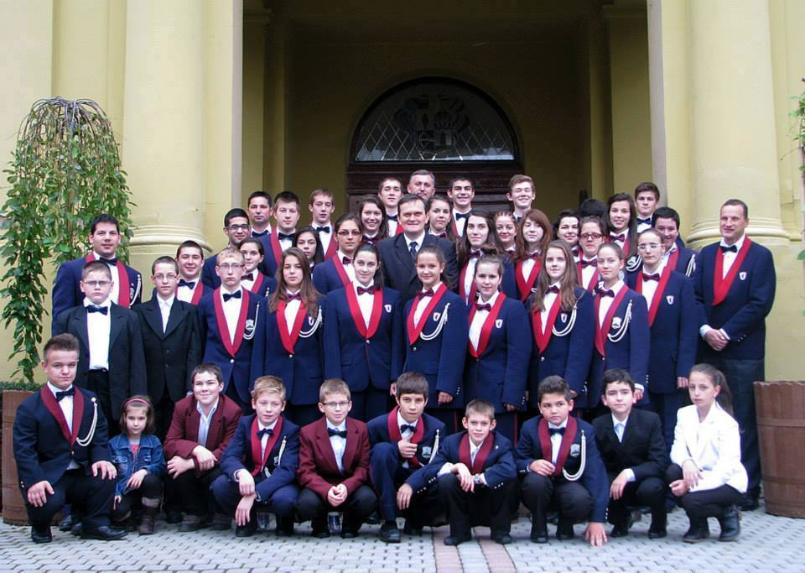
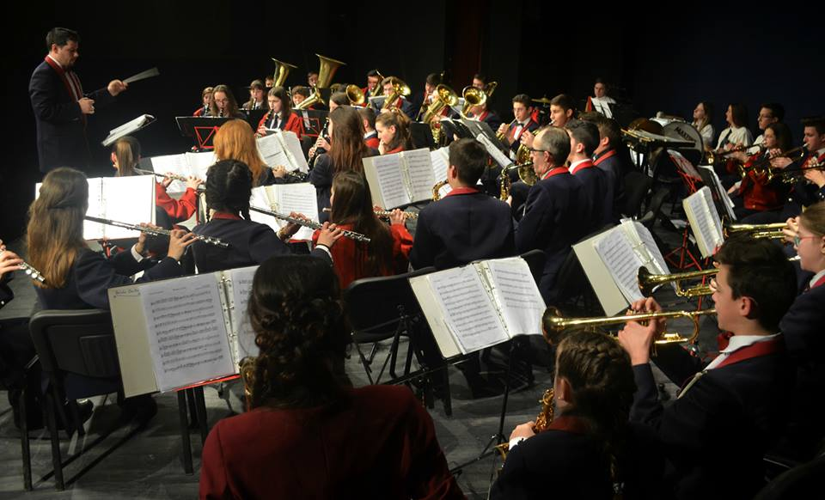
The Brass band
The Csíkszentsimoni brass band was formed in 2008. The band started wiht 30 members but it is constantly expanding and currently has 74 members.
Árpád Sándor is the conductor.
The band’s reputation has spread across countries.

