Slide 1
HISTORICAL EVENTS AND CHARACTERS OF THE POLISH NATION

Slide 2
I. Historical events having a significant impact on the fate of Poland and Poles.

Slide 3
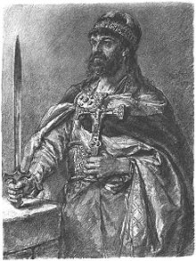
Polish baptism (966 year)
Baptism of Mieszko the first is also considered the baptism of Poland. Christianity in Poland was initiated by Mieszko I. The baptism took place on the island in Ostrów Lednicki. Mieszko I was baptized because he did not want to expose Poland to attacks by other countries that made up the Christian community.

Slide 4
Battle of Grunwald (1410 year.)
It was one of the greatest battles in the history of medieval Europe, fought between the Teutonic Order and the armies of Poles and Lithuanians.
The battle ended with a Polish-Lithuanian victory, but the capital of the order; Malbork was not conquered.

Slide 5
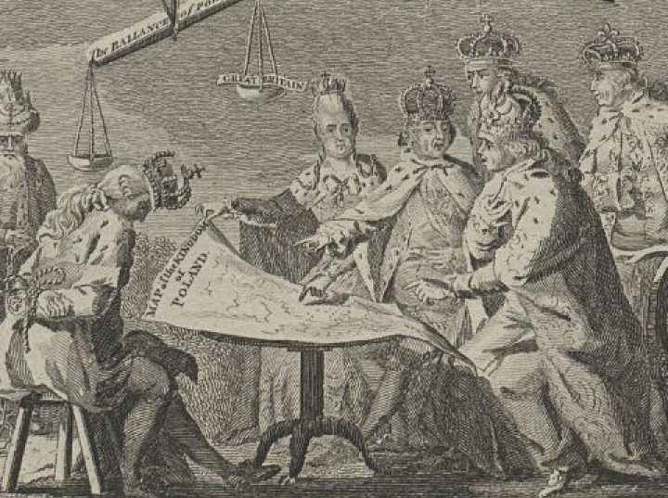
I partition of Poland
It took place in 1772 through Prussia, Austria and Russia. As a result, Austria was granted lands reaching Zbrucz and Lwów. Russia received Polish Livonia and the eastern ends of the Polish-Lithuanian Commonwealth. Prussia received Warmia and Royal Prussia, but without Gdańsk and Toruń.

Slide 6
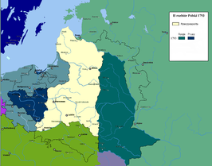
II partition of Poland by Russia and Prussia
On October 23, 1793, the Russian-controlled Seym in Grodno agreed to the Second Partition of Poland, as a result of which Prussia received Wielkopolska, Gdańsk, Toruń and the land of Sieradz. Russia seized wide areas of the Kiev and the Minsk regions. Austria, which was at that time waging a war with France, did not participate in the Second Partition.

Slide 7
III partition of Poland by Russia, Austria and Prussia
In 1795, Russia, Prussia and Austria decided to partition Poland for the third time. Prussia took part of Mazovia with Warsaw, Austria took the rest of Mazovia and the territory between Pilica and Bug, while Russia-Lithuania, Belarusian lands, Polesie and Volhynia. Stanisław August Poniatowski relinquished the crown. Poland lost its independence and disappeared from the map of Europe for 123 years.

Slide 8
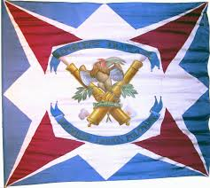
Establishment of the Polish Legions in Italy
After the fall of the Republic of Poland, most of the Polish population emigrated to France. In 1797, the French government agreed to create the Polish Legions. They were headed by Jan Henryk Dąbrowski. Legions were made up of emigrants and Poles who had either been captured or had gone over to France themselves. In 1797, in order to motivate the Poles to continue fighting, Józef Wybicki, one of the Legions' officers, wrote the text of the Songs of the Polish Legions in Italy.

Slide 9
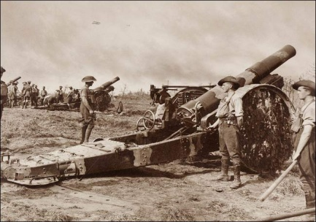
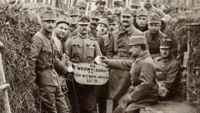
I World War (1914-1918)
105 years ago, 28 July 1914 year., World War I broke out. It was called the "Great War" by those still alive
The immediate cause of the outbreak of the war was the murder in Sarajevo, on June 28, 1914, of the heir to the Austro-Hungarian throne, Archduke Franz Ferdinand. The killer was Gawriło Princip, a young Serbian nationalist, member of the "Black Hand" organization
33 countries took part in the war. About 10 million soldiers died, and another as many were injured. There was an economic crisis in almost all the European countries that took part in the war.

Slide 10
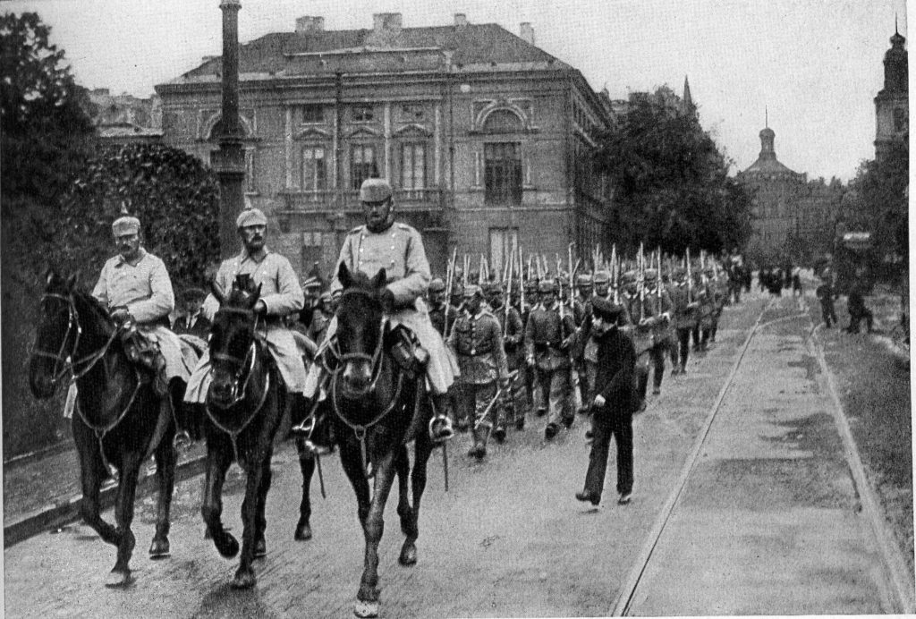
Poland's regaining of independence
On November 11, 1918, after 123 years of absence from the political maps of Europe, Poland regained its independence. Poland's regaining of independence was a gradual process. A watershed moment was the arrival in Warsaw of Józef Piłsudski, who was appointed commander-in-chief of the Polish army and then Interim Head of State.
.

Slide 11
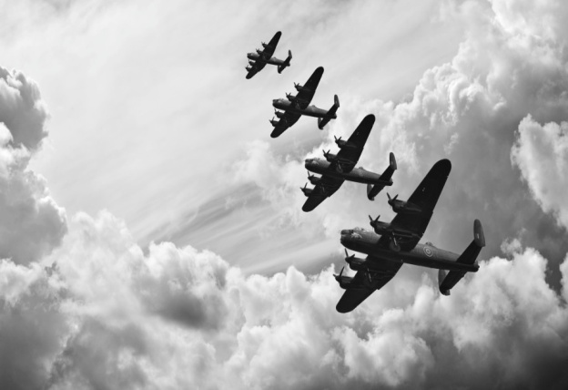
The Second World War
World War II began on September 1, 1939 with an attack by Germany on Poland. World War II was the greatest conflict in human history. The total number of victims is estimated at more than 60 million people. Poland was particularly affected. It is estimated that between 1939 and 1945 it lost more than 20% of the population. The war officially ended on 2 September 1945.

Slide 12
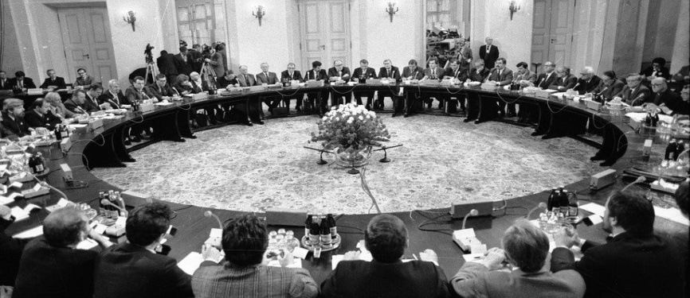
Round Council Table
On February 6, 1989, the Round Table began in the Governor's Palace in Warsaw. The agreements between the solidarity opposition and the authorities, signed on 5 April 1989, have had a significant impact on the collapse of the communist system and political change not only in Poland, but also throughout Central and Eastern Europe.

Slide 13
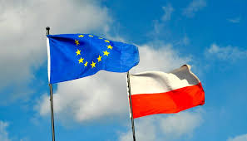
Poland joining The European Union
1 May 2004 Poland, together with Cyprus, the Czech Republic, Estonia, Lithuania, Latvia, Malta, Slovakia, Slovenia and Hungary, has joined the European Union. This was the largest ever enlargement of the EU. Poland has been in the Union for 15 years. More than a decade ago, we launched one of the most fruitful alliances in the history of Poland.

Slide 14
II. Well-deserved Poles

Slide 15
Bolesław Chrobry (967 in Poznan – 17.06.1025 in Krakow)
The Polish from the Piast dynasty, the first crowned king of Poland. In the years 1003-1004 he was the Prince of Bohemia as Bolesław IV. He was the son of Mieszko I. He took power over Poland in 992r.

Slide 16
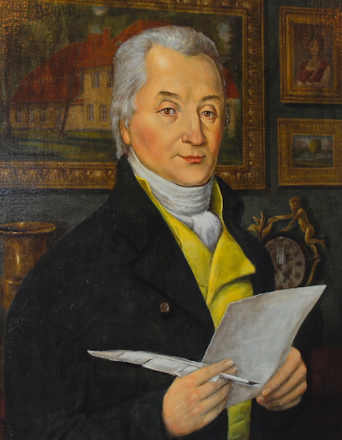
Józef Wybicki (29.09.1747 in Będomine – 10.03.1822 in Manieczka)
Polish writer and politician. Author of the words of the Song of the Polish Legions in Italy later known as "Mazurek Dabrowski", which in 1927 officially became the national anthem of the Republic of Poland.

Slide 17
Józef Piłsudski (5.12.1867 in Zułowo near Vilnius – 12.05.1935 in Warsaw)
Independence activist, military commander, politician, Head of State and Marshal of Poland. Twice he served as prime minister and formed sanitation governments. His main objective was the struggle for the independence of Poland. On November 11, 1918, the Regenerative Council transferred military power to him. This day is the symbolic date of Poland's regaining independence.

Slide 18
John Paul II( 18.05.1920 in Wadowice – 2.04.2005 at the Vatican)
His name was Karol Wojtyła. Polish Roman Catholic priest, bishop, archbishop, cardinal, and from 16.10.1978 to 2.04. 2005 - Pope. A sensitive and wise man who understood people and their problems. The election of Karol Wojtyla as pope, and subsequently his pontificate, contributed greatly to the overthrow of communism in Central and Eastern Europe and the return of freedom and democracy in this part of the world.

