Slide 1
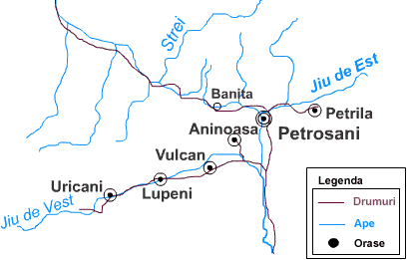
Touristic Opportunities in Jiu Valley

Slide 2
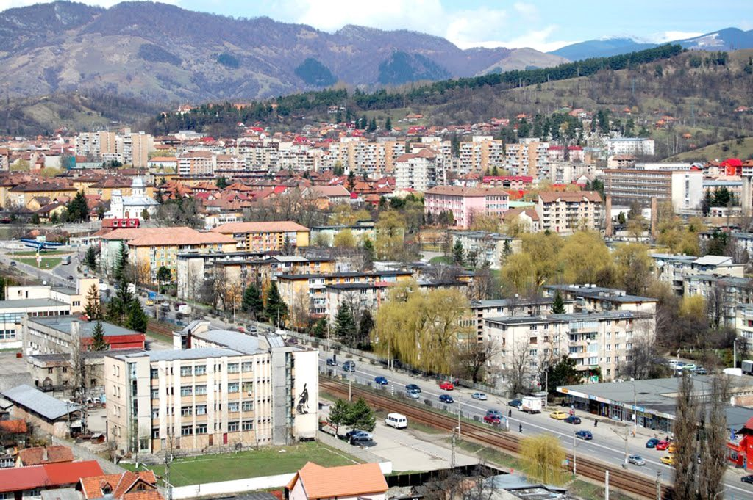
Jiu Valley is a mountain depression that lies on the river Jiu. It is well known for its natural resources, which are exploited by the Romanian state, from pit-coal mines. The mountain range, that surrounds it, are the Retezat – Godeanu Group of the Carpathian Mountains. The main towns in this area are: Petroșani, Vulcan, Petrila, Aninoasa, Lupeni, Uricani. In folk speaking, Jiu Valley refers to Petroşani Depression in the southern of Hunedoara County. The autochthonous people of the area are known as momârlani.

Slide 3
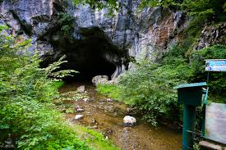
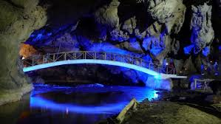
Touristic Attractions
1. Peștera Bolii / Bolii (Disease) Cave.
Bolii (Disease) Cave is considered one of the most spectacular touristic attractions in Jiu Valley. It is situated at about ten kilometers distance from Petroşani, at the feet of Băniţa fortress and Retezat and Sebeş Mountains. The length of the cave is of about 500 meters, and in the past it used to be crossed on horseback.

Slide 4
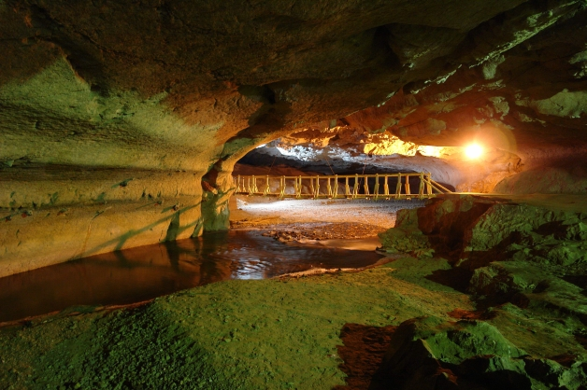
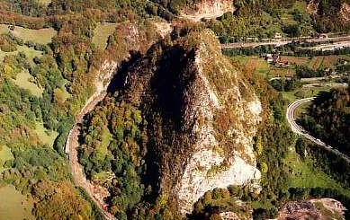
Bolii Cave has got a remarkable acoustics , and that’s why , nowadays, in the spacious cave, cultural events are often held.

Slide 5
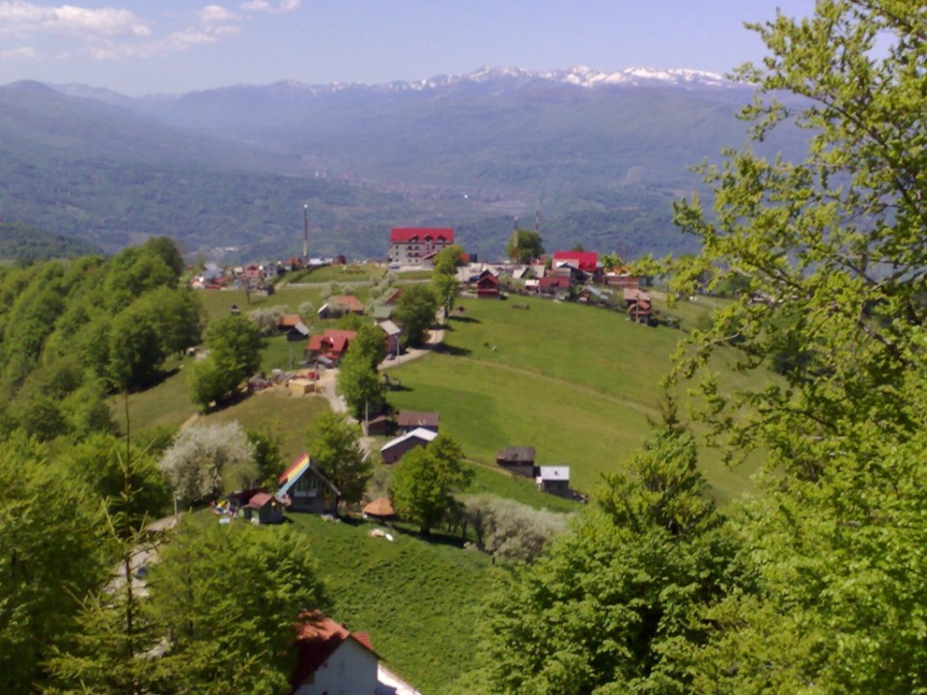
2.Munții Parâng - Parâng Mountains
Parâng Mountains lie on the largest surface among all the mountains in Romania and the main touristic attractions for those who are fond of trips and come in Jiu Valley. Parâng Mountains are crossed by the highest road in Romania, Transalpina, that is at an altitude of 2,000 meters high. There are also many glacial lakes and the most known are Câlcescu and Roşiile. And the highest mountain top is Parângul Mare (Big Parâng) of 2,519 meters high.

Slide 6
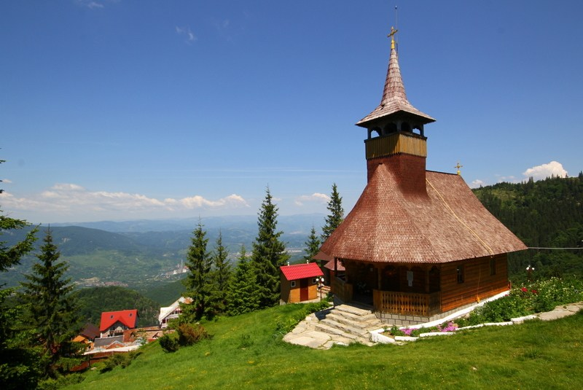
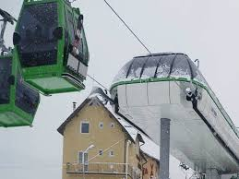
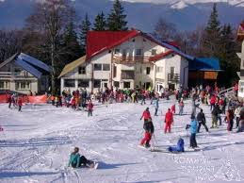
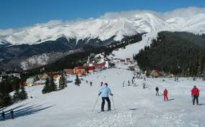
3. Straja
Straja Mountain Resort, that lies in Vâlcan Massif, became one of the mot important touristic attractions in the western part of the country in the last years. During the winter it is especially visited by ski lovers, while during the summer time, those tourists who arrive in Straja are invited on hikes on the mountain paths that start from the amusement park, situated at 10 kilometers distance from Lupeni.

Slide 7
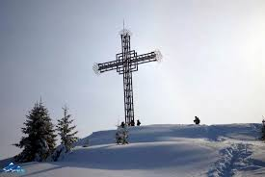
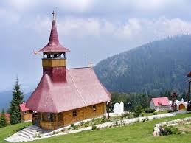
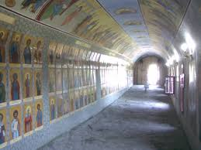
In the memory of those over 800 soldiers who lost their lives during World War I, on the top of the mountain has been built, St. Constantin and Elena Hermitage, that has become one of the important touristic sights in the area. Some of these brave heroes were buried in the Heroes Graveyard in Lupeni.

Slide 8
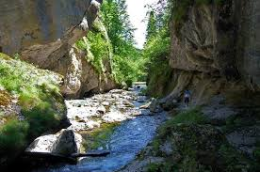
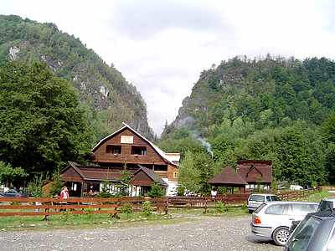
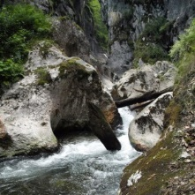
4. Cheile Buții -Buţii Keys
This touristic sight is situated at about 30 kilometers away from Petroşani, on DN66A, being closer to Uricani. The place I preferred by mountain trip lovers, and of those who are fond of speleological activities and also by those who enjoy climbing.

Slide 9
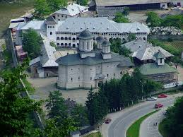
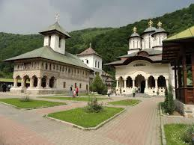
5. Mănăstirea Lainici -Lainici Monastery
Lainici Monastery is the most important in this region of Jiu Valley, being a monks settlement, situated at 25 kilometers distance far from Petroşani, in Jiu Canyon. The old church of the monastery was built at the beginning of the 19th century and is a historic monument too.
At present, Lainici Monastery is one of the most visited religious settlements in Jiu Valley.

Slide 10
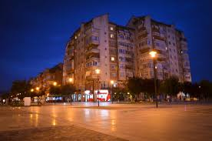
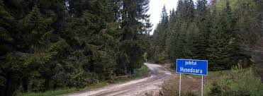
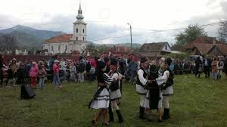
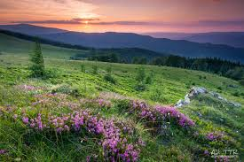
We are waiting eagerly for you in Jiu Valley!

