Slide 1
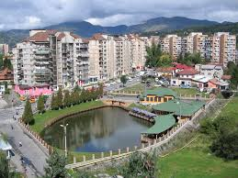
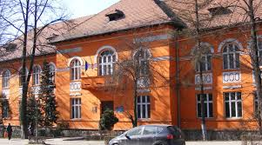
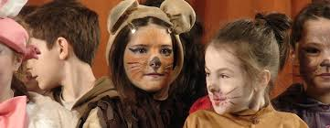
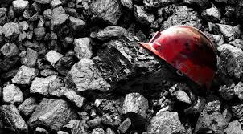
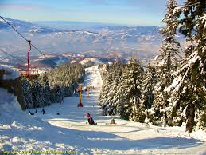
Welcome to Petroşani- Romania!

Slide 2
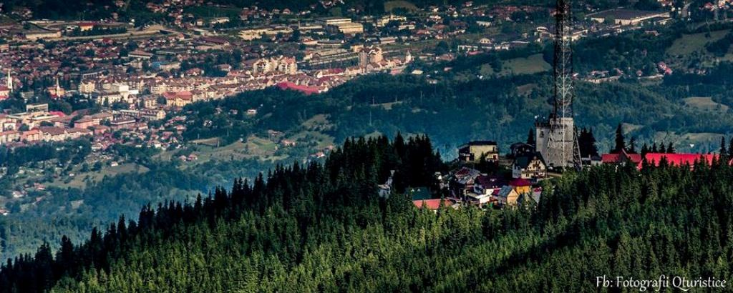
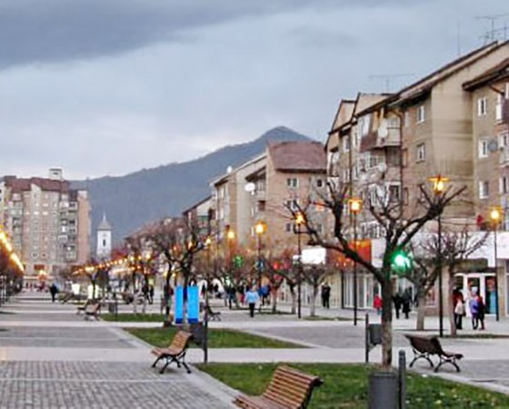
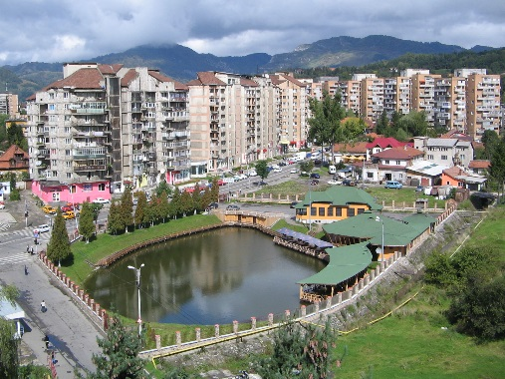
The description of the community. Petroşani Town-Romania
Petrosani is a city in Hunedoara County, Romania. It has a population of 34,331 inhabitants according to the census of 2011 and is located at an altitude of 615-620 m in Petroşani Depression or popular "Jiu Valley", is the main city of this area.
It is recognized as a mining town, this being the headquarters of the National Coal Company, which includes several mines.

Slide 3
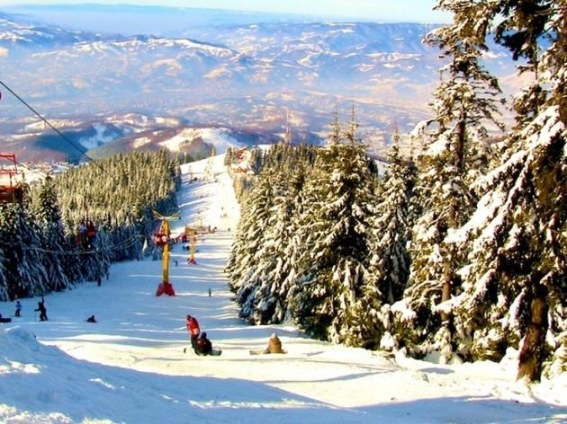
One of the most pleasant things about Petroşani is that being situated in Jiu Valley is surrounded by superb mountains. One of the most beautiful mountain resorts is Parâng which is not far from Petroşani, at a distance of about 5 kilometers from the town. Parâng resort is situated at a height of about 1 800m. Its slopes are situated in the heart of the mountains, being appreciated by all those who love winter sports

Slide 4
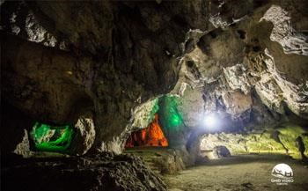
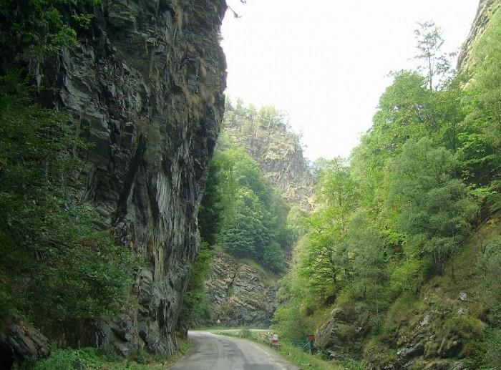
“Bolii” Cave, which is situated in the north part of the town, is another nice and interesting place that can be visited if you come to Petroşani.
“Jieţului Keys” are situated along the River Jieţ were you can see the amazing landscapes with its wild, high, stone walls and unexplored caves.

Slide 5
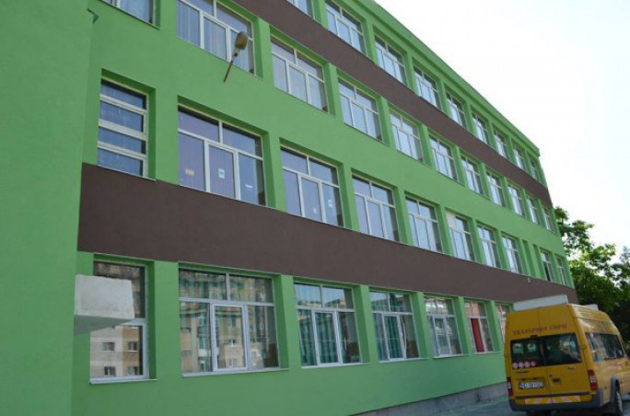
Presentation of the school
“I.G.Duca” Secondary School is situated in the centre of the municipal town Petroşani, in Hunedoara county/region. Our school carries out its education activities in two buildings which are situated to a small distance one from another. The main building is on Şt.O.Iosif Street, No.4 and the second one is on 1 Decembrie 1918 Avenue. It is one of the biggest schools in our county and including different types of education for a big number of pupils of different ages (5 to 16 years old): pre-school education, primary school education, secondary school education, inclusive education and additional musical education.

Slide 6
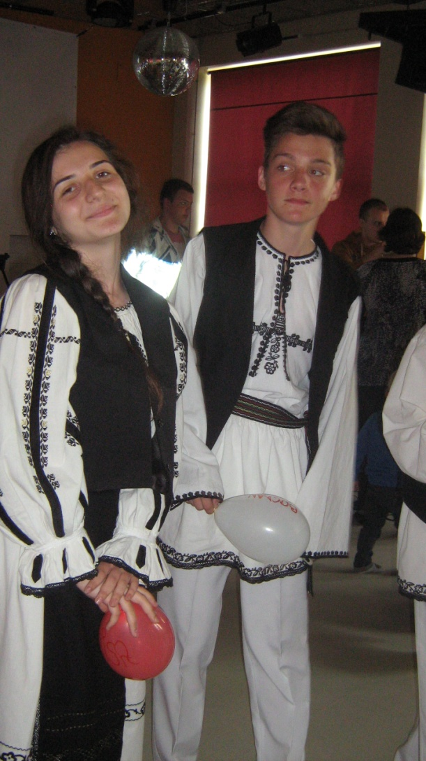
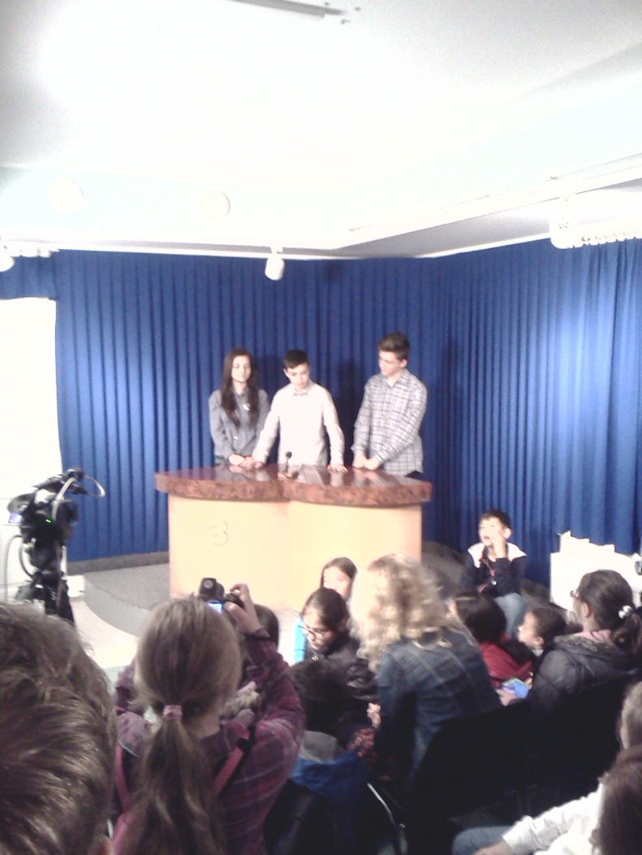
Our school has got qualified teachers and a varied school population. It has at its disposal good resources and good equipment, being the property of the City Council Petroşani.
Some of the types of educational activities offered to the Roma children at our school include programs that aim at the integration of these pupils into the mass education and the assistance for the pupils with special needs through compensatory activities and their involvement in all the extra-curricular activities.

Slide 7
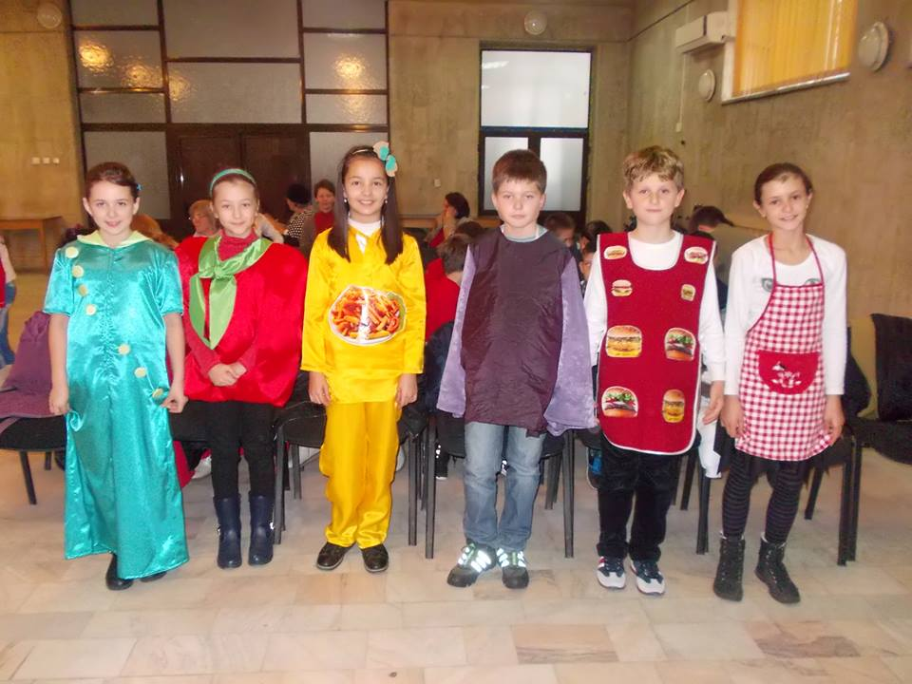
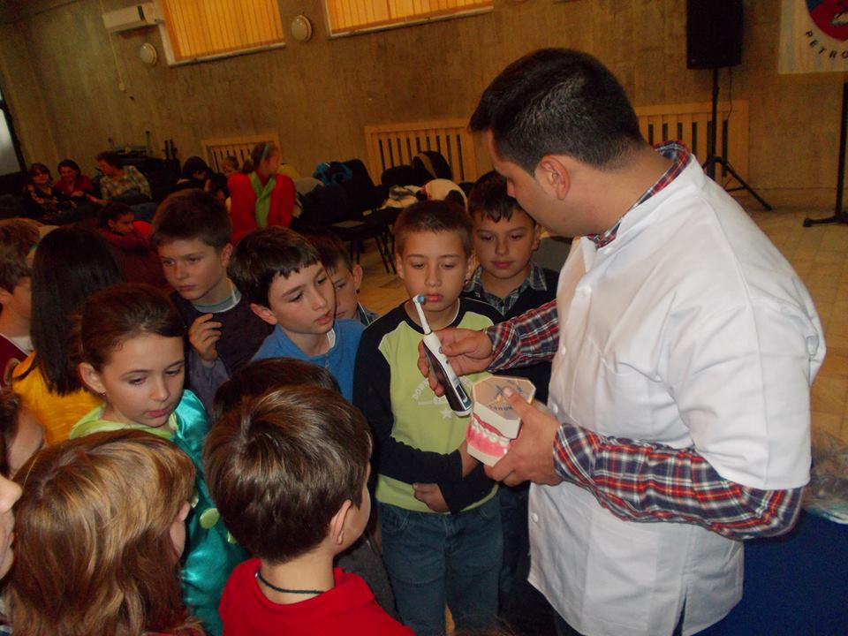
We are a very active school with a lot of educational activities. So instead of a boring presentation, I'll let the pictures speak, because a picture is worth more than a thousand words.

Slide 8
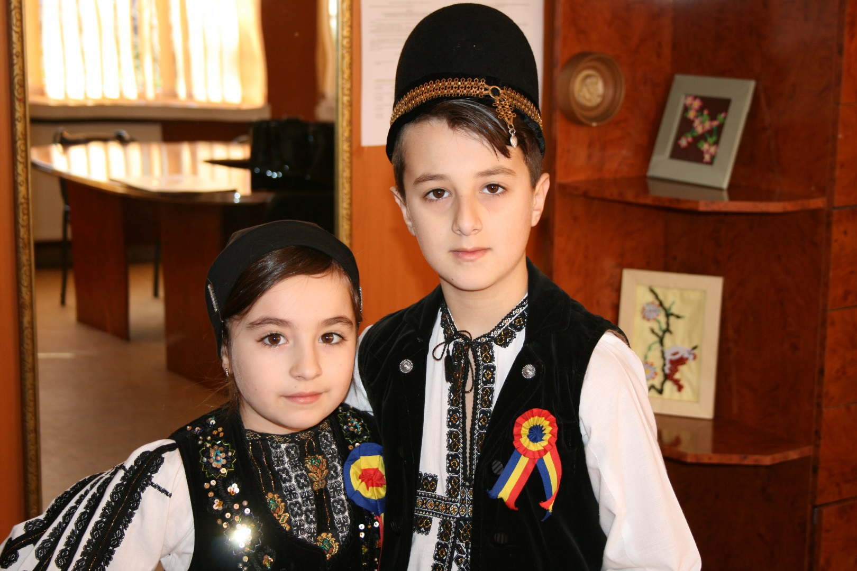
Our beautiful Romania !

Slide 9
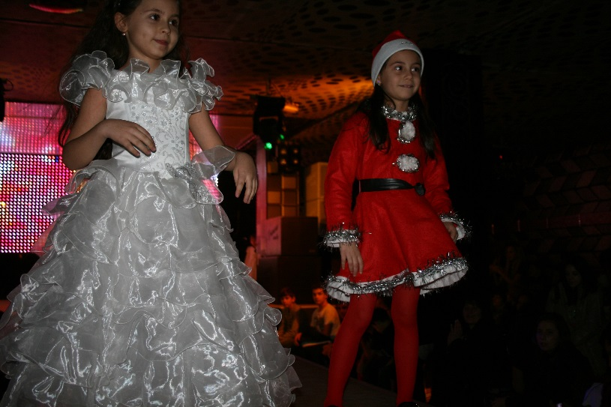
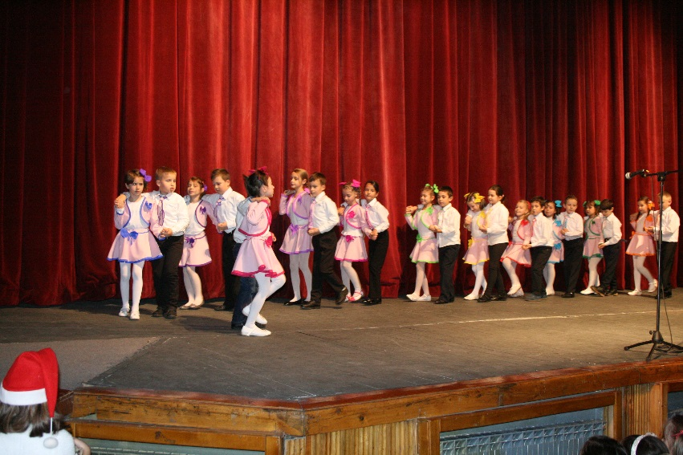
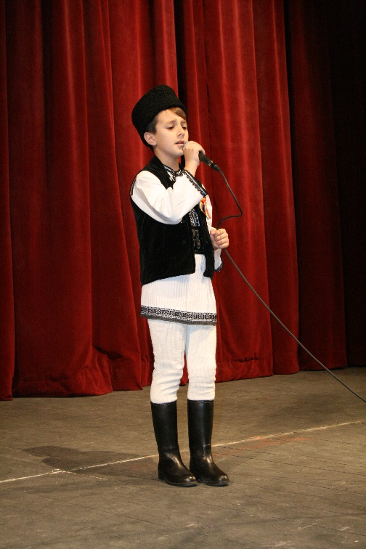
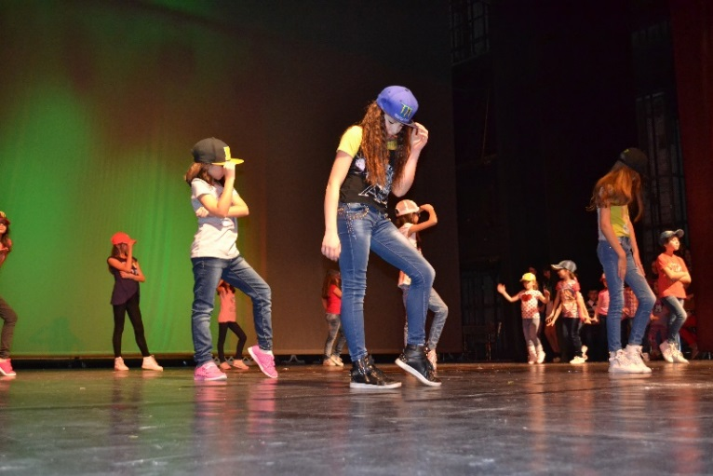
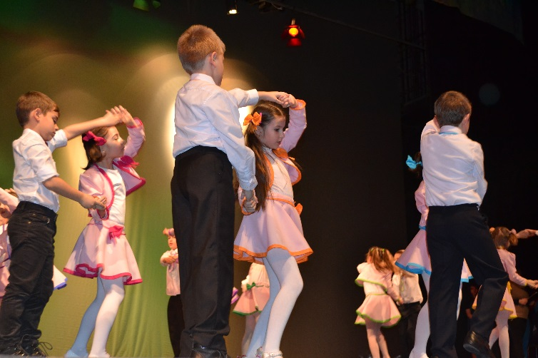
Our shows for charity!

Slide 10
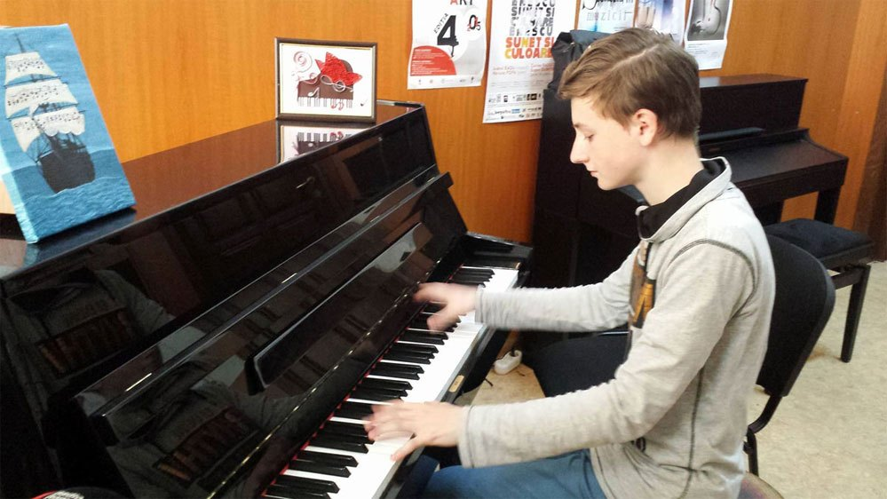
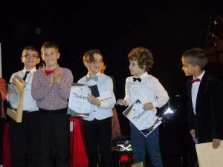
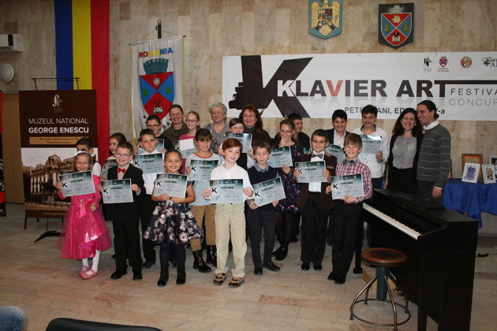
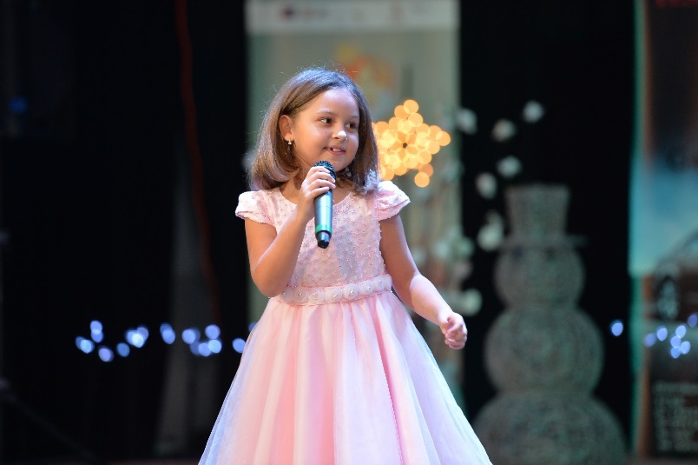
Our talented pupils from the additional musical education!

Slide 11
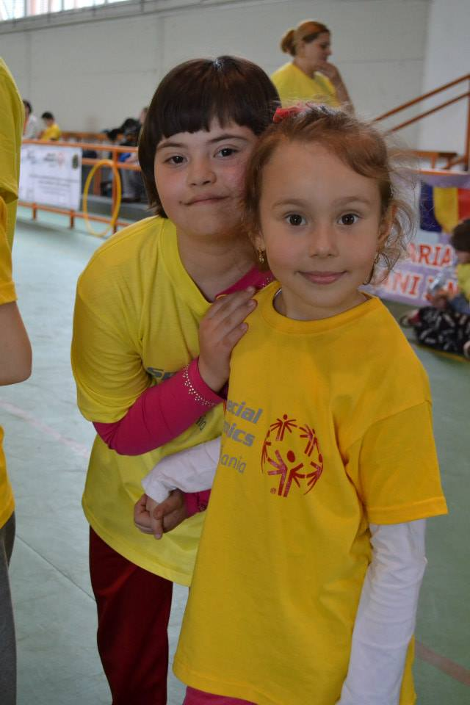
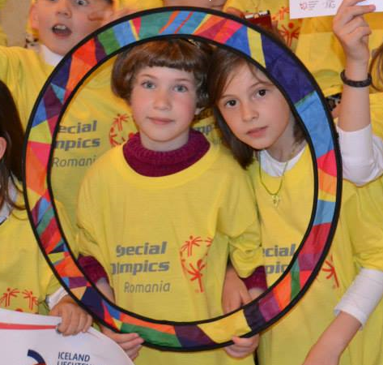
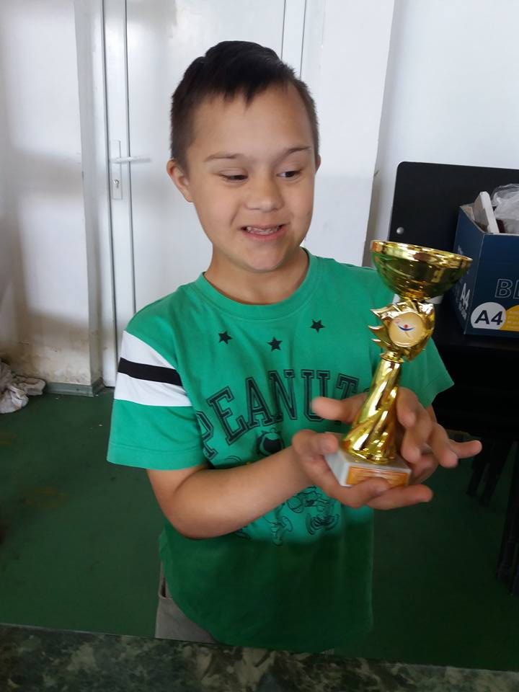
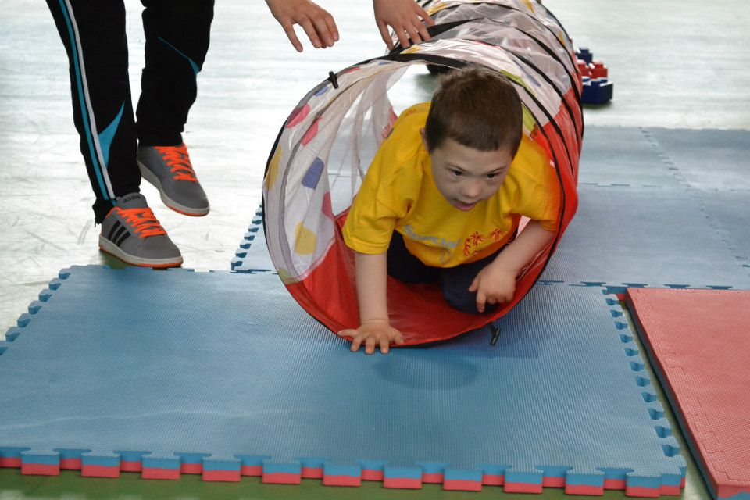
Our special pupils from the inclusive education!

Slide 12
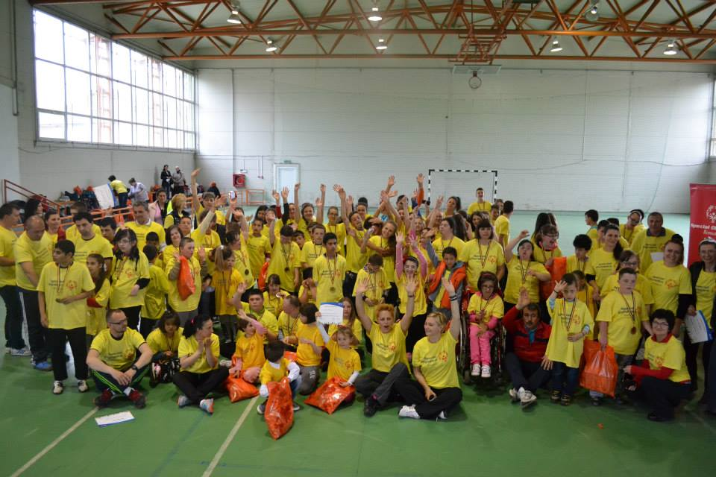
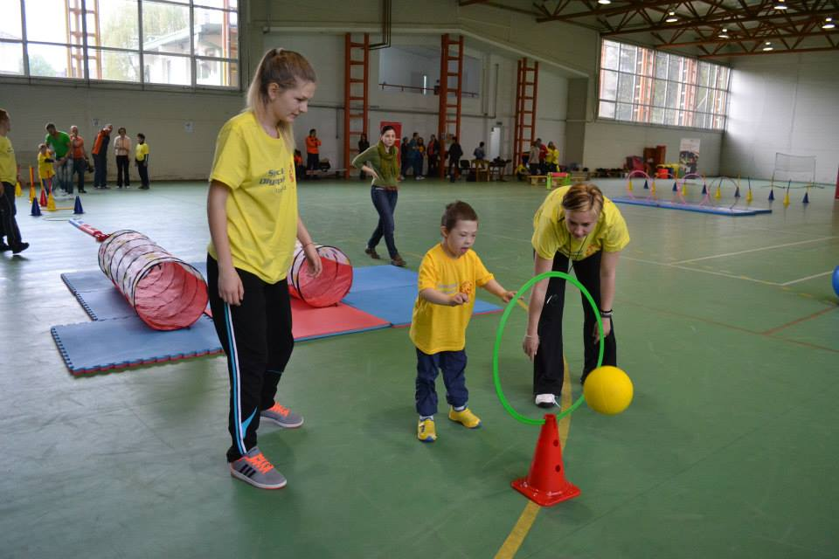
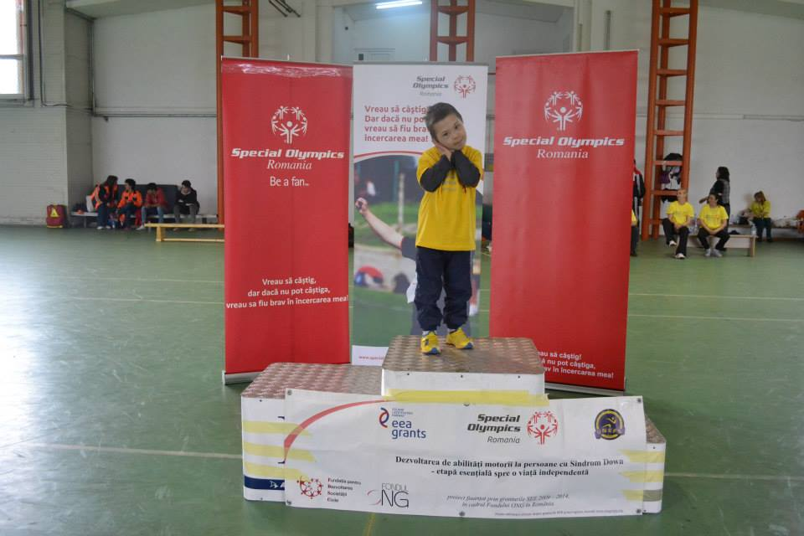
Special Olympics Games!

Slide 13
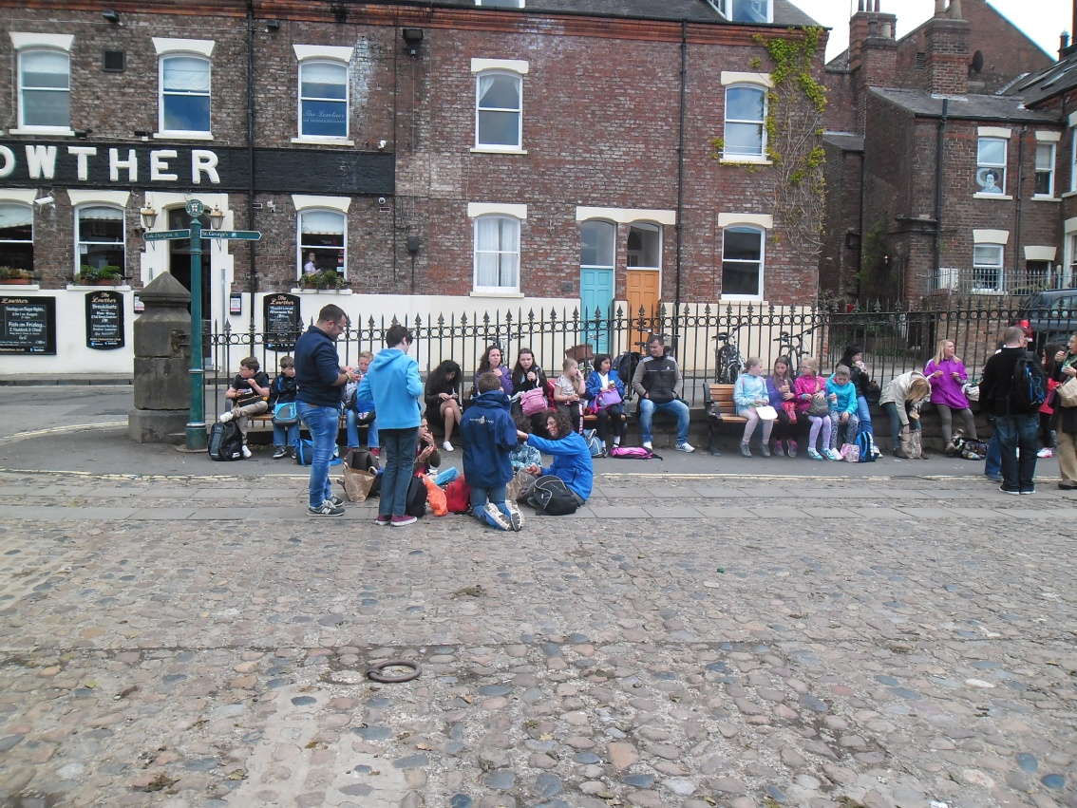
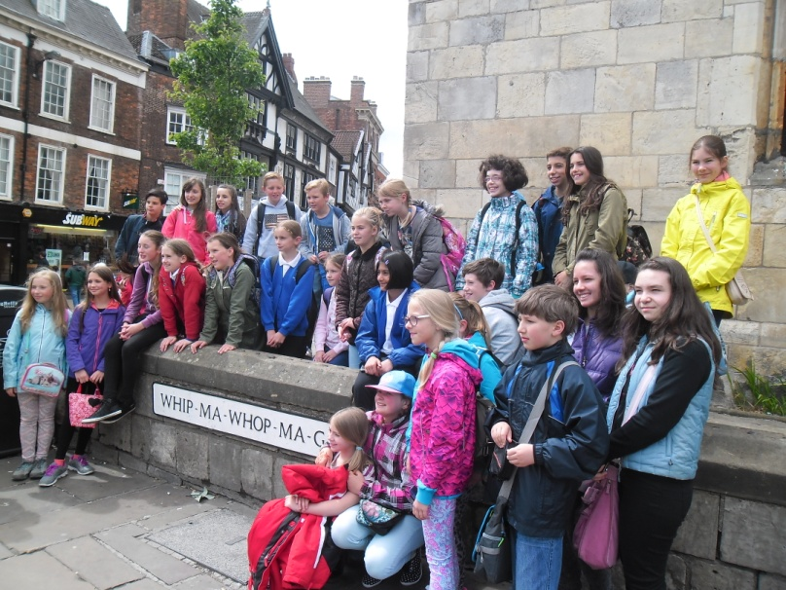
PICTURES FROM THE ERASMUS+ PROJECTS

Slide 14
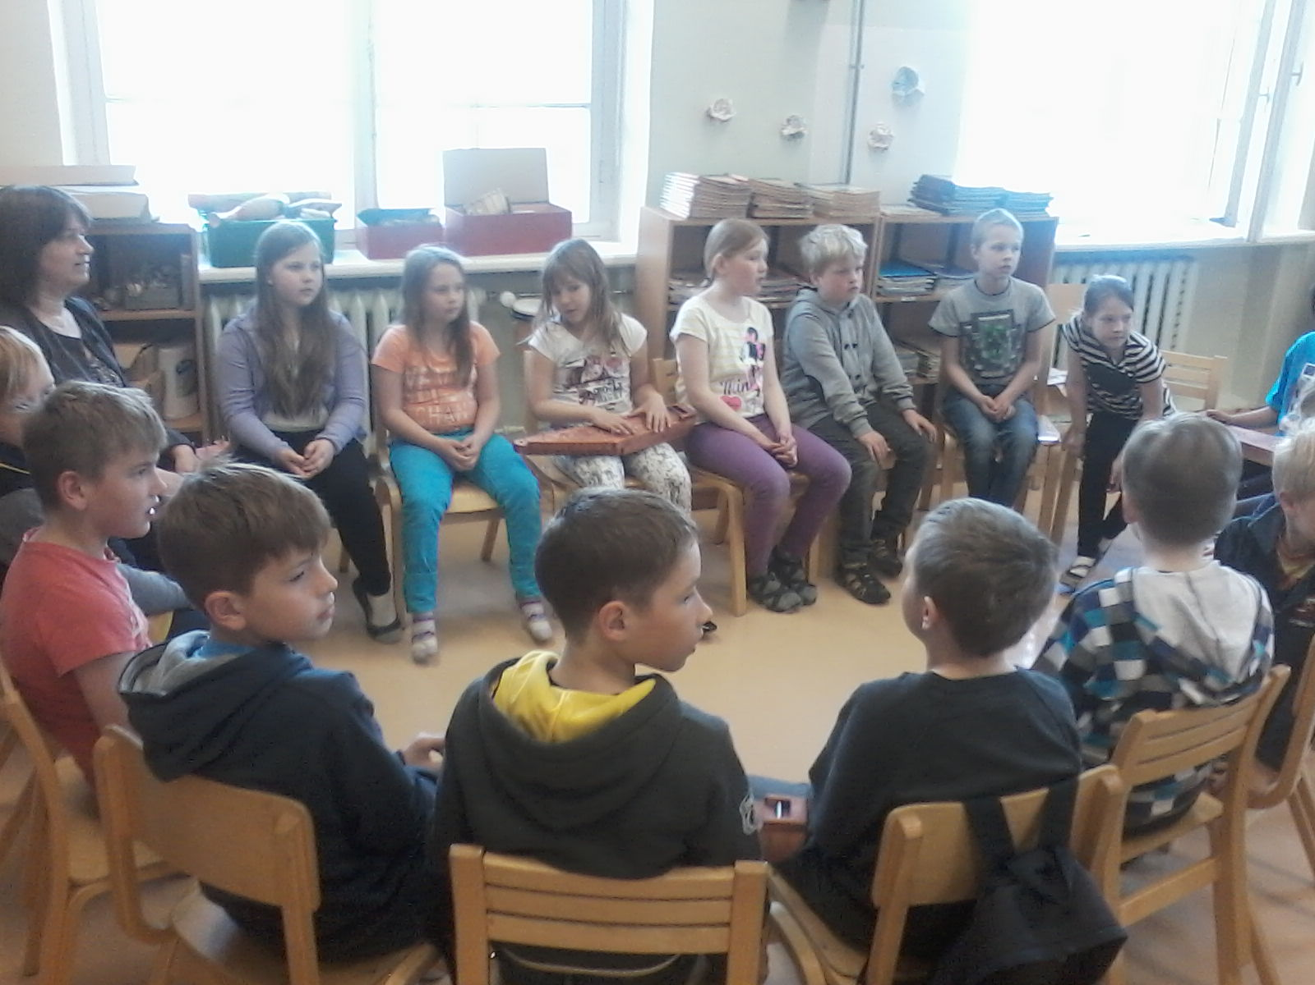
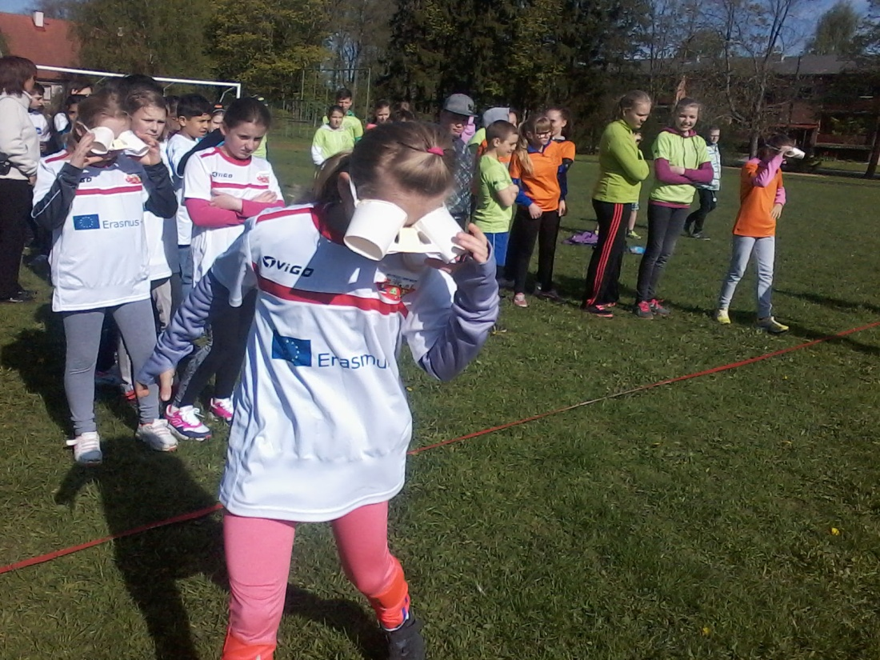
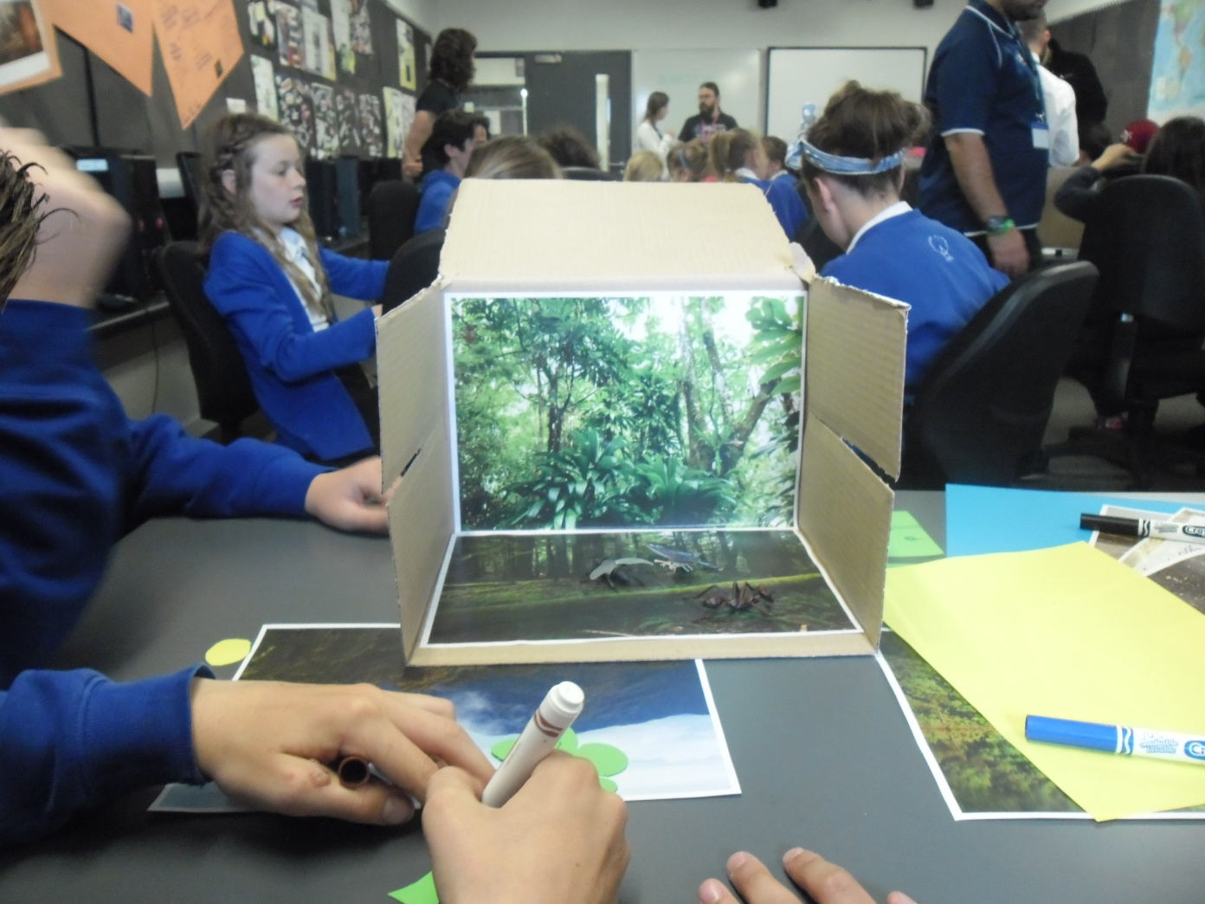

Slide 15
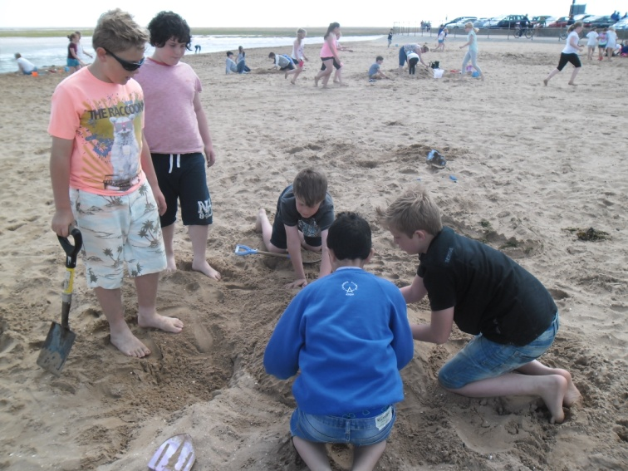
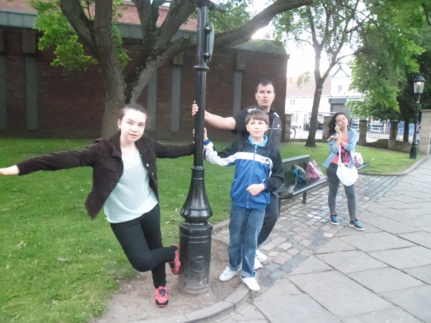
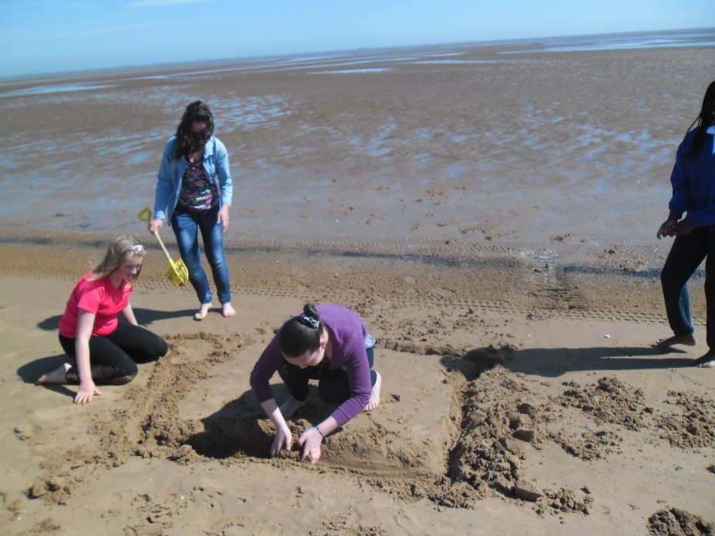

Slide 16
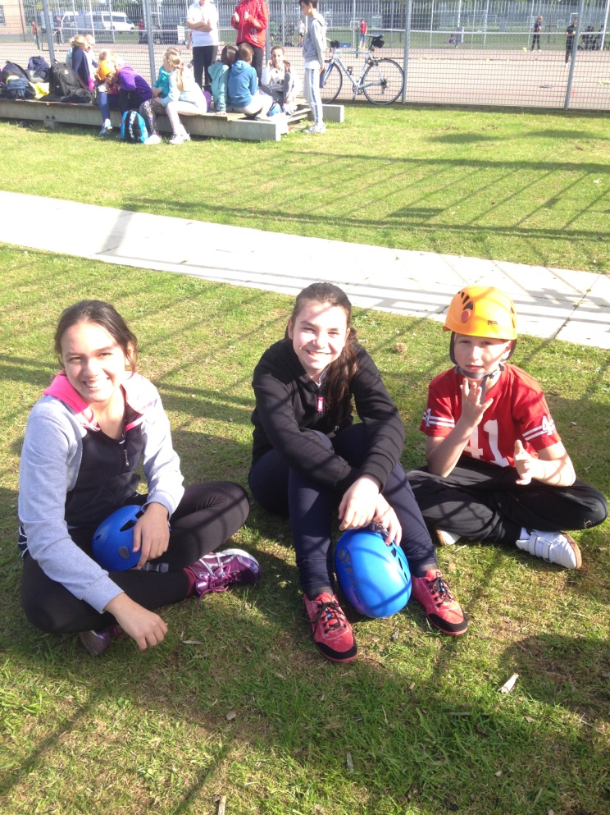
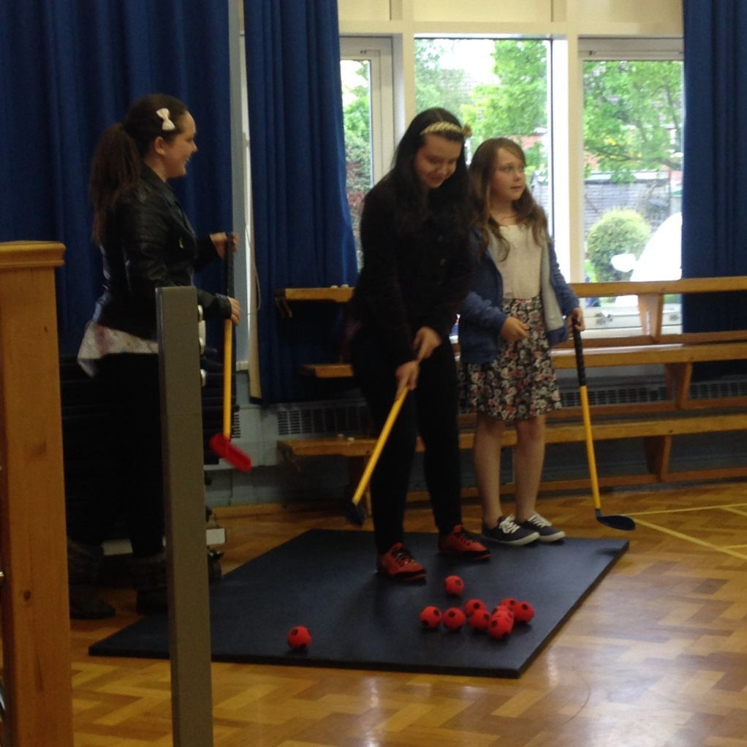
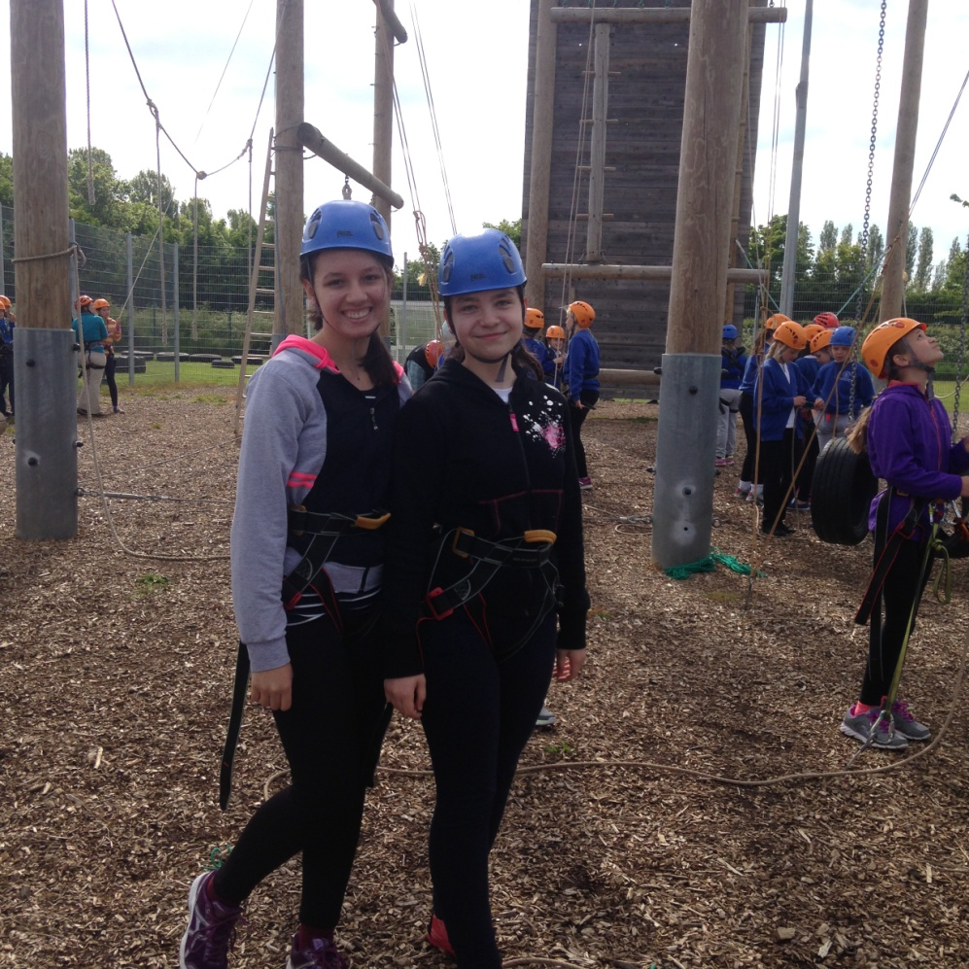

Slide 17
TO BE CONTINUED…
WE WILL DEARLY WAITING
FOR YOU IN ROMÂNIA!!!

