Slide 1
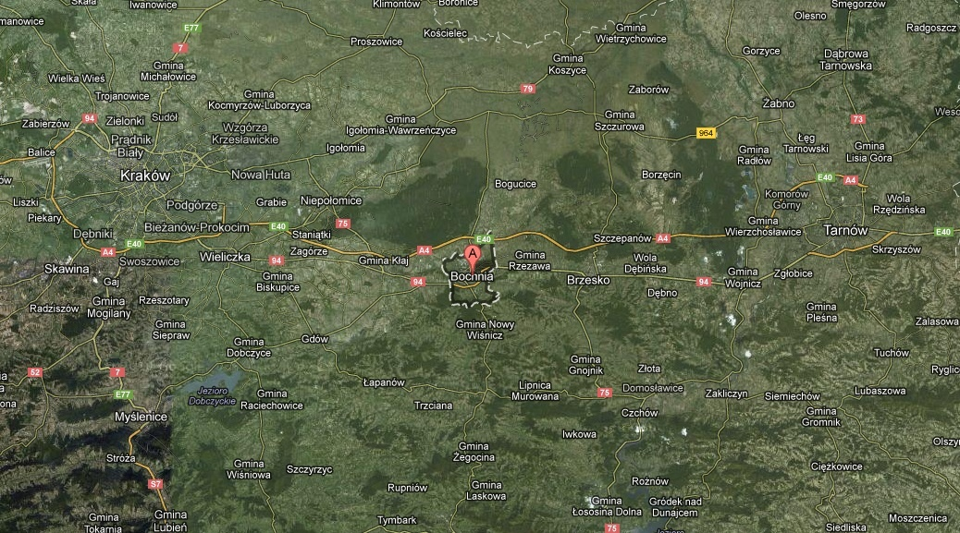
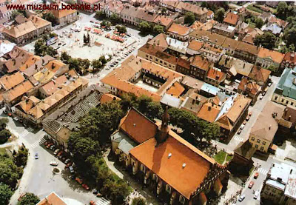
A FEW WORDS ABOUT BOCHNIA
Bochnia – a city located in southern Poland about 50 km from Cracow and 30 km from Tarnow.
Near the town flows the river Raba. Bochnia is one of the oldest towns in Małopolska. Its formation dates back to year 1253. Bochnia became famous in Poland and around the world because of the salt mine.

Slide 2
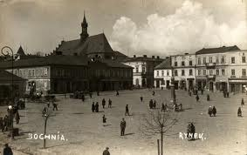
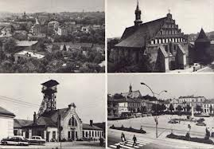
SHORT HISTORY OF BOCHNIA
Bochnia is one of the oldest towns in Poland. The biggest development of the town was in 1248, when resources of salt were discovered. Bochnia had huge economic importance, therefore Duke Bolesław Wstydliwy granted it town rights in 1253. In next years during the reign of Kazimierz Wielki III the town developed fast. The main mineral that contributed to the growth of the town was salt and therefore a saying „Poland is worth nothing without Bochnia and Wieliczka”.

Slide 3

BOCHNIA IN NUMBERS (selected data)
The city area is 2987 ha. The population of out town is about 30300 people (including 15759 women). The population according to age group in 2011 resulted as follows:
0-2 years – 1045 people
3-6 year – 1392 people
7-12 years – 1880 people
13-15 years – 989 people
In Bochnia there is 8 kindergartens, 9 primary and secondary schools. There are also located 7 libraries with branches, one cinema and one swimming pool. In the libraries are registered 9789 people.

Slide 4
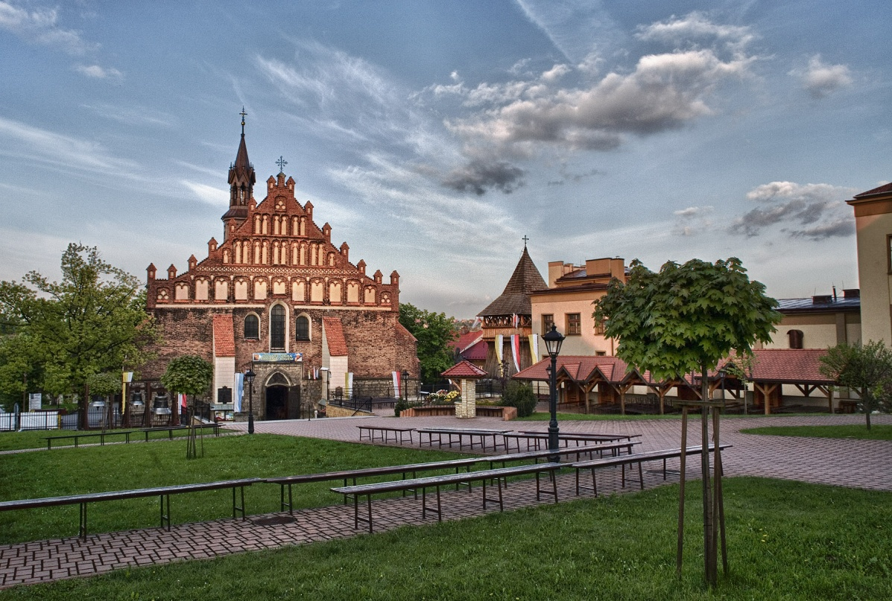
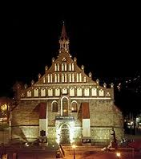
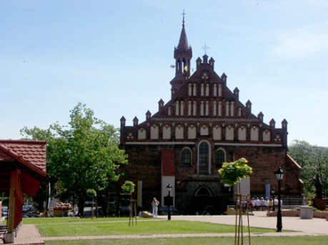
MAIN MONUMENTS - part 1
St. Nicolas Basilica was built in 1440-1445. It is the oldest and biggest church in Bochnia.

Slide 5
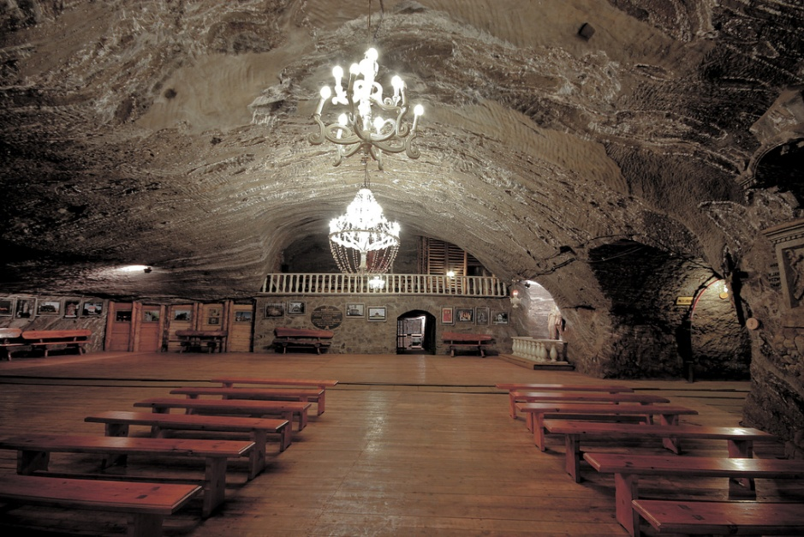
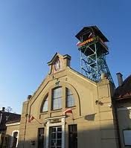

MAIN MONUMENTS - part 2
The Salt mine in Bochnia is the greatest attraction of the city. Every year it is visited by thousand of tourists from all over the world.

Slide 6
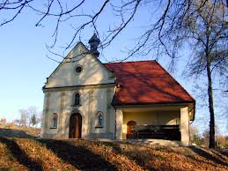
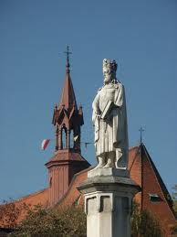
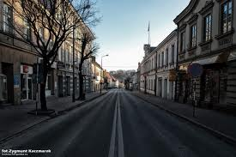
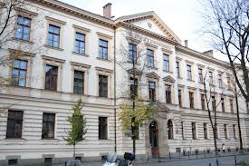
MAIN MONUMENTS - part 3
Monument of Kazimierz the Great – was located in 1871 in the center of Bochnia market.
Building of high school in Bochnia
Many houses located along the main street of Kazimierz the Great
Chapel at “Murowianka”

Slide 7
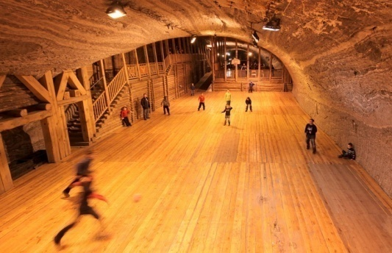
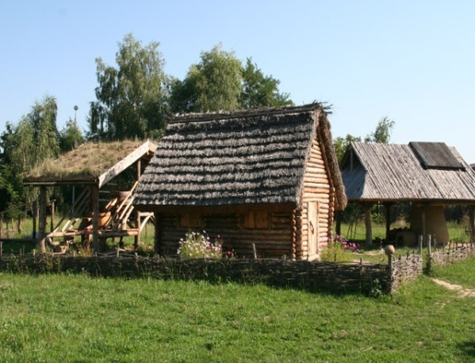
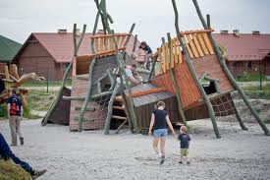
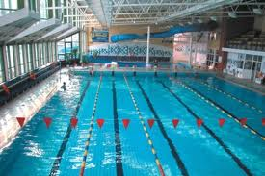
TOURIST ATTRACTION BOCHNIA AND REGION
Salt mine In Bochnia with Tourist Route
Archeological Park near the salt mine presenting the life of former Bochnia's inhabitants
Active Recreation Center - Borek near Bochnia
Swimming pools in Bochnia, Proszówki and Nowy Wiśnicz near our town.

Slide 8
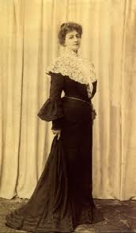
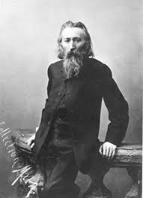
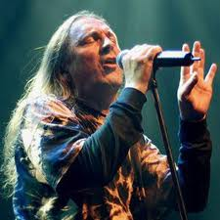
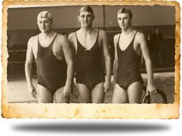
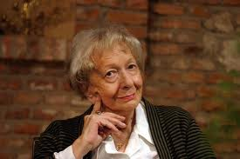
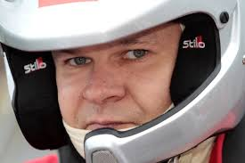
FAMOUS PEOPLE ASSOCIATED WITH BOCHNIA
They lived and worked here:
Helena Modrzejewska-actress
Jan Matejko-painter
Jan Kot- sportsman
Wisława Szymborska-poetess
Michał Bębenek-race car driver
Marek Piekarczyk –rock singer

Slide 9
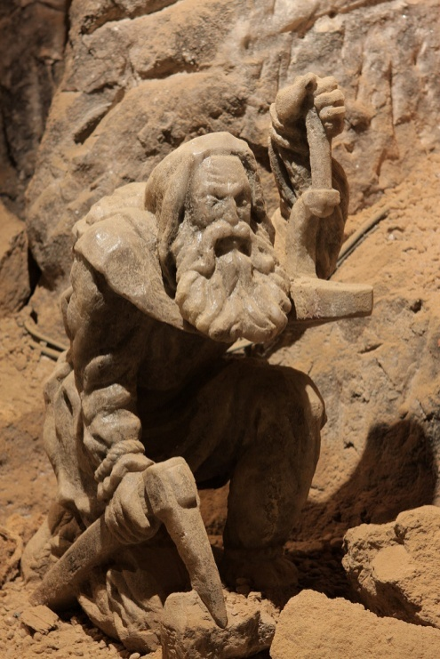
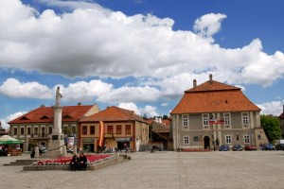
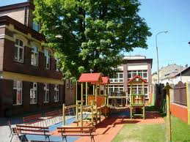
DO YOU KNOW
Bochnia is older than Cracow (became a town in 1253 year and Cracow not until 1257)
The first parochial school was located on Biała street
In 1913 was established the first cinema in Bochnia

Slide 10
SOURCESS
http://www.stat.gov.pl/vademecum/vademecum_malopolskie/portrety_gmin/powiat_bochenski/bochnia-m.pdf
http://www.sztetl.org.pl/pl/article/bochnia/3,historia-miejscowosci/
GOOGLE GRAFIKA
CLIPART GALLERY

