Slide 1
Activating thinking skills and differentiating
Enhanced by the use of digital learning resources

Slide 2
State of affairs school year 2017-2018
5th year of scale-up
45 classes
1200 students using iPads
120 teachers using an iPad when teaching
iPads also used in the upper levels (havo 4th year and vwo 4th year)

Slide 3
State of affairs organisation digital learning resources
New policy plan approved (June 2016)
Transition from pilot to embedding standing organisation
Line management is now primarily ’in charge’
iCoaching
iInspire sessions for the early adopters
iTraining sessions (4 times a year)
Checklist basic ICT skills (setting up a baseline)
3 ICT coordinators assisting colleagues – allotted a total of 600 hours per year
Each department has a teacher researching digital learning resources
iHelp Crew – 15 students providing (technical) support

Slide 4
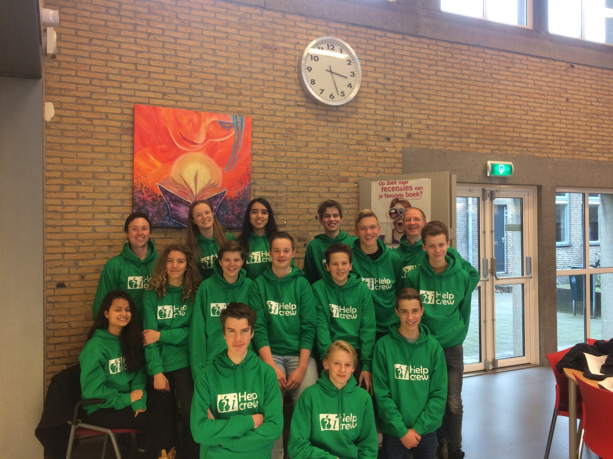

Slide 5
Aanpak ontwikkeling ICT bekwaamheid
Training afdelingsleiders: doel vaardig in ‘Vier in balans’ model, ICT bekwaamheidsmodel, TPACK model.
iTraining sessies (4x intern per jaar, extern promoten)
iCoaching
Gerichte ondersteuning secties door ICTO coördinatoren
iInspire bijeenkomsten voor voorlopers
Leernetwerken op didactische thema’s

Slide 6
Activating thinking skills and differentiating
Enhanced by the use of digital learning resources

Slide 7
‘Book behind glass’ methods

Slide 8
Adaptive learning methods

Slide 9
Adaptive learning methods

Slide 10
Adaptive learning methods

Slide 11
In-house developed course material

Slide 12
In-house developed course material

Slide 13
Formative assessment

Slide 14
Formative assessment

Slide 15
Teaching method: asking questions

Slide 16
Par. 3.3: Christian Holy Days
What are the 6 main Christian Holy days?

Slide 17
Asking questions using Nearpod
All students are being activated, have to start up the thinking process and come up with a result;
Every student is individually accountable for his/ her own contribution;
You will have a clear view on the thinking process of every student in your class;
The teacher can share the answers in class anonymously. Students will feel safe to express their answer freely.

Slide 18
iPad apps
Kahoot: online quizzes using smartphones or tablets
Cerego: flash cards and games for language learning
Simple Mind+: creating mindmaps
Quizlet: flash cards and games for language learning
Newsela: reading comprehension (differentiated reading)
Padlet: activating prior knowledge
Showbie: student portfolio management
iBooks: ebook app (Apple) to create interactive content
Pinterest: inspiration for students and teachers
Bookwidgets: creating interactive content
Apple Classroom: remotely launch apps, websites or books, lock devices

Slide 19
Thanks for your attention
Any questions?
Source: www.pinterest.com

