Slide 1
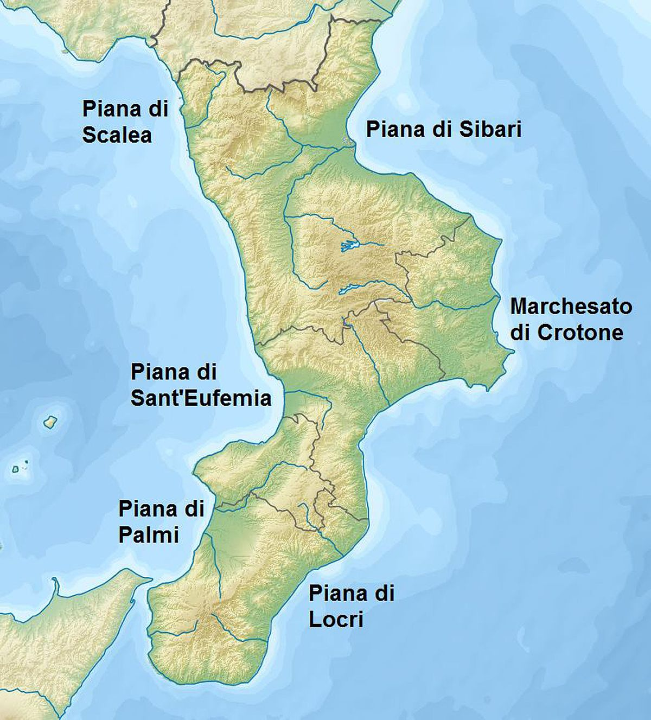
Hi I’m Francesco, I live in Calabria
Precisely in Cutro a small town..

Slide 2
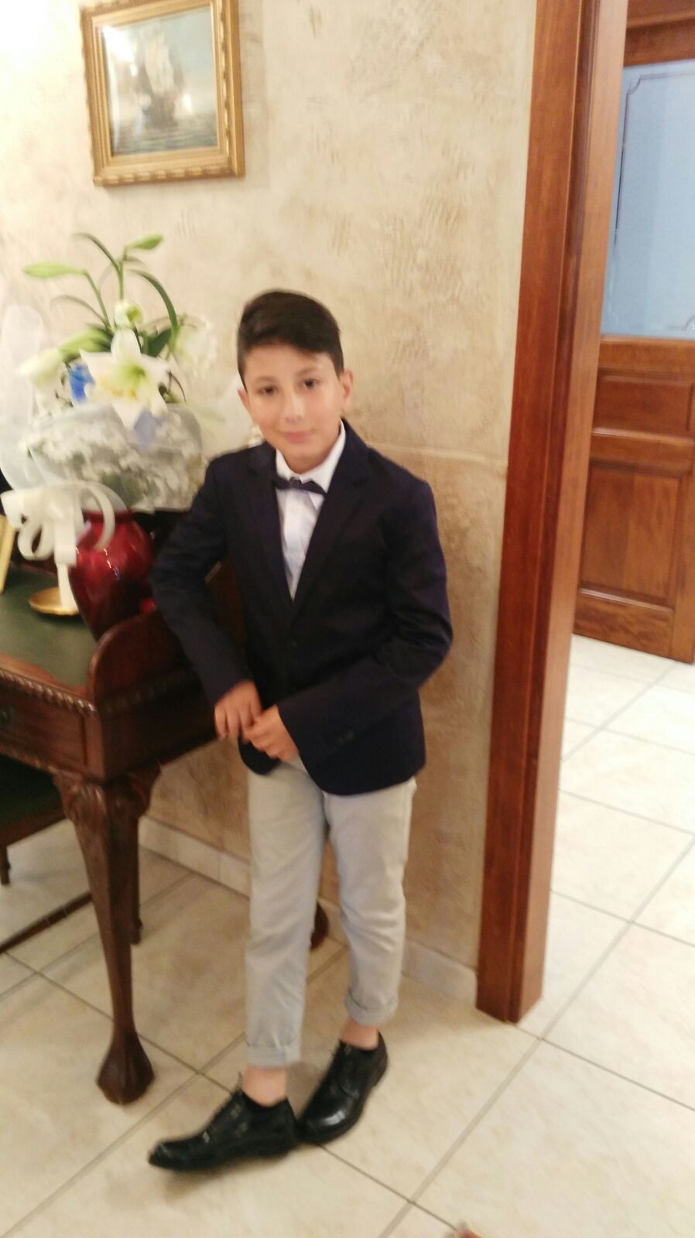
My name is Francesco Antonio, my surname is Lorenzano. I’m thirteen years old and my birthday is the 13/06/07.
This photo was taken on my communion day 2 years ago.

Slide 3
This photo of the square of cutro, Historical photo depicting the chessboard representing the story of cutro with Giovanni Leonardo Di Bona, who by winning the chess match against the king of Spain obtained the title «Cutro city of schess».

Slide 4
This is the entrance to my school i attend to class 3C which is located upstairs. It is a medium-sized school. There is a gymnasium and a multipurpose court outside .My class consist of 18 students and i feel good.My favorite subjects are english and science.

Slide 5
My favorite hobbies is football its my passion. I attend a football school and my role is a midfielder. My dream when I grow up is to became like Lionel Messi.

