Slide 1
GLOBAL ECO PROJECT

Slide 2
ELENA PACE
Hi, my name is Elena, i’m 12 years old, i from Italy and i live Ribera.
I have many hobbies: dancing, singing and acting.
I parteciping because i love my territory, and to have a new experience.
I LOVE MY TOWN

Slide 3
MARIA GIOVANNA SEGRETO
Hey, i’m Maria Giovanna, i’m twelve years old and i from Italy, Sicily and i’ live in Ribera
I have many hobbies to dance and sing.
I have partcipated because i like my country.

Slide 4
NICOLE CASCIO FERRO
Hello, my name is Nicole, i’m 12 years old, i from Italy and i live in Ribera.
My hobbies is acting and i like listening to music.
I parteciping because i love nature and i want to project it.

Slide 5
CHIARA NOTO
Hello guys my name is Chiara Noto ,i am eleven year old i from italy ,sicily and i live in ribera city of orange
I have many hobbies and some of these are dancing and playng video games
I partecipate because because i like the word…

Slide 6
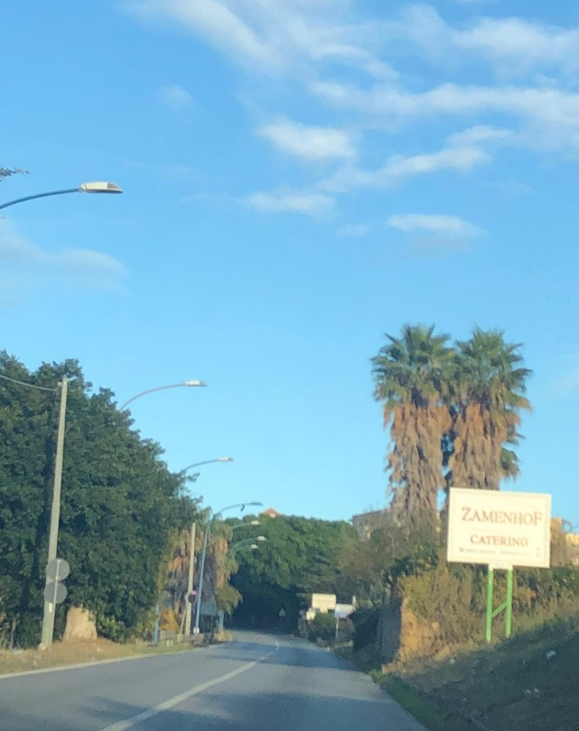
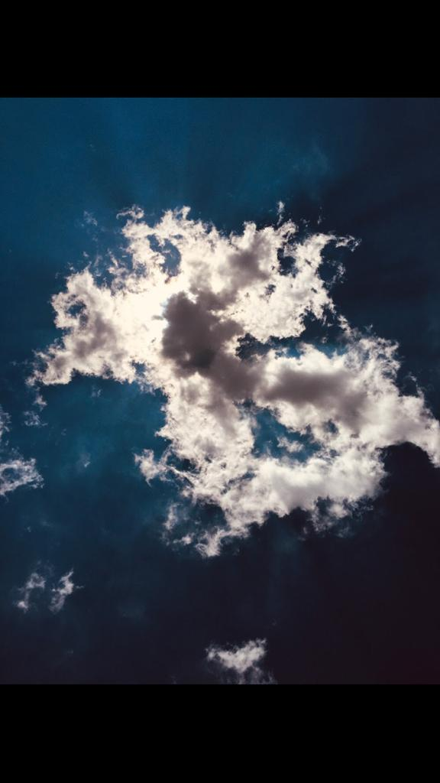
OUR BEAUTIFUL CITY

Slide 7
THE CITY OF ORANGE

Slide 8
OUR SCHOOL

Slide 9
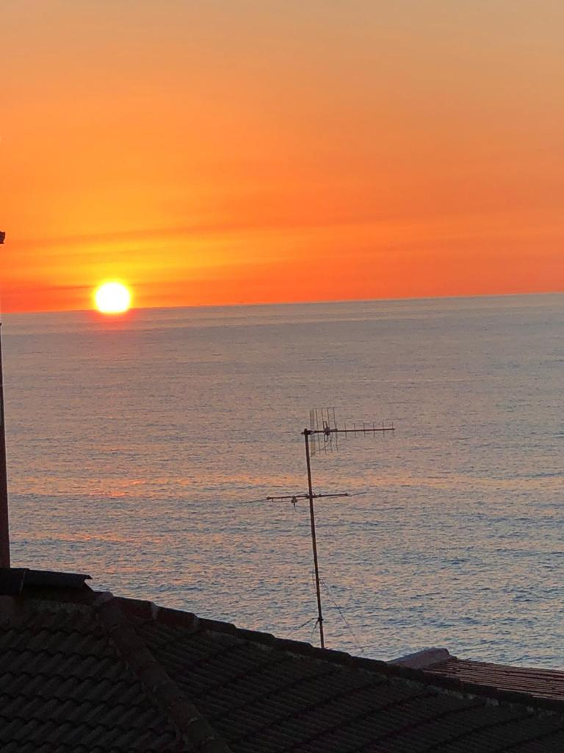
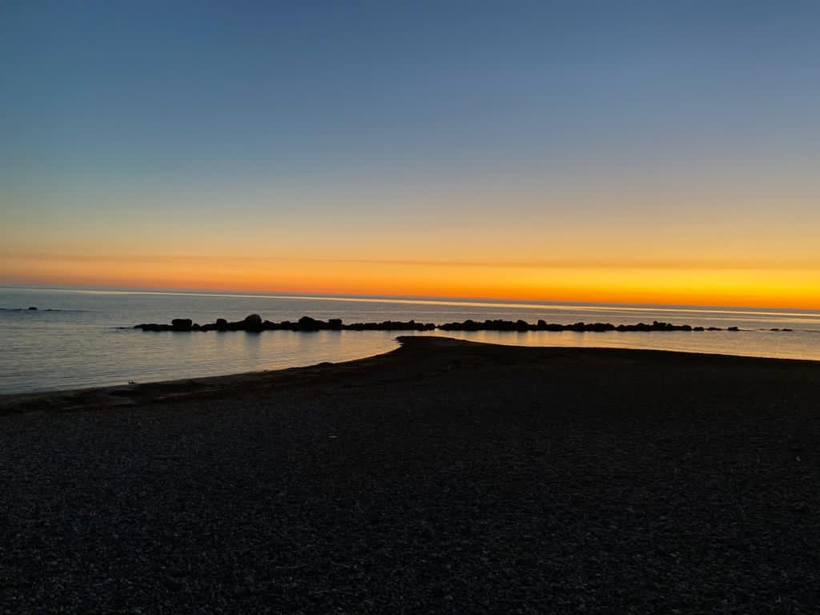
SECCAGRANDE

Slide 10
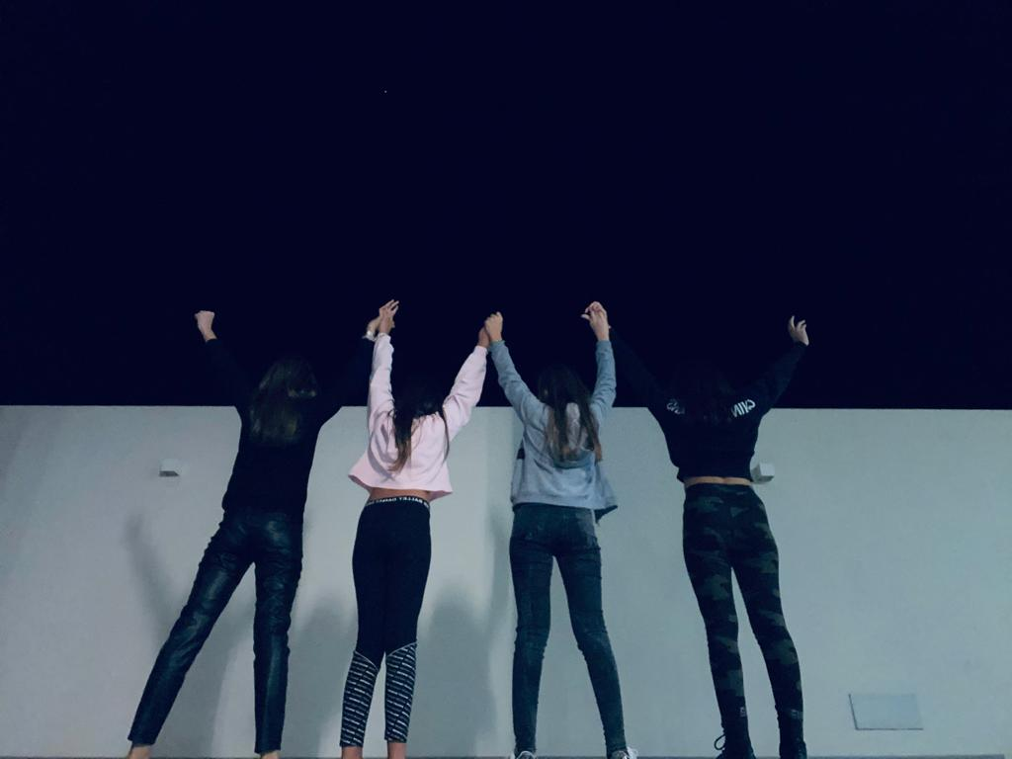
MADE BY:
NICOLE CASCIO FERRO
ELENA PACE
MARIA GIOVANNA SEGRETO
CHIARA NOTO
MENC

