Slide 1
Liceul Tehnologic Octavian Goga Jibou, Romania
EBE LEARNING CROSSING BORDERS
-eTwinning project-

Slide 2
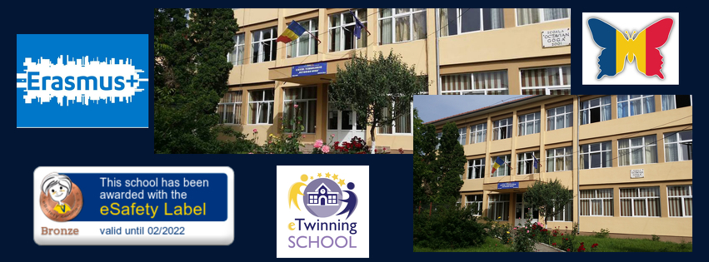
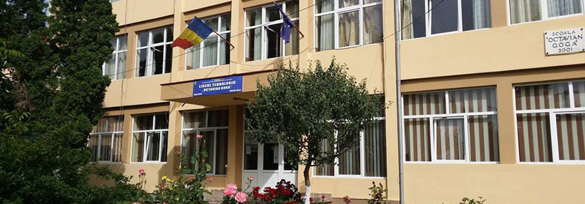

Slide 3
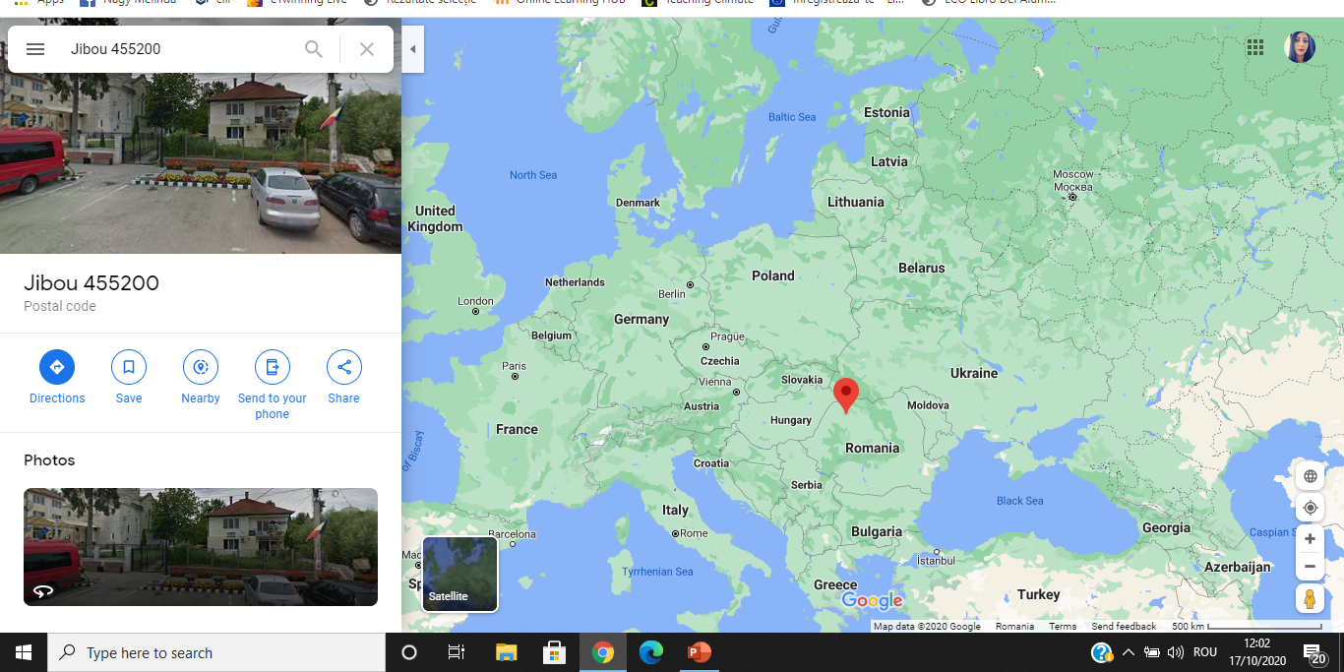

Slide 4
Human resources
We are:
585 students
45 teachers
17 auxiliary staff

Slide 5
Forms of education:
1. Primary education – preparatory class to 4th grade (students aged 6-10)
2. Secondary education – 5th grade to 8th grade (students aged 11-14)
3. Vocational/Technical education – 9th to 12th grade (students aged 15-18) Specializations: economics, electrics, mechanics, textile industry)

Slide 6
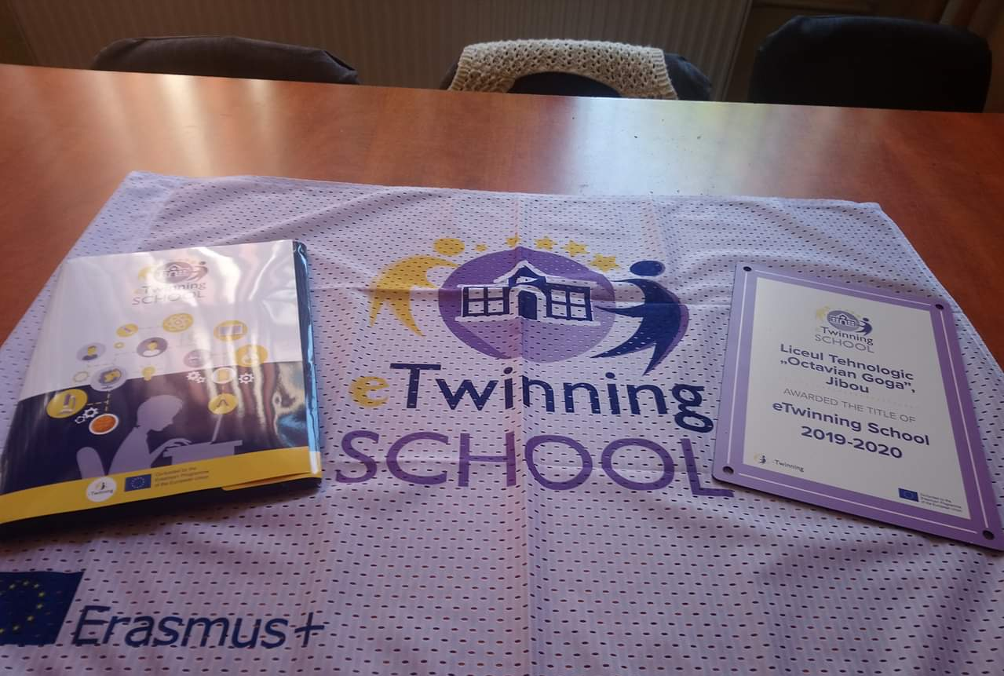
We are an eTwinning SCHOOL for the year 2019-2020 and we are going to apply in November for this award for 2021-2020

Slide 7
Erasmus + accreditation
Currently, we are working on the application for the ERASMUS + accreditation for 29th October deadline.

Slide 8
34 eTwinning projects:
We have:
6 active projects
28 closed projects

Slide 9
Awards for the projects:
We have received National and European Quality Labels for our projects. We also, received a prize for the best eTwinning and Erasmus KA2 project, called "Enriching Leisure Lifestyle for European Youth" - ELLEY

Slide 10
6 Erasmus + projects
So far, we had 6 Erasmus + projects in our school of which 4 coordinated by us.

Slide 11
"Roots & Wings"
1. Erasmus + project KA1 Youth, "Roots & Wings" (Latvia, Lithuania, Bulgaria, Romania) 2016, Youth Exchange
Coordinator: Youth Centre Latvia

Slide 12
"Creative, Active, Responsible Students in the Digital World"
Erasmus + project KA219 "Creative, Active, Responsible Students in the Digital World" 2016-2018 (Romania, Greece, Turkey, Portugal, Czech Republic)
Coordinator: Liceul Tehnologic Octavian Goga Jibou, RO

Slide 13
"Enriching Leisure Lifestyle for European Youth - ELLEY"
Erasmus + project KA219 "Enriching Leisure Lifestyle for European Youth - ELLEY" 2016-2018 (Spain, Italy, Netherlands, Germany, Bulgaria, Turkey, Romania)
Coordinator: IES La Minilla Las Palmas de Gran Canaria, Spain

Slide 14
"Outdoor Learning - Real Learning!"
Erasmus + KA219 "Outdoor Learning - Real Learning!" 2017-2019 (Romania, Italy, Spain, Portugal and Greece)
Coordinator: Liceul Tehnologic Octavian Goga Jibou, RO

Slide 15
Reading for Life
Erasmus + KA229 Reading for Life
2019-2021
Coordinator: Liceul Tehnologic Octavian Goga Jibou, RO

Slide 16
Click on e-CLIL
Erasmus + KA229 Click on e-CLIL
2019-2021
Coordinator: Liceul Tehnologic Octavian Goga Jibou, RO

Slide 17
Students in this project are aged 12-15

Slide 18
You can find out about us:
Website: http://www.ogogajibou.ro/
Facebook page: https://www.facebook.com/ogogajibou/

