Slide 1
ISTITUTO D’ISTRUZIONE SUPERIORE «FRANCESCO REDI» LICEO SCIENTIFICO “A. RUSSO GIUSTI ”
EBE-LEARNING CROSSING BORDERS

Slide 2
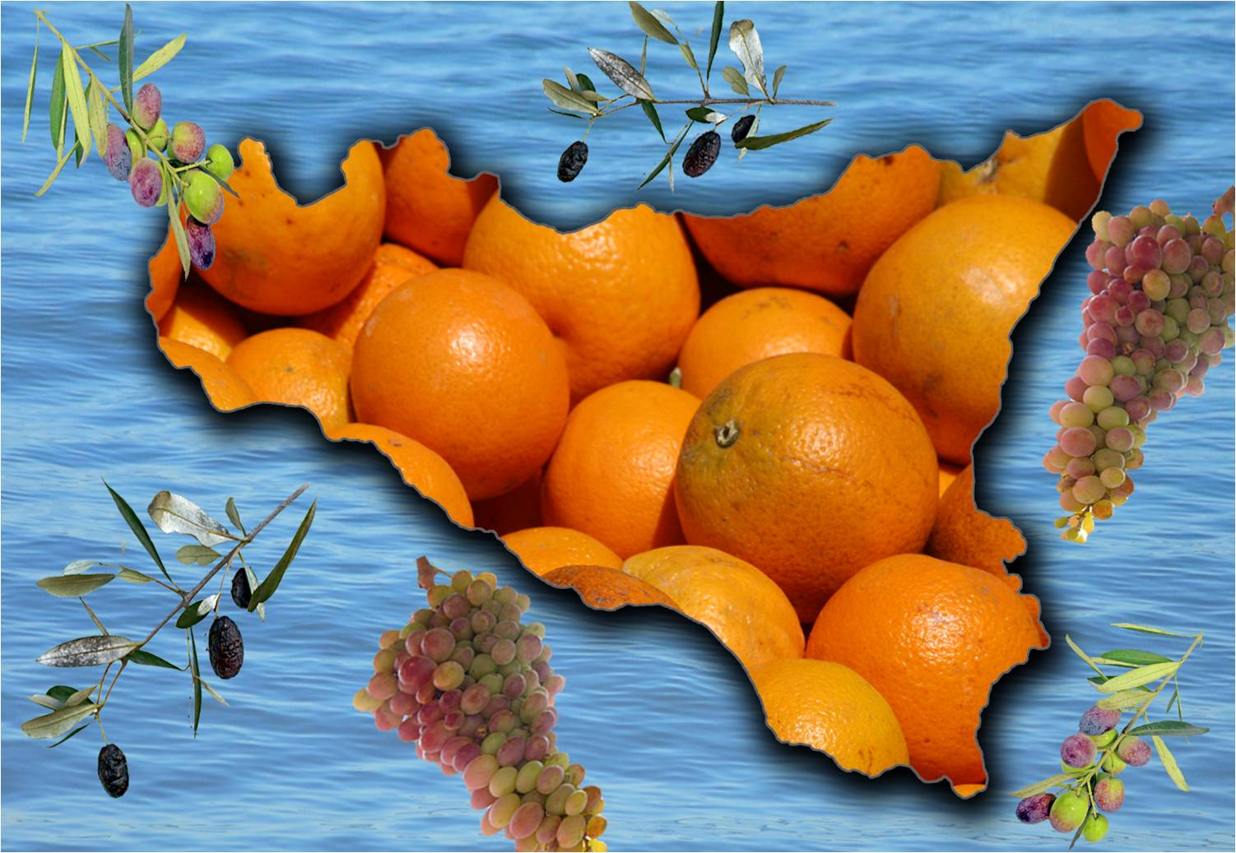
SICILY
BELPASSO
OUR SCHOOL

Slide 3
IThe school building : ITISThe school building : ITISTIS
I.I.S.S. State Industrial Technical Institute
“Telecommunication-Information technology and Liceo Scientifico
- Informatics

Slide 4
THE HALL

Slide 5
H. 11,00 It ‘s Break Time

Slide 6
Telecommunications and Informatics labs

Slide 7
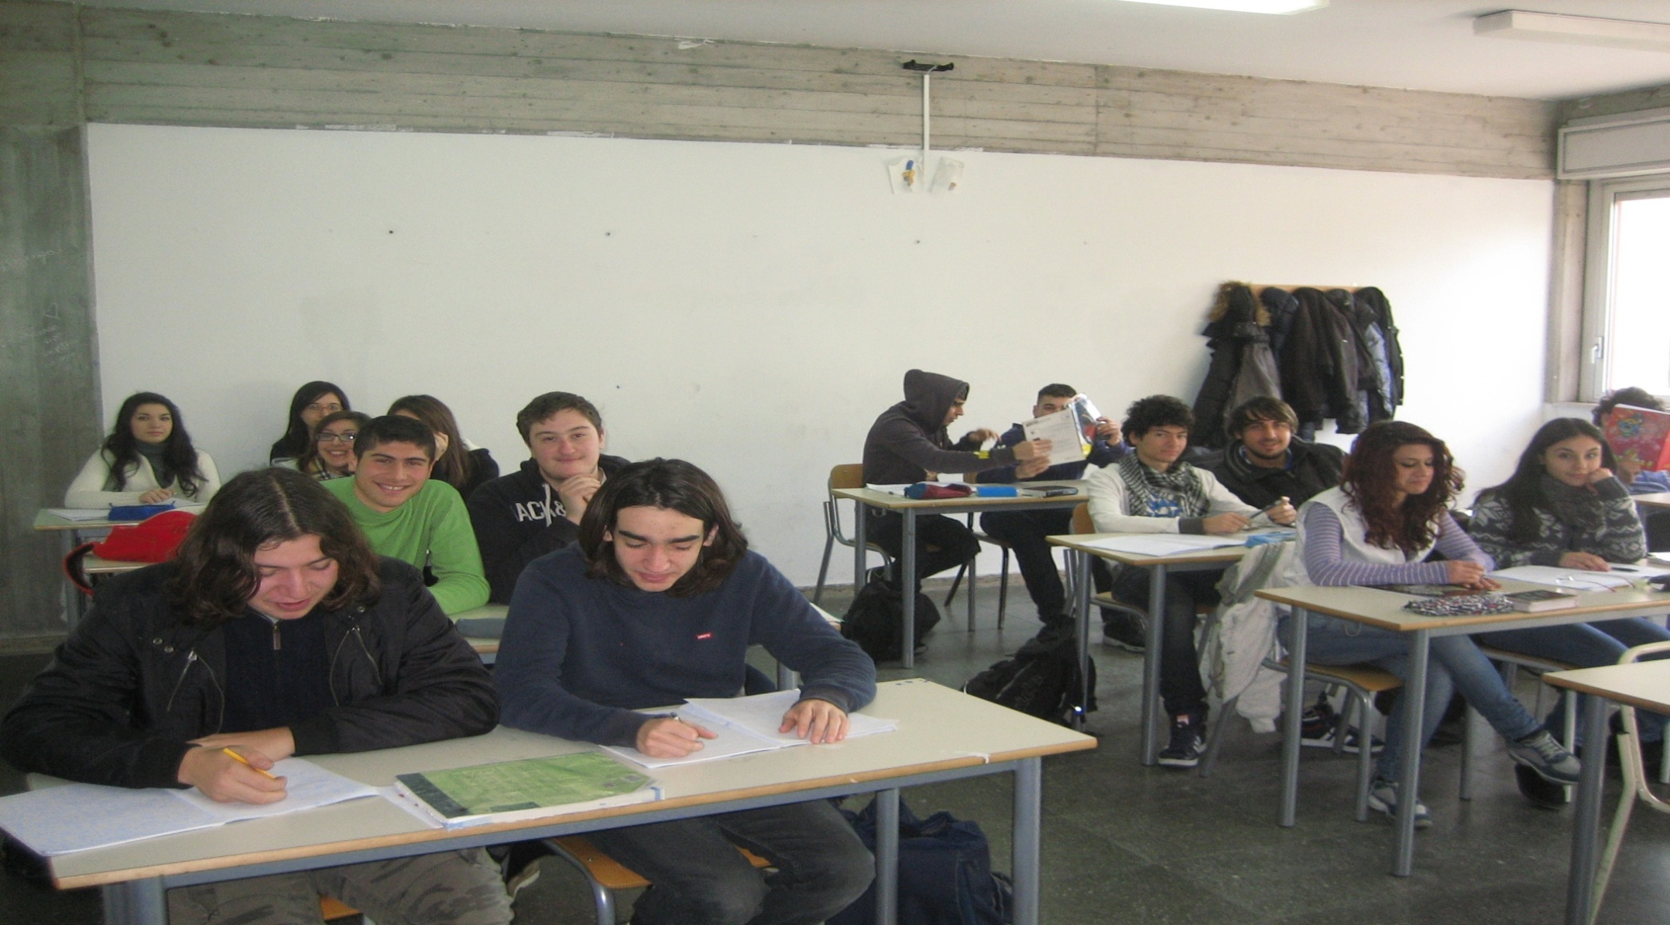
Classrooms

Slide 8
All classrooms have internet access

Slide 9
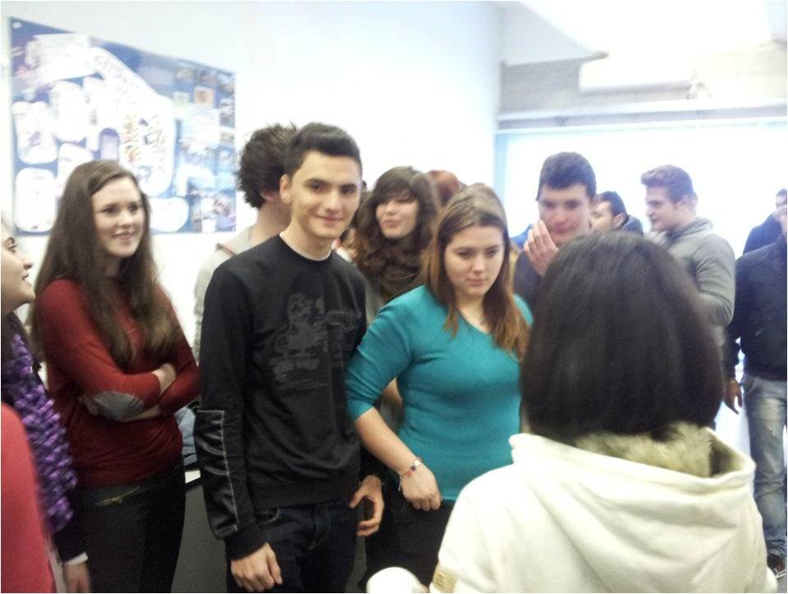
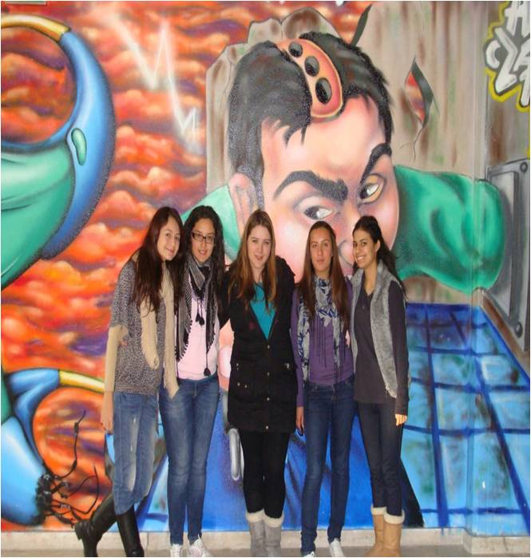
Work group at school (before Covid Alert )

Slide 10
Outdoor gym football field

Slide 11
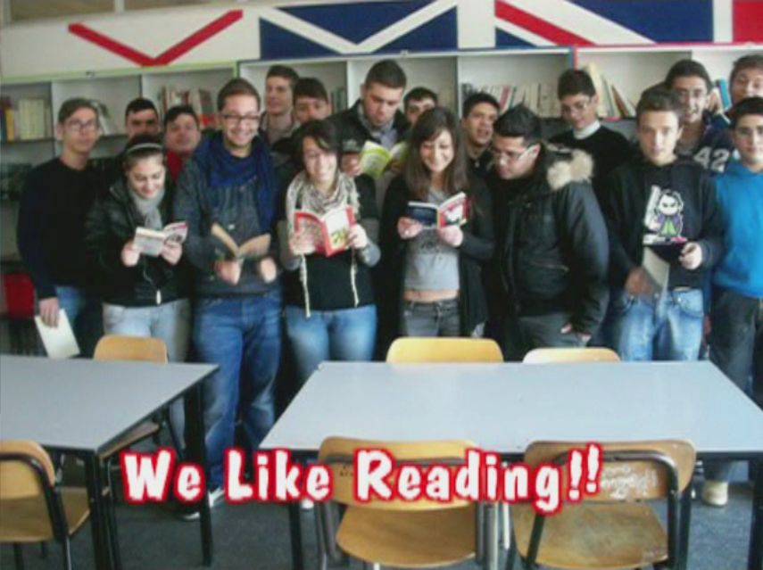
In the library

Slide 12
In the school canteen

Slide 13
One month Stage in Stochkolm «IOT smart city Stockolm» (school year 2019/20)

Slide 14
i.I.S.S. «FRANCESCO REDI
Forms of Education
Our school includes three different courses of study: a technical institute with specialization in
computer science
electronics
and the scientific high school.
The students are 14-18 years old

Slide 15
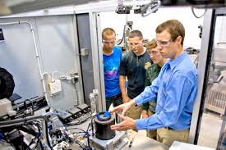
The "Electronics and Electrical Engineering
The "Electronics and Electrical Engineering" course integrates scientific and technological skills in the field of materials, design, construction and testing:
- “Electronics”, to deepen the design, construction and management of electronic systems and circuits;
- “Elettrotecnica”, which focuses on the design, construction and management of electrical systems and installations, both civil and industrial;
- "Automation", for the in-depth study of the design, construction and management of control systems.

Slide 16
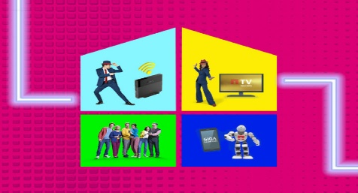
The "IT and Telecommunications
The "IT and Telecommunications" course integrates scientific and technological skills in the field of computer systems, information processing, Web applications and technologies, networks and communication equipment; has two joints:
- "IT", which deepens the analysis, comparison and design of IT devices and tools and the development of IT applications;
- "Telecommunications", which deepens the analysis, comparison, design, installation and management of electronic devices and instruments and telecommunication systems.

Slide 17
scientific high school
The five-year course of studies of the ordinary scientific high school aims to offer a general cultural base of a multidisciplinary type using the interaction between humanistic and scientific culture,
Although the curriculum of the scientific high school is particularly congruent with the frequency of courses degree in scientific disciplines, engineering and architecture, medicine and surgery, economics and commerce and law, there is no doubt that this course of study provides a vast basic culture essential for a successful continuation of studies in any university field.

Slide 18
Human resources
The headteacher
The staff
There are 118 teachers on duty
500 pupils
10 administrative employees
25 auxiliaries

Slide 19
OUR SCHOOL DRAWN ON EUROPEAN STRUCTURAL FUNDS AND COMPLETED VARIOUS PROJECTS

Slide 20
OUR SCHOOL FROM 2000 TO TODAY HAS BEEN PARTNERS IN SEVERAL PROJECTS: THE 1ST WAS CALLED SOCRATES THEN ANOTHER ONE COMENIUS AND 5 ERASMUS.

Slide 21
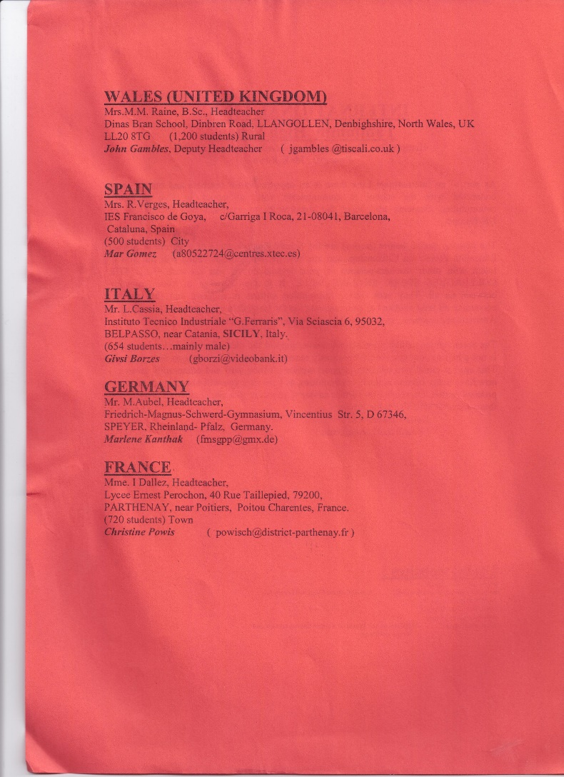
The 1° Socrates /Comenius project European Citizens (1999/2001)

Slide 22
FOURTEEN ETWINNING PROJECTS HAVE ENRICHED THE CURRICULUM OF MANY STUDENTS AND TEACHERS-

Slide 23
ts of study
Core subjects:
Italian language and literature
Latin
English
History and geography
Mathematics
Science
Biology
Physics
Chemistry
Religious education
Physical education

Slide 24
Professional subjects
Electronics
Electrotechnical
Telecommunications
Systems and Automation
Technology, Design and planning
Informatics
Statistics
Calculus and probability.

Slide 25
The Redi Jazz Orchestra is the jazz orchestra of the scientific high school "A.Russo-Giusti" and of the ITIS "G.Ferraris" of Belpasso and Rose in 2017 from the successful meeting between prof. Fabio Desiderio, jazz musician, and a group of brilliant and musically talented guys.

Slide 26
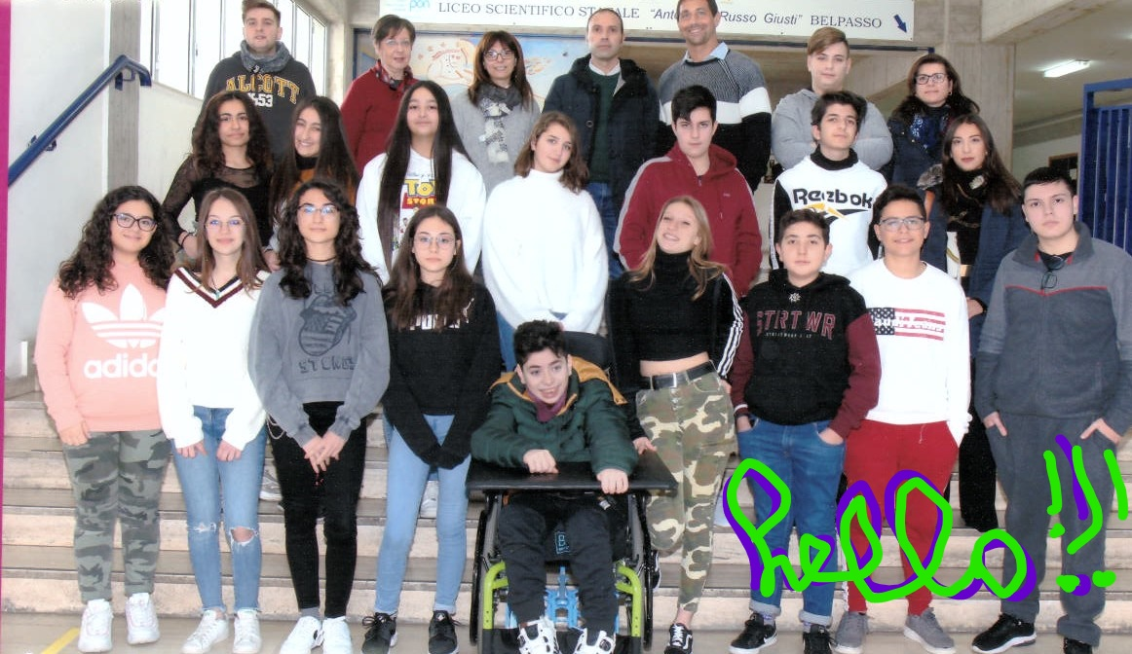

Slide 27
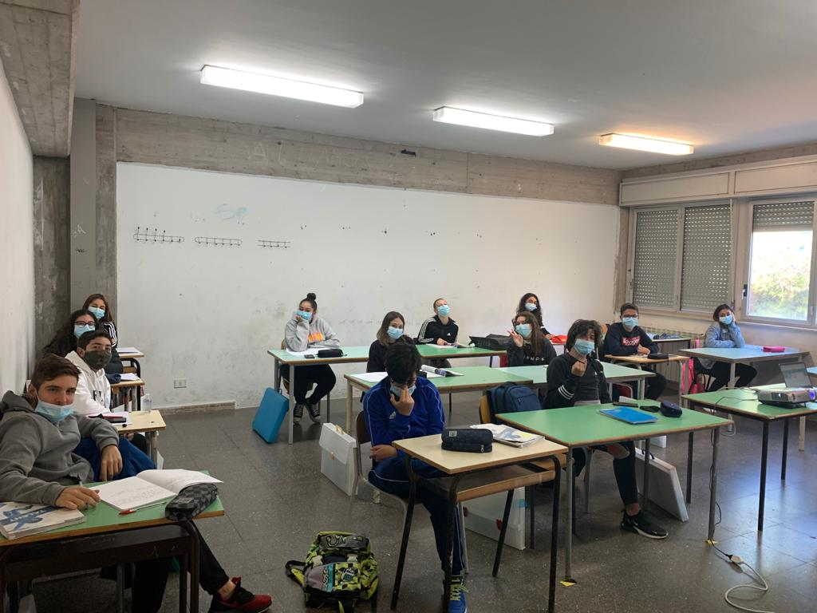
Hello by the students who are working in the Project

Slide 28
Thanks for your attention!
This work has been Realized by
I.I.S.S «Francesco Redi” students
E:mail istisbelpasso@itisbelpasso.it BELPASSO
THE
24.10.2020
Belpasso (CT)

