Slide 1
Medieval fortress
Iva petronijević 8/3

Slide 2
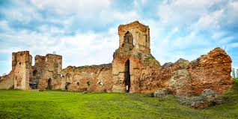
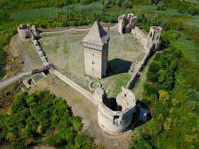
Bač fortress
Best conserved medieval fortress on the teritory of Vojvodina is in city of Bač on the northwest of Serbia. It was built in the middle of 14 century on the small hill of the once river Mostonga. It is built from brick, stone and terracota . Donjon was in the southeast yard and it is still one of the best medieval Donjon towers in this part of Europe.

Slide 3
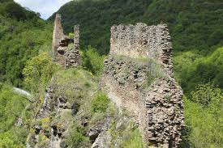
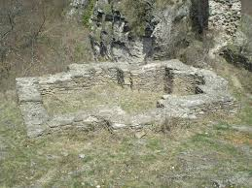
Marco`s cale
Only four and a half km from Vranje there is a fortress called Marco`s cale or Marco`s city. According to the legend, this medieval town belonged to Marco, who, when turks came, jumped with his horse Šarac on the mountain Pljačkovica(Crying mountain) and cryed. However, tehre are some facts that show that fortress dates in 6th century, when Emperoro Justinian ruled.

Slide 4
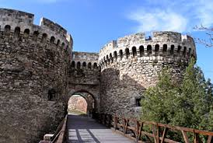
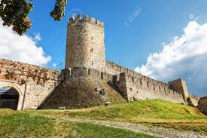
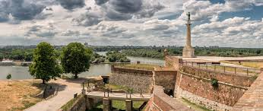
Belgrade fortress
Belgarde fortress is situated at the mouth of river Sava into Danube. Belgrade fortress is called also Kalemegedan and Gate of Wares for special position between East and West. This complex monument was built from 2.-18.th century.

Slide 5
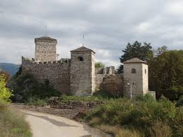
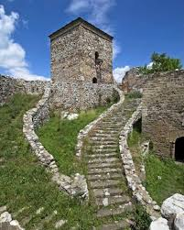
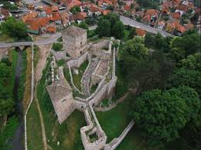
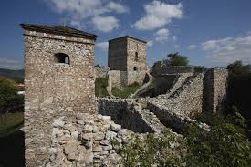
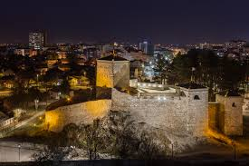
City of pirot
City of Pirot or City of Momčilo is a fortress near river Nišava, and it is situated at the gate of Pirot from city of Niš. City was built by duke Momčilo during rule of prince Lazar. Fortress was used untill 20th century. Though there were many wars that took place arround the city, it is well preserved.

Slide 6
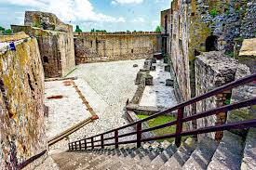
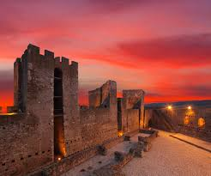
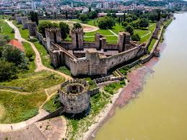
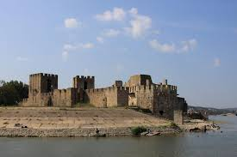
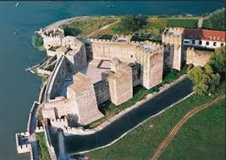
Smederevo fortress
Smederevo fortress is built in Smederevo at the mouth of river Jezava into Danube from 1428. by despot Đurađ Branković(1427-1456) who got his nickname upon it- Smederevac. It is classical fortress surrounded by water- rivers Jezava and Danube and artifical canal from south that connects two rivers. It is built ion the valley- that is unique in the medieval serbian architecture and as pattern was udes Constantinople fortress.

