Slide 1
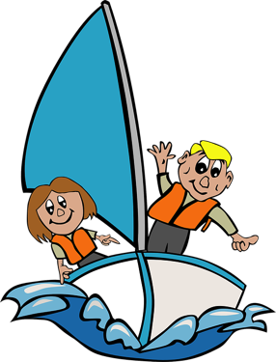
Equality gender and and sport On the routes of equality
I.C. CENTRO 1
BRINDISI
S/he’s equal in Europe
Project

Slide 2
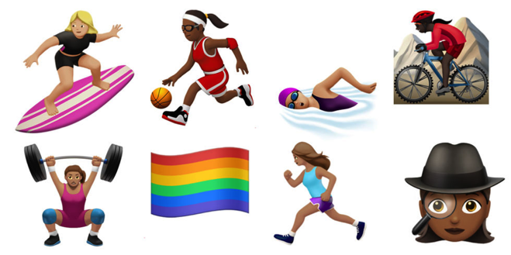
Sport is traditionally a sector dominated by men, and progress in gender equality in this field is hampered by the social conceptions of femininity and masculinity, which often associate the sport with "male" characteristics such as physical strength and endurance , Speed ​​and a very combative spirit, if not aggressive. Women engaging in sport can be seen as "mascoline", while men who are not interested in sports can be considered "less virile."
Prevailing gender stereotypes influence women's participation not only in decision-making in sports organizations, but also in sporting practice.
Traditional gender roles can dictate the number of hours women spend on care tasks, which can have a chain effect, reducing the time available for sports.

Slide 3
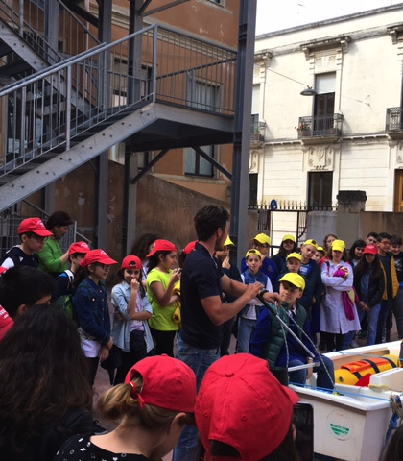
What the school can do in order to promote the equality gender in the sport field?
Our school hosted this year the sailing school instructors of our city.
Sailing is one of those sports that, despite being natural for a seaside town like ours, has nevertheless been a great success among the girls ...

Slide 4
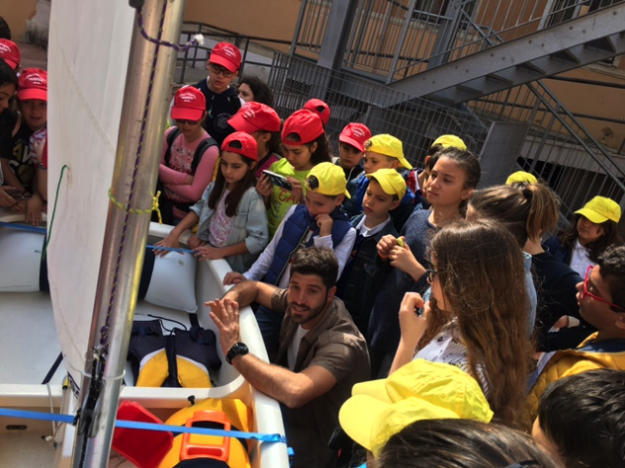
Experts have told girls and children the early rudiments of a sport that combines a series of educational values ​​such as autonomy and collaboration, environmental respect.

Slide 5
Who wants to try it?

Slide 6
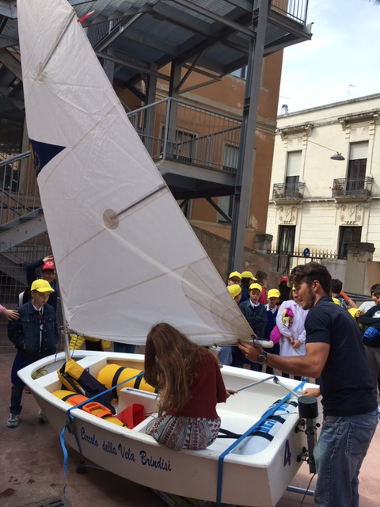
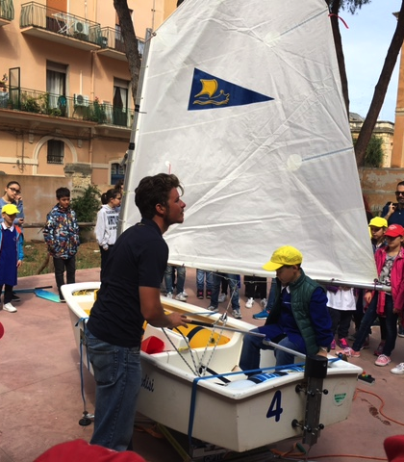

Slide 7
Keeping the balance is not easy but everyone wants to try it!

Slide 8
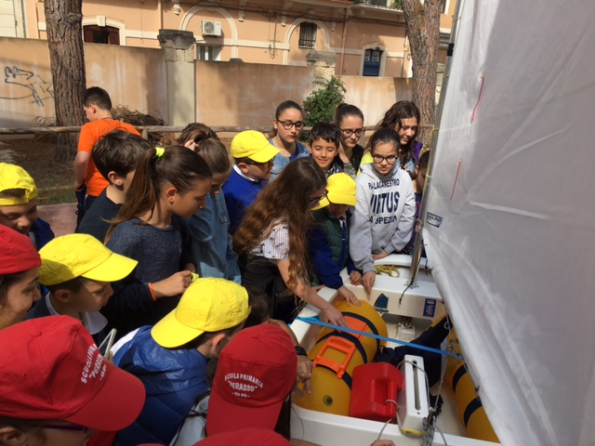
It was a great experience: difficulties, curiosity and involvement were at an equal level!

Slide 9
What the school can do to overcome gender stereotypes?
The school can offer the opportunity to live experiences in which boys and girls live together, beyond stereotypes.

