Slide 1
S/he’s equal in Europe 1 st Evaluation meeting FILIATES (GREECE) 24th – 27th MAY 2016

Slide 2
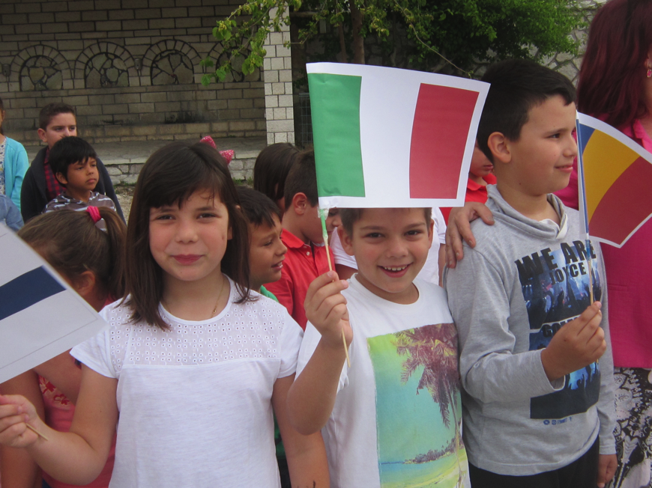
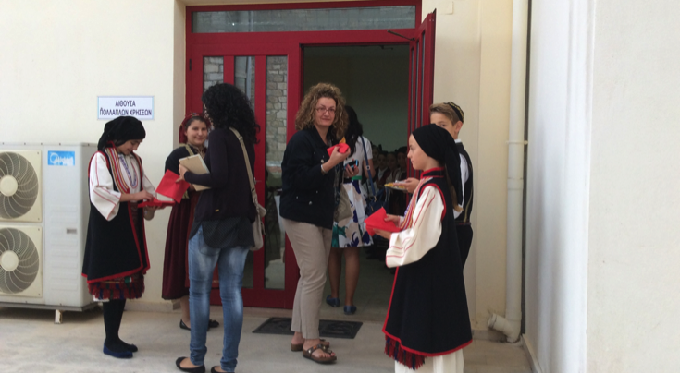
Arriving in Konstantinos Zappas school

Slide 3
Accepted by the school community

Slide 4
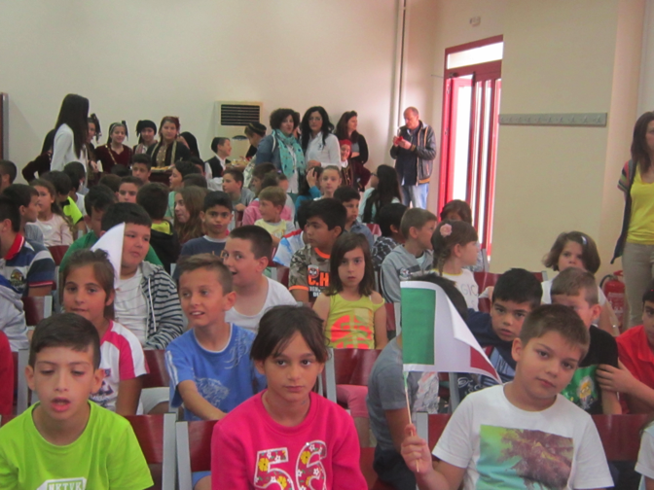
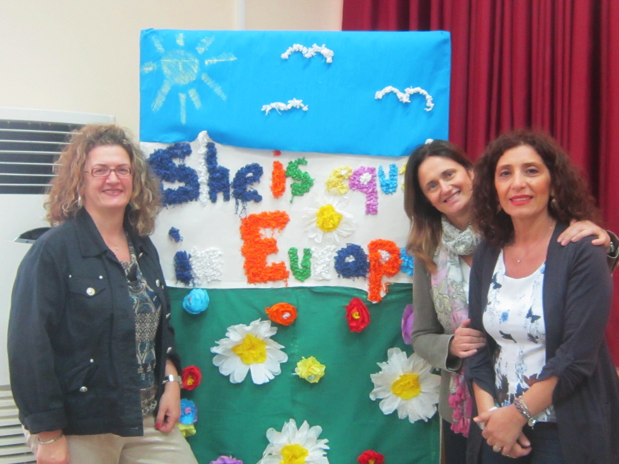
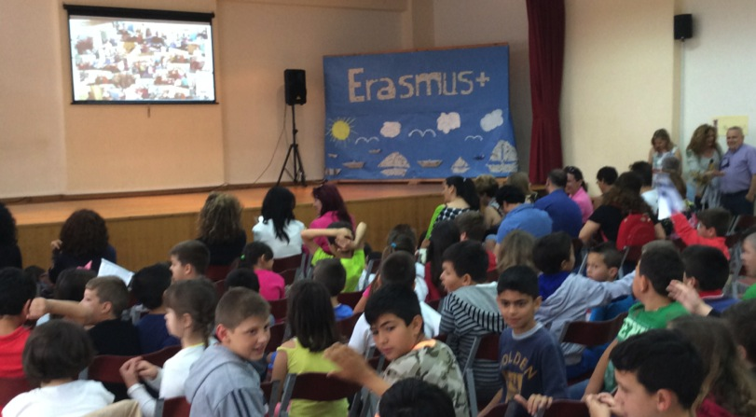
Welcome Ceremony

Slide 5
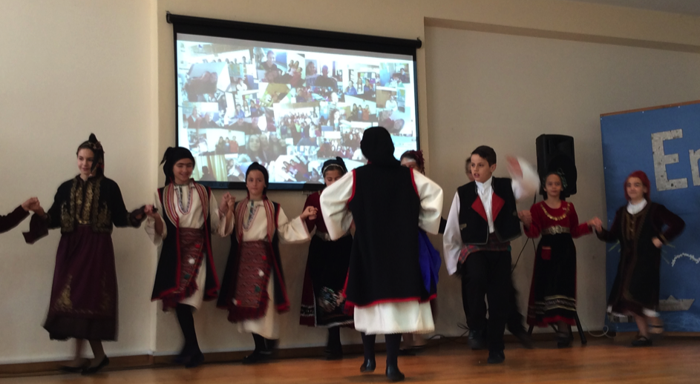
Songs and dances by boys and girls
And traditional Sirtaki

Slide 6
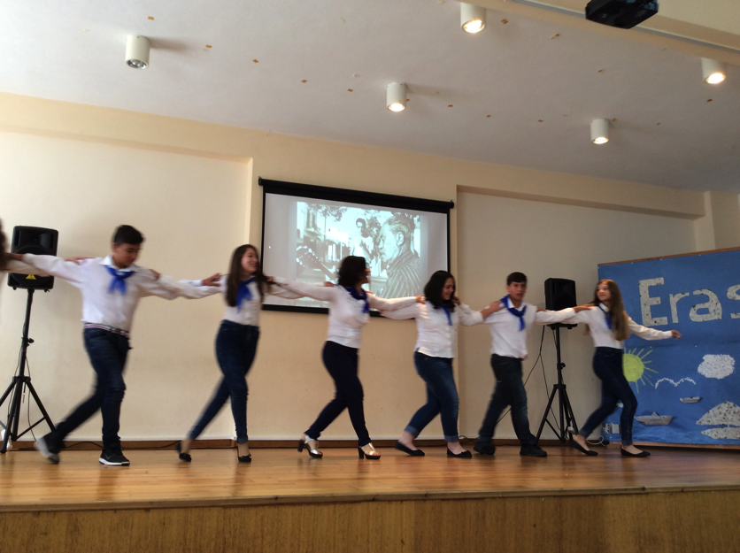
The Sirtaki is contagious and moreover, an Erasmus project is also this!

Slide 7
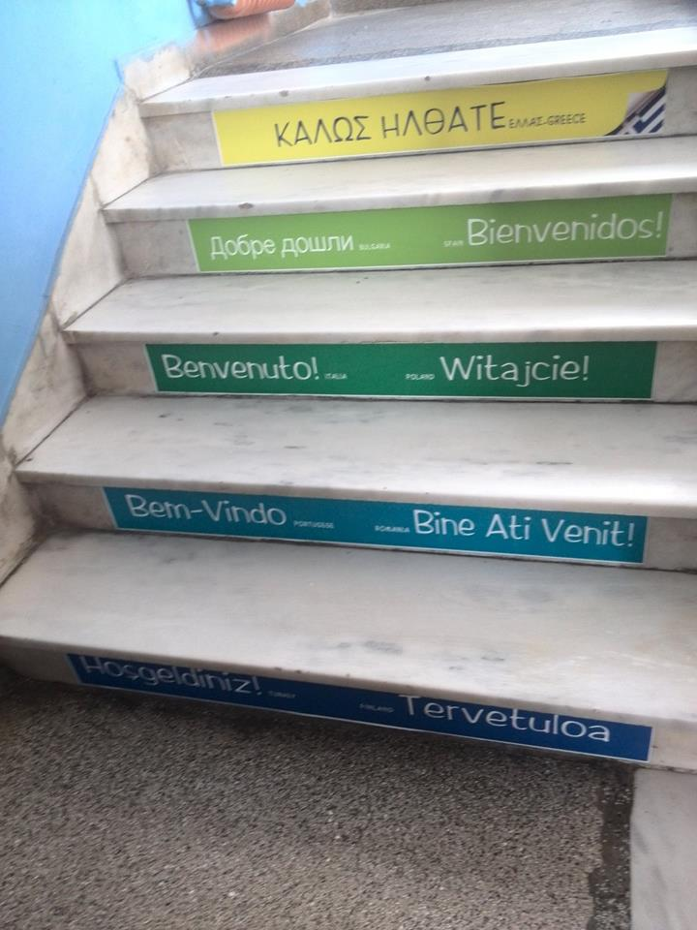
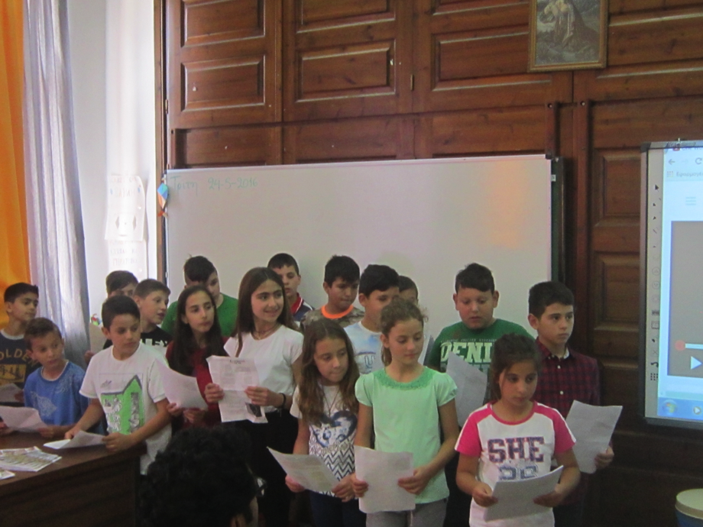
At school to visit classroom, assist to lessons, sing together, exchange presents…

Slide 8
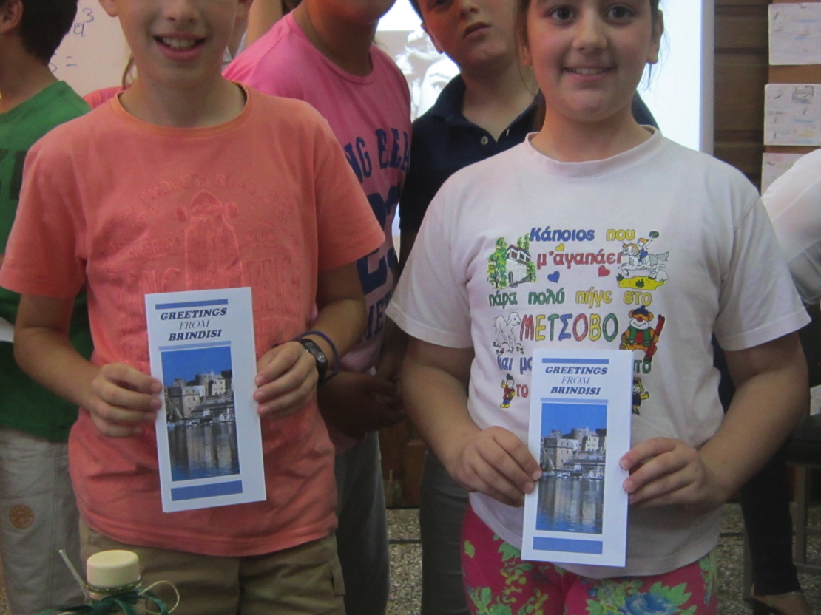
Song, sweets and cards from Italy

Slide 9
With Alexandra Tsiavou Olympic champion Mrs. Alexandra Tsiavou. She is a Greek rower. She won the bronze medal (along with Christina Giazitzidou at the 2012 Summer Olimpics in London and she took the 6th place (along with Chrysi Biskitzi) at the 2008 Summer Olympics in Beijing. She spoke about the importance of equality in sport and she invited the students to follow their own dreams, no matter if they are boys or girls

Slide 10
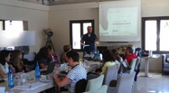
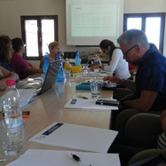
Our meetings’ agenda
Checking timeline;
Discussing some points about the main activities from the next period;
Strategies for dissemination of the project;
Preparing the next exchange of pupils in Finland;
Database equality activities and library;
Doubts, difficulties, purposes.

Slide 11
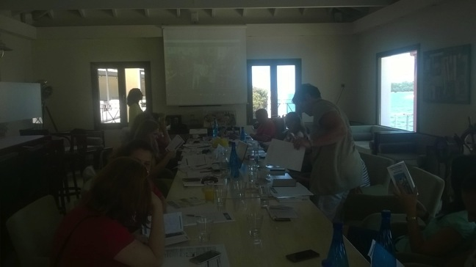
Italy presents its own equality song with a video and puprpose to learn and sing the song in all the school partners

Slide 12
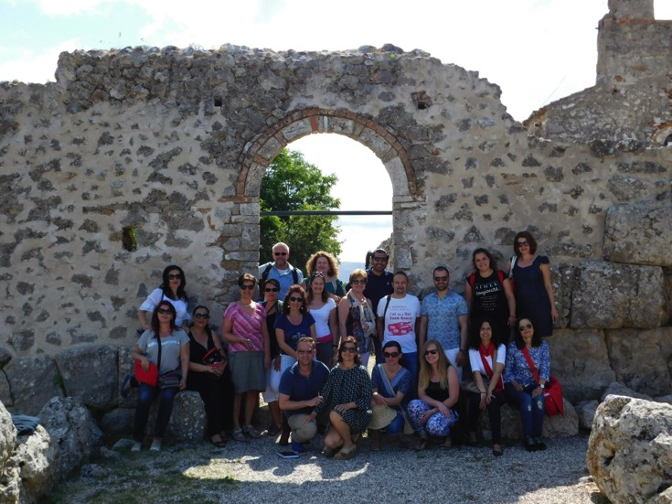
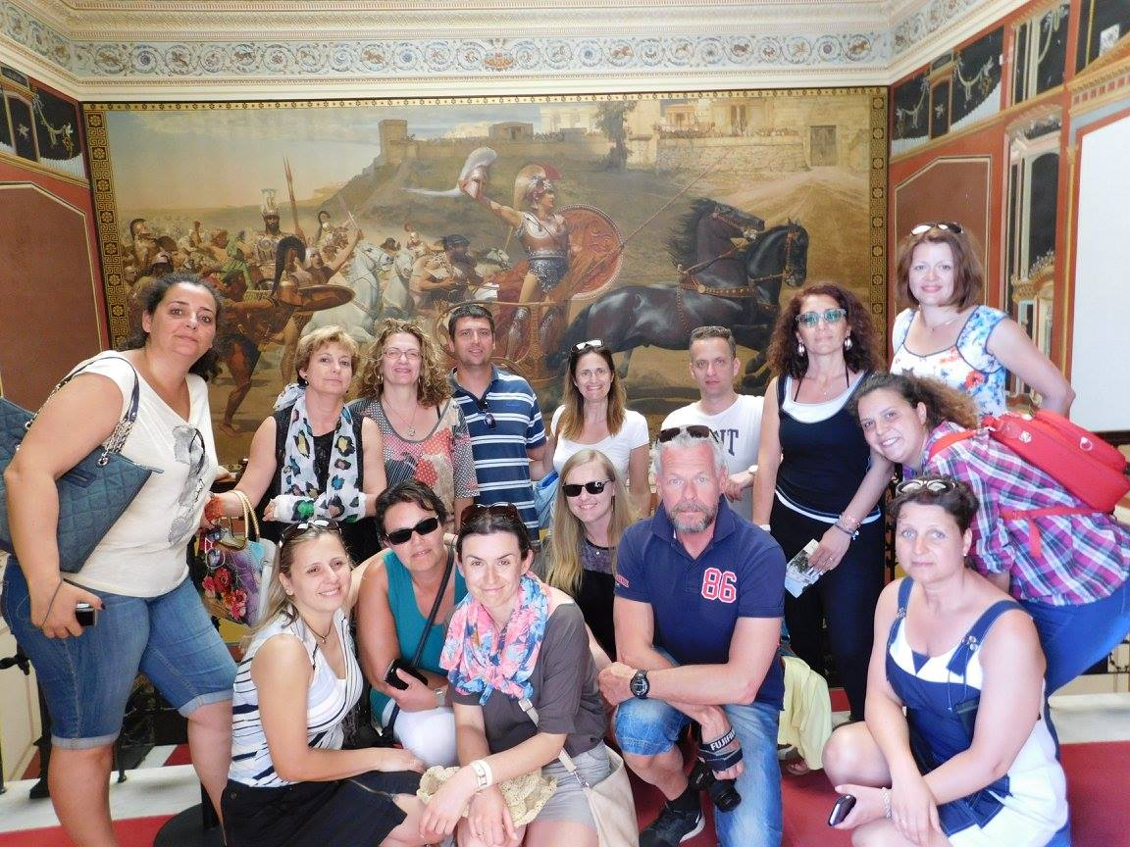
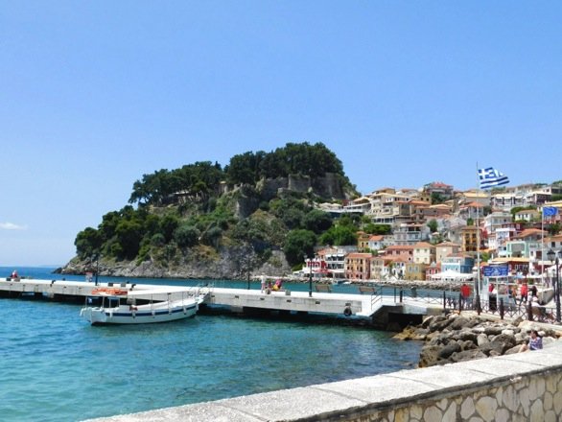
The amazing history of Greece and the blue of its fantastic sea
Parga Town
Nekromanteion
Achilleion (Kerkira)

Slide 13
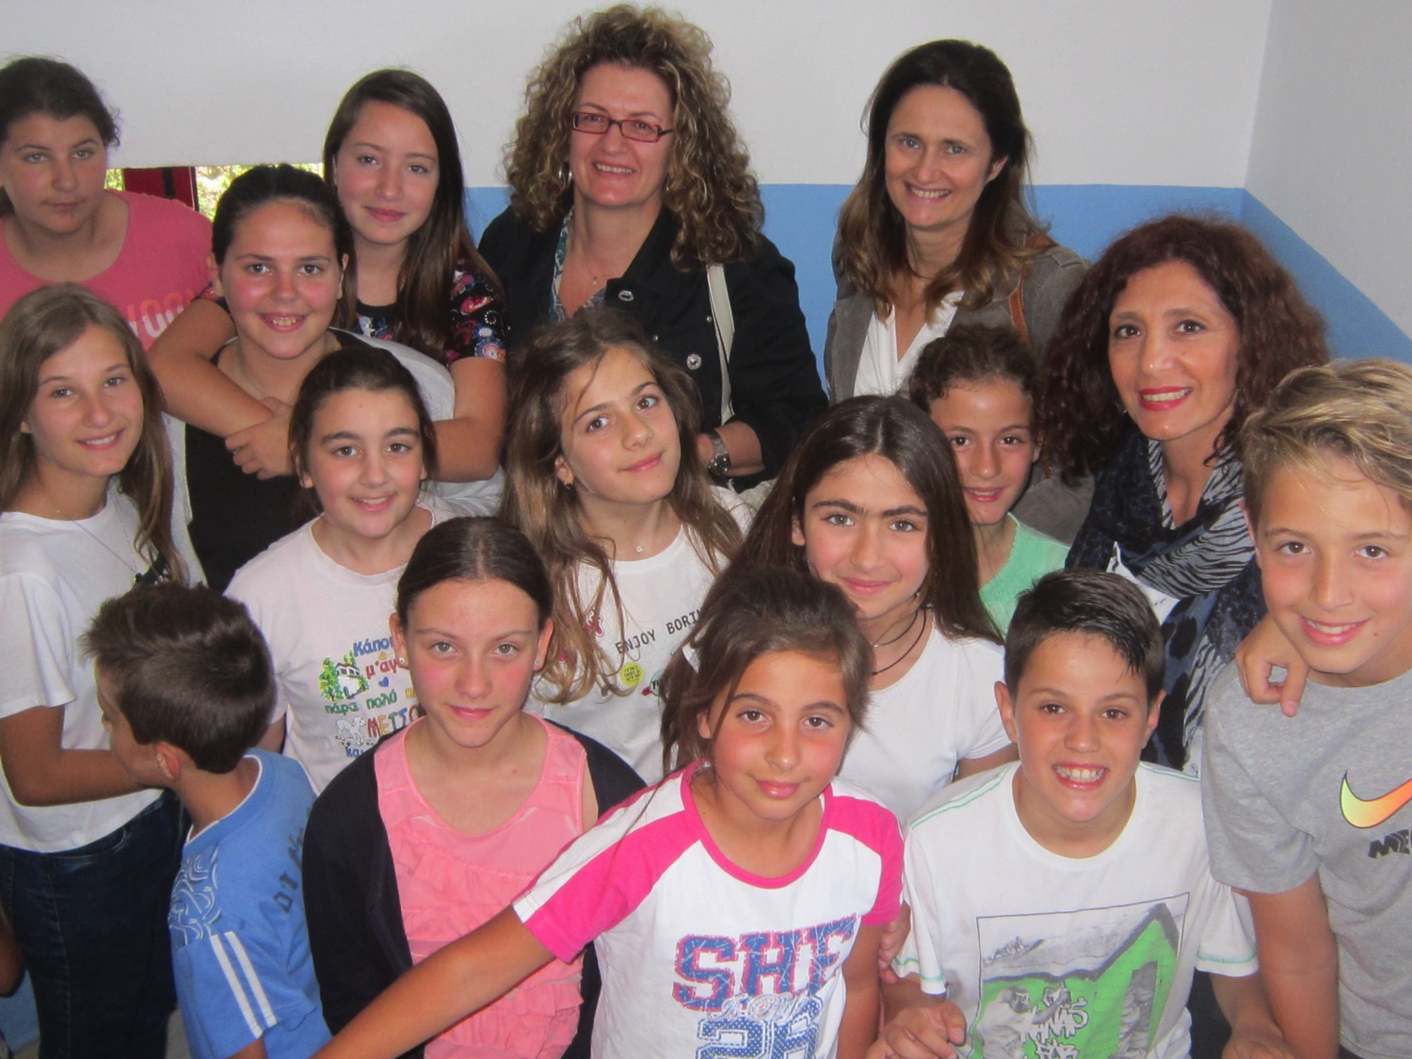
Thank’you!

