Slide 1
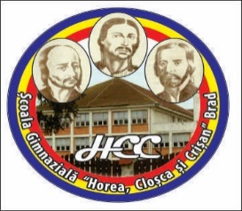
Let`s travel! activity for teaching equality
„Horea, Cloșca and Crișan” Middle School Brad
S/HE’S EQUAL IN EUROPE
This project is funded by the European Commission with the ANPCDEFP support

Slide 2
ARIEȘENI trip
During the intersemestrial holiday, teacher Daniela Tace organized a trip to Arieșeni with the students from our school 5th to 8th degree.
Arieșeni is a big village located in Alba County, Romania which has 18 belongings small villages. It has a population of 1,921.
It is a very popular ski resort among the people of Bihor and Alba counties having 3 ski-slopes: the old one is about 500 meters long, the second about 1,000 m and the third one, opened in January 2011 is the longest having 1,600 m.
The first ski lift in Romania was installed in Arieșeni and with the opening of the new slope, the resorts has also got a brand new funicular. There are several notable natural tourist sites such as the Vârciorog Waterfall, Ghețarul de la Scărișoara, Groapa Ruginoasă, Piatra Grăitoare, Pătrăhăițești village, Bihorul Peak (1848m).

Slide 3
Attending group

Slide 4
On the slope

Slide 5
For tree days

Slide 6
Having fun together

Slide 7
Waiting for our lunch
.

Slide 8
Unfortunately... Back home!

