Slide 1
MEETING with Vanessa Scalera: the actress who played the role of Lea Garofalo
DISCUSSION

Slide 2
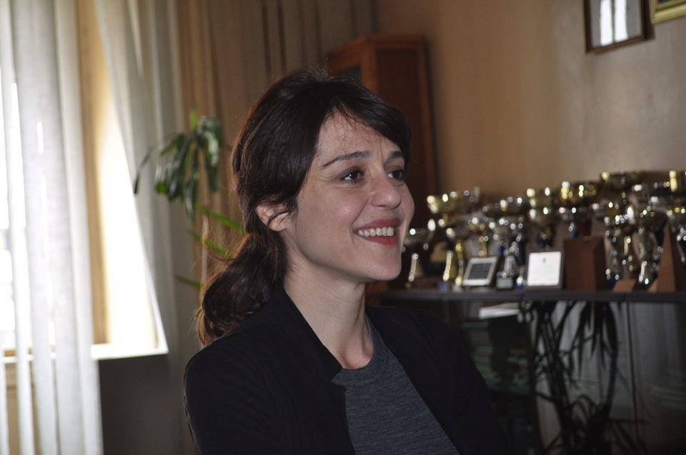
Vanessa is in our school…

Slide 3
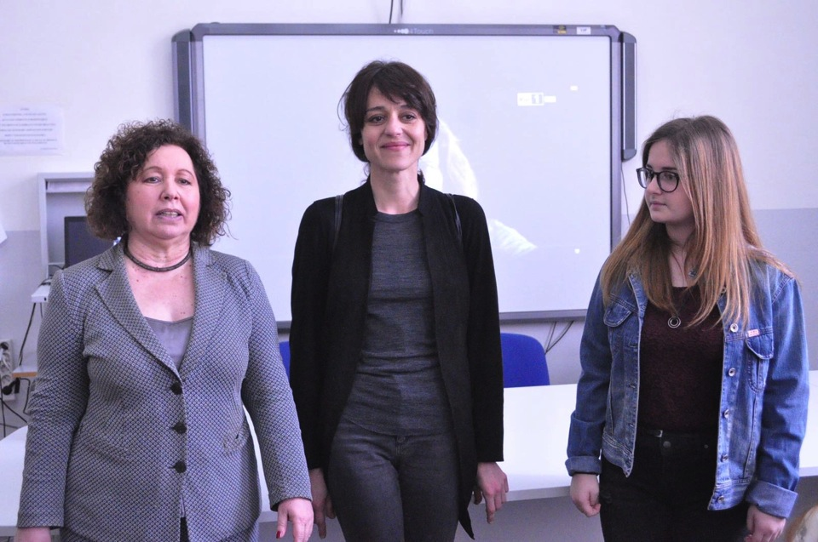
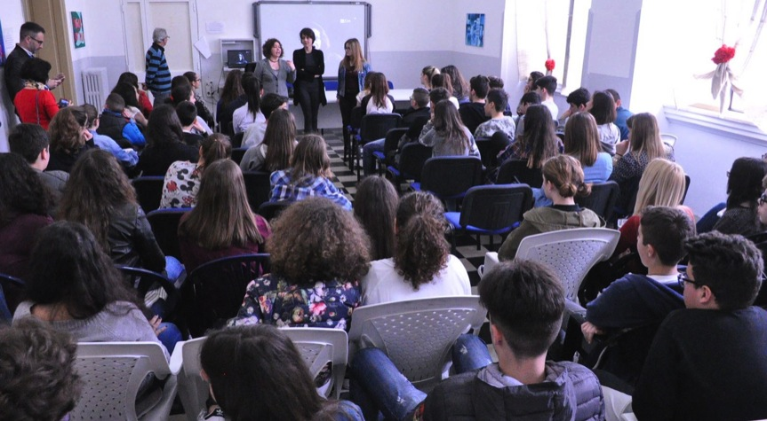
Introducing Vanessa

Slide 4
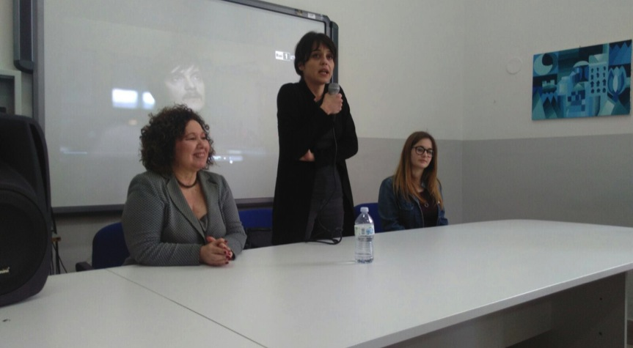
We review together some scenes of the movie… Vanessa tells us about his acting experience, but also about research and reflection on a civil reality in which women are often slaves of a system that you can only fight risking your own life

Slide 5
In Brindisi we have the major of kids and she is our spokesperson, but also a young woman who already can speak about her citizenship experience

Slide 6
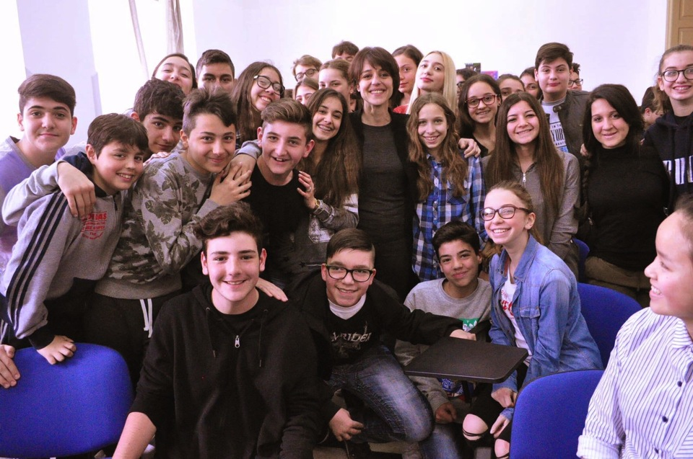
At the end… Who can resist the temptation of a photo with a celebrity?

