Slide 1
SPORTS AND EQUALITY
ERASMUS+ PROJECT
ISTITUTO COMPRENSIVO CENTRO1-BRINDISI-
ITALY

Slide 2
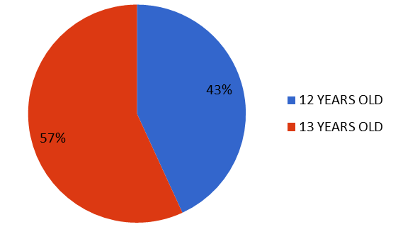
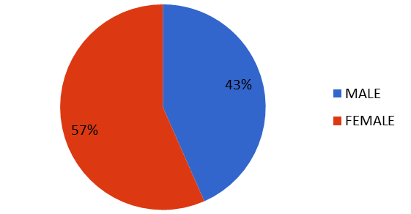
GENDER
AGE

Slide 3
DO YOU USUALLY PRACTICE SPORTS?
WHICH ONES?

Slide 4
WHAT IS YOUR FAVOURITE SPORT?

Slide 5
HOW OFTEN DO YOU PRACTICE SPORT?

Slide 6
DO YOU PLAY OR PRACTICE SPORTS WITH BOYS AND GIRLS AT SCHOOL?

Slide 7
Write the name of 3 sports that can be played/practiced by men and women together

Slide 8
Do you know any sport that can be played/practiced by people who have any type of special need?

Slide 9
Do you know any sport that can be played/practiced only by boys or men?
Do you know any sport that can be played-practiced only by girls or women?

Slide 10
Write the name of 3 women who are famous for practicing sport

