Slide 1
I.C.Centro 1
Equality Compromise

Slide 2
After thinking generated during the various activities, our students have discussed an agreement to respect in order to faight discriminatory attitudes.
Everyone has been invited to propose an ideal behave.
Then, some of them have made a billboard on which to affix their own signatures.

Slide 3
Here are our agreements!
1 -Listen to other people and respect any opinion without gender differences.
2 -Watch or play sports without sex discriminations.
3 -Don’t have gender prejudices in politics.
4 -Don’t discriminate boys who are ballet dancers or girls who are footballers.
5 -Work together without differences between men and women.
6 -Don’t use nicknames or offensive names.
7 -Always share ideas with other people

Slide 4
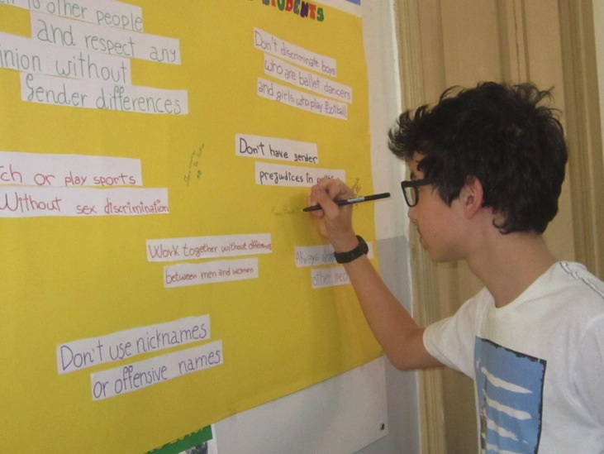
Let’s sign!

Slide 5
Boys and girls…everybody wants

Slide 6
You are signing and we all can see you!

Slide 7
Now the deal is there.
Everyone can see it and remember the commitment made with their peers.

