Slide 1
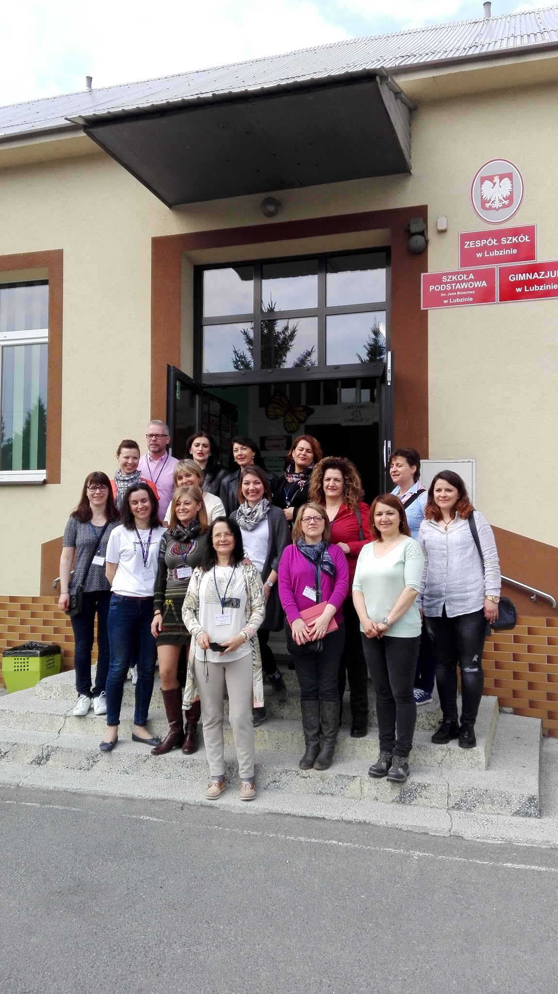
Erasmus +
POLAND
3rd-8th APRIL 2017
I.C.”CENTRO 1” BRINDISI

Slide 2
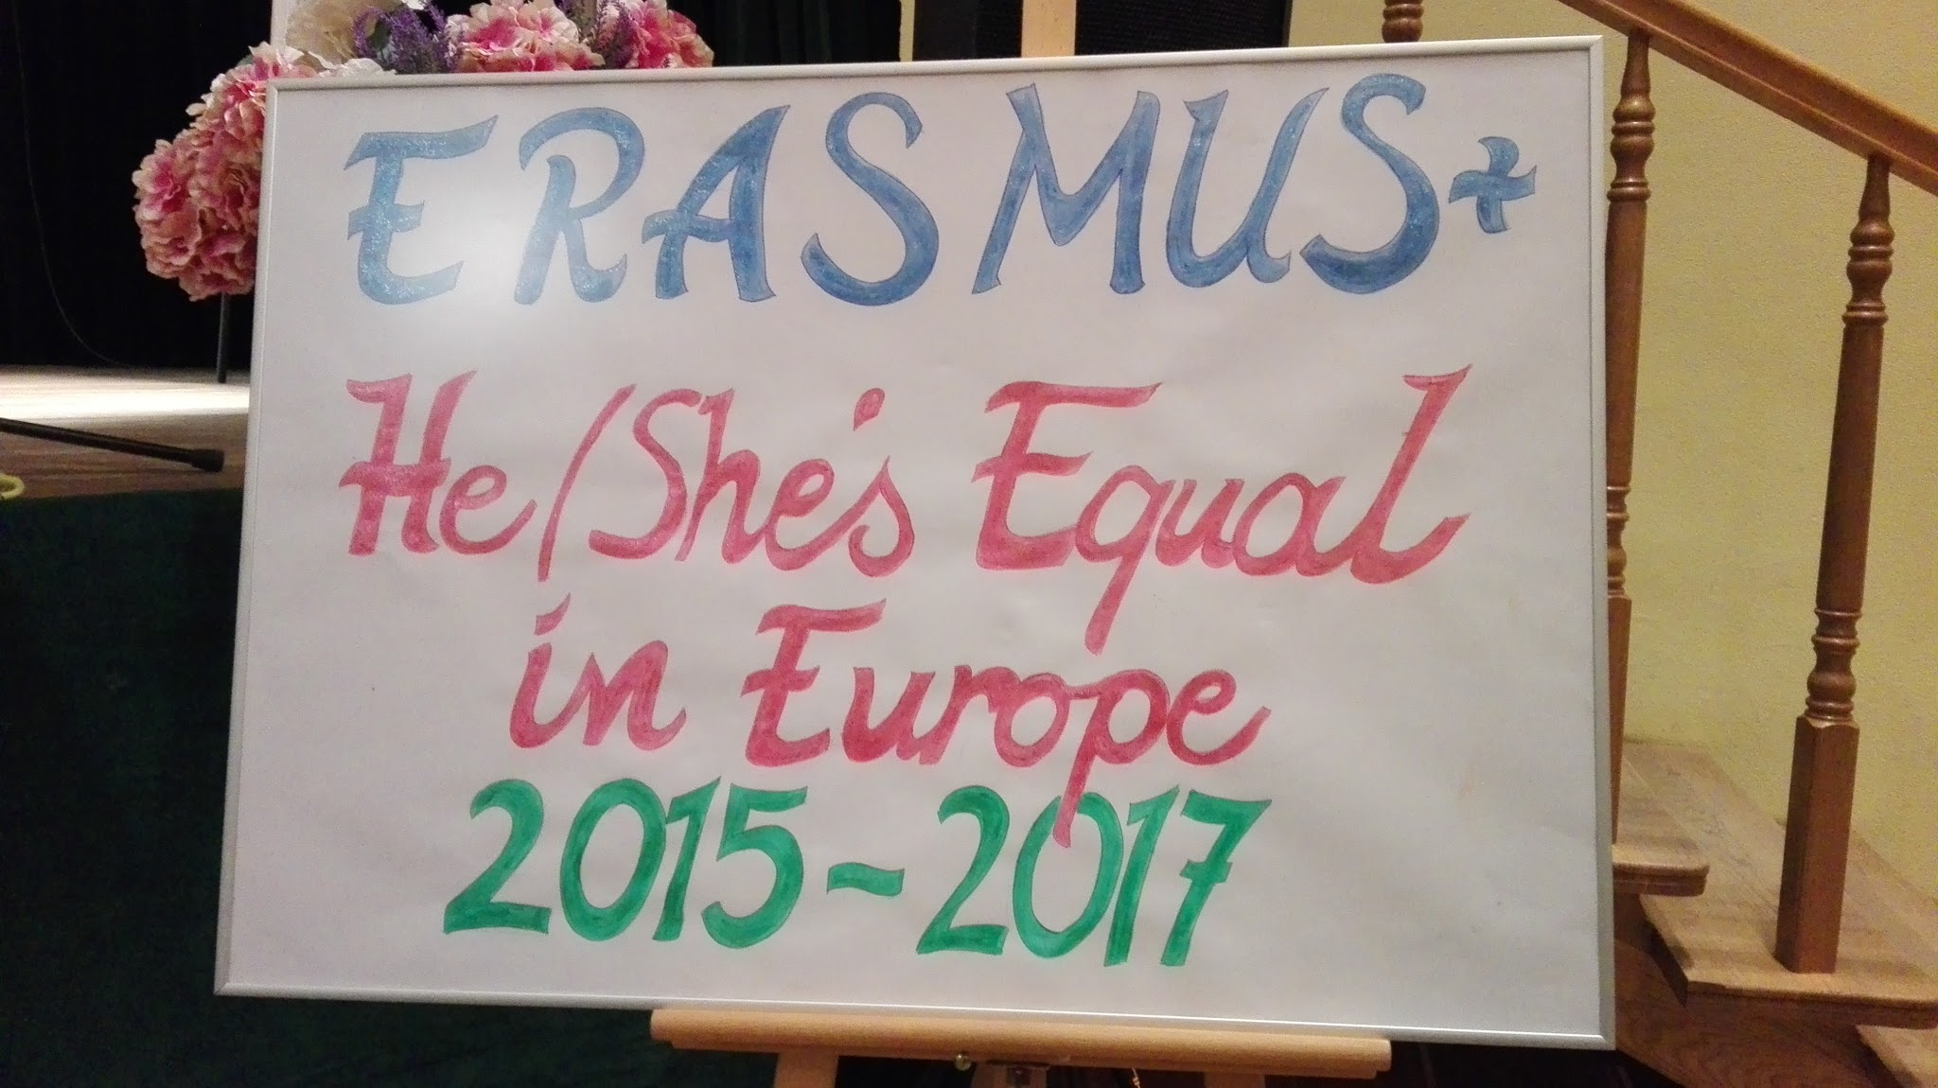
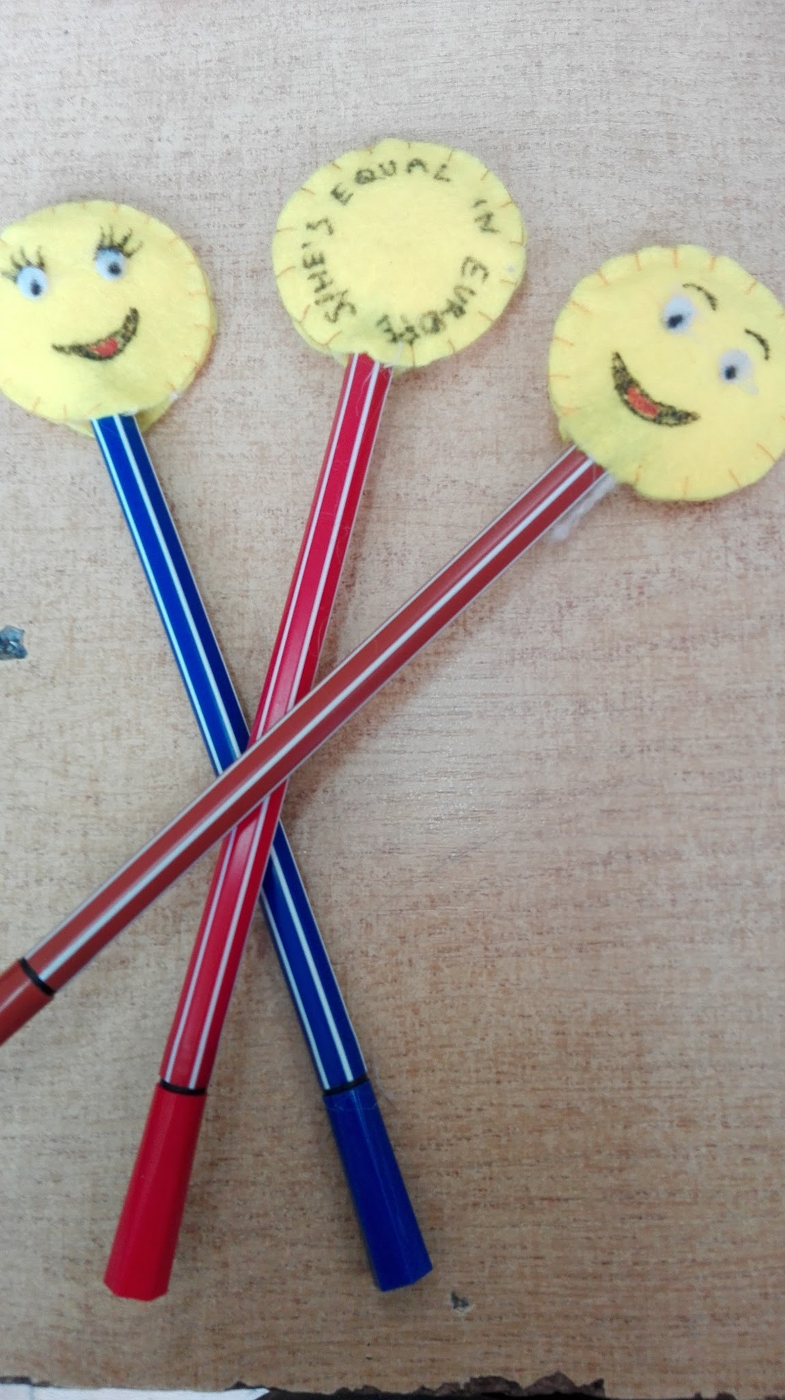
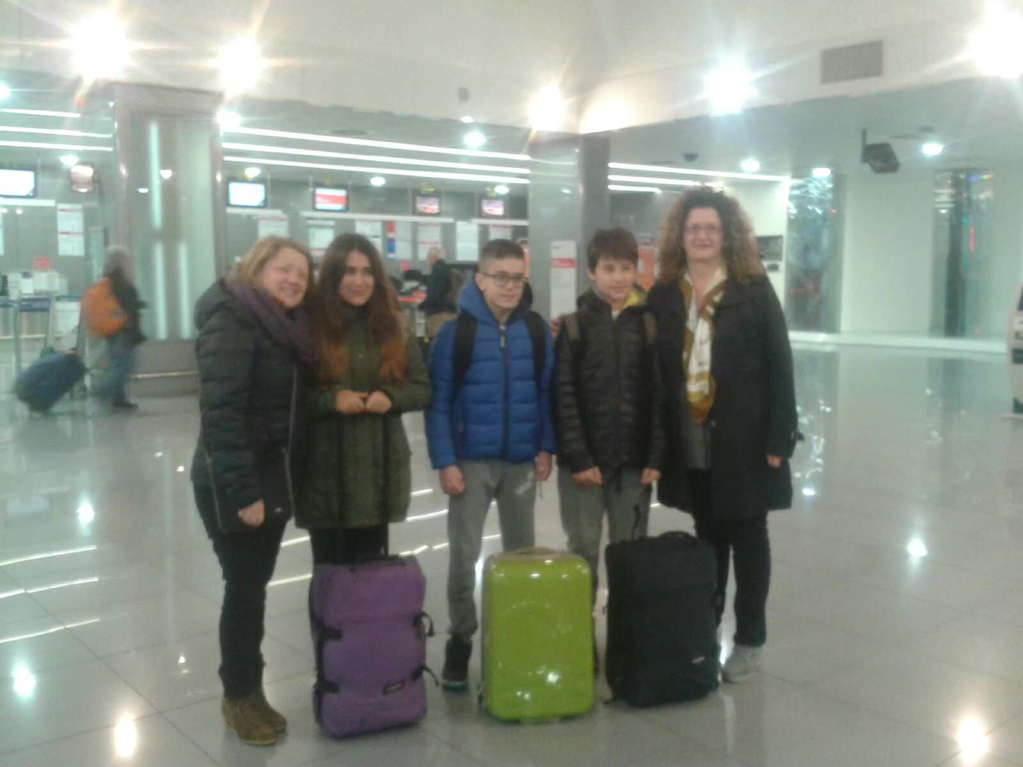
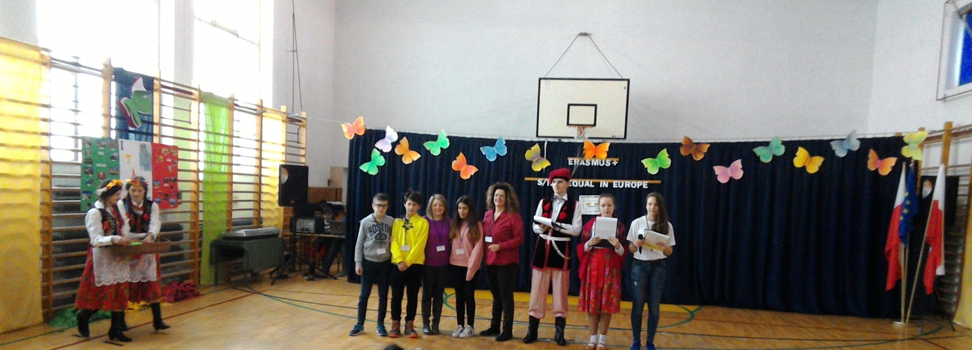
THE PROGRAMME IS RICH, OUR
EXPECTATIONS ARE HIGH, BUT THE
ITALIAN TEAM IS READY TO LIVE
THIS NEW EXPERIENCE!

Slide 3
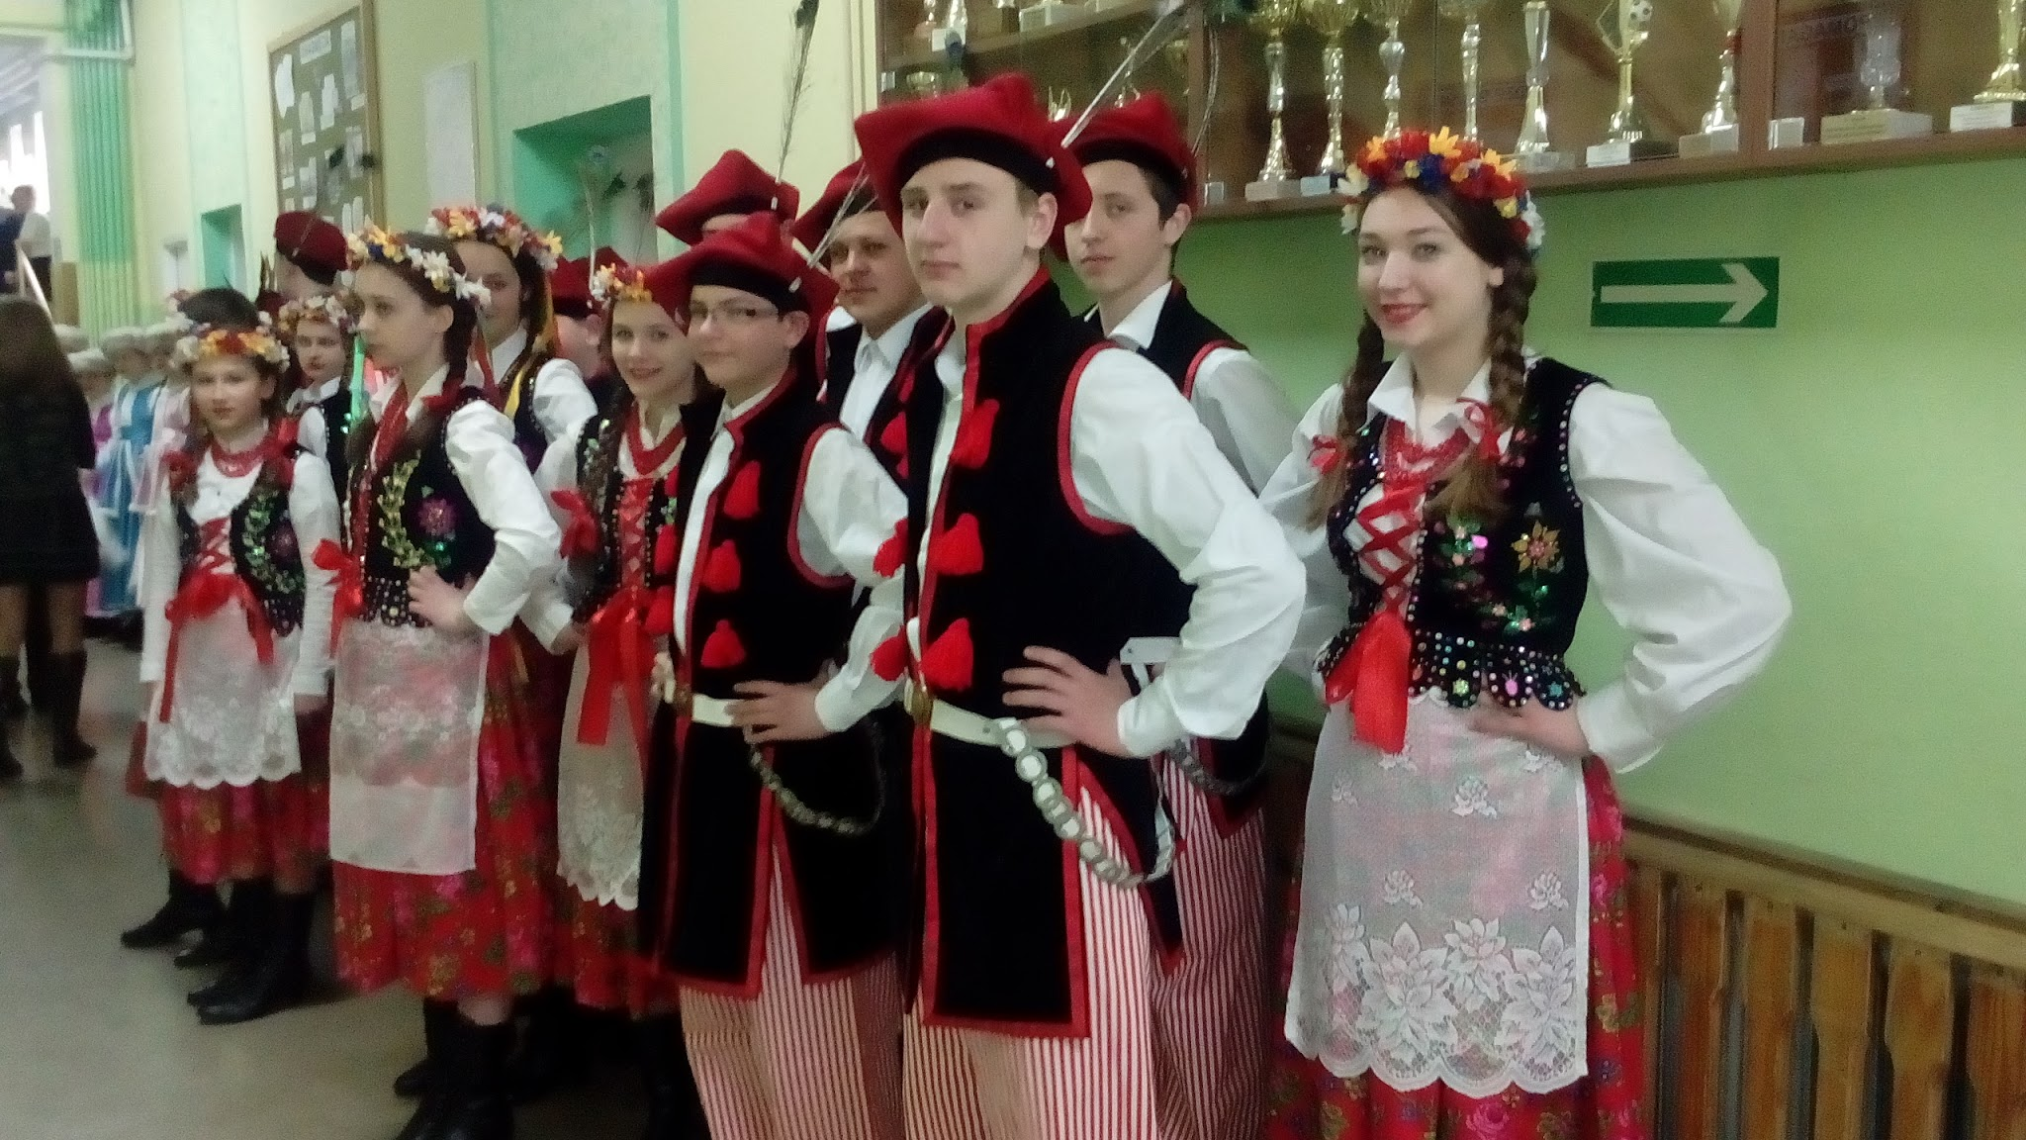
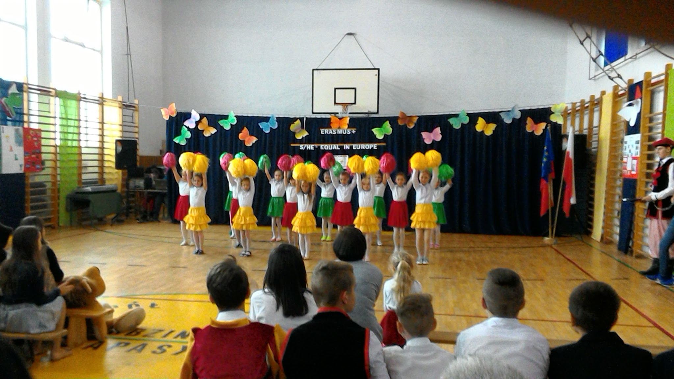
Welcome ceremony at school
WITH A GLANCE TO TRADITION, A TOUCH OF MODERNITY AND PLENTY OF COLOURS, WE ARE WELCOMED!

Slide 4
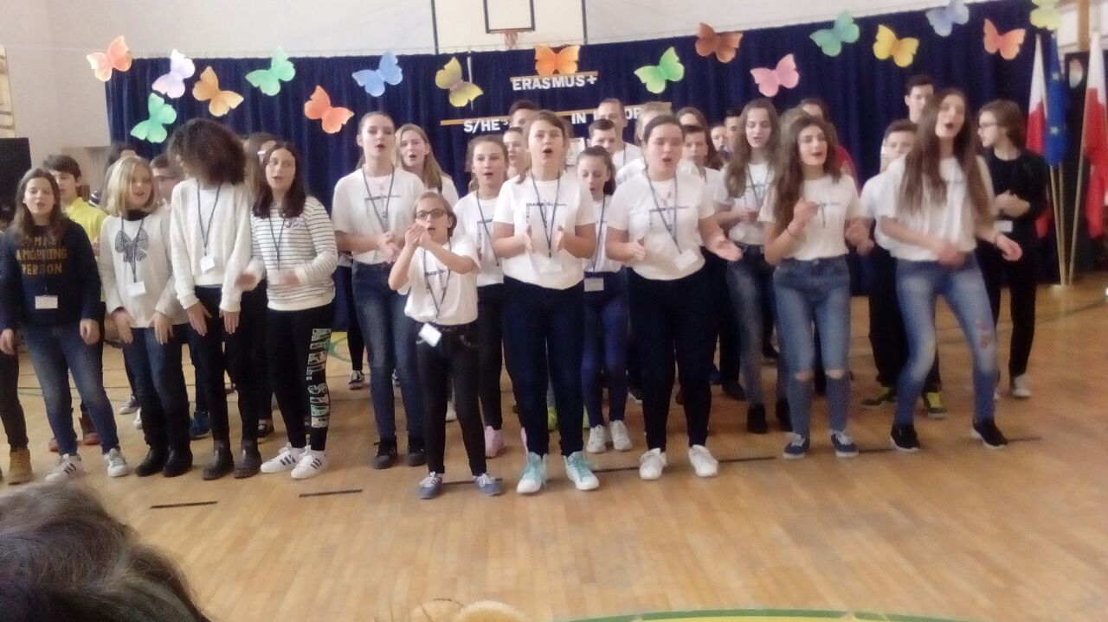
let’s
sing!
WE ARE VERY PROUD! ALL THE ERASMUS+ PARTNERS SING THE EQUALITY SONG
AFTER ITALIAN STUDENTS COMPOSED IT ON THE TUNE OF “WE WILL ROCK YOU”(QUEEN)!
ehi we are
boys…..
ehi we are
girls...
we are
we are equal…
equal!

Slide 5
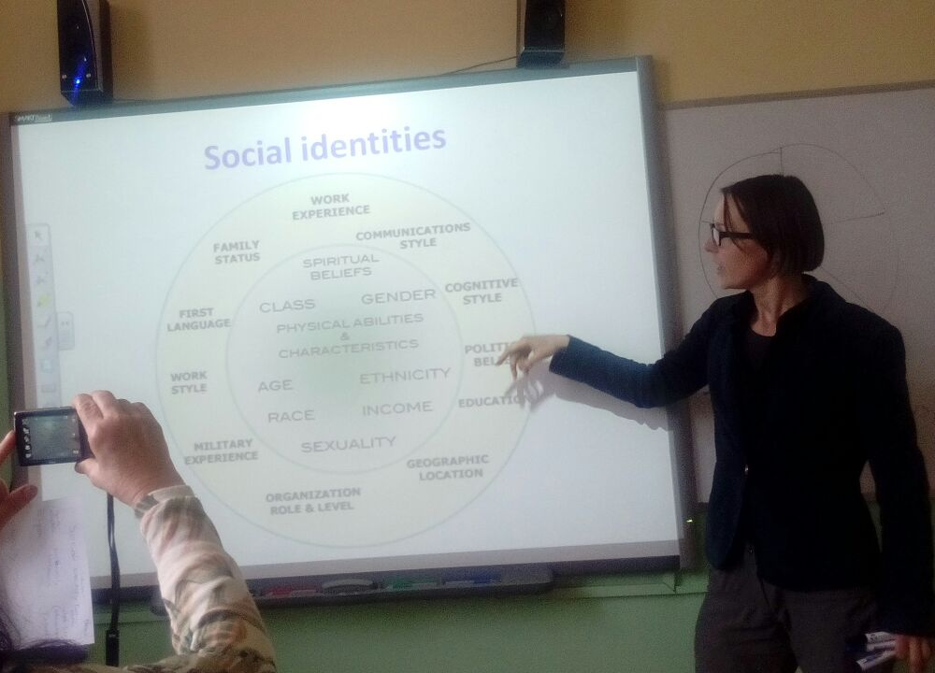
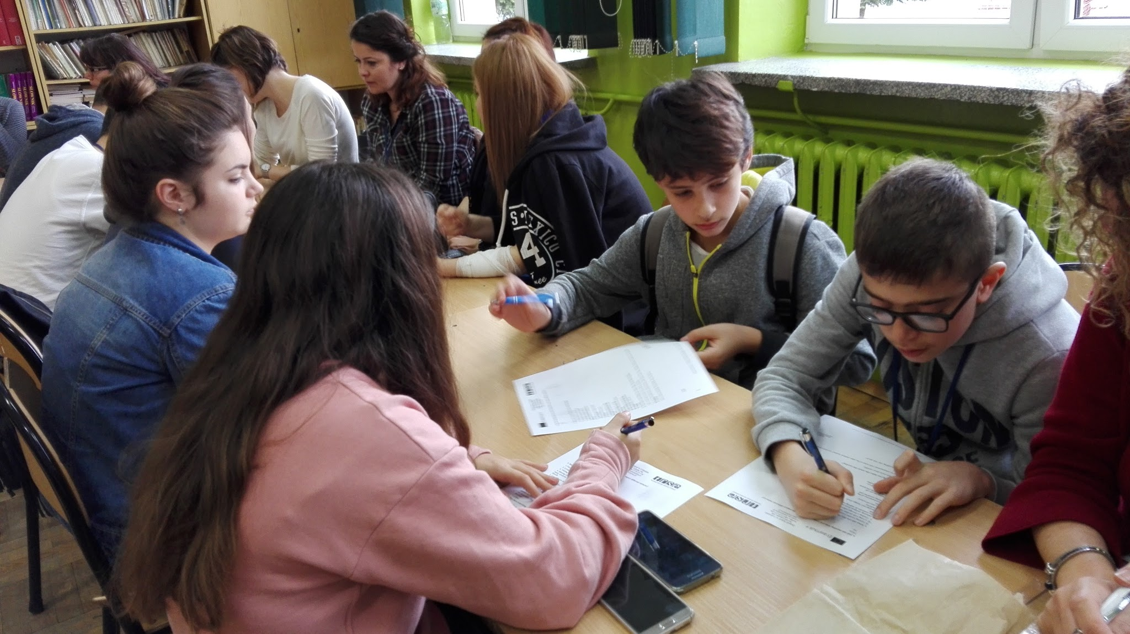
Workshops for teachers and students
TOLERANCE, SOCIAL IDENTITIES AND GENDER EQUALITY ARE AMONG THE MAIN TOPICS OF OUR MEETING

Slide 6
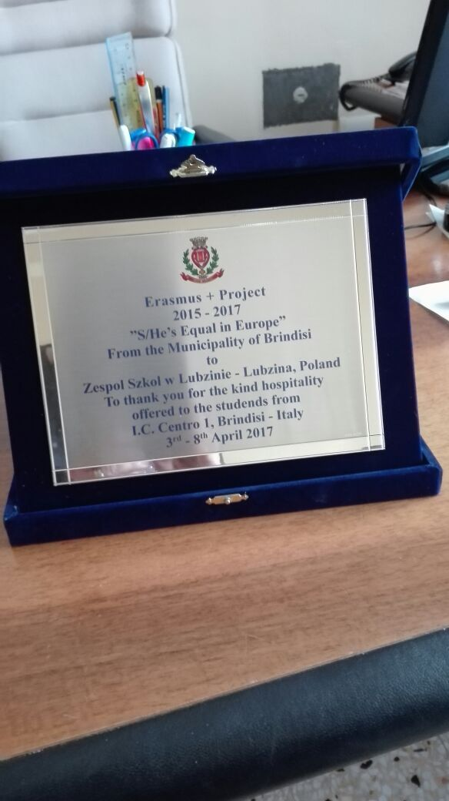
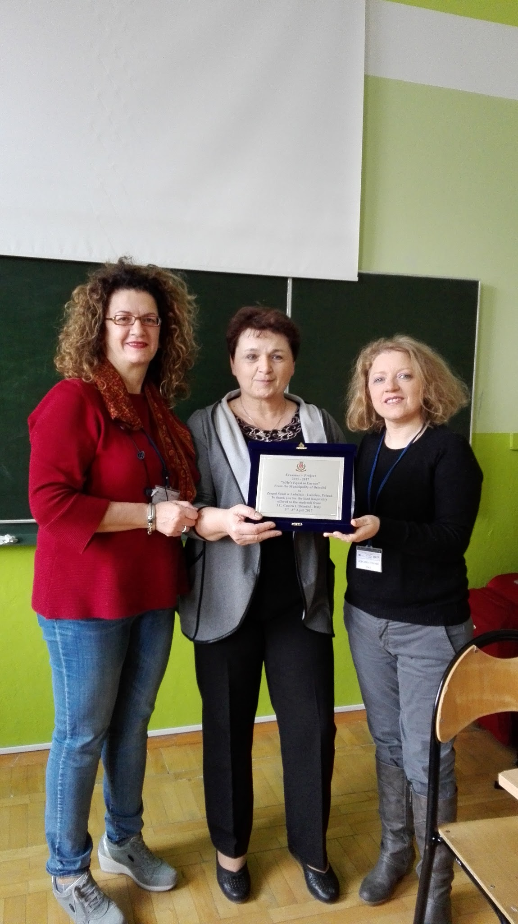
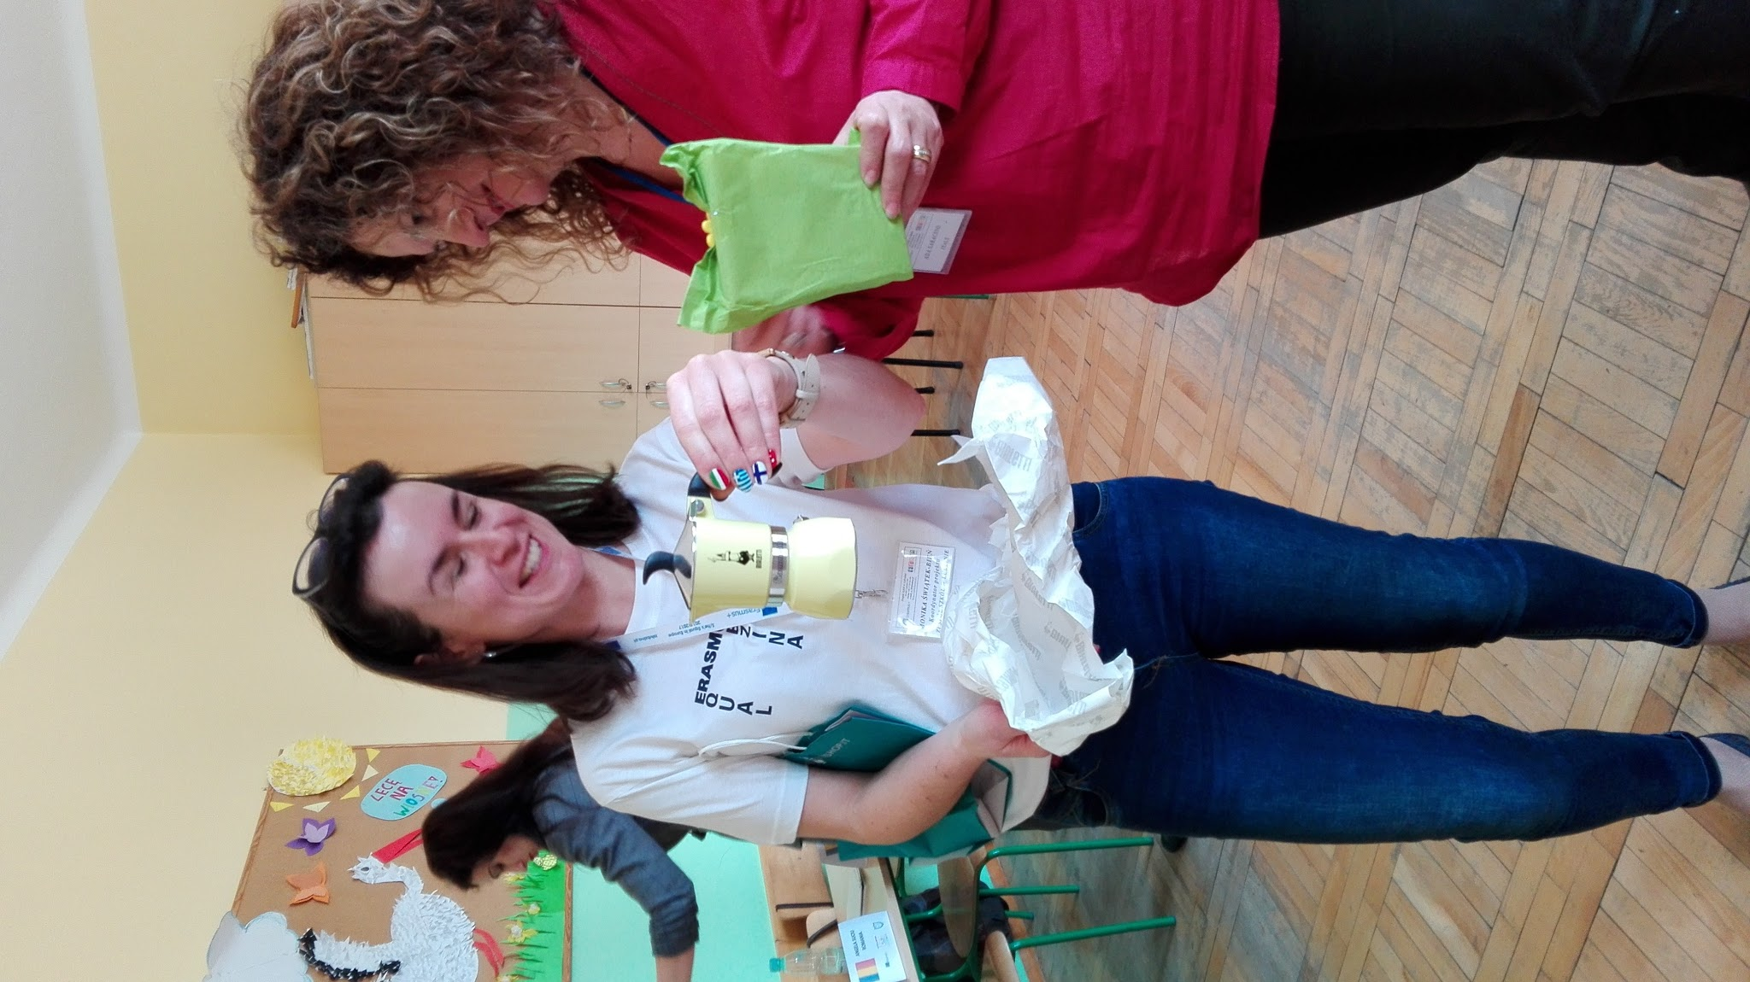
GIFTS...
A FEW PRESENTS TO SAY THANK YOU TO OUR PARTNERS FOR THE NICE HOSPITALITY!

Slide 7
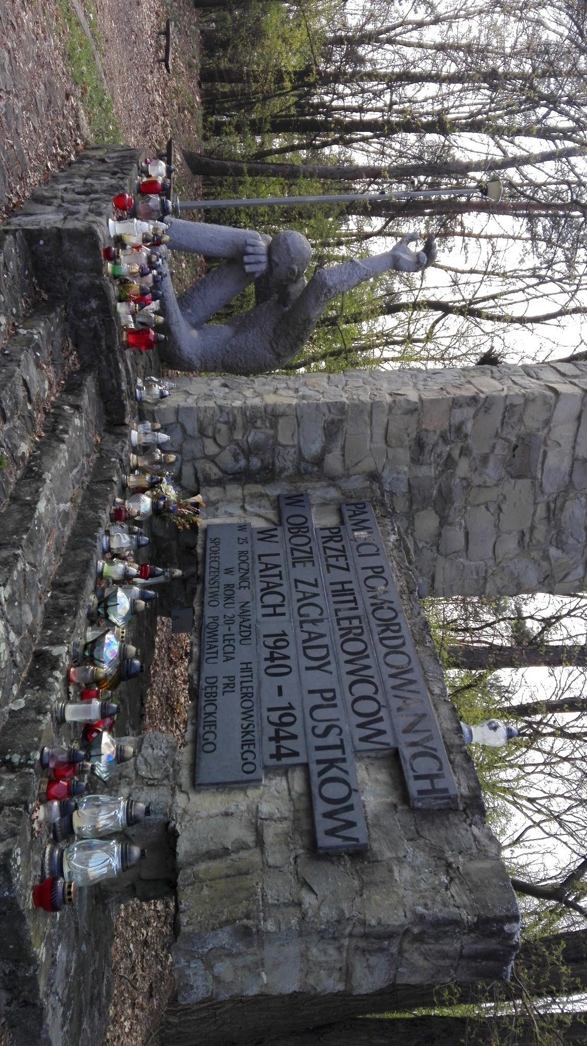
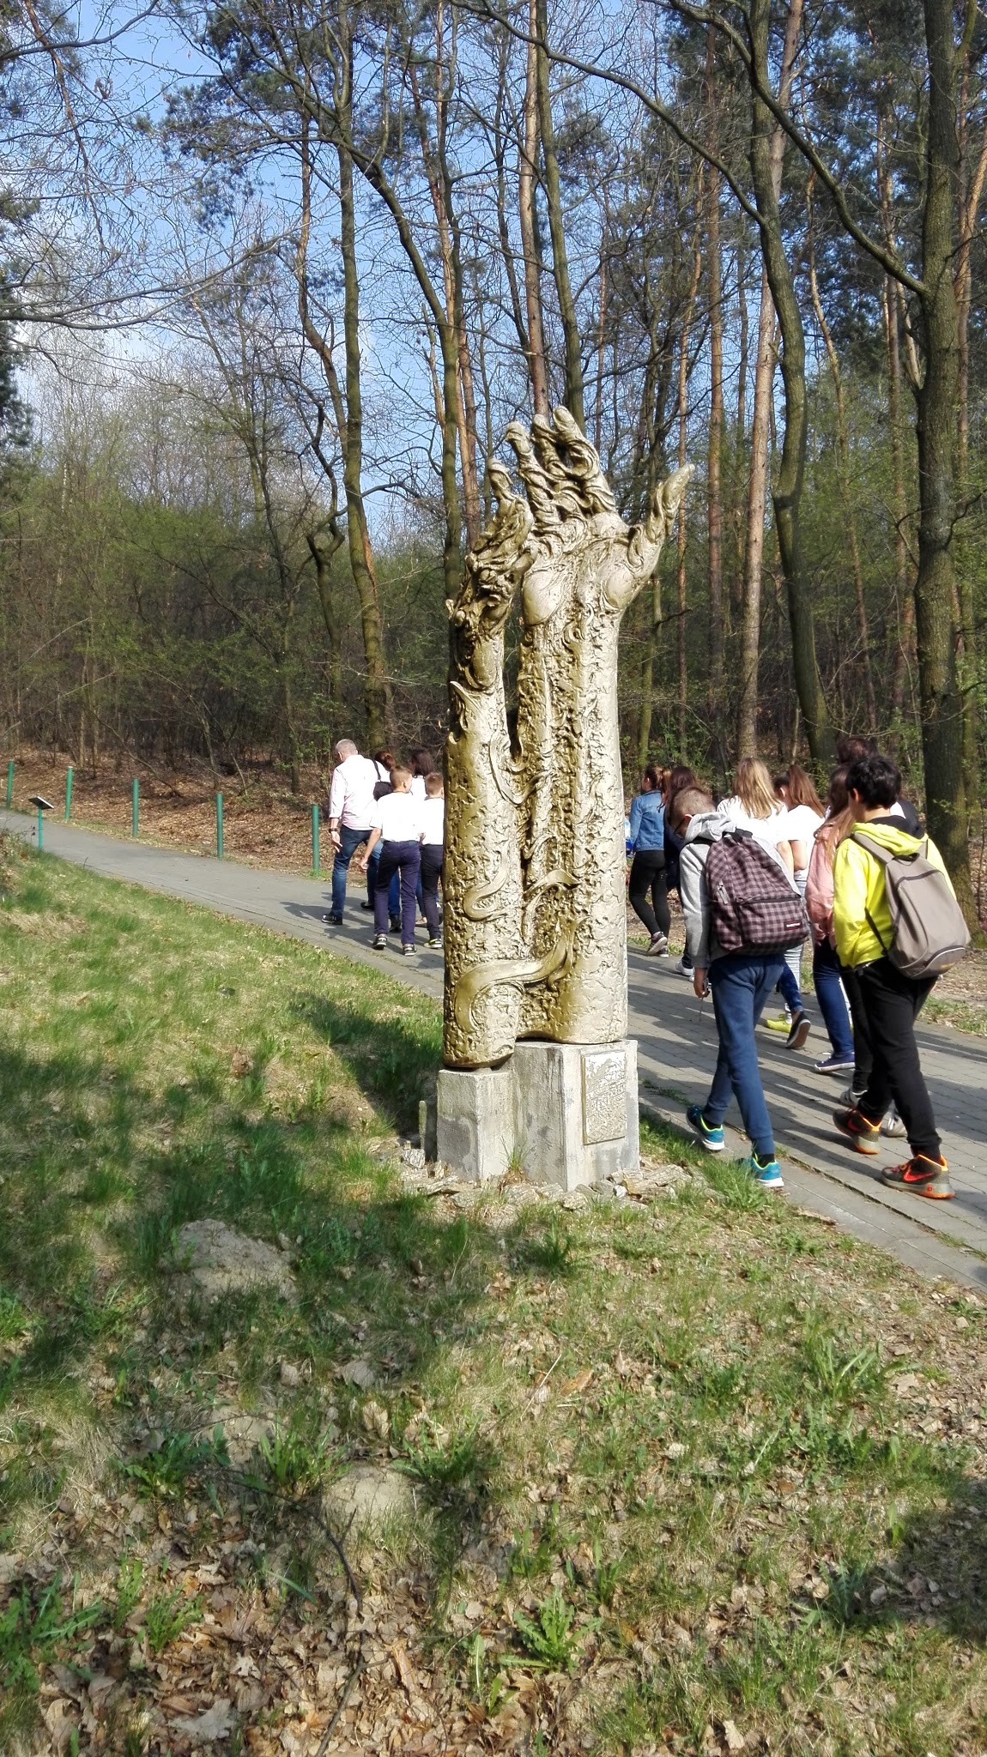
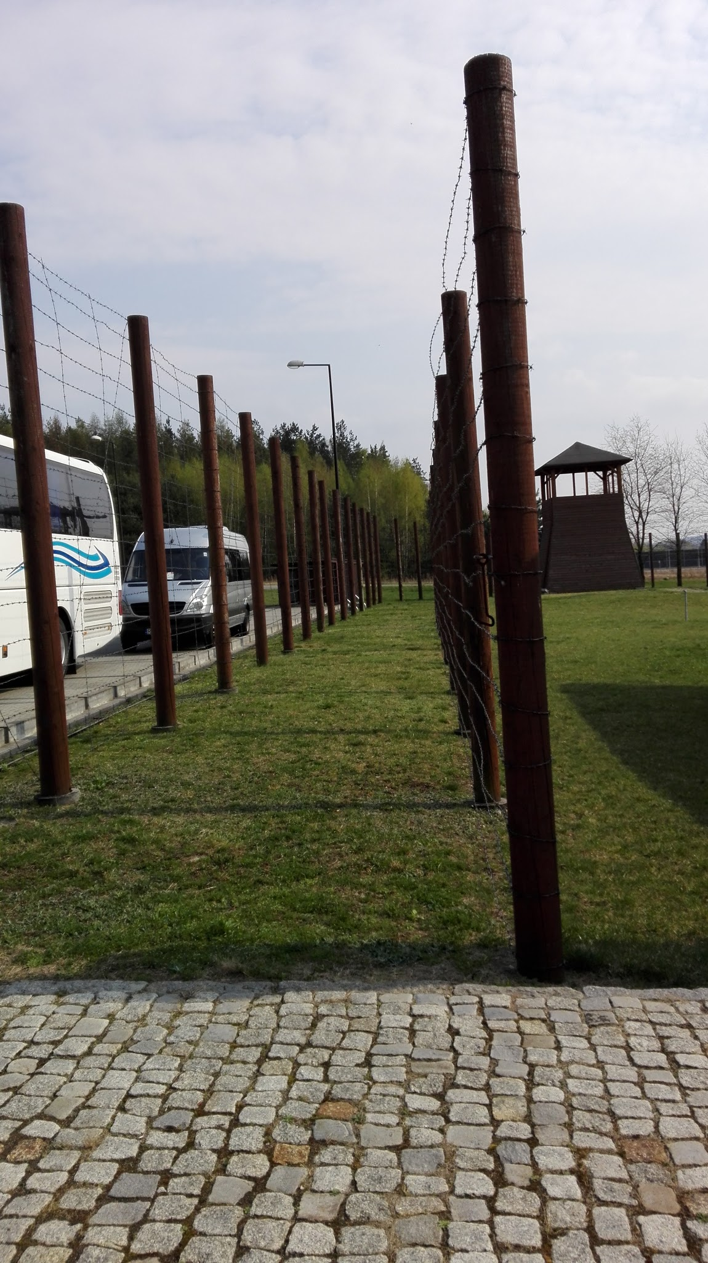
Visiting the European Centre of Remembrance and Reconciliation in Pustkow, where History and human kind are given the chance to repair to their mistakes and never repeat them again.

Slide 8
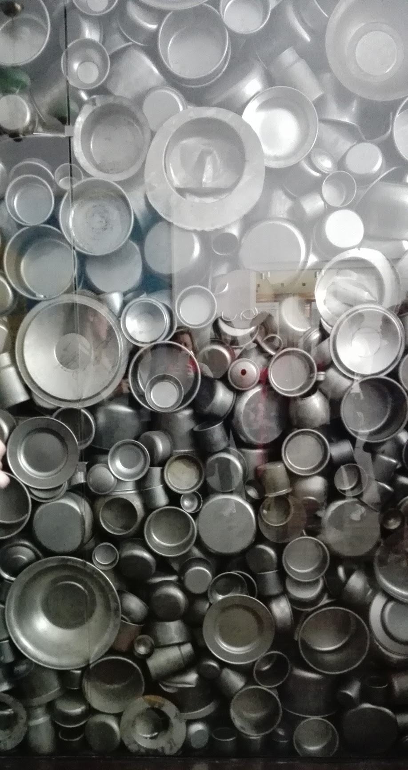
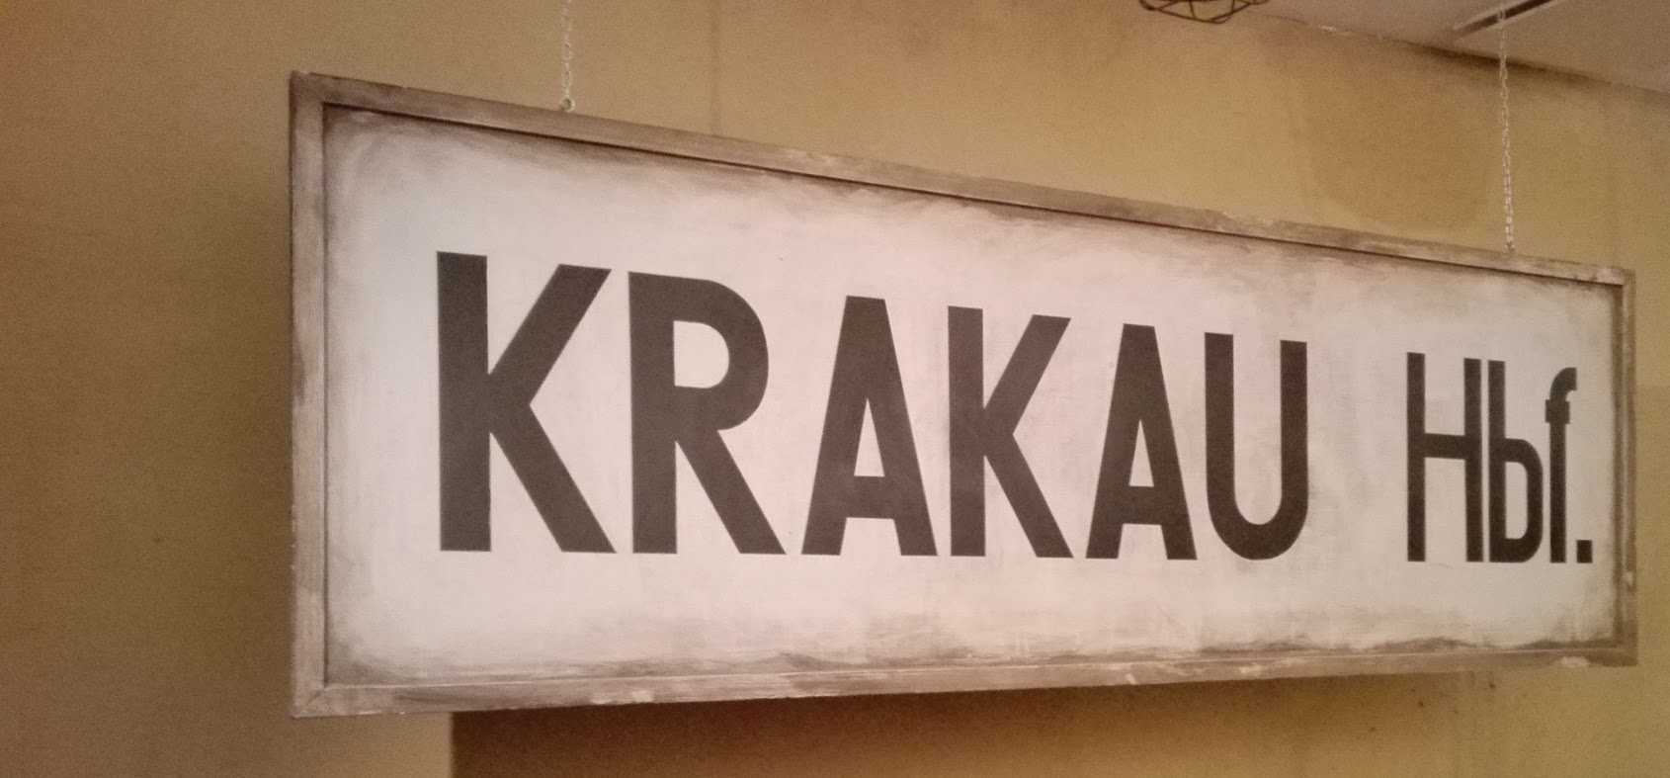
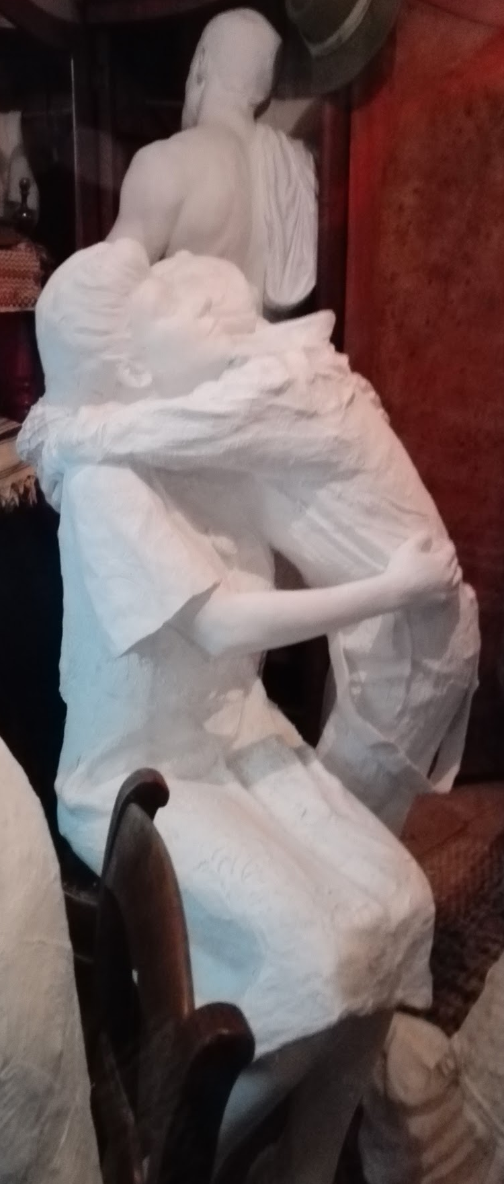
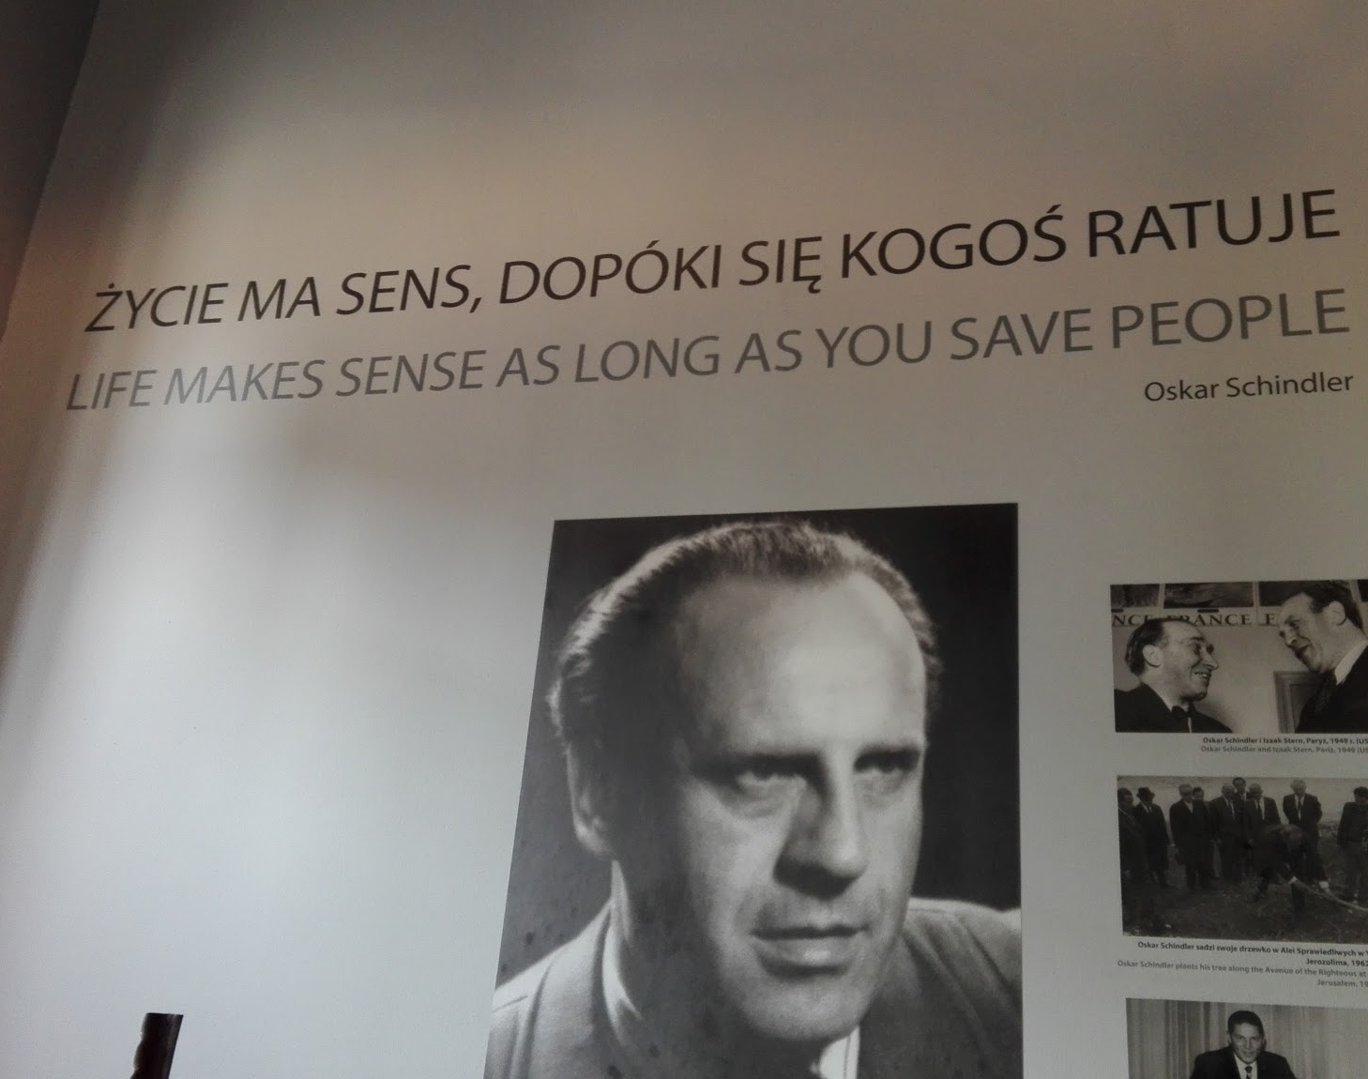
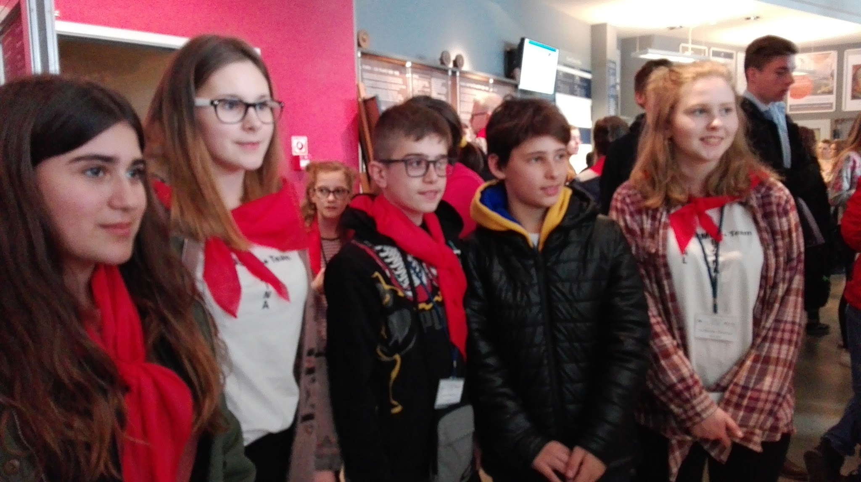
Visiting Krakow and learning about its history and its heroes
OSKAR SCHILNDLER’S ENAMEL FACTORY AND KAZIMIERZ HISTORICAL DISTRICT OF KRAKOW

Slide 9
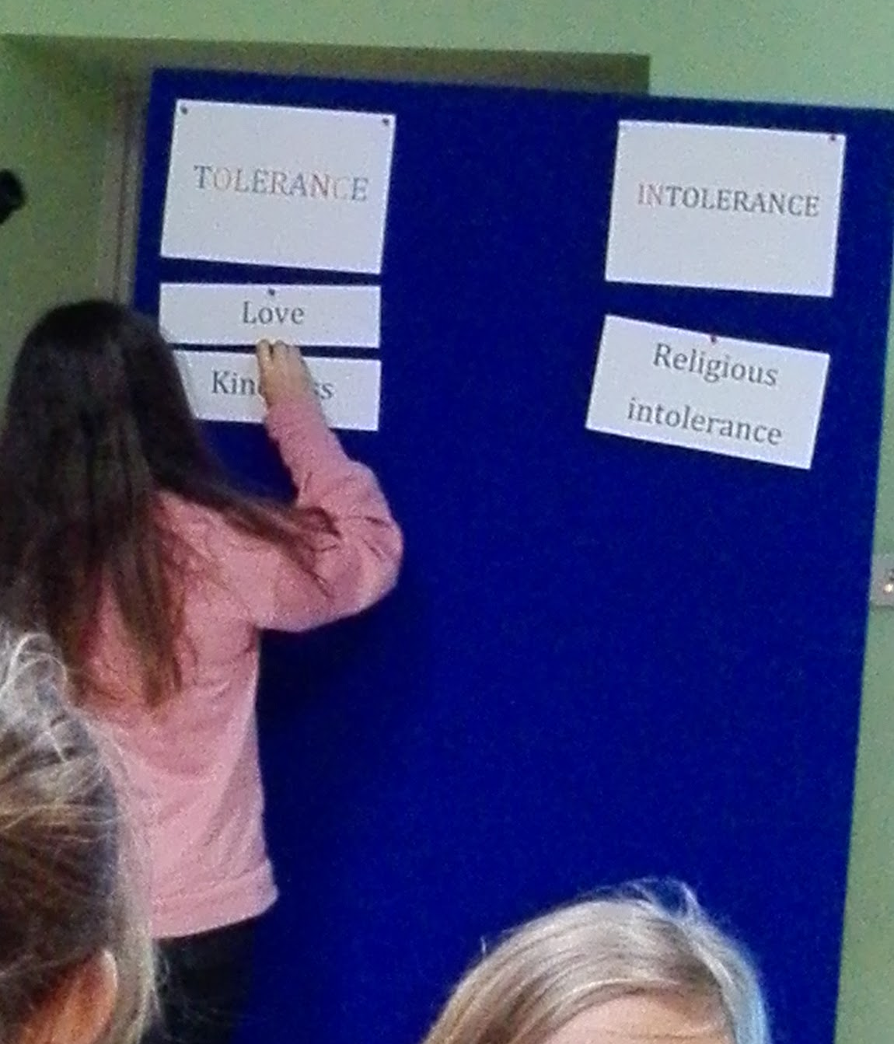
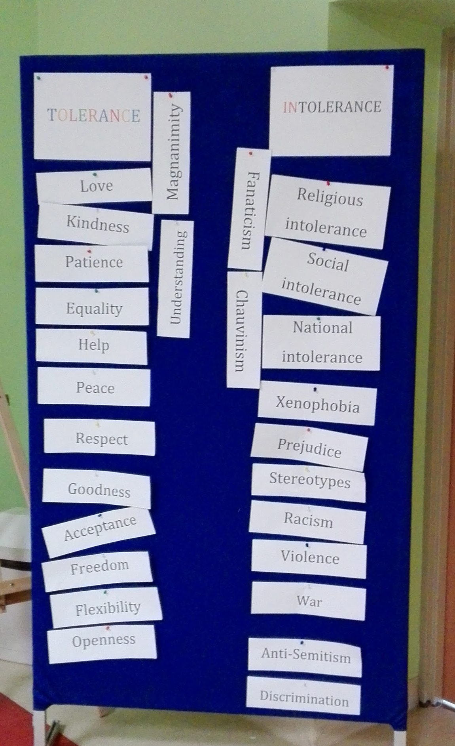
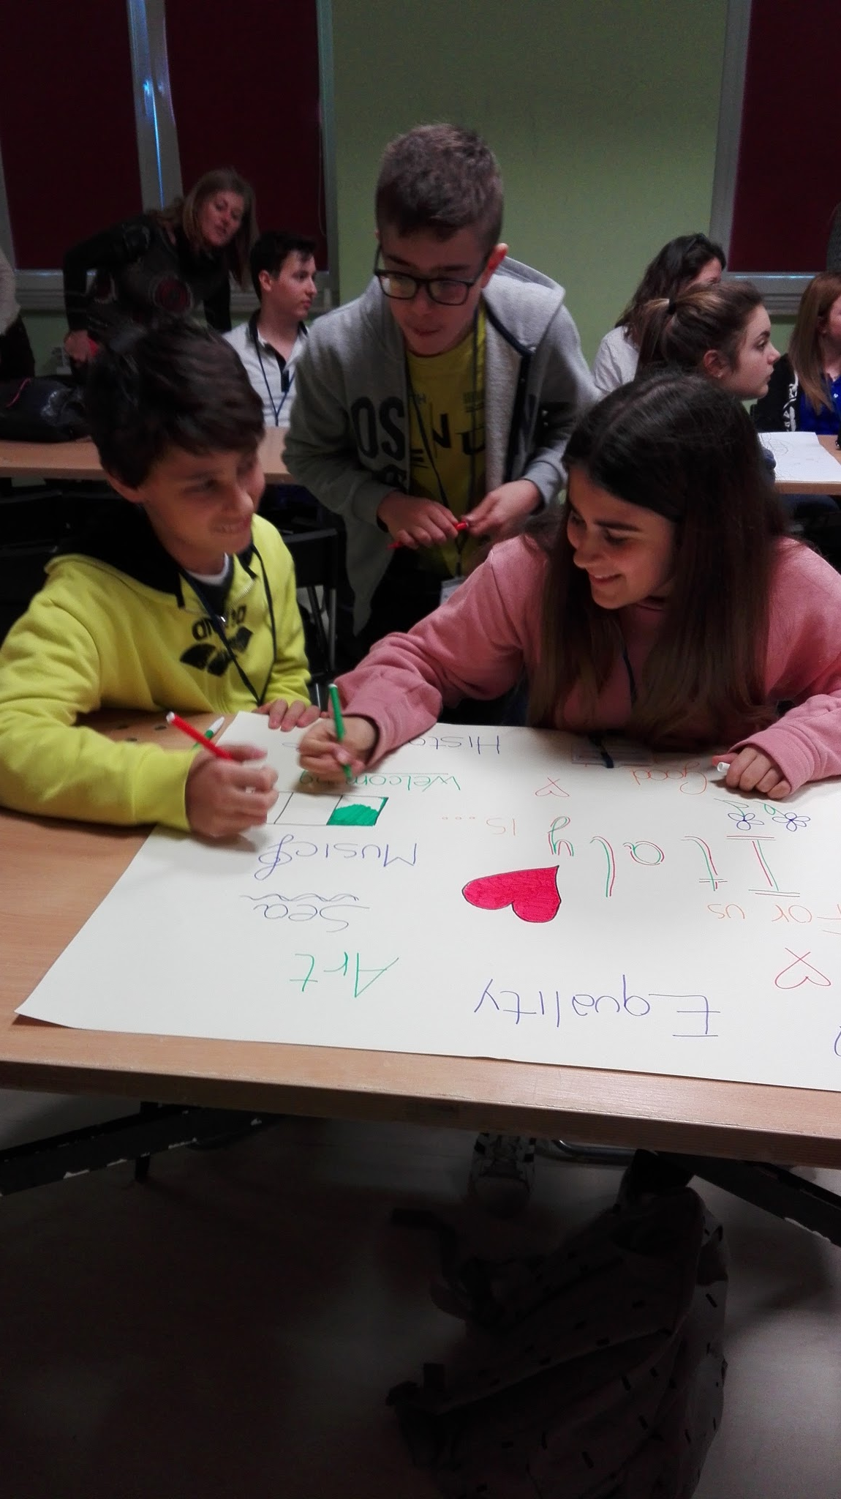
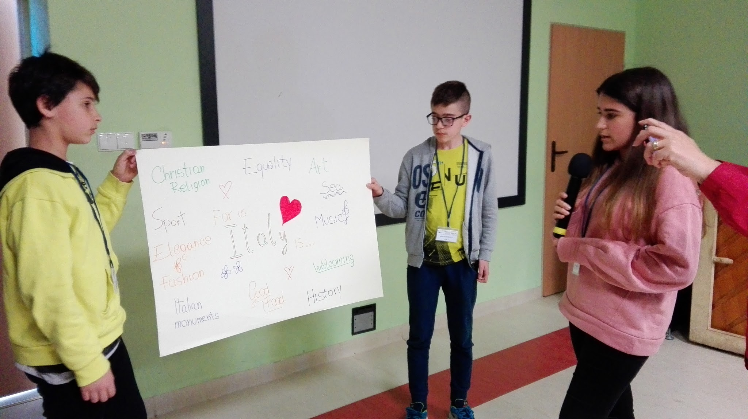
WORK-SHOPS
“TOLERANCE & INTOLERANCE”
“MY NATIONAL IDENTITY”

Slide 10
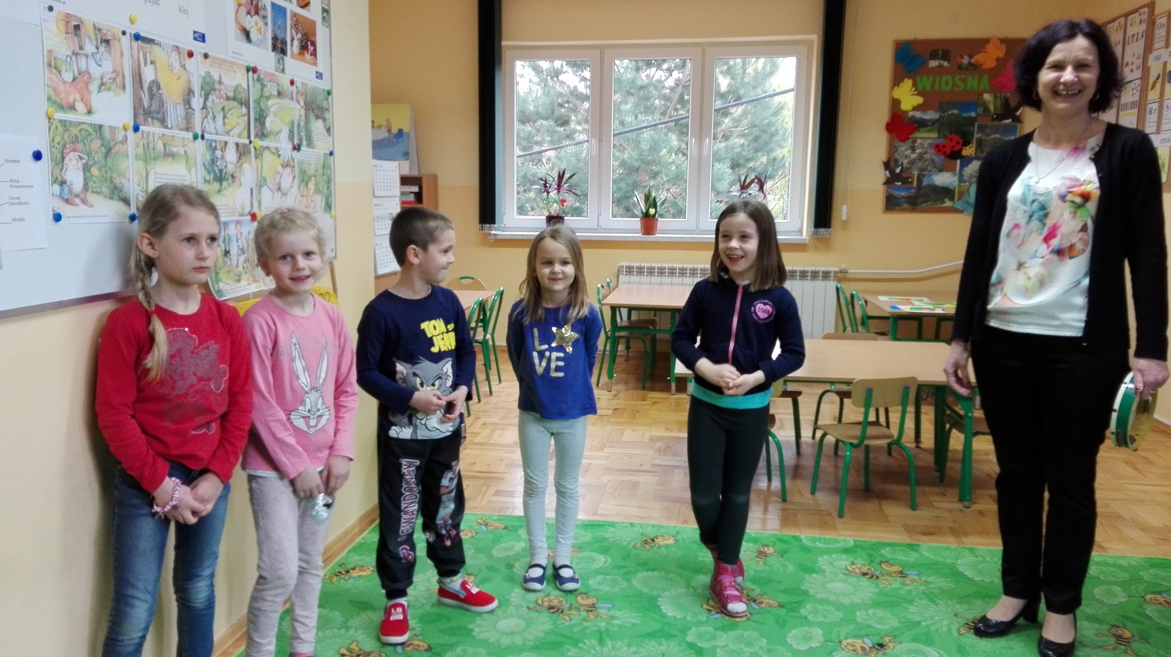
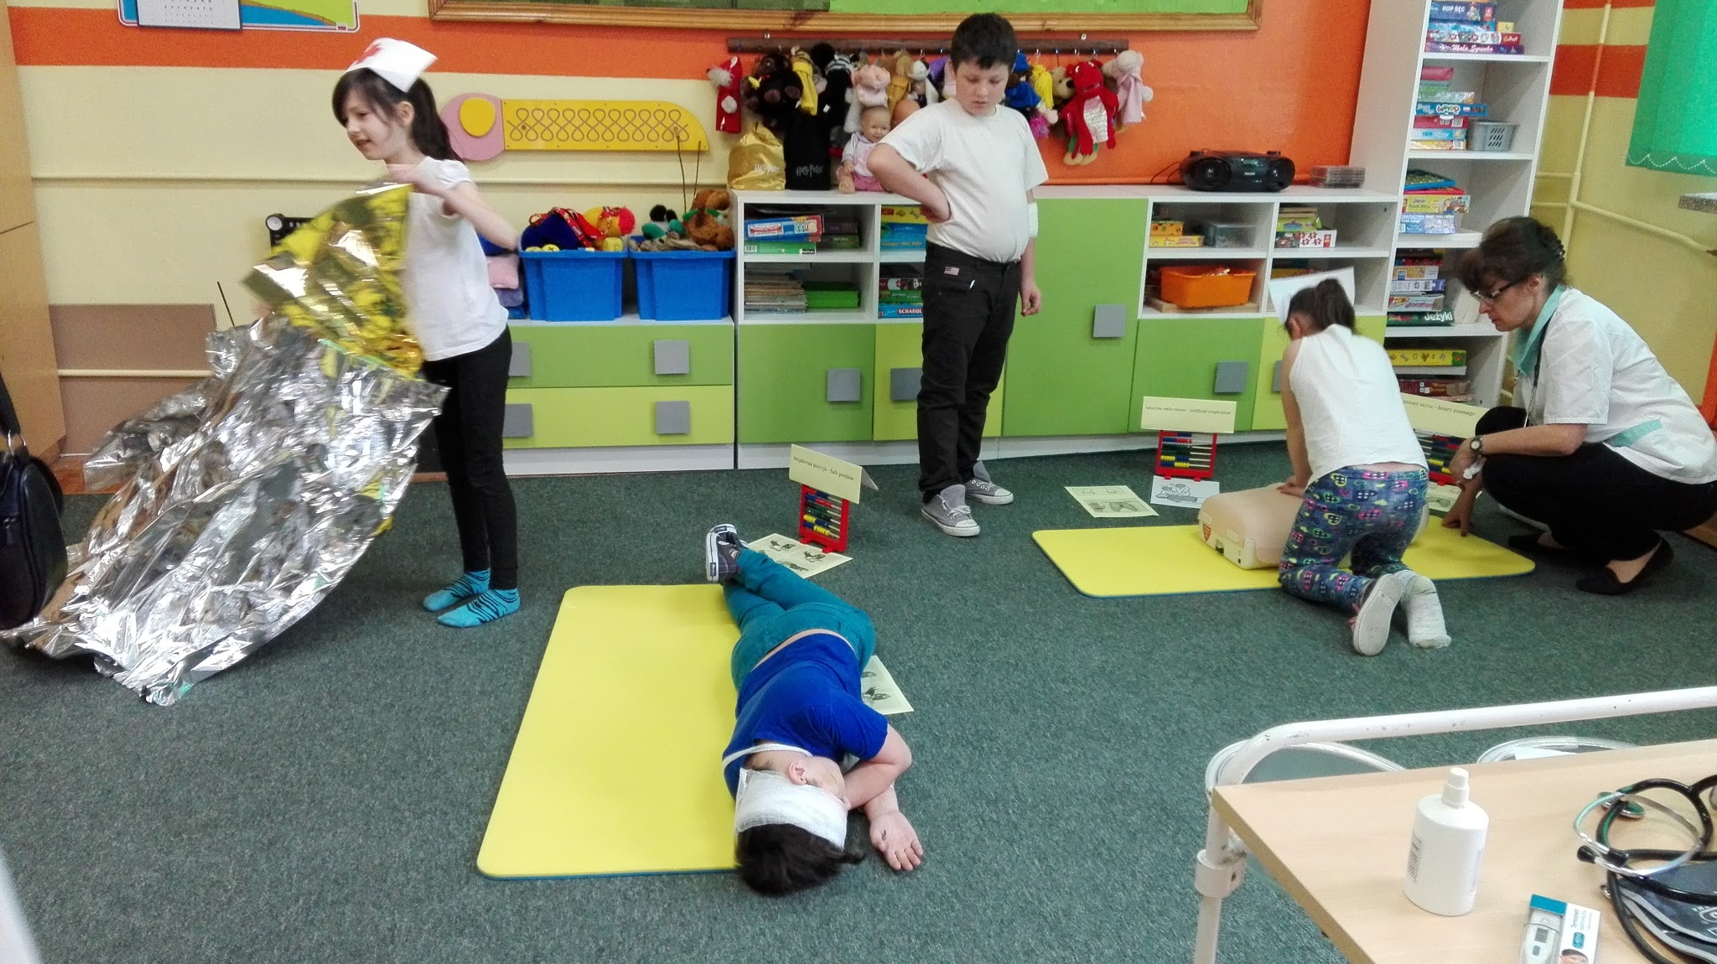
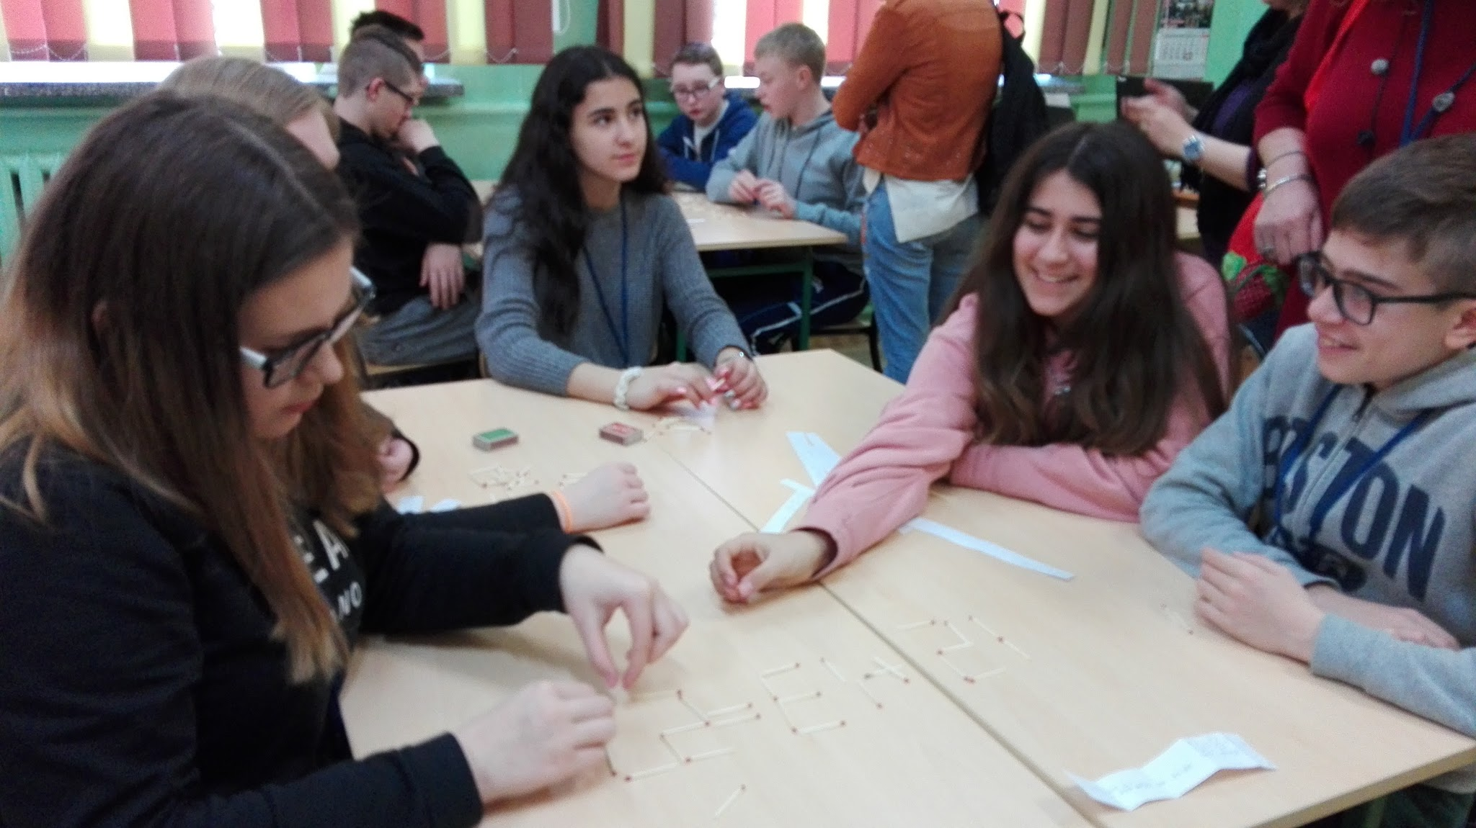
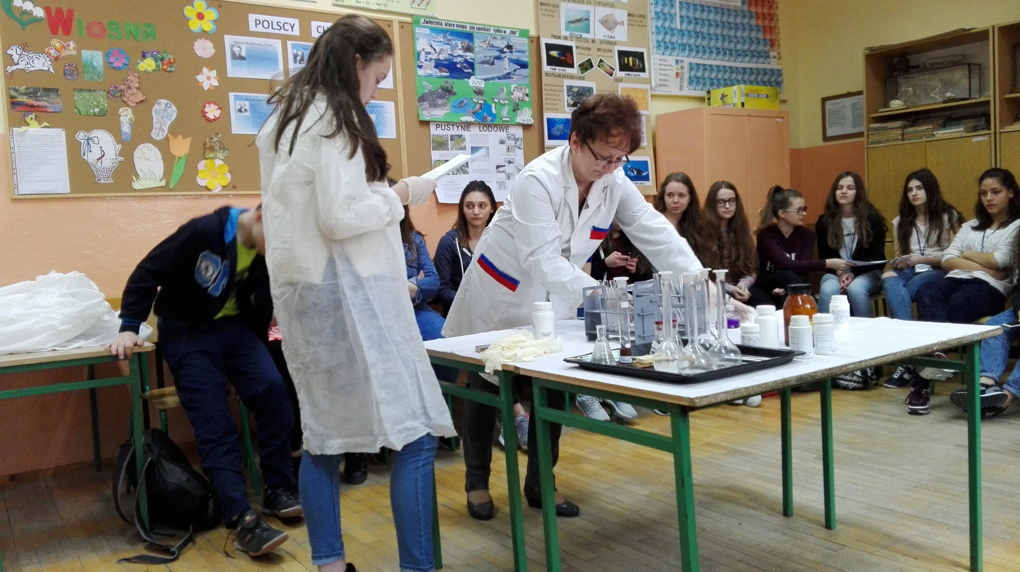
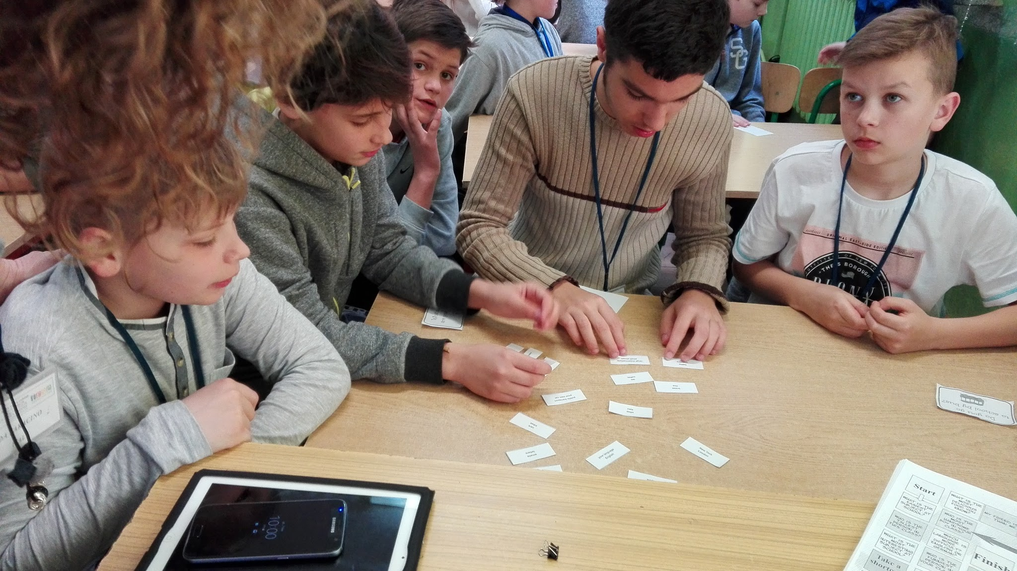
A DAY IN LUBZINA SCHOOL
..PRACTICING, LEARNING BY DOING, ...
...SHARING, HAVING
FUN!

Slide 11
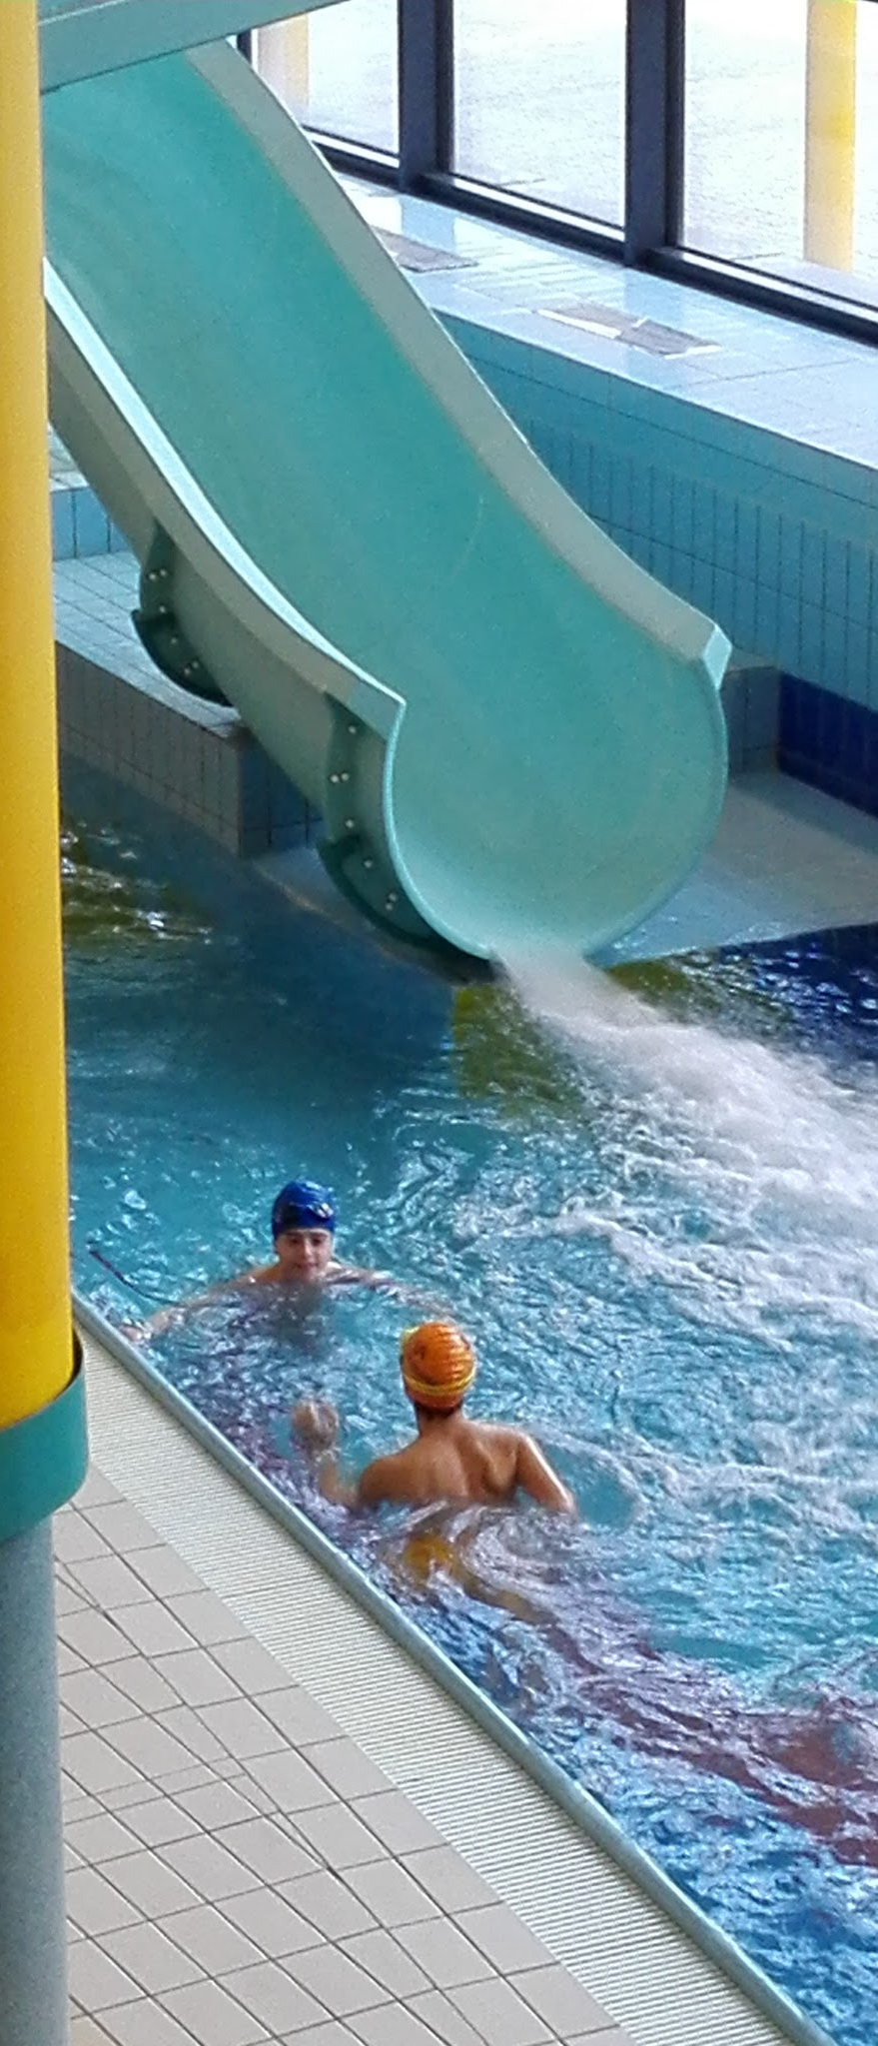
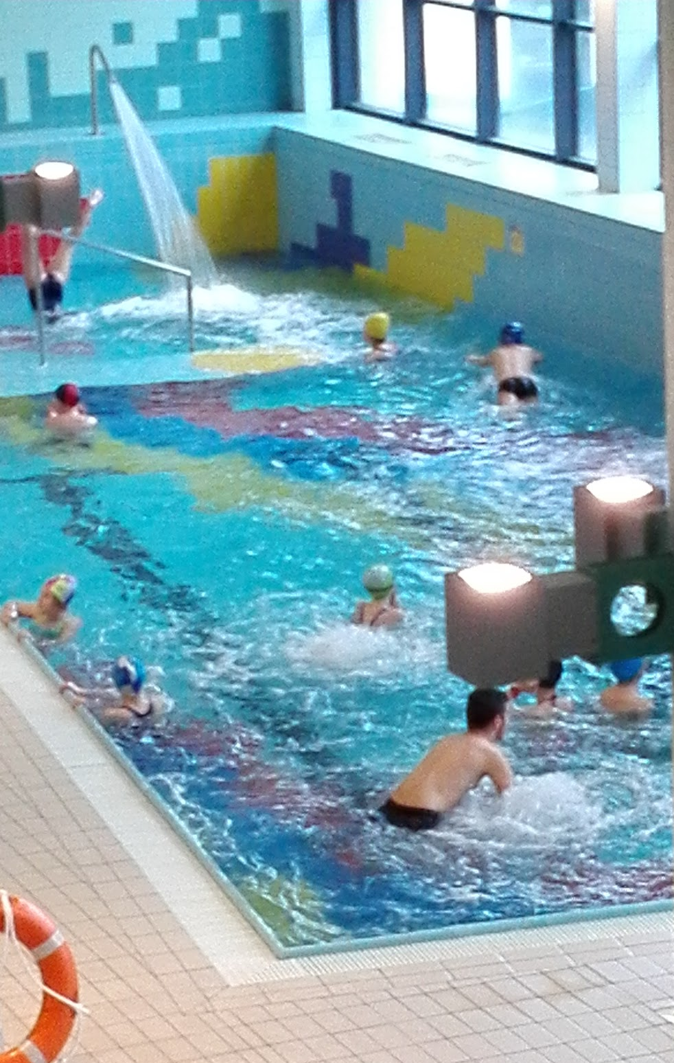
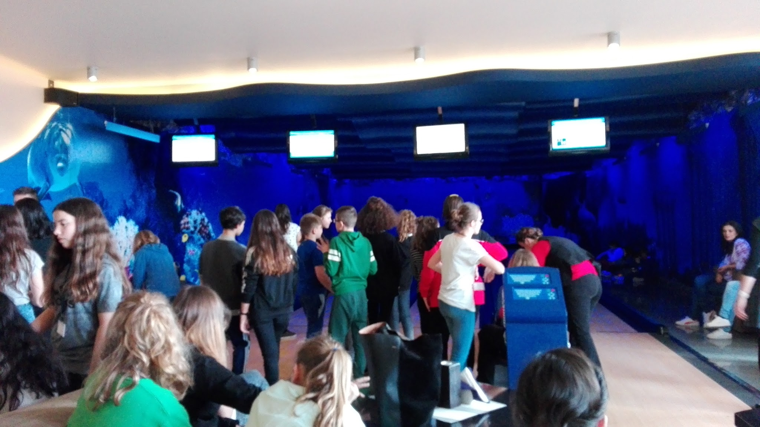
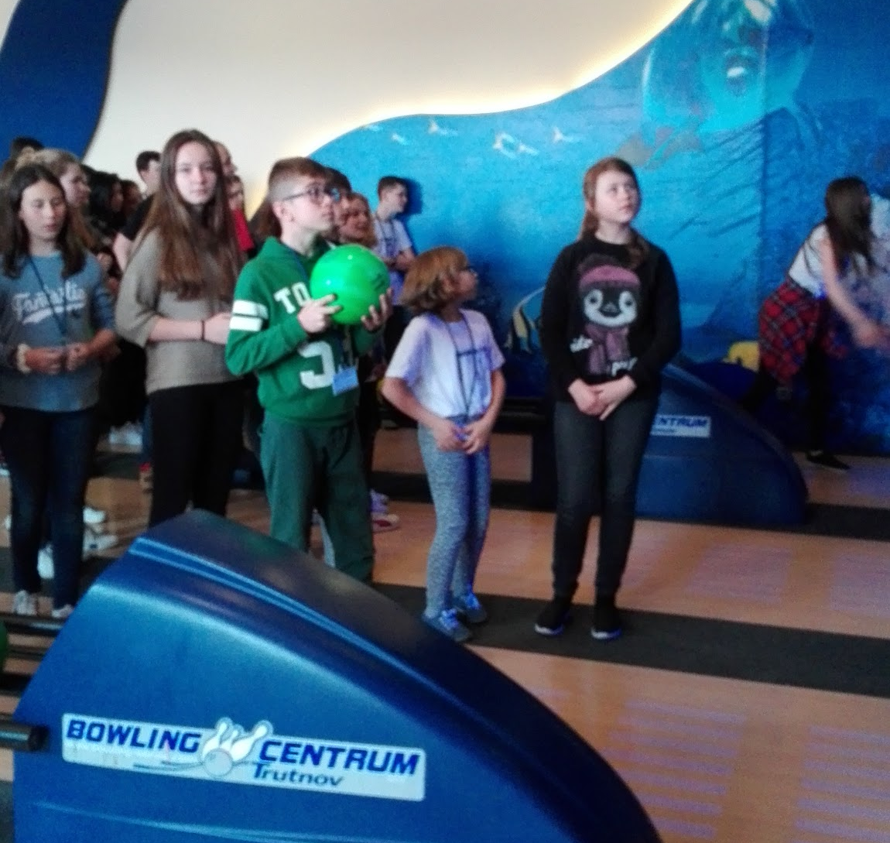
GENDER EQUALITY
&
SPORT

Slide 12
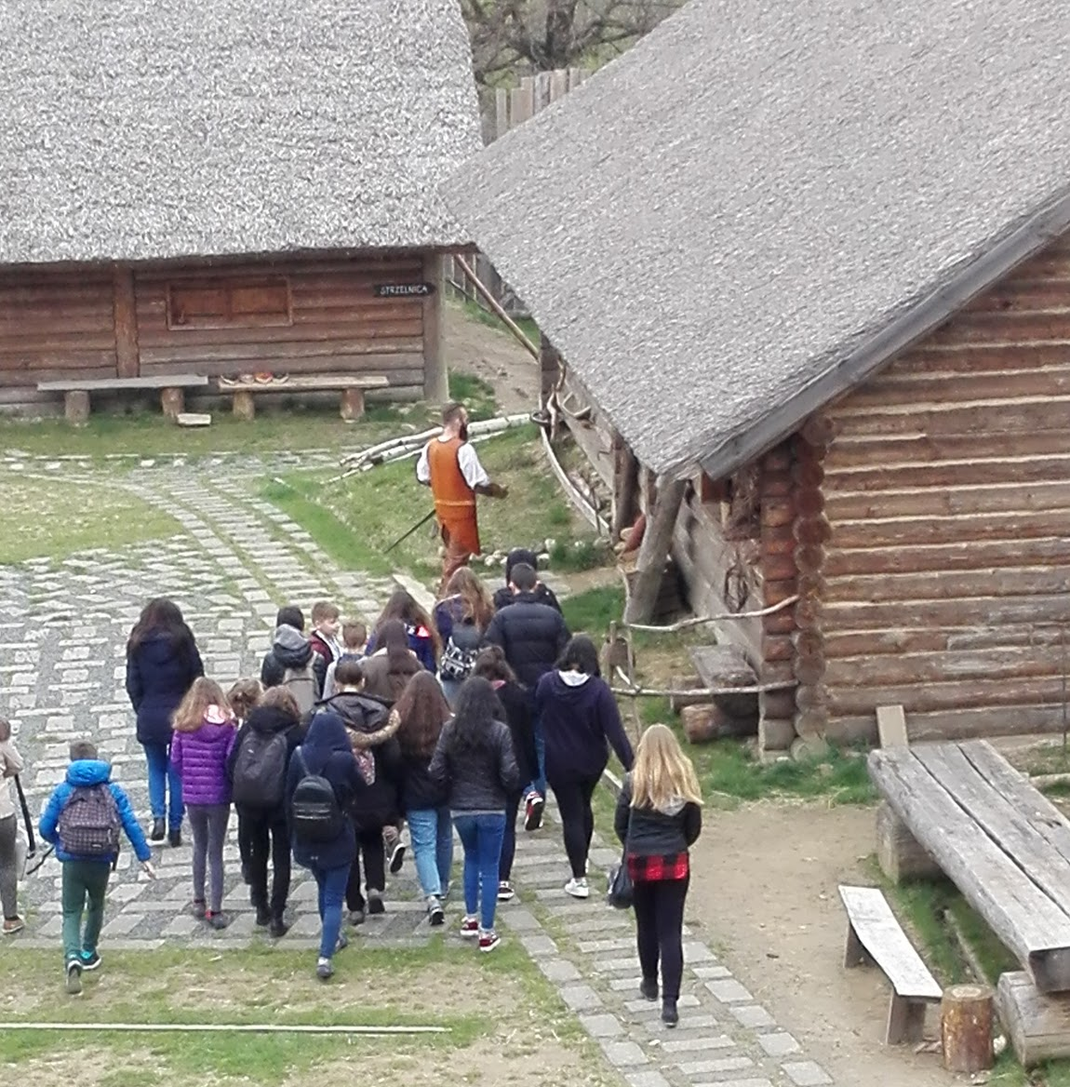
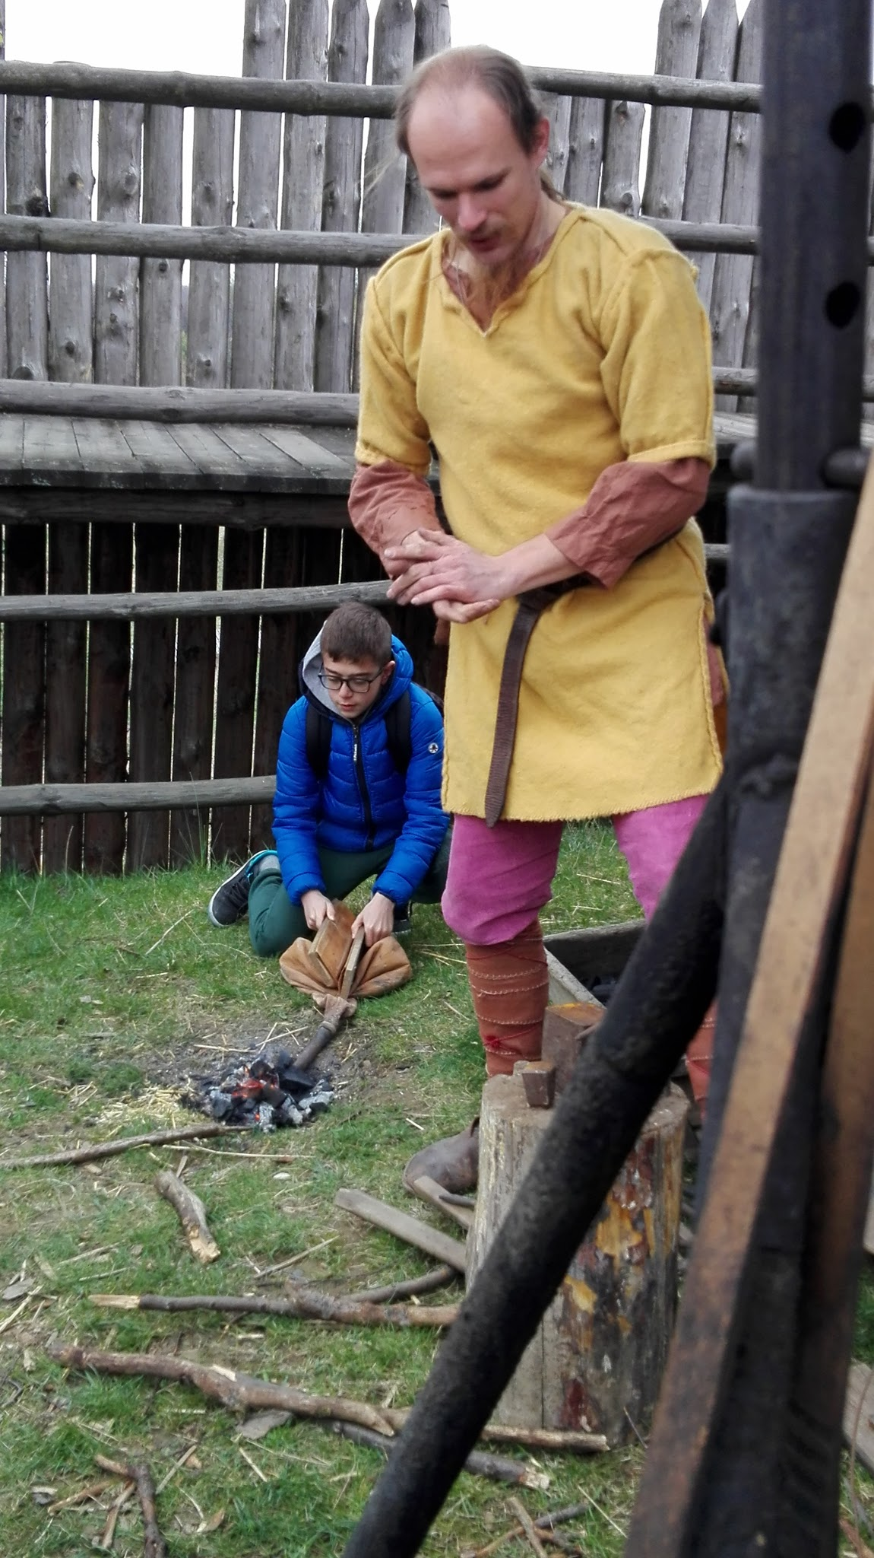
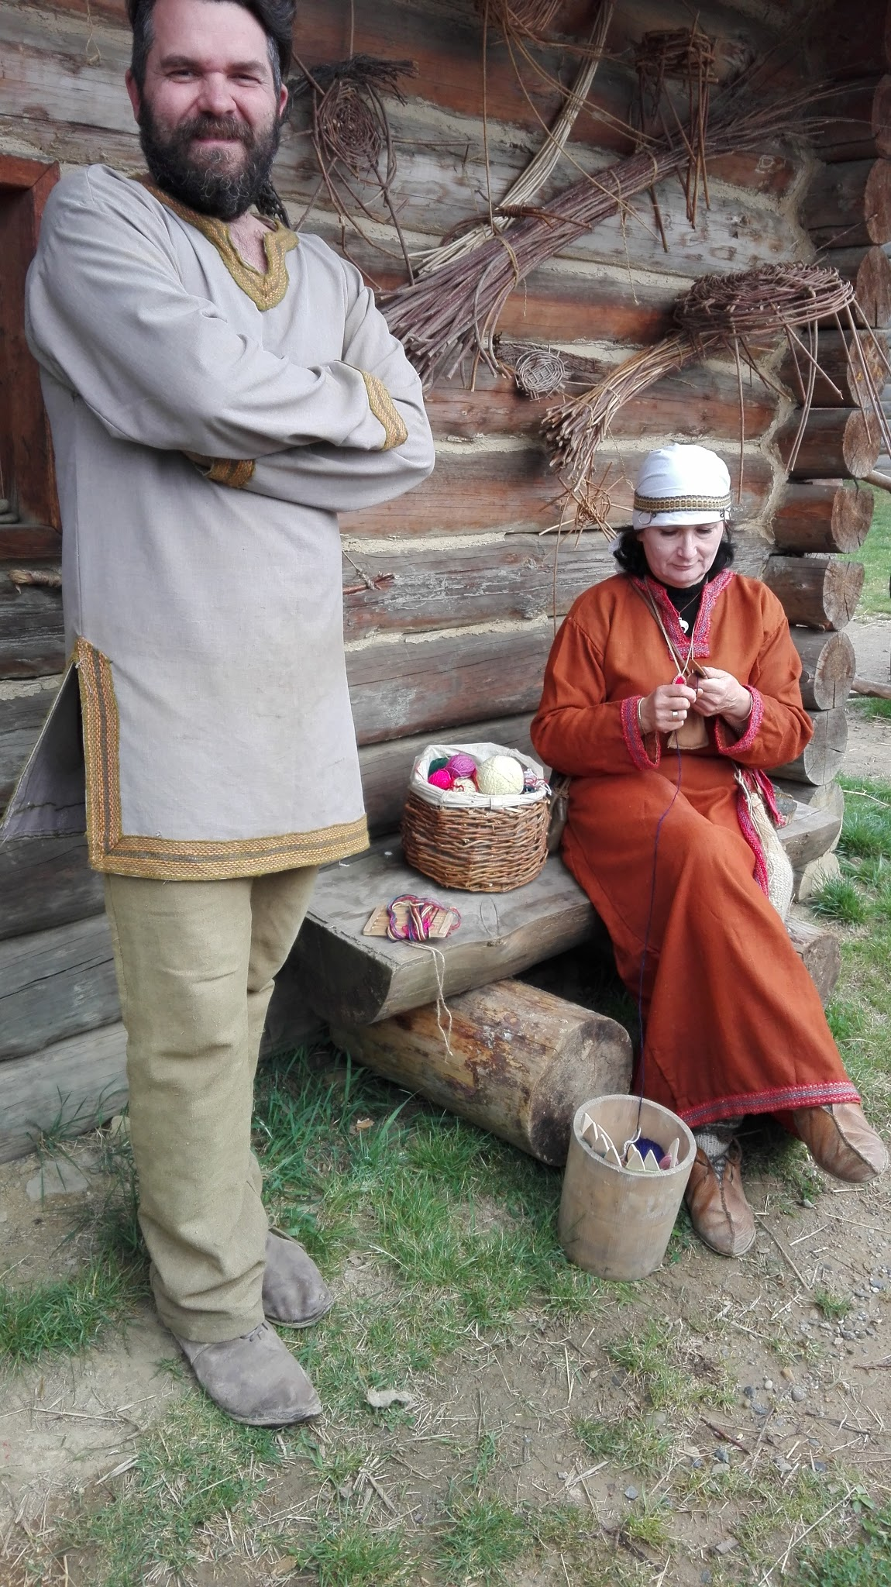
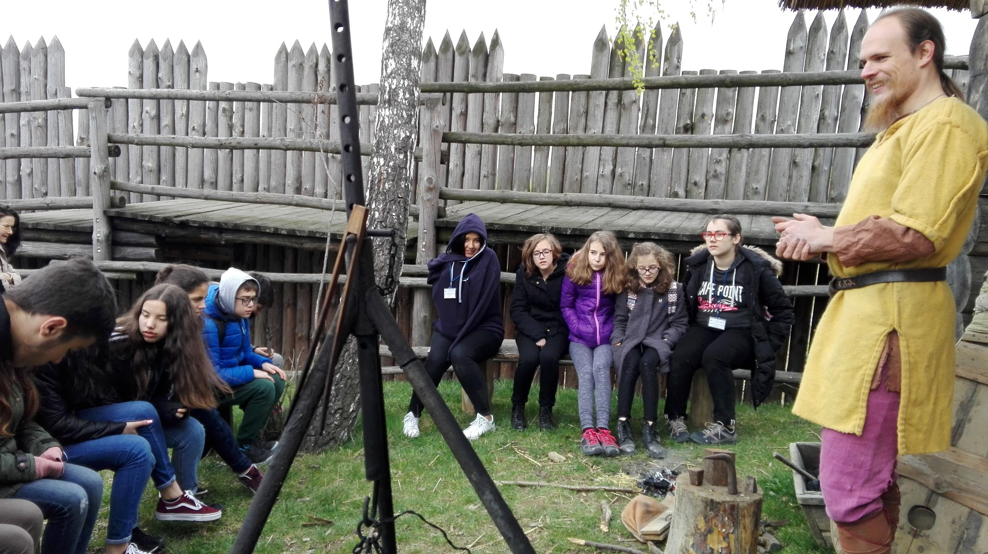
SLAVIC SETTLEMENT IN STOBIERNA VILLAGE
WE ENJOY OUR
WORSHOPS IN
A 10th CENTURY
VILLAGE

Slide 13
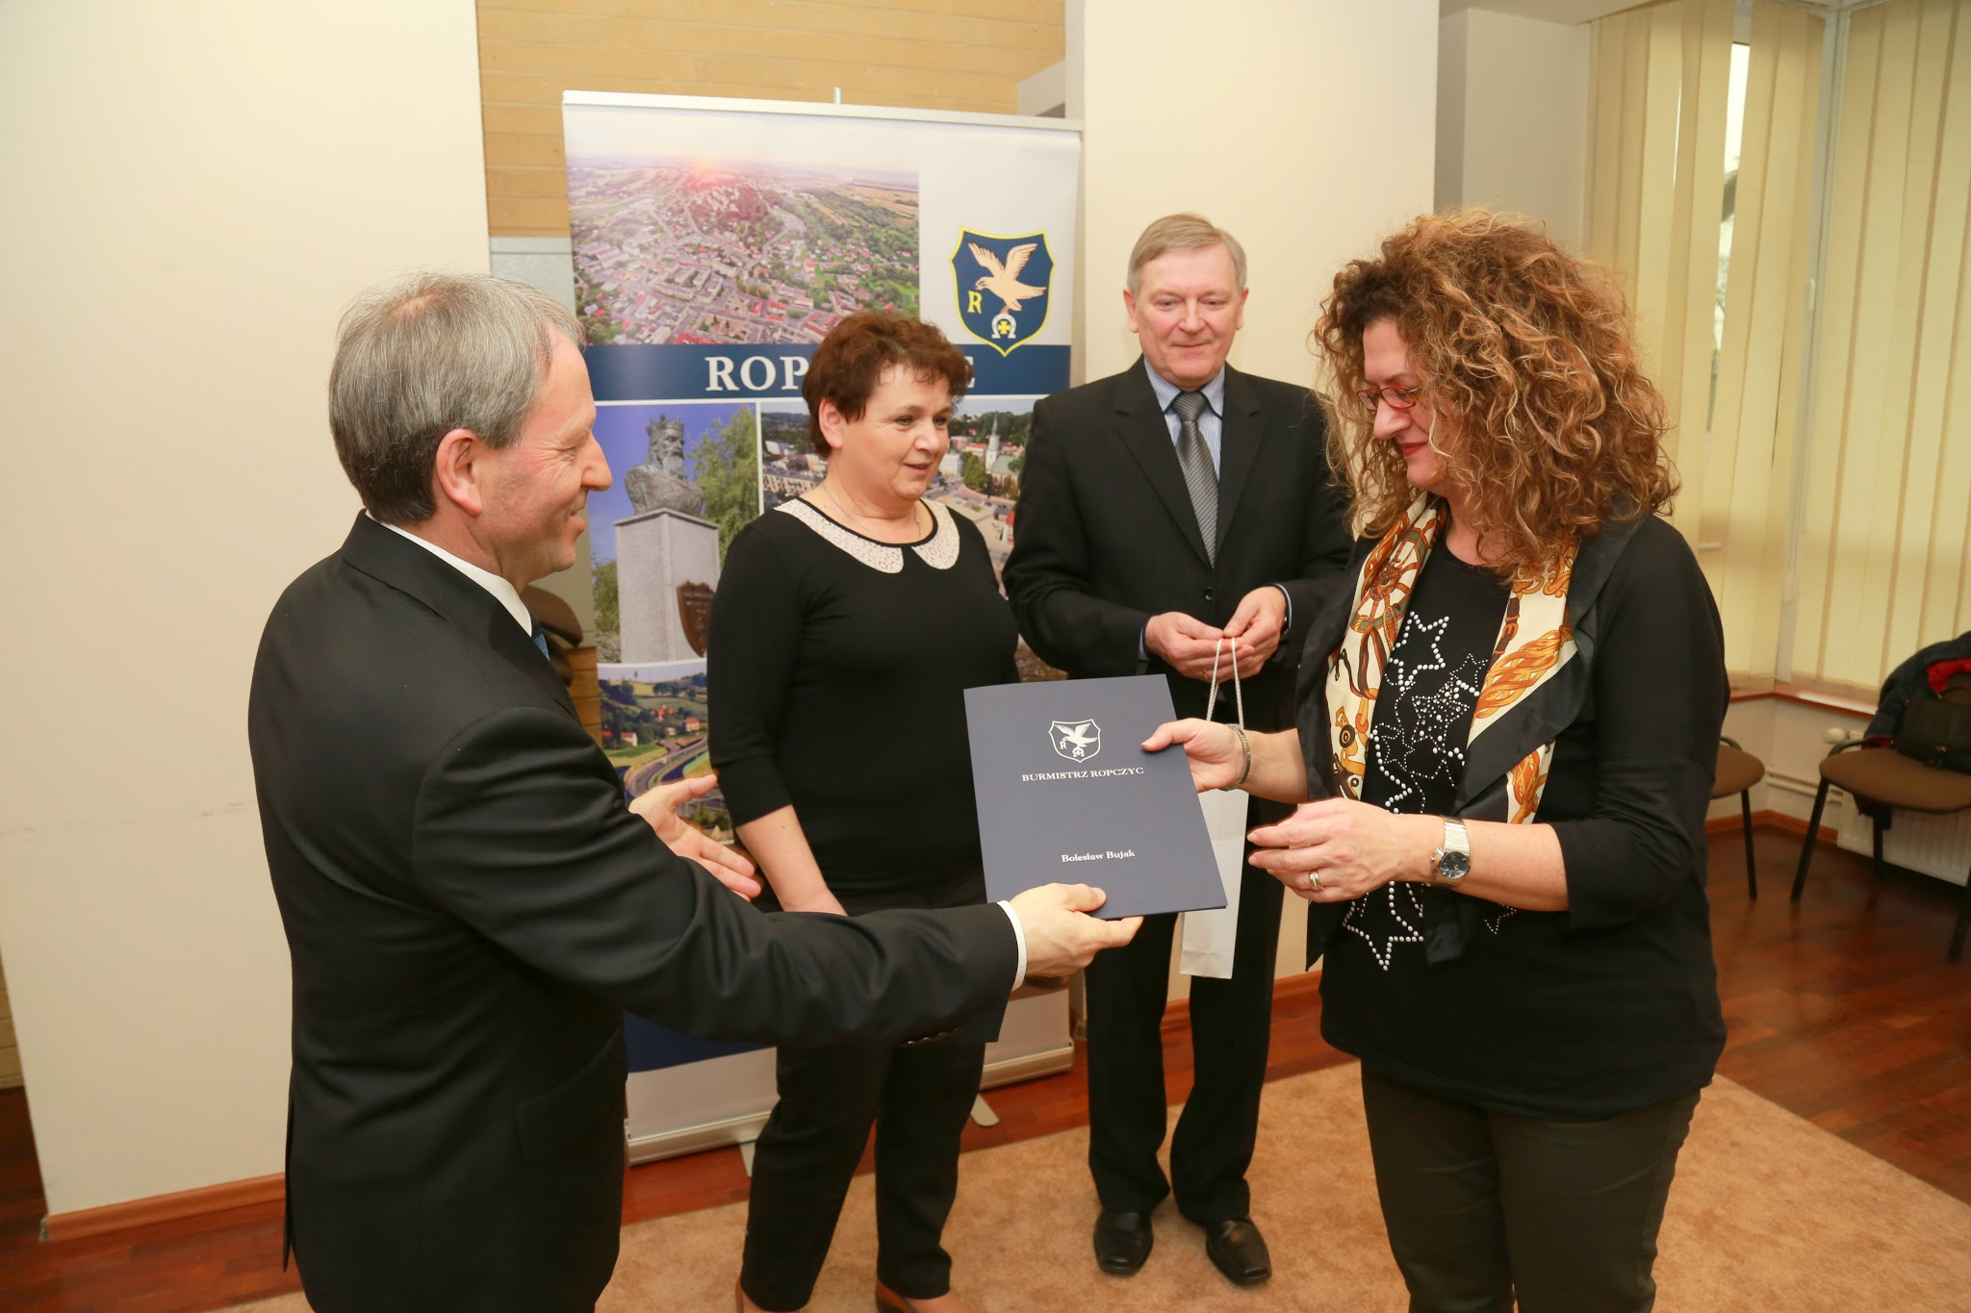
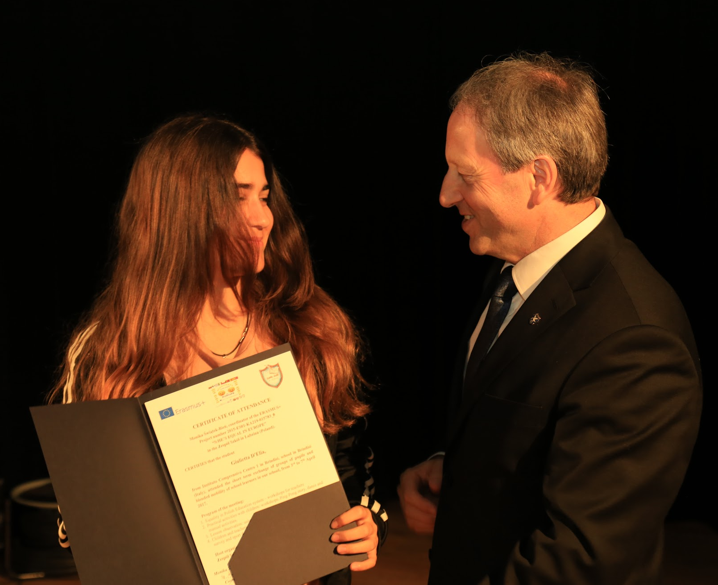
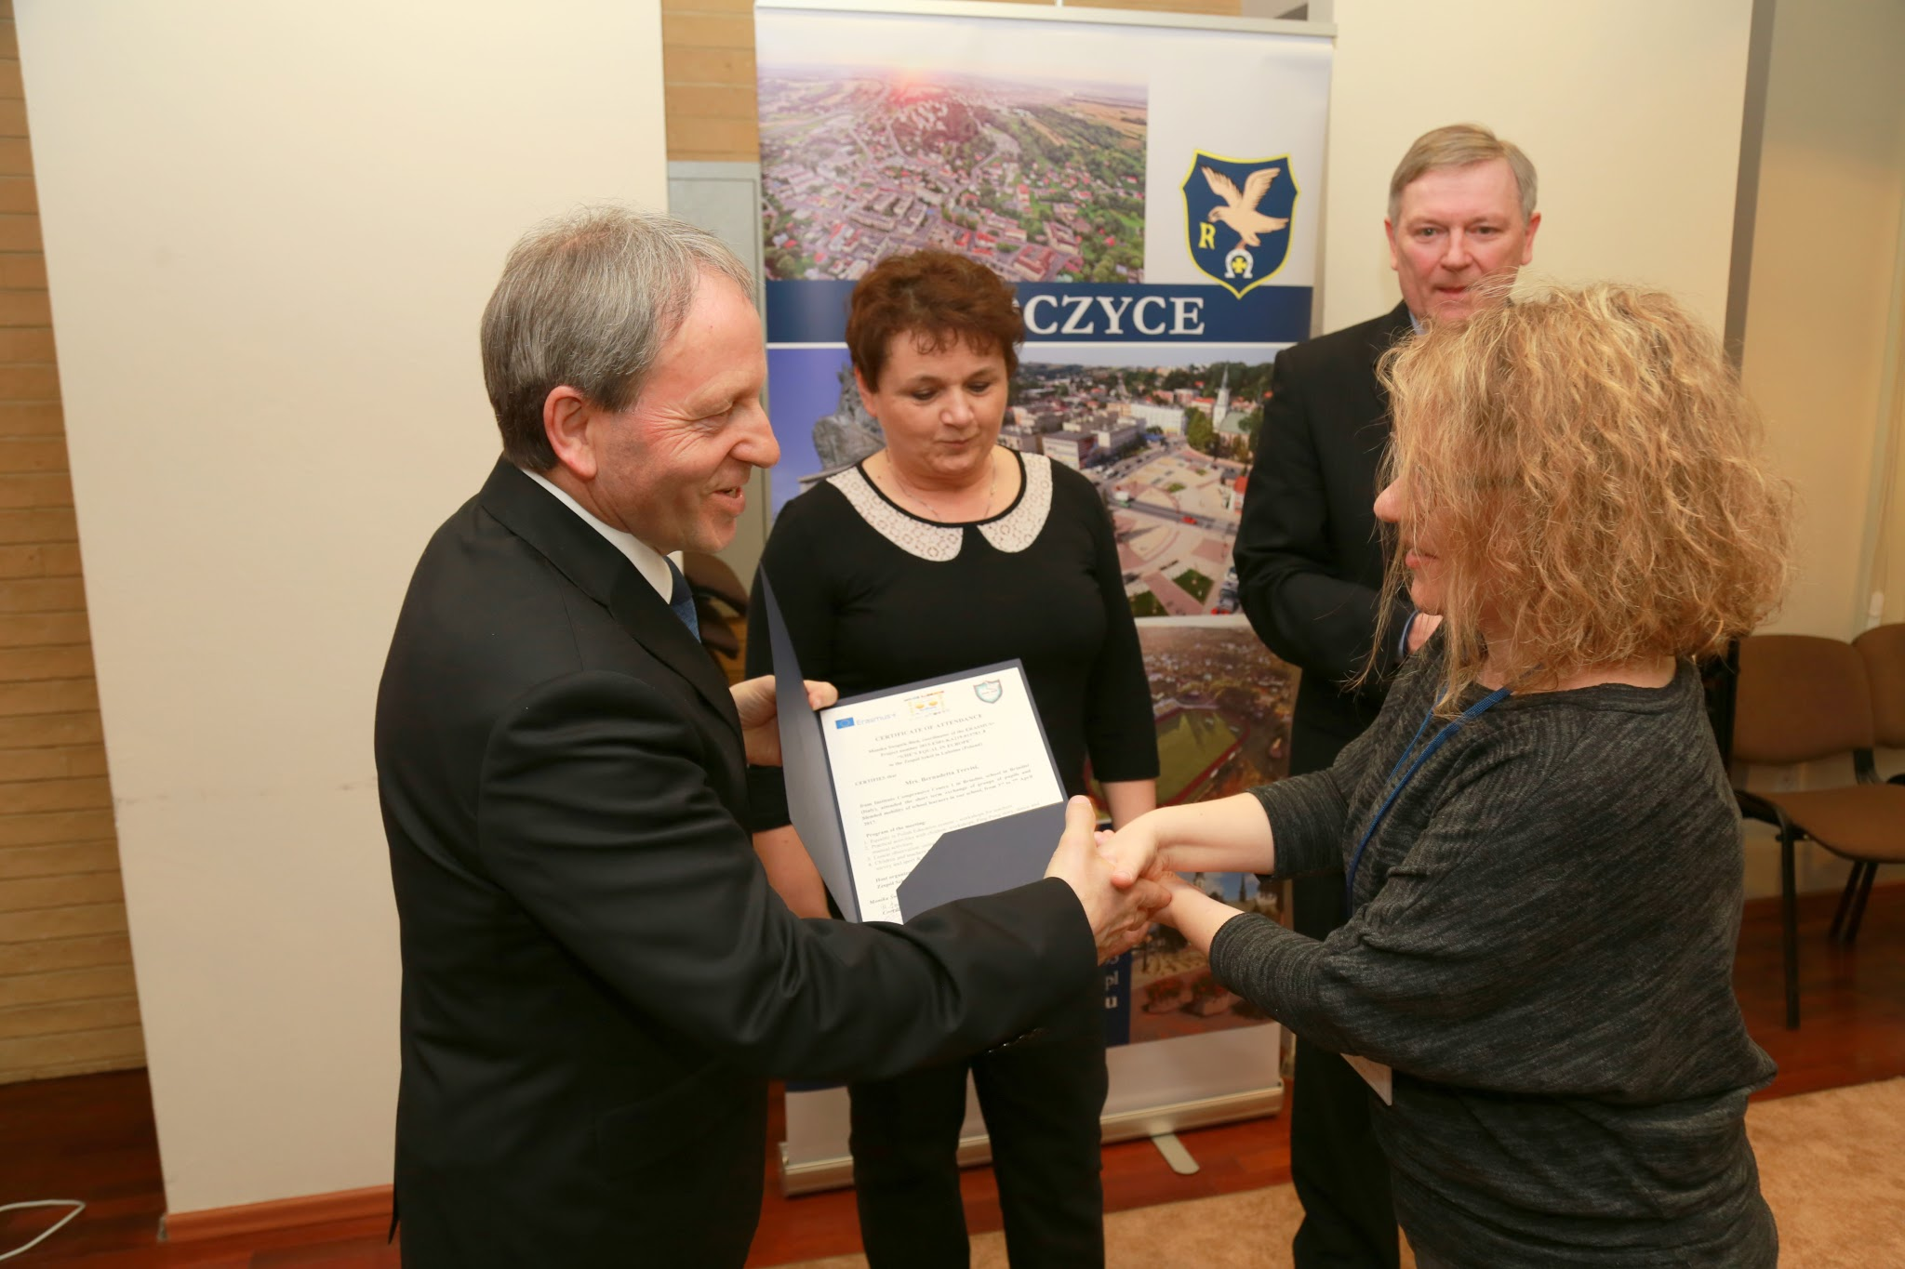
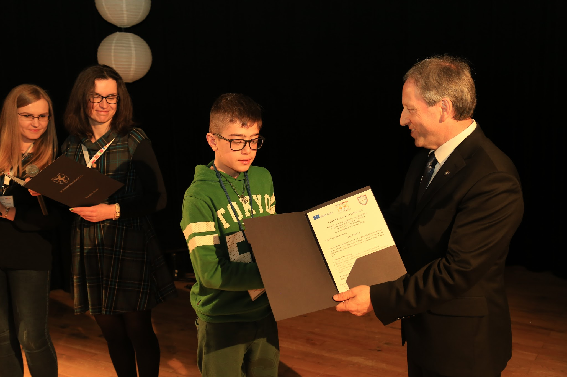
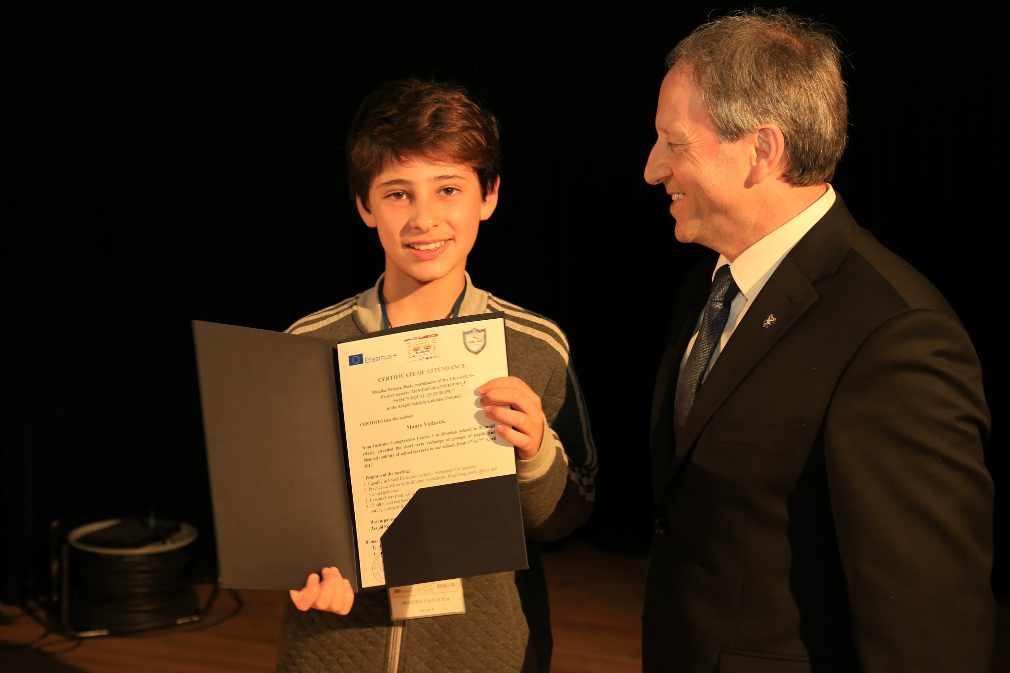
WE ARE ALL GLAD TO RECEIVE OUR CERTIFICATE OF ATTENDANCE FROM THE LOCAL AUTHORITIES

Slide 14
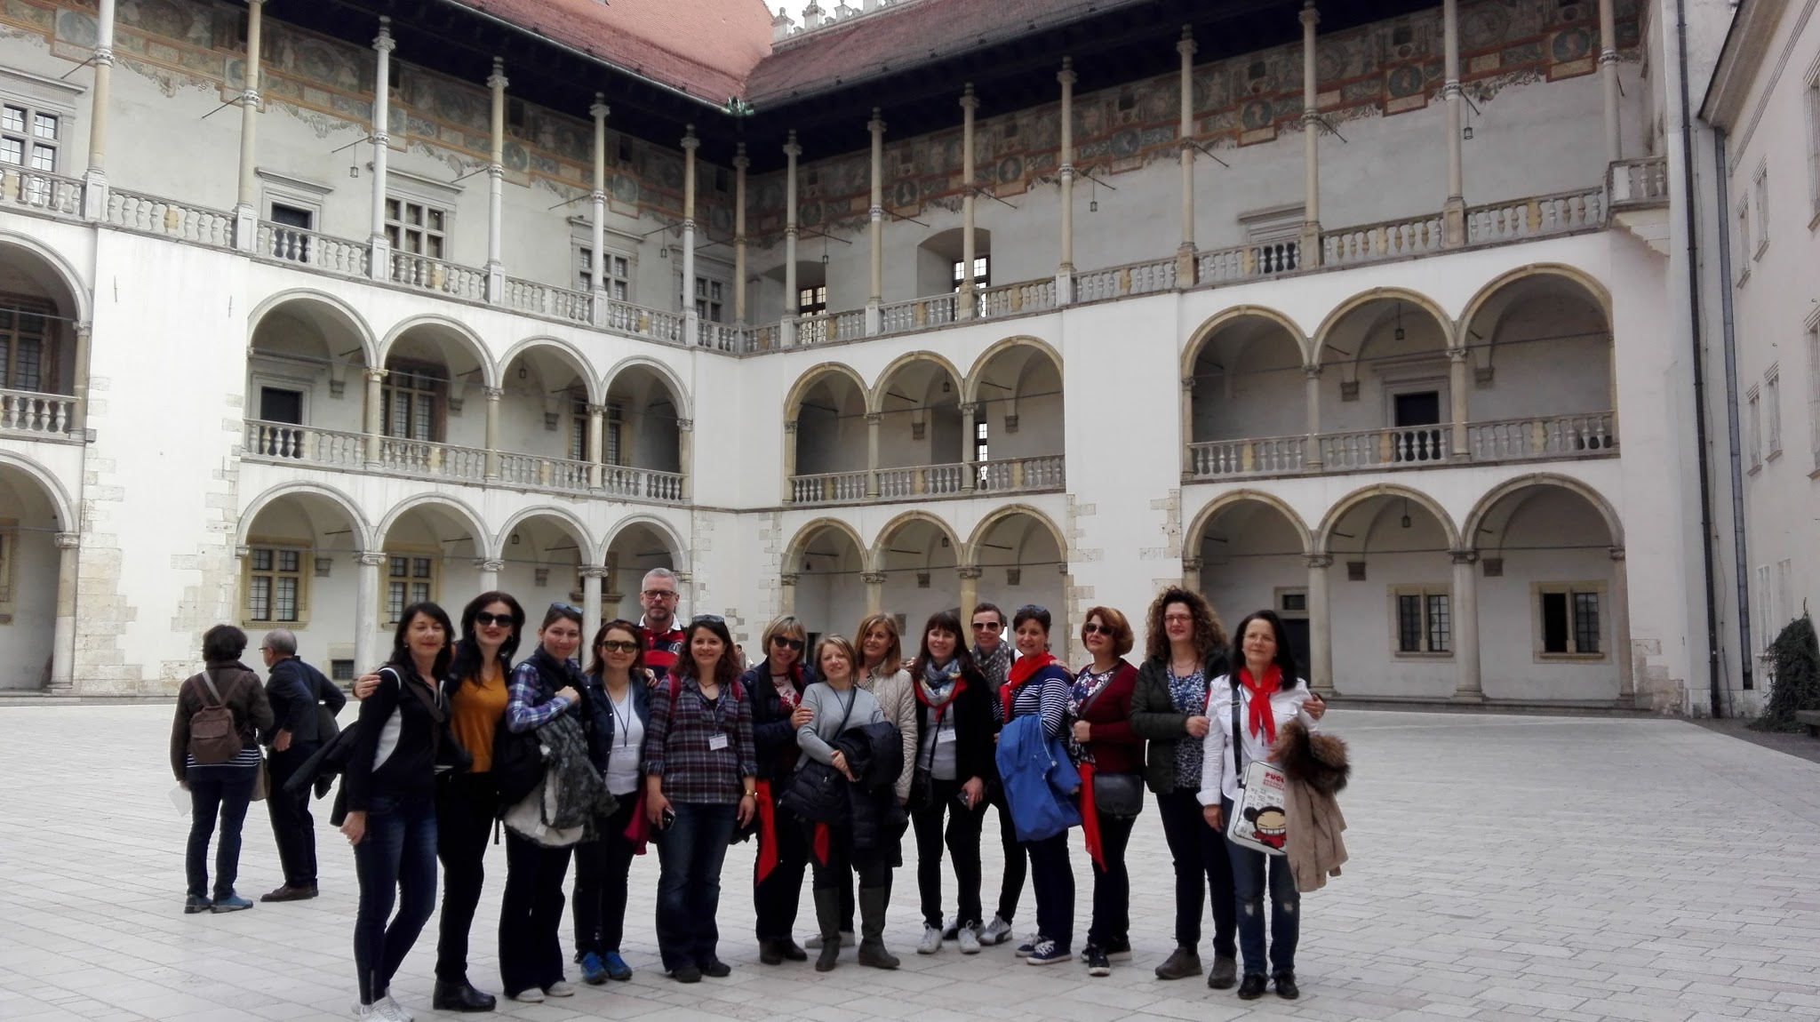
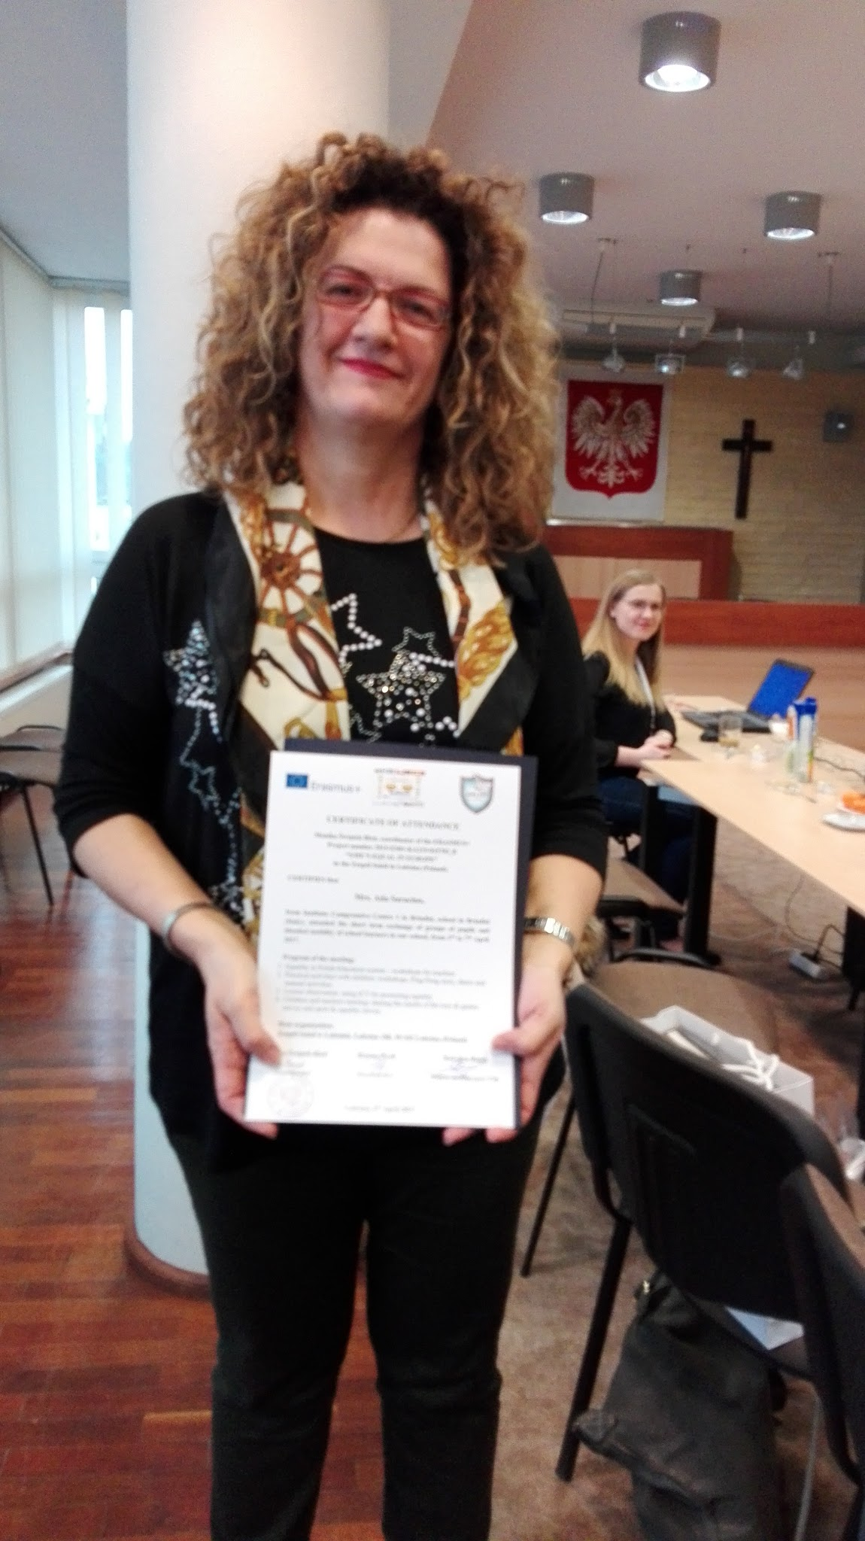
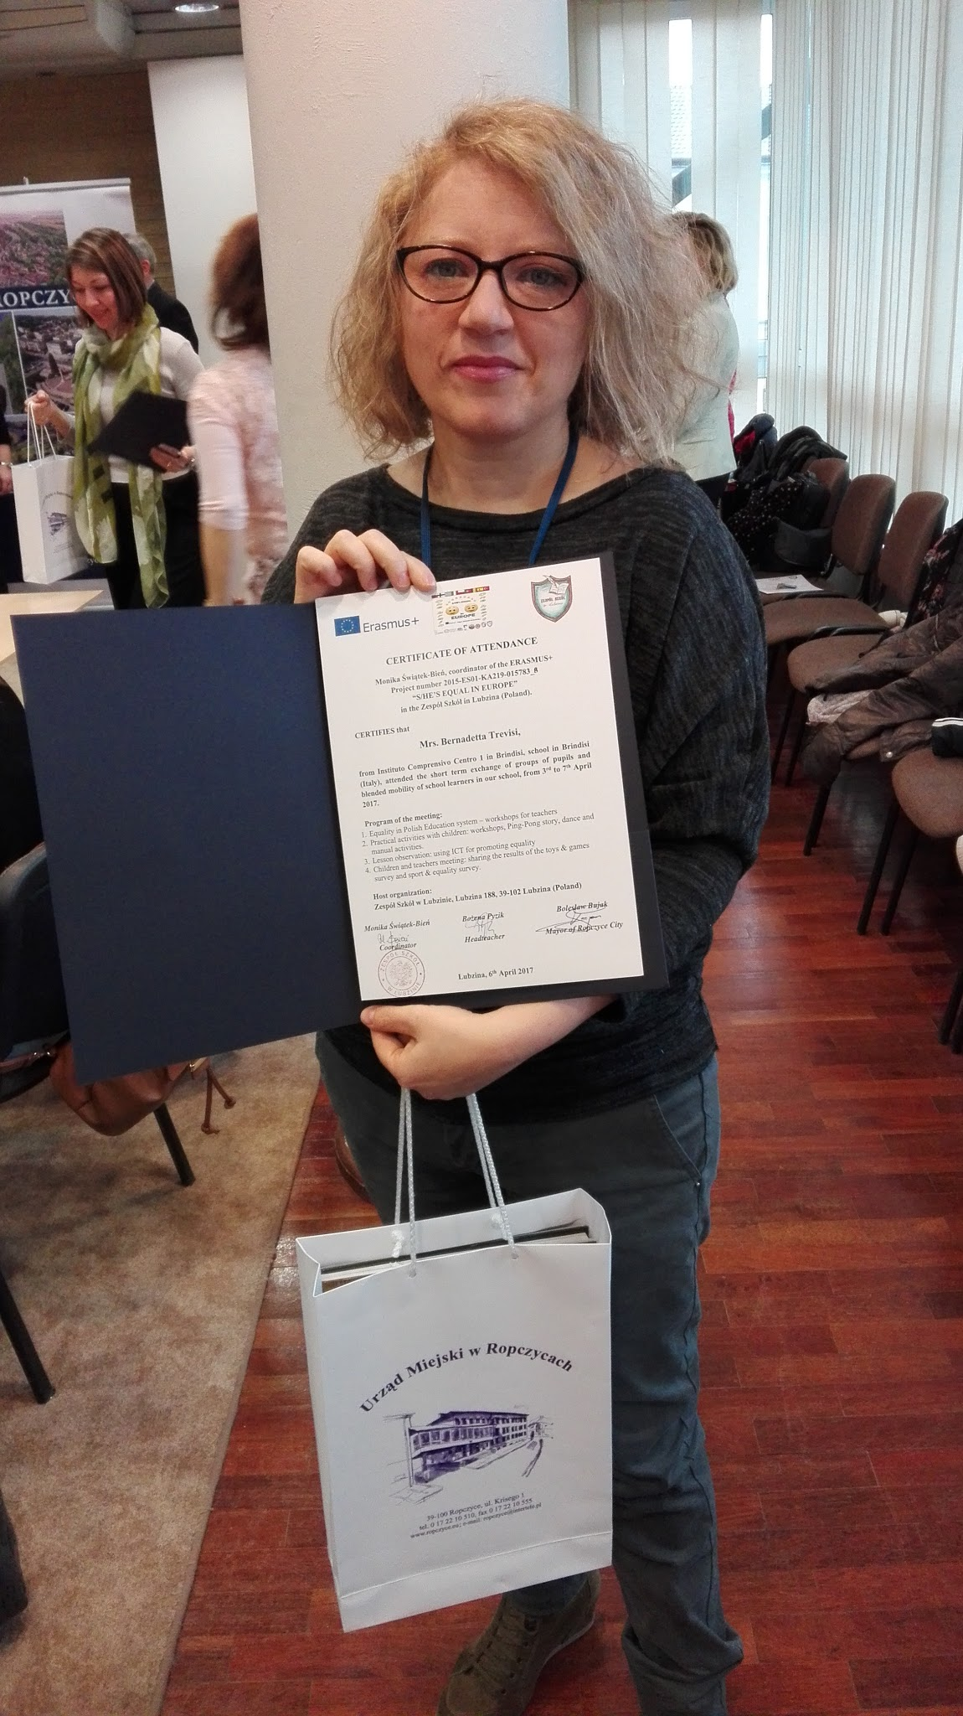
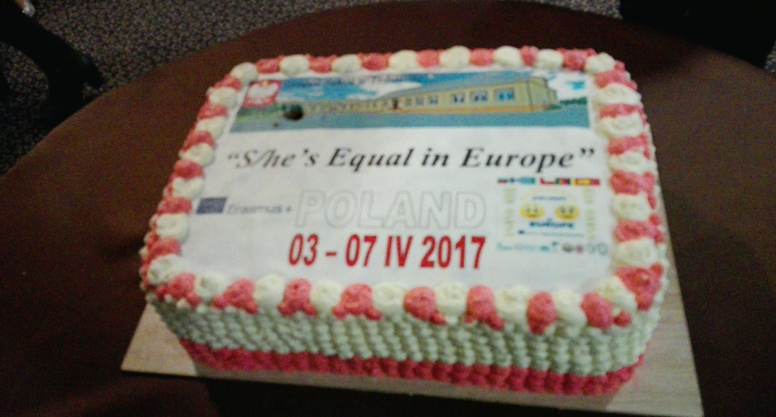
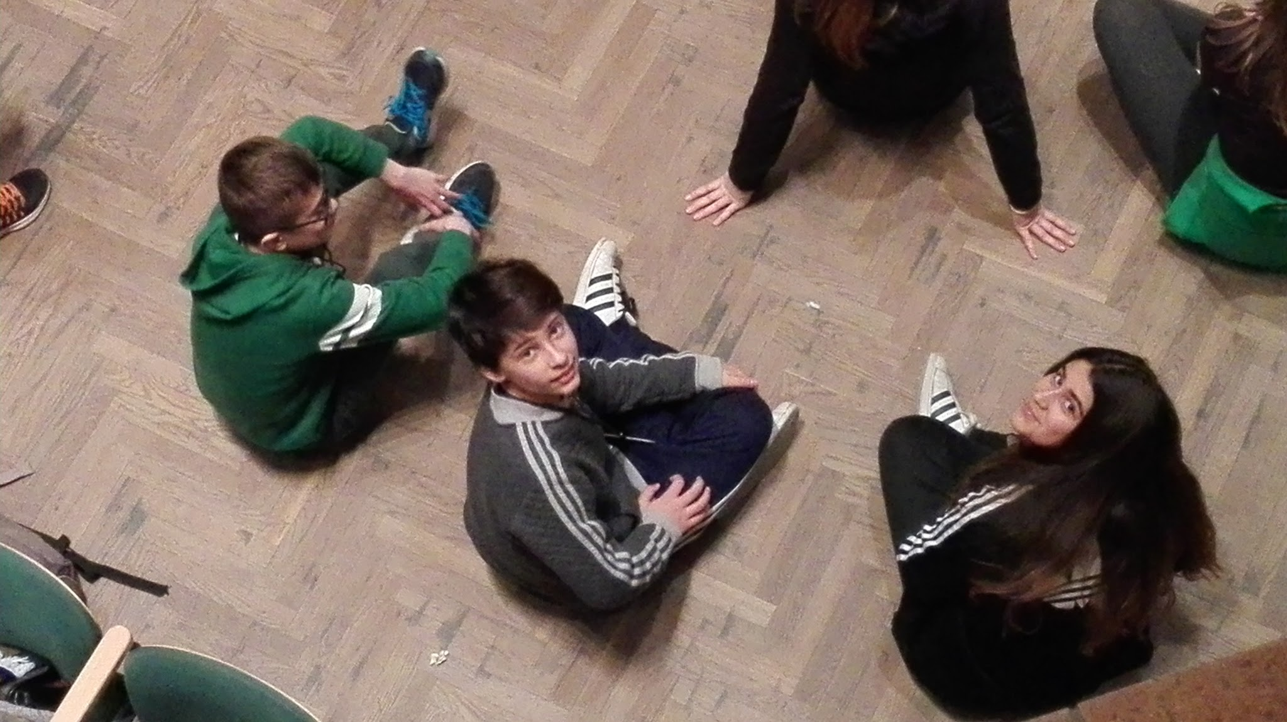
THANKS TO THE POLISH TEAM AND TO ALL THE ERASMUS+ PARTNERS FOR THE GREAT TIME WE HAD
TOGETHER!

