Slide 1
Group 6 repair

Slide 2
White flour

Slide 3
Product made from white flour

Slide 4
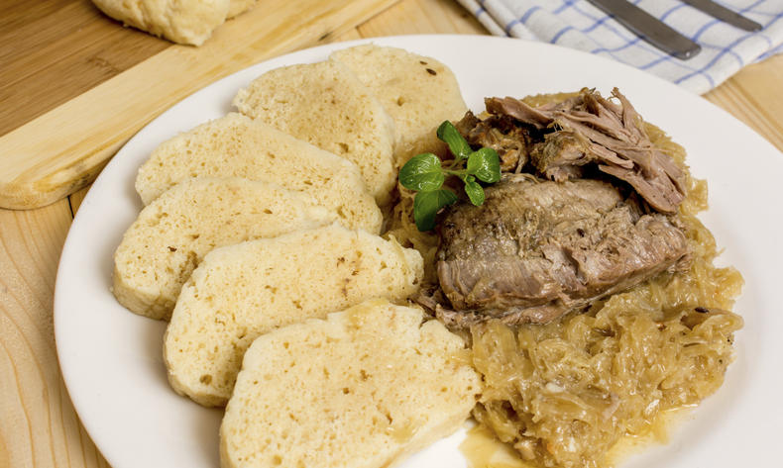
Vepřo, knedlo, zelo
Czech cuisine uses mostly white flour. It makes dumplings from white flour that also can be seen in the Czech national dish called vepřo, knedlo, zelo.

Slide 5
Thank you for wotching

