Slide 1
Advertisements as Language Teaching Materials: The Starbucks Sample
Ayşe ZAMBAK

Slide 2
Notes:
Example graph/chart.

Slide 3
Body Copy
In this ad, the tagline appears as a body copy and all of the words are written in upper-case to emphasize the message and it has an assertive effect on the viewer.
Some words such as coffee, perfect, Starbucks are in larger points. When these words come together, they form a subtle message and represent a connotation that Starbucks offer the perfect coffee as it is suggested in the ad.
Notes:
Conclusion to course, lecture, et al.

Slide 4
There is a repetitive use of if conditionals.
If-clauses are also known as conditional clauses or conditional sentences. This means that the event in the main clause (not counting the if) only takes place if the condition in the clause containing if is fulfilled.
If clauses are negative implying the unanticipated situations.
In the first sentence, the main clause suggests that the company takes the responsibility of that situation.
However, in the second sentence, the main clause includes an imperative (Make sure) putting the responsibility on the customer.
Notes:
A list of procedures and steps, or a lecture slide with media.

Slide 5
the use of still as an adverb symbolizes that something is going on, which is frustration about the taste of coffee.
With the use of imperative and still adverb in the second conditional sentence contributes to the meaning that the company rejects the failure.
Use of pronouns (You, We) emphasizes the direct communication between the company and its customers.
This use also clearly makes a clear distinction between the parties. (the Starbucks Company and the customers).
Notes:
A list of procedures and steps, or a lecture slide with media.

Slide 6
In the signature line, just adverb is used to make a statement stronger; namely, the message that is given above.
The Starbucks that is written in bold characters supports the effect given in the whole ad.
The name of the company thus stands out.
Notes:
A list of procedures and steps, or a lecture slide with media.

Slide 7
Illustration
In the ad, white, off- white and green, which the color of the company,come to fore and draws attention.
The company logo and the size of coffee cup in the foreground put so much emphasis on how much the company trusts their product.
The logo is stressed twice both on the cup and at the bottom of the ad.
Notes:
A list of procedures and steps, or a lecture slide with media.

Slide 8
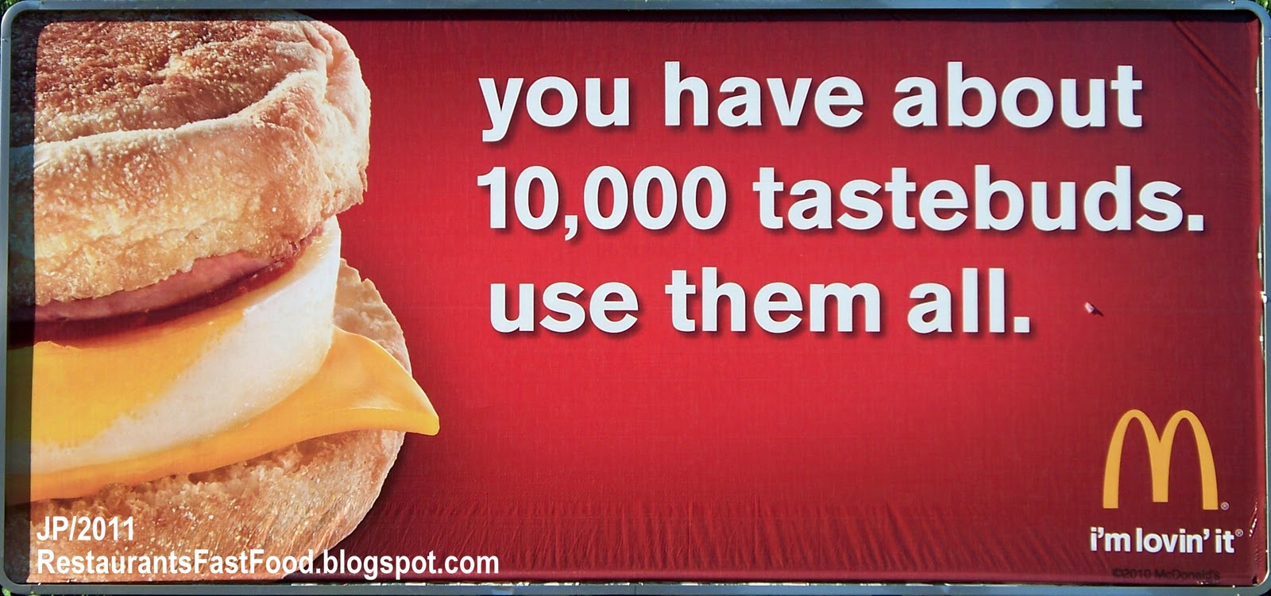
How advertisement can be used for improving English language learning and teaching?
1. as a prompt for basic speaking and writing activities in English.
2. to develop the vocabulary of learners.
3. the English language use on an almost daily basis.
4. to increase the use of the 4Cs in the classes.

