Slide 1
TwinSpace Daniela Usmiani eTwinning ambasador Webinar, 11th March 2020
Notes:
Zahvaliti

Slide 2
Twinspace
great support for Erasmus+ projects
We can use it :
for archive of our materials
for dissemination (pages) – link on the school page

Slide 3
Twinspace
Project working area
Safe platform visible only to teachers who are members of the team
we can add students, parents, guest
different role – different possibilities
teacher, admin

Slide 4
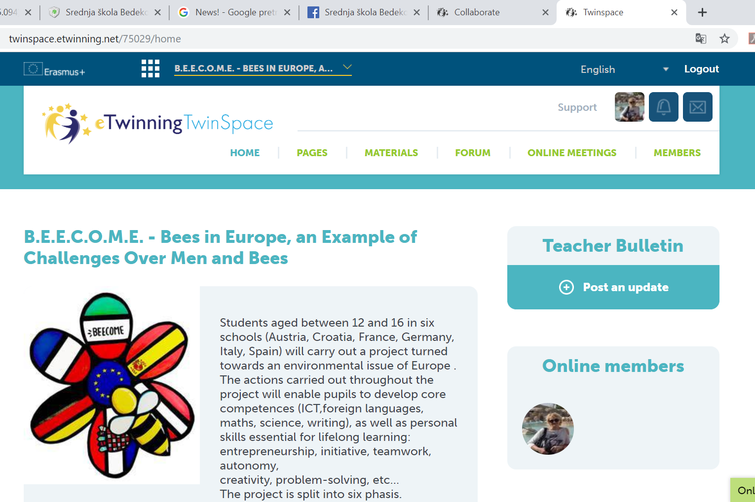
Interface
For description of the project activities or dissemination
Archive of the materials (photos, videos, files)
Project diary
Communication
Messages visible only to teachers

Slide 5
How to add teachers and students?
Teachers – eTwinning – project – add partner – only project founders
Students – Twinspace – members – invite
- can be added by teachers
They are able to see only Twinspace

Slide 6
Let˙s see how it works!
eTwinning.net
Open the project Twinspace

Slide 7
TwinSpace and integrated tools?
How to communicate and collaborate inTwinSpace?

Slide 8
Twinboard
Collaboration board
Notes:
Izraditi stranicu eTwinning ambasadori – predstaviti aktivnosti ambasadora – napraviti Twinboard s pitanjem – Predložite temu sljedeće radionice.

Slide 9
Polls
Evaluation

Slide 10
Communication
Very important during eTwinning project
Main part of every partnership
It can be part of planning process or as a part of the activity

Slide 11
Chat & Forum
Communication tools
introduction of the TwinSpace members
discussion
planning activities
Notes:
Kreirati Forumsku temu Upoznajmo se! - zamoliti svakog sudionika da se kratko predstavi, Otvoriti temu na chatu – Zašto je dobra komunikacija toliko bitna u eTwinning projektima?

Slide 12
Online meetings
videoconferences - Adobe Connect
great for introduction, planning activities
good for motivation – we can see each other (students)

Slide 13
Web tools
feedback
collaboration
lessons, eTwinning projects
improvement of the teaching methods
Web tools
Presentation
E- publication
monitoring

Slide 14
Benefits
strengthening digital and linguistic competences
encouraging creativity, collaborative learning and teamwork
creating a more interesting teaching process
easy to use

Slide 15
Which IT Tools to use?
Symbaloo, Thinglink, Doodle, Zeemaps
Quizlet, Voki, Animoto, Scratch
Prezi, Biteable, PosterMyWall, AnswerGarden
Adobe Spark, Forum, Adobe Connect

Slide 16
Answergarden
simple tool for feedback
short answers (20 – 40 signs)
share and embed
result - wordcloud

Slide 17
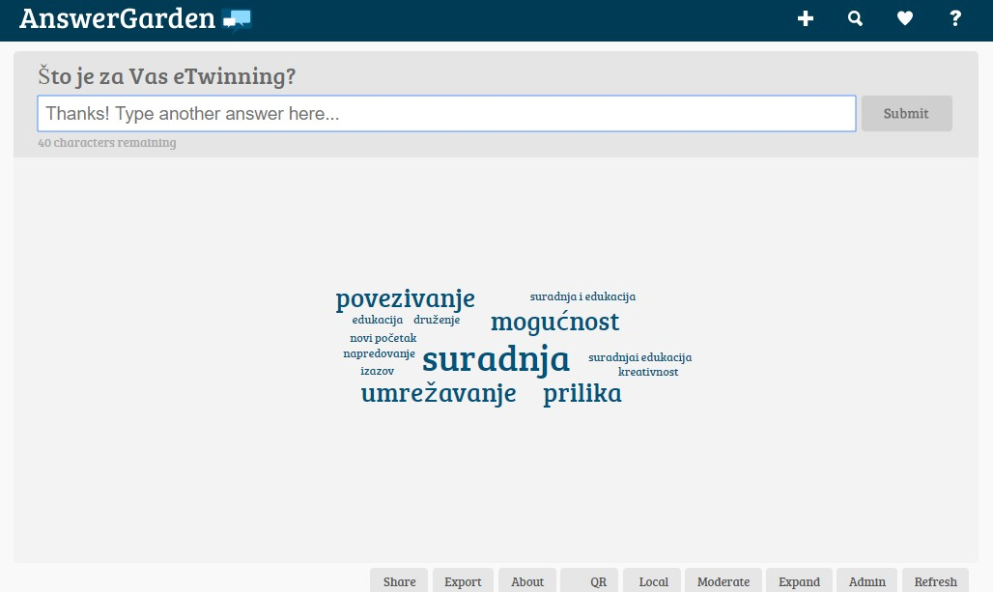
Answergarden

Slide 18
https://answergarden.ch

Slide 19
Tricider
exchanging ideas
voting – project logo
critical thinking, making decisions, arguments
easy to embed into TwinSpace

Slide 20
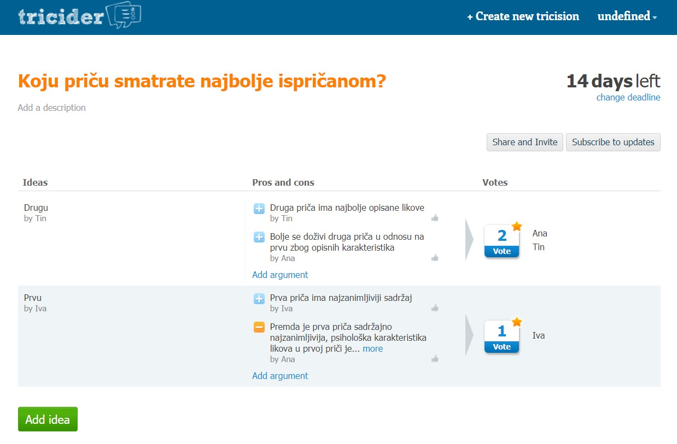

Slide 21
https://tricider.com/

Slide 22
Maps
Great for the begining of the project
Google maps - Padlet

Slide 23
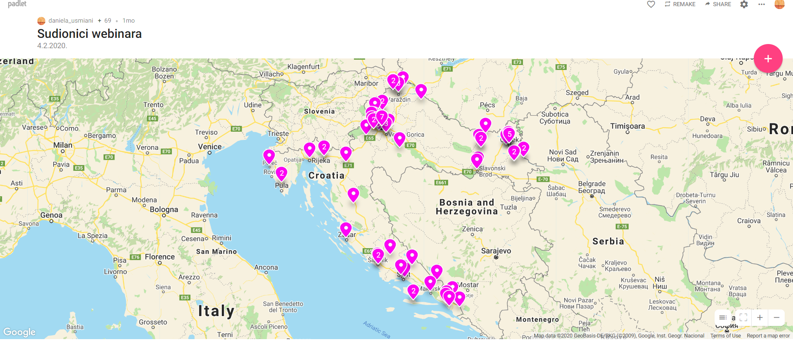

Slide 24
https://www.google.com/intl/hr/maps/about/mymaps/
https://padlet.com

Slide 25
Meme
Easy to make
Fast creating
share and embed
Result – photo with a message

Slide 26
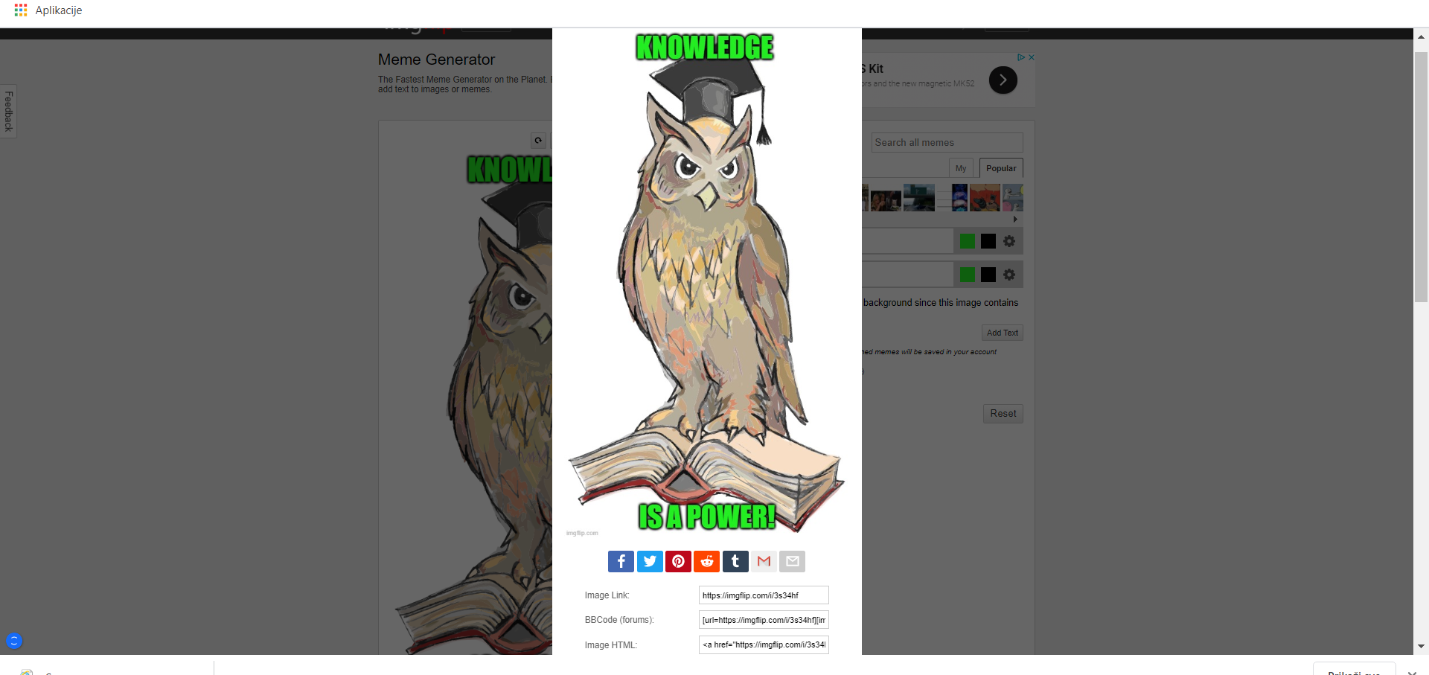

Slide 27
https://imgflip.com

Slide 28
Biteable
registration through Facebook or Google account
simple, interesting and creative way of making video
lots of templates
easy to embed to TwinSpace

Slide 30
https://biteable.com/

Slide 31
Evaluation
On the Twinspace

Slide 32
Thank for your attention!
daniela.usmiani@skole.hr

