Slide 1
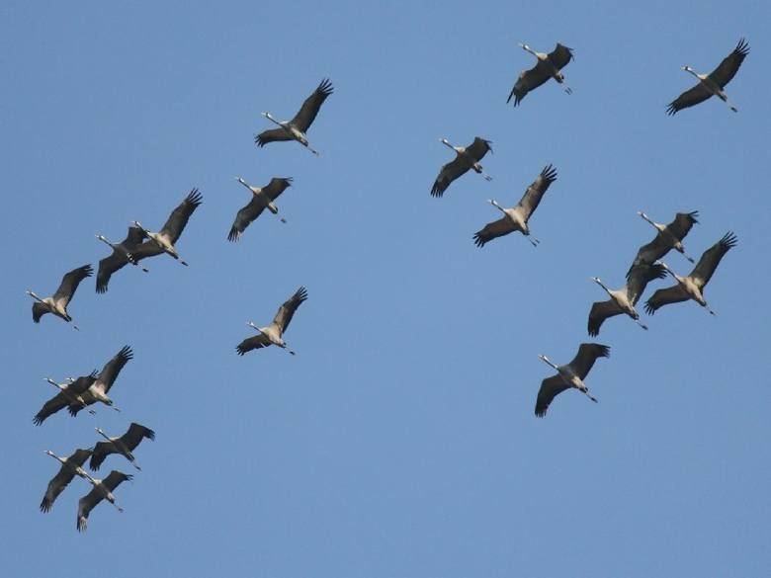
Crane

Slide 2
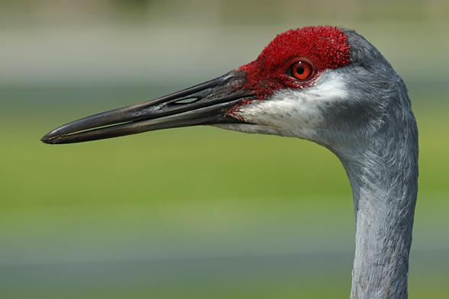
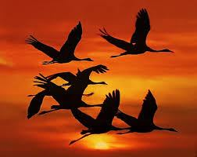

Slide 3
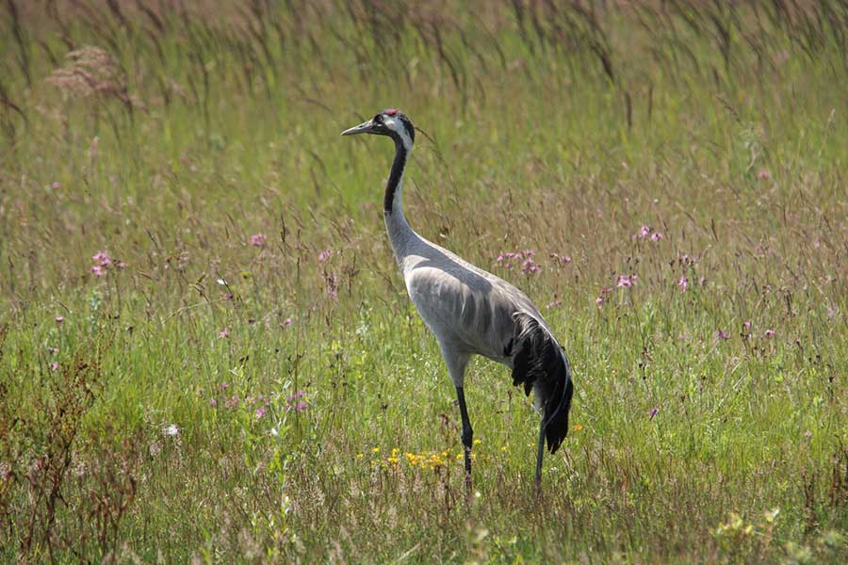

Slide 4
Crane
Silhouette slender, straight. Larger than the stork and easily distinguishable from the long, plum-shaped decorative feathers on the tail and back. These are elongated, folded third-order ailerons. The mating plumage of the crane is gray and the wing tips are black. Upper part of head of carmine color, white sides, forehead and front of long neck black. In summer, the top of the body becomes brownish from the rubbed sludge or ferrous peat bogs. Young are brown with no spots on the head and ornamental feathers. dimensions Body length about 140 cm, wingspan up to 240 cm Mass 5-6 kg Voice and behavior During the flight the flock flies in keys or slanting ranks and produces a loud voice called a klangor, resembling the sound of a trumpet. It is audible within a few kilometers. It is formed by a looped tracheal structure, acting like a resonant box. The crane is often called, and in the nest itself - "grrk grrk"

Slide 5
Rushed lakes and ponds, wetlands, marshy fields, wetlands and bogs number A small breeding bird nest Mound of vegetation on shallow water hidden among the vegetation brood 2 olives or beige, brown mottled eggs. Getting out: 30 days. Youngsters achieve volatility in 65-70 days food Mainly varied vegetable food, but also eat small animals hiking Migratory. Arrival: II-III, Departure: IX-X protection Species protected, listed in the Birds Directive, threatened with dehumidification links

Slide 6
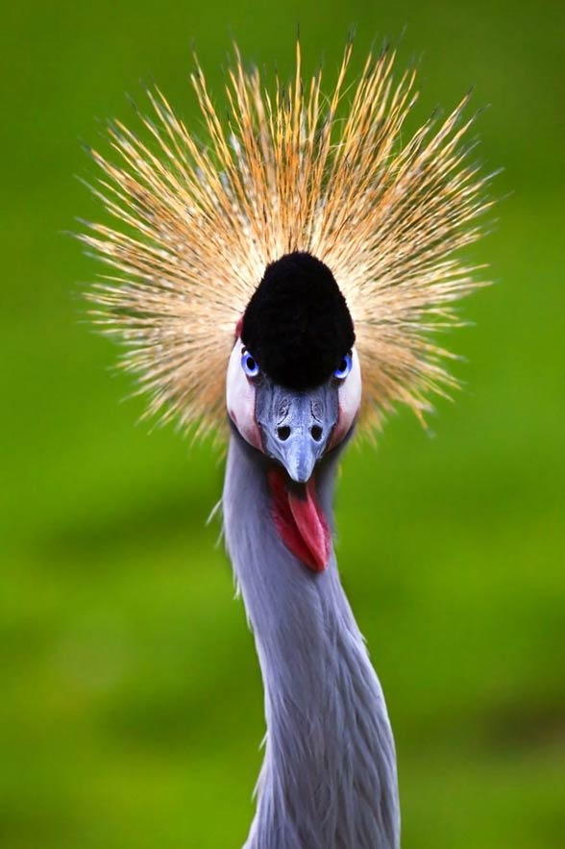

Slide 7
