Slide 1
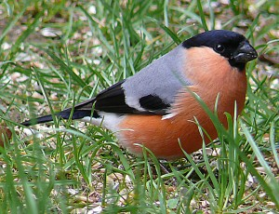
It is found throughout Poland, in much of Europein Asia, Japan, Turkey and even Iran. It is worth mentioning at this point that the gil is a bird of many species. The individual regions are the places specific to them. Other gile in this region occur. In Poland, the place of occurrence of these birds are dense wet, leafy and mixed forests. It is also seen in stakes, parks, alleys, and other places, not necessarily far removed from human settlements. By nature, he is rather shy, but in the search for food he often decides to visit places in the vicinity of human settlements. The nest assumes in the vicinity of watercourses - streams, rivers, streams, rarely in places where water is standing. The nest is usually built on a tree, at least 1.5 meters high, but most often at a much higher level. The nest consists of dry branches, roots, grasses and other elements.
Bullfinch

Slide 2
937/5000
Body length: 15-17 cm A well-built bird with prominent breast and large head, larger than the sparrow. Beak strong, short, conical. On his head a black cap covering his face. Male in gray, pink-red bottom, black wings and tail, wing belt and white collar. In the womb bottom pink-brown. Gila we know mainly from the winter season when it appears in the flocks of fruit trees, but in the breeding season is a hidden bird and it is difficult to see it. place Whole lowland area of the country habitat Spruce and fir forests, mixed forests, trees number A small breeding bird nest Among dense branches, especially spruce; The base is made up of dry twigs, rooted bees and grasses brood

Slide 3
4-5 bluish, brownly mottled eggs. Getting out: 12-14 days. Young leave the nest after 14-16 days. food Seeds, buds, spring also invertebrates hiking Partly wandering protection Protected species

